Slide 1
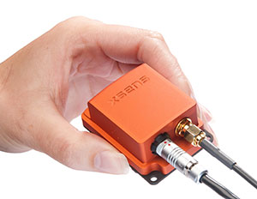
IMU Supported Parking
Thomas Eiband
Final Presentation
Supervisor: Hoang Dinh Khoi (M.Sc.), Prof. Dr.-Ing. habil. Dirk Wollherr

Slide 2
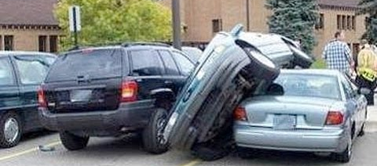
Problem
Car not aligned parallel to wall
Identify triggers for state transition
Adaption of many parameters

Slide 3
Solution
Capture front and rear laser scans
State machine for parking states
Read Params from YAML file
(change params at runtime)

Slide 4



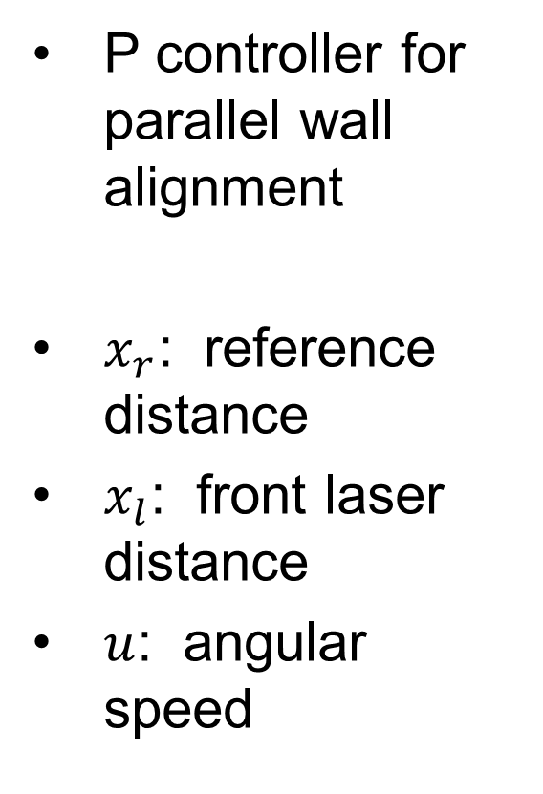





Solution
P controller for parallel wall alignment
$x_{r}$: reference distance
$x_{l}$: front laser distance
$u$: angular speed
$$x_{r}$$
+
$$K_{p}$$
$$u$$
$$G$$
$$x_{l}$$
$$−$$
wall
$$x_{l}$$
$$x_{d}$$

Slide 5
IMU Support
Capture IMU yaw, when car aligned to wall
If IMU yaw difference > threshold:
reverse steering angle
1
2
2
1

Slide 6
Summary
Too much drift in IMU Position → Only considered IMU Yaw (very low drift)

Slide 7

References
A. Bauer, K. Klasing, G. Lidoris, Q. Mühlbauer, F. Rohrmüller, S. Sosnowski, et al. The Autonomous City Explorer: Towards Natural Human-Robot Interaction in Urban Environments. In: International Journal of Social Robotics, vol. 1(2), 2009, pp. 127–140.
M. Buss, D. Carton, B. Gonsior, K. Kühnlenz, C. Landsiedel, N. Mitsou, et al. Towards Proactive Human-Robot Interaction in Human Environments.
In: 2nd International Conference on Cognitive Infocommunications (CogInfoCom), 2011, pp. 1–6.

