Slide 1
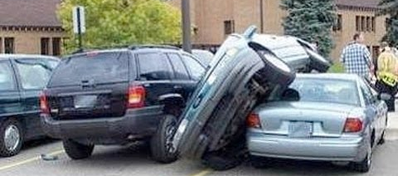
Adaptive Speed Control
Goals:
Simulate human driver
Adapt velocity depending on curvature
Break before curves & accelerate on straights
Design Choices:
Curvature based on local path
Angle and distance as curvature weights
Linear mapping from weights to velocity
Beispielfolien
<Foliennummer>

Slide 2
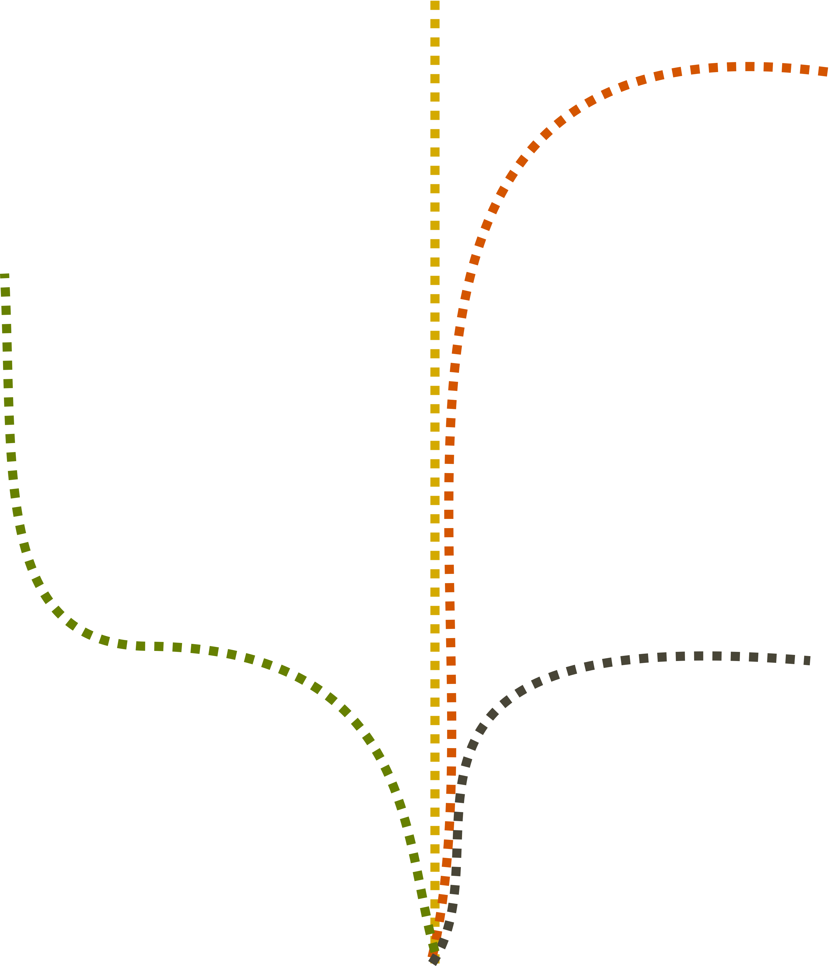
Approach 1 – Accumulating Angles
0°
Accumulate angle
90°
180°
90°
Beispielfolien
<Foliennummer>

Slide 3
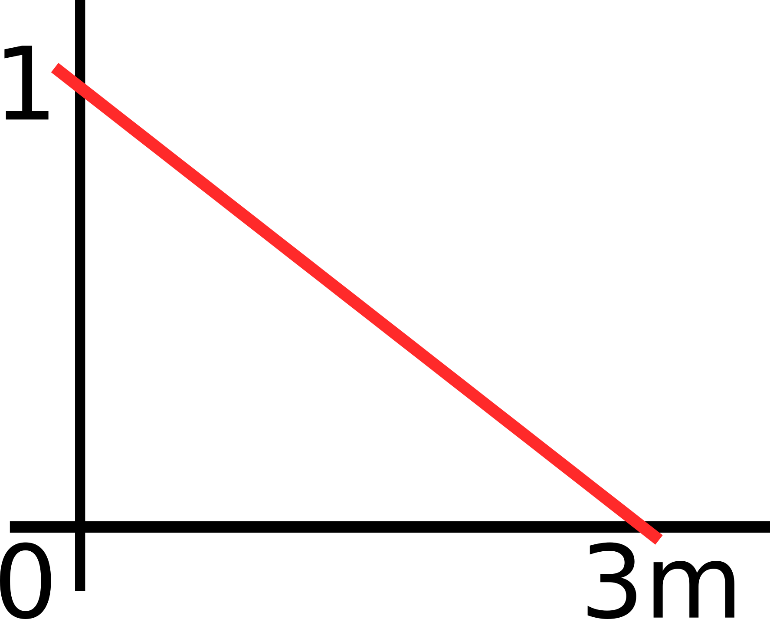
Approach 1 – Accumulating Angles
0°
Accumulate angle
Weigh with distance
180°
90°
0
0.9
0.4
90°
0.8
Beispielfolien
<Foliennummer>

Slide 4
Approach 1 – Accumulating Angles
0
Accumulate angle
Weigh with distance
0.9
0.4
1600
1555
1580
0.8
3) Compute velocity
1560
Beispielfolien
<Foliennummer>

Slide 5
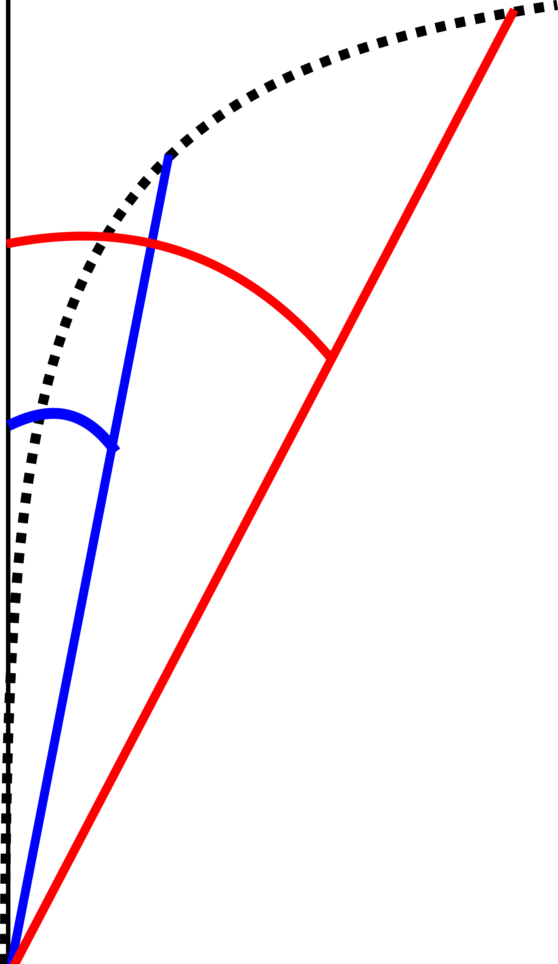
Approach 2 – Multiple fixed points
Find points with fixed distance in path
Determine angle
Weigh depending on distance
Compute velocity from weights
Angles between fixed points and current heading
Beispielfolien
<Foliennummer>

