Slide 1
TAS – Autonomous Driving and parking roboter
Christopher Zeiser, David Full, Hans Böhme
TAS - Final Presentation/Report
Prof. Dr. Wollherr, Khoi Hoang Dinh

Slide 2
Table of Contents
Motivation
Task 1
Map Saving
Parameter Optimization
Single-Goal Autonomous Driving
Task 2
Simulation Extension
Flexible Parking
Summary

Slide 3
Motivation
Interesting facts about autonomous driving:
2025 - Law and insurances are ready
2035 - 20-35% autonomous cars
Accident reduction by 15% thanks to car assistant systems in the past 10 years in Europe

Slide 4
Task 1 – Map Saving
Record map with hector mapping
→ ‘run1.launch‘
2. Save map with „map_saver“ service
→ ‘run2.launch‘ and ‘run2.sh‘
3. Start necessary nodes
→ ‘run3.launch‘
→ Flexible starting position

Slide 5
Task 1 - Parameter Optimization
Preset parameters for each car
Forward and backward speed
Steering angle offset
Parameter server for real time driving optimization
Additional speed (forward and backward)
Additional steering angle offset
Local/Global planner parameters
Notes:
Inflation radius, Obstacle avoidance factor, Obstacle look ahead factor, Tolerances, Maximum velocity, Cost map parameters

Slide 6
Task 1 – Single-Goal Autonomous Driving
Reducing the number of waypoints to one
Independent of map shape and size, only low requirements close to the robot
Possible to start at nearly every position
→ High flexibility

Slide 7
Task 1 – Single-Goal Autonomous Driving
Idea:
Change the map temporarily by faked laser data.
Approach:
Wait until wall is published
Set goal directly behind the car
Start autonomous driving
Remove the wall and slightly correct the goal to the starting position

Slide 8
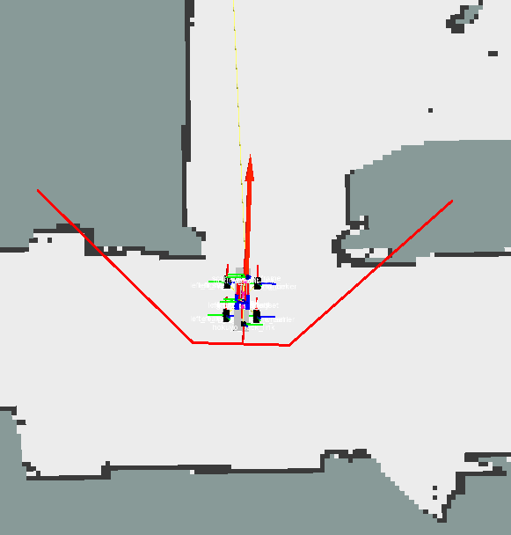
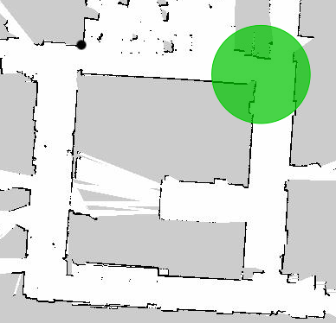
Task 1 – Single-Goal Autonomous Driving
U-shaped wall behind the car
Relevant area in green

Slide 9
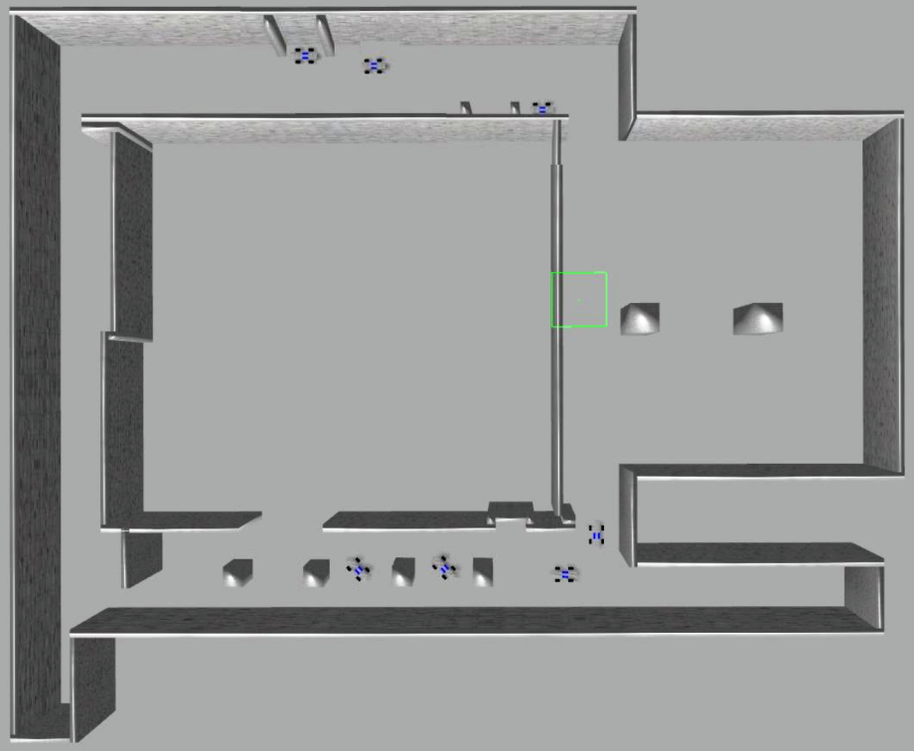
Task 2 - Simulation Extension
Additional parking slot
Additional slalom course
8 different starting positions accessable on simulation startup
roslaunch tas_simulator startSimulation.launch pos‘x‘:=1

Slide 10
Task 2 – Flexible Parking
New parking node for laser (position) + imu (orientation) communication.
Task implemented with final state maschine like approach
Start park procedure with pressing the A-button
Detect parking slot and drive to starting position
5 binary coded state indicators + 7 states + formulas depending on car indicators, states and parking attempt (left – right, in - out)

Slide 11
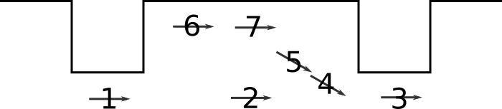

Task 2 – Flexible Parking
LSB
current_orientation == start_orientation
current_roentation == start_orientation 45°
car in parking slot
car near the wall in the parking slot
front_scan == back_scan
➔ Truth tables for velocity and steering angle
MSB

Slide 12
Summary
Stable autonomous driving + obstacle avoidance
Parking with flexible side and (un-)parking and partially independence of starting position
Optimized simulation
Optimized parameters for all treated application
Problems and feedback
Hardware issues (LAN, bluetooth, screen)
Software issues (malfunctioning simulation)
Car issues (battery, steering parameters)

Slide 13
Thank you for your attention!

