Slide 1
Fast Texture Classification Using Tactile Neural Coding andSpiking Neural Network
Tasbolat Taunyazov, Yansong Chua, Ruihan Gao, Harold Soh, Yan Wu

Slide 2
Outline
Motivation
Background
Problem Statement
Realization
Results

Slide 3
Motivation
It is hard to differentiate textures by vision, thus touch sense is very important in this task.
State-of-the-art texture classification techniques use Artificial Neural Network (ANN) based methods which are “power and data hungy”.
On the other hand, a Spiking Neural Networks (SNNs) are power efficient and has lower latency than ANNs.
Hence, we need to convert the raw continuous real time tactile signal into spike trains to learn texture classification using SNNs using neural coding.

Slide 4
Problem statement
In this paper, we tackle the following questions:
Given the raw continuous real valued tactile signal, how do we encode so that the encoded data preserves sufficient information about texture classification?
Does encoded tactile spike trains simplify the data so that it is easily learnable? Can it classify in a short amount of time?
How does SNNs on encoded tactile spike trains perform compare to state-of-the-art ANN methods?

Slide 5
Outline for the presentation
Datasets
A prosed neural encoding
Proposed classification model using SNN.
Results

Slide 6
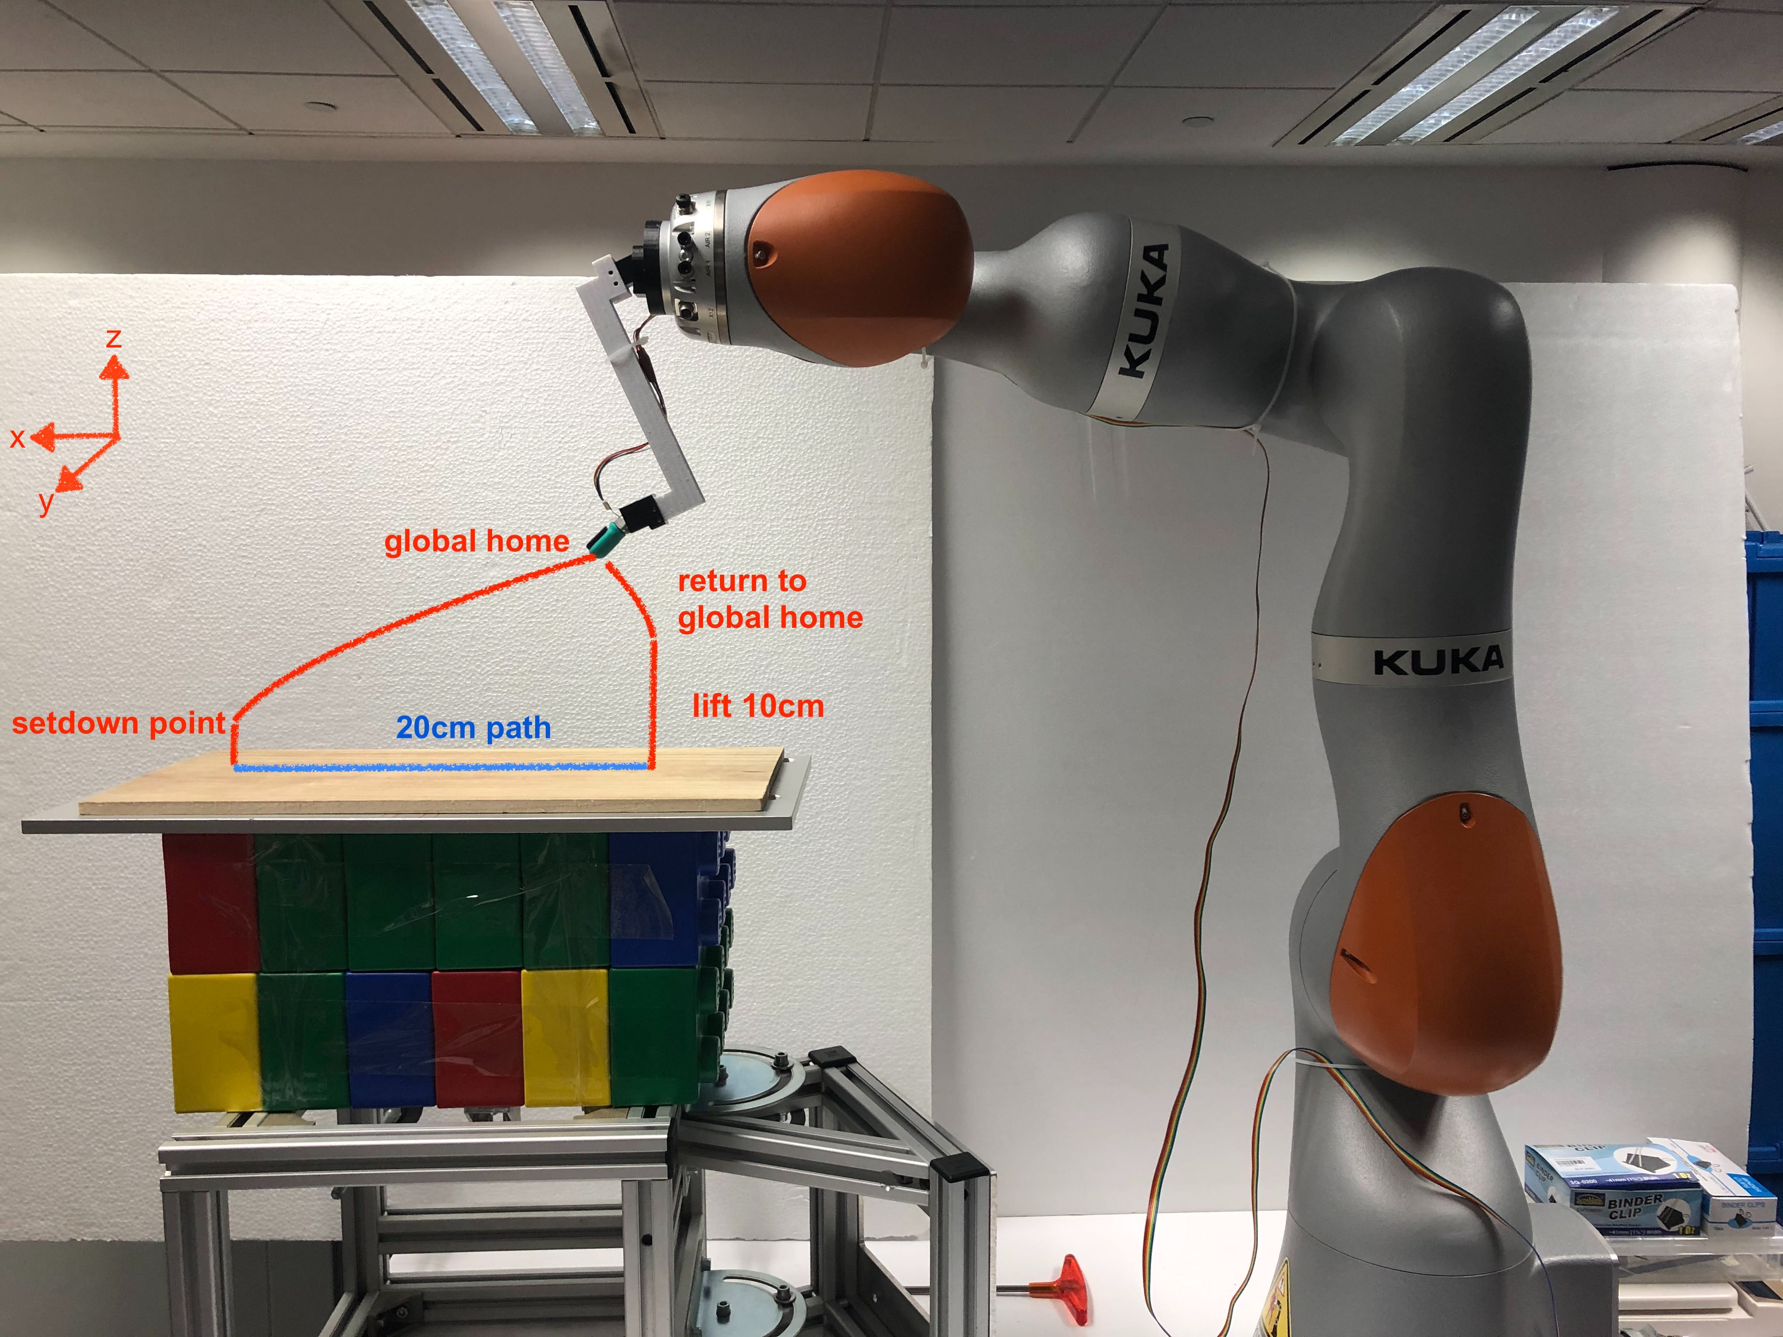
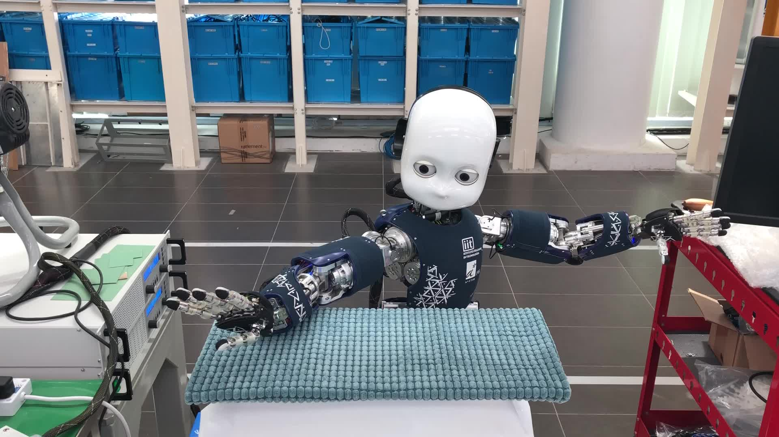
Datasets: data collection
Two different tactile datasets collected from different data collection setups are used to test our models.
1. BioTac dataset:
BioTac attached to Kuka LBR is used to collect data
Closed loop force and velocity control exerted during data collection
2. iCub dataset:
iCub’s forearm is used to collect data
Loose control and high variance due to tendent based mechanical structure of the forearm
No velocity or force control exerted

Slide 7
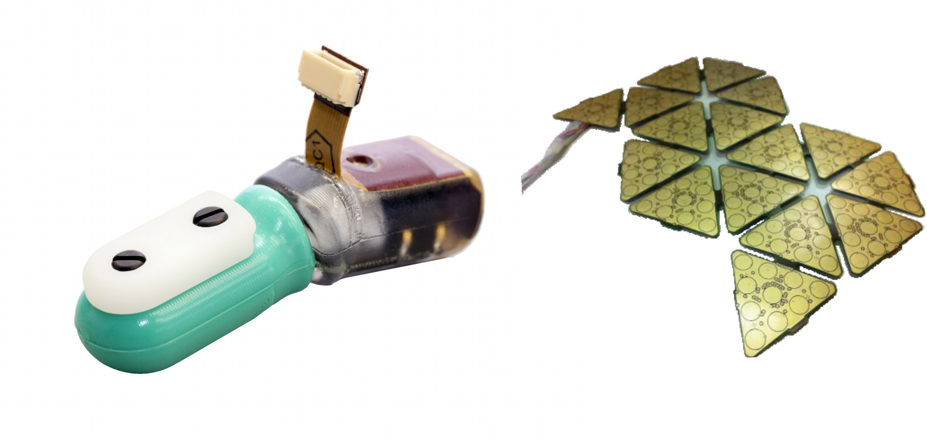
Datasets: tactile sensors
Capacitive tactile sensor
Barometric tactile sensor
6 patches with 10 taxels = 60 taxels
23 taxels
50 Hz sampling rate
BioTac
iCub’s tactile sensor
100 Hz sampling rate
Signal length: 1.5 s
Signal length: 4 s

Slide 8
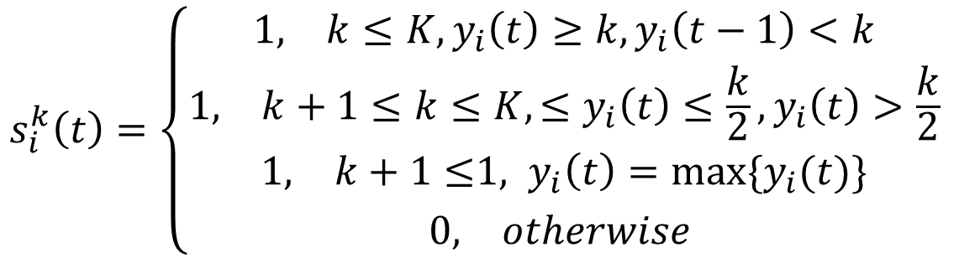
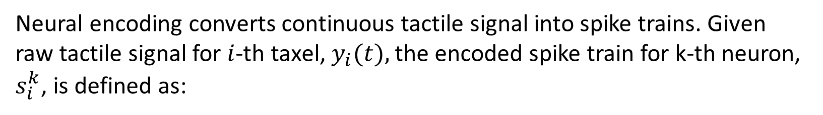
Proposed Neural Encoding
Neural encoding converts continuous tactile signal into spike trains. Given raw tactile signal for $i$-th taxel, $y_{i}(t),$the encoded spike train for k-th neuron, $s_{i}^{k}$, is defined as:
$$s_{i}^{k}\left(t\right)=\left\{\begin{aligned}{\begin{matrix}1, & k≤K, y_{i}\left(t\right)≥k, y_{i}\left(t−1\right)<k\end{matrix} \atop \begin{matrix}1, & k+1≤k≤K,≤y_{i}\left(t\right)≤\frac{k}{2}, y_{i}\left(t\right)>\frac{k}{2}\end{matrix}} \\ {\begin{matrix}1, & k+1≤\end{matrix}1, y_{i}\left(t\right)=max⁡\{y_{i}(t)\} \atop \begin{matrix}0, & otherwise\end{matrix} }\end{aligned}\right.$$
Where $k∈ [1, …, K, …, 2K + 1].$In total, it outputs $2K+1$ spike trains.

Slide 9
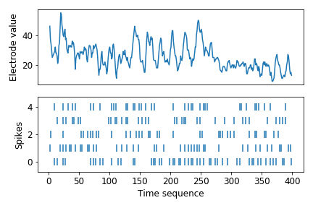
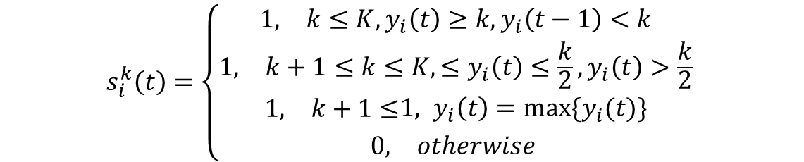
Neural Encoding: example
We chose $K=2$ for both BioTac and iCub tactile data.
$$s_{i}^{k}\left(t\right)=\left\{\begin{aligned}{\begin{matrix}1, & k≤K, y_{i}\left(t\right)≥k, y_{i}\left(t−1\right)<k\end{matrix} \atop \begin{matrix}1, & k+1≤k≤K,≤y_{i}\left(t\right)≤\frac{k}{2}, y_{i}\left(t\right)>\frac{k}{2}\end{matrix}} \\ {\begin{matrix}1, & k+1≤\end{matrix}1, y_{i}\left(t\right)=max⁡\{y_{i}(t)\} \atop \begin{matrix}0, & otherwise\end{matrix} }\end{aligned}\right.$$
Example of proposed neural encoding for a taxel.

Slide 10
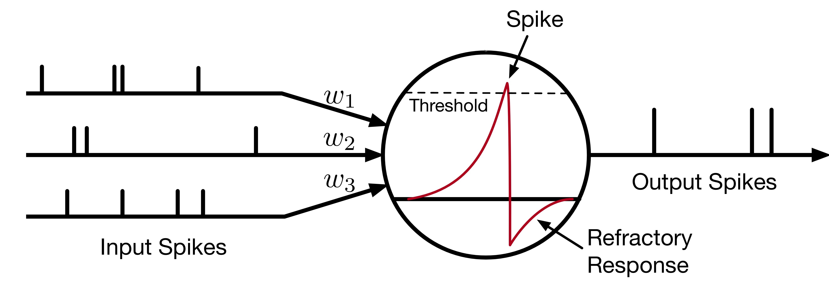

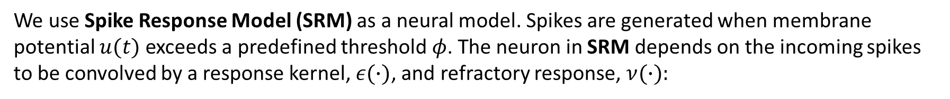
Neural Model: SRM
We use Spike Response Model (SRM) as a neural model. Spikes are generated when membrane potential $u(t)$ exceeds a predefined threshold $φ$. The neuron in SRM depends on the incoming spikes to be convolved by a response kernel, $ε(∙)$, and refractory response, $ν(∙):$
$$u\left(t\right)=∑ω_{i}\left(ε∗s_{i}\right)\left(t\right)+(ν∗o)(t)$$
where $ω_{i}$ is a synaptic weight, $∗$ indicates convolution, $s_{i}(t)$are the incoming spikes from input $i$, and $o(t)$ is the neuron’s output spike train.

Slide 11
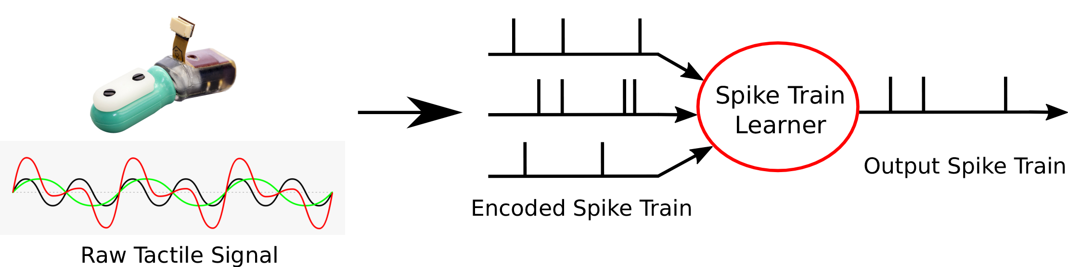
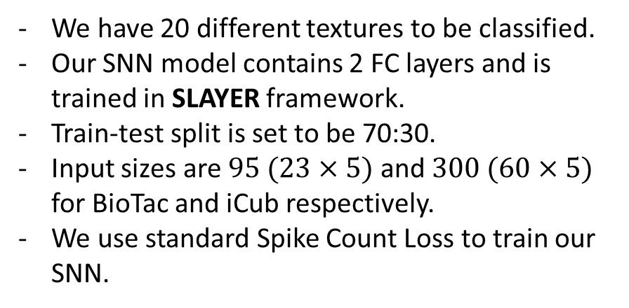
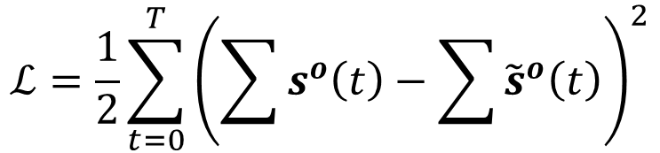
A Spiking Neural Network (SNN)
We have 20 different textures to be classified.
Our SNN model contains 2 FC layers and is trained in SLAYER framework.
Train-test split is set to be 70:30.
Input sizes are $95 (23×5)$and $300 (60×5)$ for BioTac and iCub respectively.
We use standard Spike Count Loss to train our SNN.
$$ℒ=\frac{1}{2}\sum_{t=0}^{T}{{\left(\sum{s^{o}\left(t\right)−\sum{{\tilde{s}}^{o}\left(t\right)}}\right)}^{2}}$$
Output spikes
Desired spikes

Slide 12

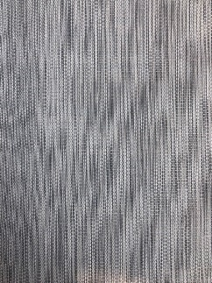
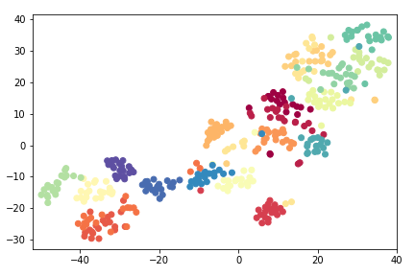


Results: Neural Encoding
t-SNE performed on encoded iCub tactile data using Van-Rossum distance. The clusters are visually separable. Some examples of clusters are indicated with respective textures.

Slide 13
Results: test accuracies
We compared our SNN model to
MLP-LSTM based ANN model that mimics our SNN
SVM (spike) with inputs of encoded tactile data where time dimension is summed.
SVM with inputs of raw tactile data where time dimension is summed.
Models | BioTac | iCub
SNN | 0.946 (0.013) | 0.922 (0.005)
ANN | 0.945 (0.015) | 0.935 (0.005)
SVM (spike) | 0.935 (0.015) | 0.633 (0.018)
SVM | 0.942 (0.007) | 0.505 (0.056)

Slide 14
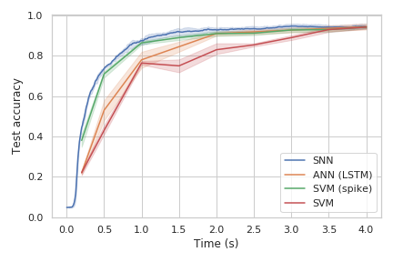
Results: fast classification for BioTac
Even though “final testing accuracy” is similar for all models, the SNN slightly outperforms the rest at the early classification.
SVM results show that the data is easily learnable even with “first moment” approximation.
SVM (spike) results show that encoding improves learnable information and makes it simpler to learn.

Slide 15
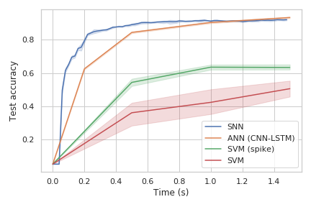
Results: fast classification for iCub
SVM does not perform well for overall classification, implying complexity of learning this dataset.
As in case with BioTac data, encoded spike trains makes it easier to learn as shown in SVM (spike) results.
Again, SNN outperforms the ANN for early classification.

Slide 16
Conclusion
Our work is preliminary study of neural encoding and learning the representation for texture classification. Throughout the work, we have shown:
Tactile Neural Encoder that extracts spike trains and makes a learning process easy.
SNN model that can classify textures with in a short time amount.
Comparing the encoder and model with state-of-the-art ANN techniques using two different tactile datasets.

