Slide 1


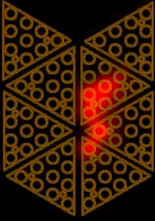
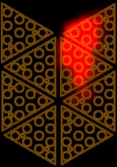


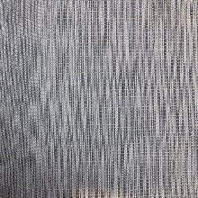
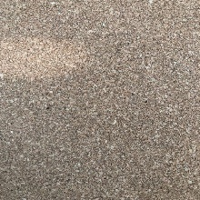
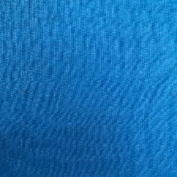

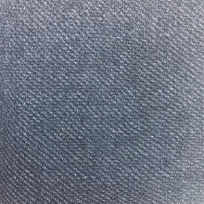




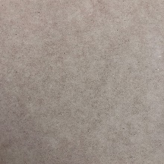
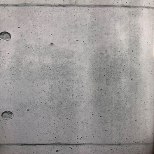
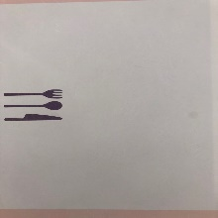

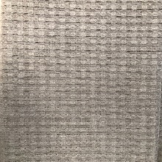
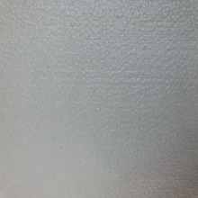

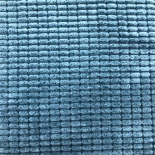
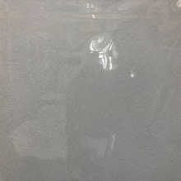
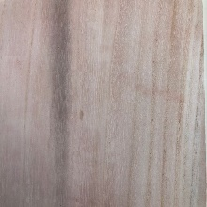

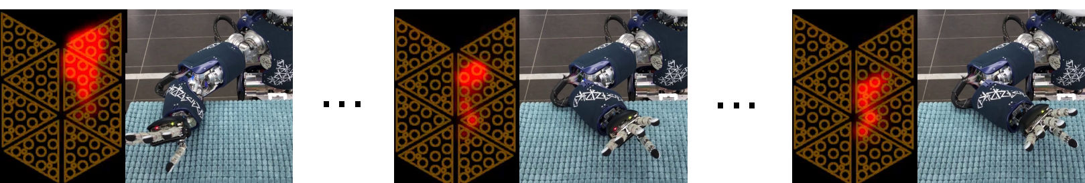




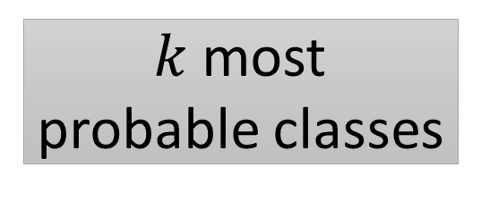
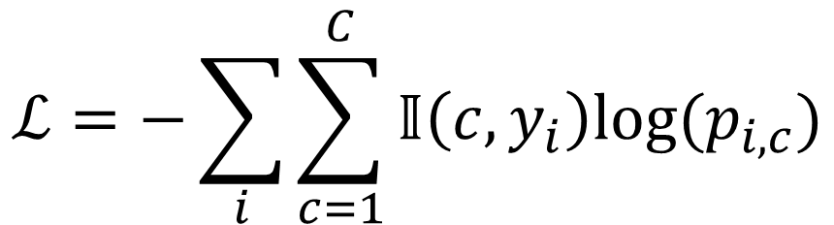




Towards Effective Tactile Identification of Textures using Hybrid Touch Approach
Tasbolat Taunyazov, Hui Fang Koh, Yan Wu, Caixia Cai, Harold Soh
If you’re in a hurry (TL;DR)
Texture Classification: Models & Results
Our robot can classify surface texture with both sliding and touch movements up to $98\%$ accuracy under loose constraints.
Three different ML models comprising statistical machine learning and connectionist approaches were benchmarked for texture classification.
A tactile dataset of 23 textures is available for download
SVM with hand-crafted features narrows down possible target classes, then LSTM chooses target within those classes. We use following features:
Sliding features: roughness, fineness, frequency at maximum intensity by Discreate Fourier Transform and statistical features such as mean and standard deviation.
Touch features: empirical mean and standard deviation of approximate slope of tactile data value.
SVM-LSTM
Motivation
Features
SVM
$k$most probable classes
In most cases, tactile data for texture classification comes from constrained robot set-up:
Constant velocity while performing exploratory procedure such as sliding or touch.
Constant force acting upon object surface.
Sliding follows linear trajectory.
Tactile data recorded with high frequency.
Learning from raw data usually requires a large amount of data.
Raw Data
LSTM
Choose from
$k$ classes
Target
PROBLEM
Raw tactile data is considered as sequences of images. At each instance the image is passed through CNN and supplied to LSTM Network.
$$t_{u}$$
6x10
CNN
18x1
LSTM
FC
Relaxed constraints on robot set-up for easier data collection:
No strict constraint on velocity and force.
Non linear trajectory for sliding.
Combined different exploratory movements such as sliding and touch during data collection to achieve better accuracy.
Created a publicly available tactile dataset for future use
CNN-LSTM
CNN
Target
$$t_{0}$$
CONTRIBUTIONS
3x5
2
3x3x2
LSTM
LSTM
Tactile Dataset
3x4x6
2
Convolution
Max pooling
LSTM
LSTM
Tactile Data is collected using iCub’s forearm tactile sensor through two exploratory behaviors: touch and sliding. Data is recorded at 50 Hz.
Touch: robot forearm moves vertically onto object surface with $1°/s\text{. }\text{The} \text{motion} \text{is} \text{actuated} \text{by} \text{shoulder} \text{through} \text{adduction} \text{for} \text{range} \text{of} 6°\text{. }$
$\text{Sliding}\text{: }\text{robot} \text{forearm} \text{moves} \text{horizontally} \text{on} \text{object} \text{surface} \text{with} 5°/s\text{. }\text{The} \text{motion} \text{is} \text{actuated} \text{by} \text{elbow} \text{joint} \text{flexion} \text{and} \text{extension} \text{for} \text{range} \text{of} 60°\text{.}$
The tactile data is collected for 23 different surface textures:
Due to the tendon-based actuation of iCub and non-linear movement, the forearm was not subject to strict constraints.
2852 sample were collected.
Collected data also includes force and torque estimations provided from iCub’s shoulder. This can be used for future work.
Initial hidden states
The LSTM and CNN were trained to minimize the multiclass entropy loss for $C$ classes with predictive probability $p_{c}$:
We use following accuracy measure:
Accuracy is tested for touch, sliding and combination of both.
EXPERIMENT SET-UP
$$ℒ=−\sum_{i}{\sum_{c=1}^{C}{𝕀\left(c,y_{i}\right)log⁡(p_{i,c})}}$$
MAIN RESULTS
$$Acc=\frac{1}{N}\sum_{i}^{N}{𝕀({\hat{y}}_{i},y_{i})}$$
where ${\hat{y}}_{i}$ and $y_{i}$ are predicted and ground truth labels.
Methods | Touch | Sliding | Combination
SVM | 0.61 (0.028) | 0.77 (0.019) | 0.88 (0.037)
SVM-LSTM | 0.61 (0.028) | 0.86 (0.035) | 0.96 (0.028)
CNN-LSTM | 0.85 (0.054) | 0.86 (0.038) | 0.98 (0.022)
Interesting: texture can be recognized using only touch, but sliding for a short time improves classification!
Example of instances of tactile data collection during sliding
Future Work: What’s Next?
Incorporate texture classification into grasping stability.
Evaluate the proposed frameworks on tactile data from different tactile sensors.
Download tactile data from:
ICRA 2019
https://github.com/crslab/TactileLearning
Montreal, Canada

