Slide 1


Towards Effective Tactile Identification of Textures using Hybrid Touch Approach
Tasbolat Taunyazov, Hui Fang Koh, Yan Wu, Caixia Cai, Harold Soh

Slide 2
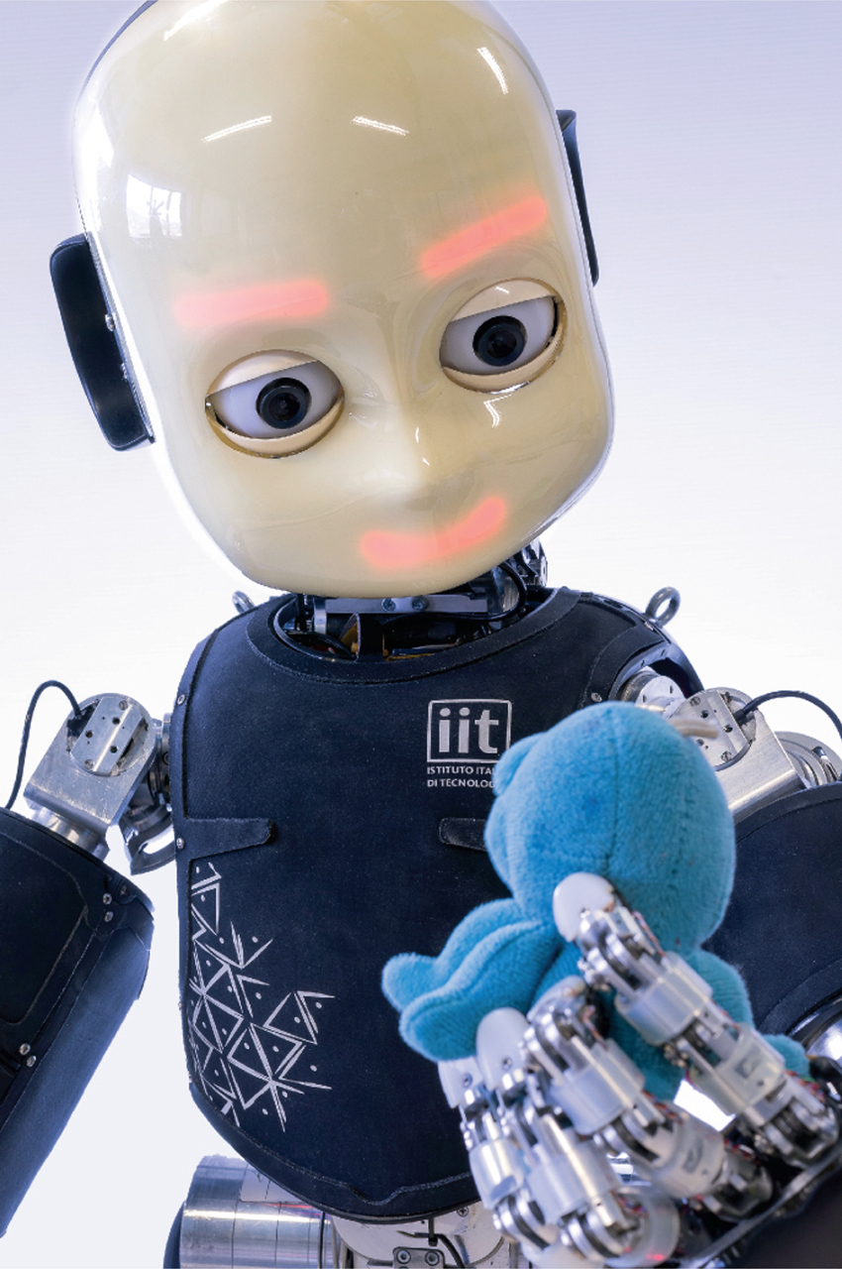
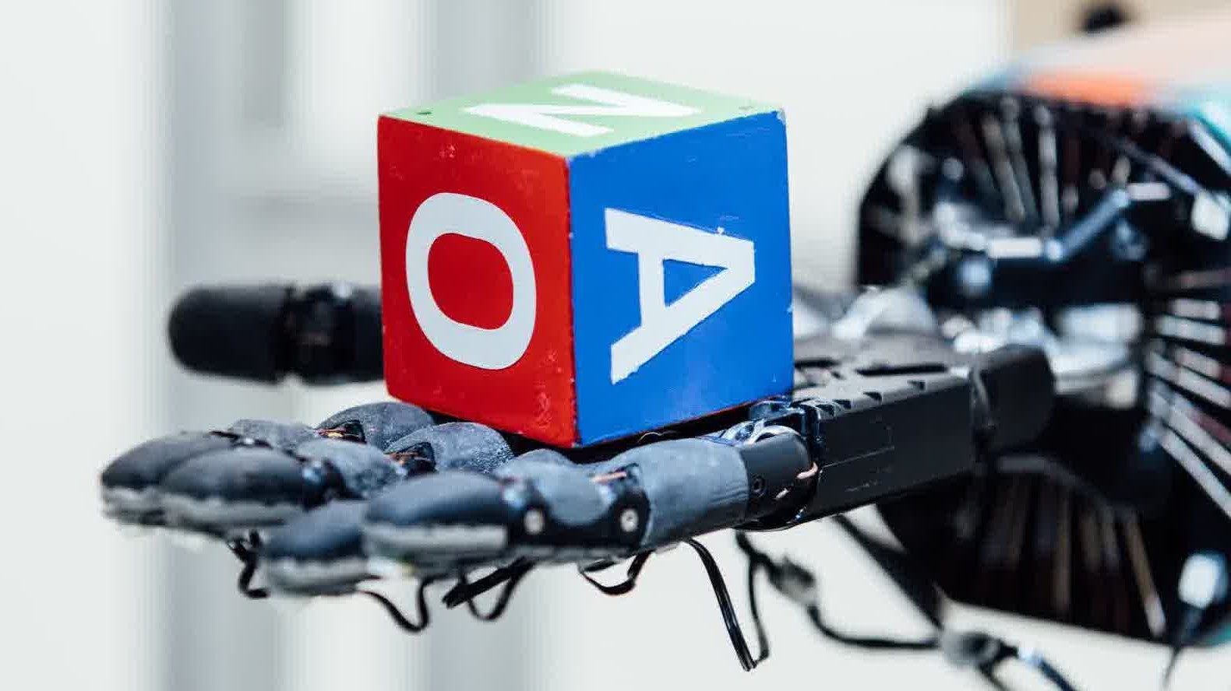
Motivation
In Hand Manipulation
Object Grasping
Texture classification is important

Slide 3
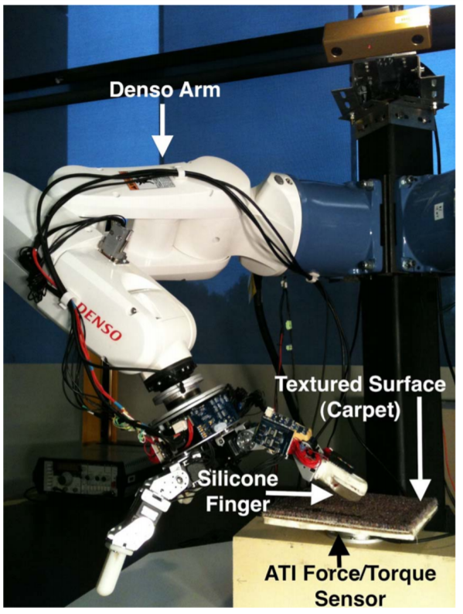
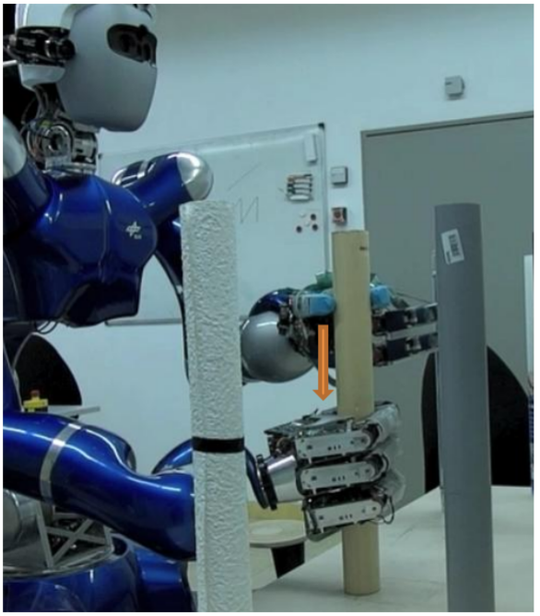
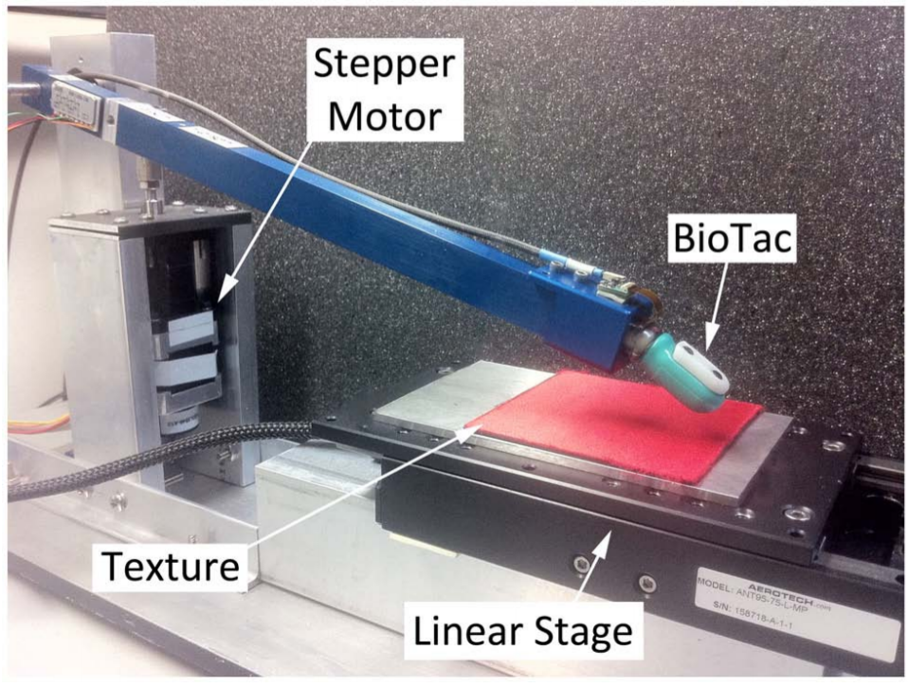
State-of-the-art Setup
[1]
[2]
[3]
Imposing constant force and velocity during motion
Linear trajectory
No tactile dataset available
[1] Jamali, Nawid, and Claude Sammut. "Majority voting: Material classification by tactile sensing using surface texture." IEEE Transactions on Robotics 27.3 (2011): 508-521.
[2] Baishya, Shiv S., and Berthold Bäuml. "Robust material classification with a tactile skin using deep learning." 2016 IEEE/RSJ International Conference on Intelligent Robots and Systems (IROS). IEEE, 2016.
[3] Fishel, Jeremy A., and Gerald E. Loeb. "Bayesian exploration for intelligent identification of textures." Frontiers in neurorobotics 6 (2012): 4.

Slide 4
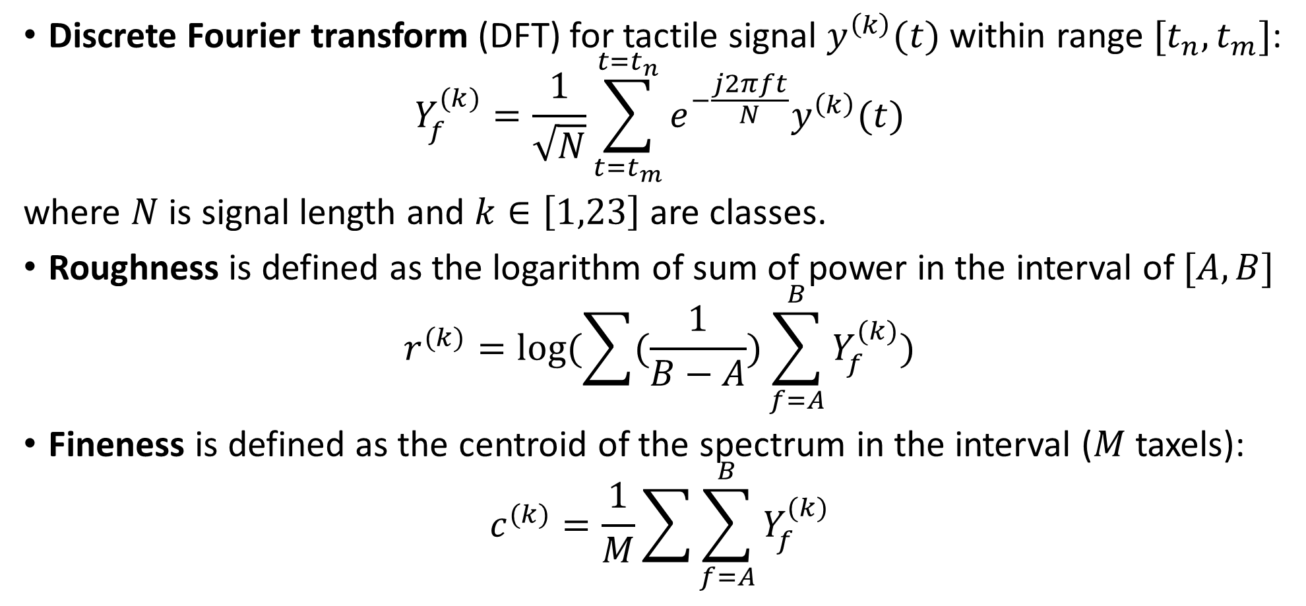
Sliding features
Discrete Fourier transform (DFT) for tactile signal $y^{\left(k\right)}(t)$ within range ${[t}_{n},t_{m}]$:
$$Y_{f}^{(k)}=\frac{1}{\sqrt{N}}\sum_{t=t_{m}}^{t=t_{n}}{e^{−\frac{j2πft}{N}}y^{\left(k\right)}(t)}$$
where $N$ is signal length and $k∈\left[1,23\right]$ are classes.
Roughness is defined as the logarithm of sum of power in the interval of $[A, B]$
$$r^{(k)}=log⁡(\sum{(\frac{1}{B−A})}\sum_{f=A}^{B}{Y_{f}^{(k)}})$$
Fineness is defined as the centroid of the spectrum in the interval ($M$ taxels):
$$c^{(k)}=\frac{1}{M}\sum{\sum_{f=A}^{B}{Y_{f}^{(k)}}}$$

Slide 5
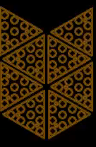
CNN-LSTM
3x5
3x4x6
3x3x2
LSTM
18x1
2
FC
Target
2
6x10
Convolution
Max pooling
. . .
50x1
LSTM
LSTM
Number of layers | 2
Hidden size | 50
Dropout | 0.8
LSTM
LSTM
Initial hidden states

Slide 6
Results
CNN-LSTM performs best overall
Touch gives distinguishing information about texture than sliding
Combining Touch and Sliding gives the most accurate result

Slide 7
Results
Sliding about ~1.5 s is enough for texture recognition

Slide 8

Download
Please download the dataset and let me know how it’s been used ☺

