Slide 1
Data for Democracy
Module 1: Introduction to Data for Decision Making
Month 2016
Awesome Conference
City, Country

Slide 2

Overview
Introductions
Administrative tasks
What is data?
What is decision-making?
Course goals and objectives
Case study
Problem definition activity
Key terms
Data visualization activity

Slide 3
Introductions
Instructor Introductions
Participant introductions
What organization are you from?
What do you hope to get out of this class?

Slide 4
What are data?
Work with a partner to brainstorm five words that you think of when you hear the word data.
Write these words on a piece of paper. Be prepared to share them with the class.
Notes:
Next, introduce the name of the workshop, taking time to write “Data for Decision Making” on the whiteboard (if possible). Underscore the word “data”, or verbally highlight it.
Ask the class to work with a partner and take a moment and think about what they think of when they hear the word “data”. Have the class write down 5 words that they associate with data. If they are having trouble thinking of words, feel free to gently guide them by providing a few words: numbers, words, etc. If you provide this information, ask the participants not to use these words as their answers. (5 minutes)
Ask for volunteers to report back on what they wrote. If possible, write their answers on the board. What did they write? Did some people write similar answers as others? Do people agree with other people’s answers? Discuss their answers with the class. (5 minutes)
Before transitioning, make sure to underscore to the participants that we are going to jump right in and define “data”, “decision making”, and “data for decision making” and then outline course goals and objectives.

Slide 5
Data definition
At is most basic level, data are collections of facts and information. This information can be packaged as numbers, words, measurements, observations, or descriptions.
Notes:
Note to instructor* This section comes before describing the workshop to provide context for the workshop.
After the class has shared with each other what they think data are and what they associate data with, offer a formal definition. On the board, write
Data:
At its most basic level, data are collections of facts and information. This information can come be packaged as numbers, words, measurements, observations, or descriptions.
An example:
If I didn’t eat breakfast and am hungry, I could ask my colleagues where the best place to get Mohinga is nearby. When I ask that question and receive responses, I collect information. Try to solicit the type of information collected from the class. Is it price? How the breakfast tastes? How close the breakfast place is to the office? How long it will take to eat the breakfast?
The information that I collected can be considered data.

Slide 6
What is decision-making?
After collecting data (information), you are free to make a decision. When you make a decision, you can use the data you collected as evidence to make an informed decision.
Notes:
Questions to ask:
Now that data have be re-framed to simply be information, ask the class what kinds of data (information) they collect in their everyday life. If the class is quiet and has not provided a response, feel free to nudge them along with a few more examples, such as do they ask their families about their days when they get home? If they want to buy a new cell phone, do they ask for recommendations?
Decision Making:
After collecting data (information), you are free to make a decision. When you make a decision, you can use the data you collected as evidence to make an informed decision.
For instance, in the previous breakfast example, if you hadn’t asked your colleagues for their suggestions for breakfast options, you run the risk of eating a bad breakfast. When you collect data from your colleagues, you can use that information (their response) as a solution to your problem (the fact that you are hungry) in order to make an informed decision that leads to a great breakfast.
The more people you ask, the more data (information) you have in which to make your decision.
Questions to ask:
Take some time to relate this information back to the participants’ own lives. Ask the class how they’ve used data to make informed decisions in their own lives. As some guiding questions, ask would they rather have a good breakfast or a poor one? If you want to buy a new cell phone, would you rather take your chances on getting a phone that seems like a great choice, only to realize later it doesn’t suit your needs? Gathering information and using it to make an informed decision is a fact of life that may happen on a daily basis for many people.

Slide 7
Data-driven decision-making
Putting it all together: Data-driven decision-making is the practice of basing decision on the analysis of data rather than using your intuition, guess, or estimate.
Notes:
Once the discussion has finished, underscore that data are information that surrounds us, and that we are all willing or unwilling consumers of data.
Putting it all together: Data-driven decision-making is the practice of basing decision on the analysis of data rather than using your intuition, guess, or estimate.
Take a moment to ask the class why they think it is important to base decisions on evidence.
Once finished, relate data-driven decision making back to organizations or local governments, saying that using data to make these decisions allows us to improve programs, respond more effectively to organization and community needs, create solutions to pre-existing problems in organizations or communities, and allows the public to use data to make decisions as well
Take a moment to answer any questions from the participants. Then, transition by mentioning that with this greater context and understand of data for decision making, we can move on to the goals and outcomes for this workshop.

Slide 8
Course goals and objectives
Goals: The goal of this 3 day workshop is to equip you with ability to understand issues and resources around data and data collection, and learn the importance of using the data to make an informed, evidence-based decision. This workshop is meant to help you and your organization better understand, use, and manage data for decision making.
Outcomes: Use a basic set of processes and questions to assess the data environment at your own organization. Understand data lifecycle theory, basic skills when working with data, and the resources needed to support working with data. Be able to create a data project plan that is specific to your own organization.

Slide 9
Case study
How can data be used to solve a problem?
Are there any examples of governments using data to make decisions that the participants can think of?
What about organizations that use data to make decisions?
Notes:
Provide context for the participants about how decisions made with data can lead to innovative, evidence based practices for organizations and governments. Take a moment to introduce the following case study to the participants, and provide context.
Guiding questions before beginning: How can data be used to solve a problem?
Are there any examples of governments using data to make decisions that the participants can think of?
What about organizations that use data to make decisions?
Many countries around the world are using data to make decision on a daily basis, and are seeking ways to solve existing problems using new forms of data.
As a prior to beginning the case study, provide context by briefly outlining the case study below in Armenia (adapted from UNDP, A guide to Data Innovation for Development, 2016). Alternatively, a locally specific example can be provided. If implementing this in Myanmar, please see the second example.
In Armenia, Tourism has great potential for growth. Commonly used data sources such as hotel booking logs and border control records are expensive and time-consuming to collect, and only provide part of the picture.
The UNDP office in Armenia saw an opportunity to help the tourism industry by using a new form of data collection: understanding tourist preferences by analyzing the number of roaming foreign SIM cards in use.
The UNDP team in Armenia used this new form of data collection to track origin and travel patterns for tourists in Armenia, and could then share the data with government decision-makers and local businesses to understand and adapt to shifting tourism trends.

Slide 10
Discussion Questions
What was the problem the UNDP in Armenia was trying to solve?
How did they use data collection to solve it?
How did they use new data to solve the problem?
How can they now use that data to make a decision?

Slide 11
Problem Definition Activity

Slide 12
Key terms
Qualitative: Information that cannot be expresses as a number or quantified. Qualitative data include descriptive data such as your friend’s favorite holiday, the most common given names in your town, or how to describe the smell of a freshly cooked meal.
Quantitative: Information that can be counted or measured.

Slide 13

Qualitative vs. Quantitative

Slide 14
Primary vs. Secondary
Primary: Data that have been collected from an original source for a specific purpose, for example, if a school wanted to know what their students thought of the provided lunch they would question the pupils directly.
Secondary: Data that are not originally collected by a group for specific purpose, for example, finding out the average age of a population by using national survey data.

Slide 15
Key Terms
Dataset: Data selected and arranged in rows and column
Documentation: documents that provide proof or evidence of something, or are a record of something.
Data visualization: a way to help people understand the significance of data by placing them in a visual context. Data visualization is the presentation of data in a pictorial or graphical format. It enables decision makers to see analytics presented visually, so they can grasp difficult concepts or identify new patterns.
Notes:
The following are ways that data can be applied. Similar to the format above, pause and ask the class for definitions of each word before providing the definitions in this instructor’s guide. Dataset: Data selected and arranged in rows and columns. Has the class seen datasets before? What do their datasets look like? How are these datasets stored?
Data visualization: a way to help people understand the significance of data by placing them in a visual context. Data visualization is the presentation of data in a pictorial or graphical format. It enables decision makers to see analytics presented visually, so they can grasp difficult concepts or identify new patterns.
Take time to pass around several sample datasets. There should be at least two quantitative sets and one qualitative set. In groups of 2-3, have the participants look at each dataset. What information is provided? Is it qualitative or quantitative? What does this information show? Who can use it/what is it for?

Slide 16
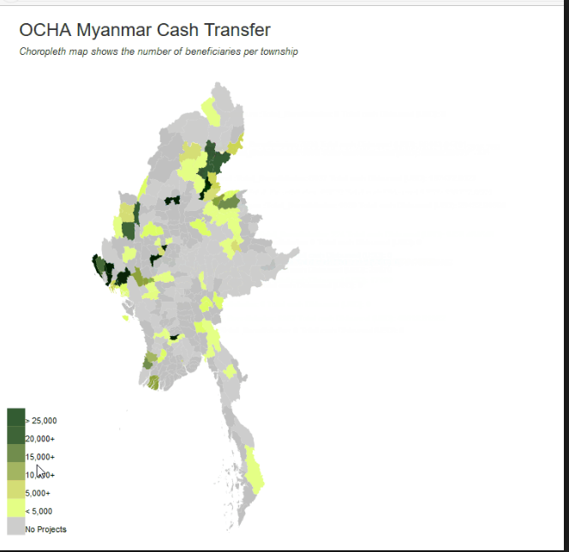
Data Visualization
Notes:
Pass around example visualized charts or project these images on the screen:
For each visualization, ask the class: What information is provided? Is it qualitative or quantitative? What does this information show? Who can use it/what is it for?

Slide 17
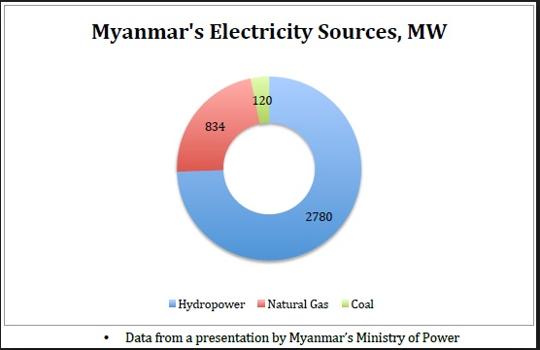
Data Visualization
Notes:
Pass around example visualized charts or project these images on the screen:
For each visualization, ask the class: What information is provided? Is it qualitative or quantitative? What does this information show? Who can use it/what is it for?

Slide 18
Key terms
Stakeholders: a person with an interest or concern in something. For example, who are the stakeholders in this class? Who are the stakeholders at a restaurant? Who are the stakeholders at a football match?

Slide 19
Data Visualization Activity
Notes:
Understanding and Working with Data Visualizations
See Activity 1.2 document for more details

Slide 20
Debrief
Notes:
Briefly review key concepts identified, pause to answer any questions, and dismiss the class for lunch.
If it wasn’t discussed after Activity 1.2, be sure to discuss the following in the module’s debrief:
- good data visualizations require good data. If the data that underlie a visualization are faulty, the result will be misleading and incorrect conclusions from the visualization.
- The processes described in Activity 1.1 of defining a data problem, audience, and goal, are also necessary to take for visualizations. As we move forward throughout this class, we’ll return to these topics. It’s always critically important to remember that for every data project, you need to keep in mind the your audience and what you are trying to accomplish with the data.

