Slide 1
Data for Decisions
Module 5: Applying Data for Decision Making to Your Organization, Part 1

Slide 2

Overview
Review
Activity 5.1
Review
Activity 5.2
Notes:
Welcome the participants back. Review the following concepts. As before, have the participants give their own definitions before providing definitions for the following:
Data life cycle
Data collection
Data analysis
Data sharing
Metadata
Primary data
Secondary data
Methods of data collection

Slide 3
Administrative tasks
Notes:
Welcome the participants back. Spend a few moments going over any administrative tasks if necessary. Then, outline the structure of today. In the first half of the day, participants will be reviewing the concepts they have learned over the past two days, and will apply these concepts to a data project in order to solve a problem at their own organization using the new skills that they learned. Then, after lunch, the participants will use the remaining time to finish their projects and then present them.
Pause to answer any questions.

Slide 4
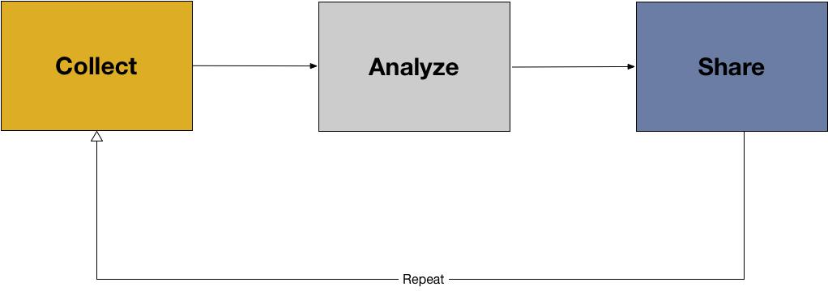
Review
Notes:
Next, take a few moments to review the following key concepts from yesterday. Project this image on the screen:

Slide 5
Review
Collecting data
Analyzing data
Sharing data
Primary data
Secondary data
Data collection protocols
Metadata (descriptive and administrative)
Choosing method of analysis
Preparing data for analysis
Notes:
Next, take a few moments to review the following key concepts from yesterday. Project this image on the screen:
Ask the class about the data lifecycle. How would they describe:
Collecting data
Analyzing data
Sharing data
As they describe the concepts, have them discuss different aspects of each step in the cycle. For instance, with regards to collecting data, what necessary steps are there?
For the collection phase, review
Primary data
Secondary data
Data collection protocols
Metadata (descriptive and administrative)
For the analysis phase, review:
Choosing method of analysis
Preparing data for analysis
Data cleaning
Data coding
Data normalization
Descriptive statistics
Visualization
For the sharing phase, review:
Why is data sharing important?
Possible digital open formats for sharing (.doc, .PDF, .JPEG, etc)
Data documentation
Publishing data
Pause to ask if anyone has questions so far.

Slide 6
Review
Data cleaning
Data coding
Data normalization
Descriptive statistics
Visualization
Why is data sharing important?
Open digital formats for sharing
Data documentation
Publishing data
Notes:
Next, take a few moments to review the following key concepts from yesterday. Project this image on the screen:
Ask the class about the data lifecycle. How would they describe:
Collecting data
Analyzing data
Sharing data
As they describe the concepts, have them discuss different aspects of each step in the cycle. For instance, with regards to collecting data, what necessary steps are there?
For the collection phase, review
Primary data
Secondary data
Data collection protocols
Metadata (descriptive and administrative)
For the analysis phase, review:
Choosing method of analysis
Preparing data for analysis
Data cleaning
Data coding
Data normalization
Descriptive statistics
Visualization
For the sharing phase, review:
Why is data sharing important?
Possible digital open formats for sharing (.doc, .PDF, .JPEG, etc)
Data documentation
Publishing data
Pause to ask if anyone has questions so far.

Slide 7
Activity 5.1
Notes:
See annotated instructor guide for more information.

Slide 8
Review key concepts
Data
Data for decision making
Stakeholders
Assessment
Mission
Vision
Data producer
Data consumer
Notes:
Review the following key concepts with the participants. This could be done by playing a review game where the class is split into teams and has to answer questions about each concept, or could be done by a simple instructor-led review. For each concept, be sure to spend time with the participants and have them describe each term’s significance in data for decision making.
Again, as before, try to have the participants provide their own definitions before
Data
Data for decision making
Stakeholders
Assessment
Mission
Vision
Data producer
Data consumer

Slide 9
Review key concepts
Steps for using data for decision making
Identify a problem or research question
Assess data available to you and your data needs
Identify stakeholders
Plan for how data will be used, analyze, and shared

Slide 10
Activity 5.2
Notes:
See annotated instructor guide for Activity 5.2 for detailed instructions.

