Slide 1
Data for Decision-Making
Module 3: Introduction to the Data Lifecycle – Collecting Data

Slide 2

Overview
Review key concepts
Introducing the data life-cycle
Case studies
Activity 3.1
Understanding data collection methods
Key considerations in designing a data collection plan
Lying with data
Debrief

Slide 3
Review
Data
Data for decision making
Stakeholders
Assessment
Mission
Vision
Data producer
Data consumer
Notes:
Welcome the participants back. Remind the participants of the structure for today: two, three-hour workshops with a break in between for lunch. Also use this time to go over any administrative tasks as necessary.
Then, review the following key concepts with the participants. Again, as before, try to have the participants provide their own definitions before
Data
Data for decision making
Stakeholders
Assessment
Mission
Vision
Data producer
Data consumer

Slide 4
Steps to Using Data for Decision Making
Identify a problem or research question
Assess data available to you and your data needs
Identify stakeholders
Plan for how data will be used, analyze, and shared
Notes:
Ask, what are the key steps to using data for decision making? Remind the participants:
Identify a problem or research question
Assess data available to you and your data needs
Identify stakeholders
Plan for how data will be used, analyze, and shared
Pause to ask if anyone has questions so far.

Slide 5
Introducing key concepts
Lifecycle
Notes:
Write the word “lifecycle” on the board or project it on the screen. Ask the class what they think the word means. Where have they seen this word before? What kind of examples of lifecycles can they provide? If the class is quiet or slow to respond, feel free to provide some guiding questions, such as what is an example of a lifecycle within their own life? An animal’s life? A plant’s life?

Slide 6
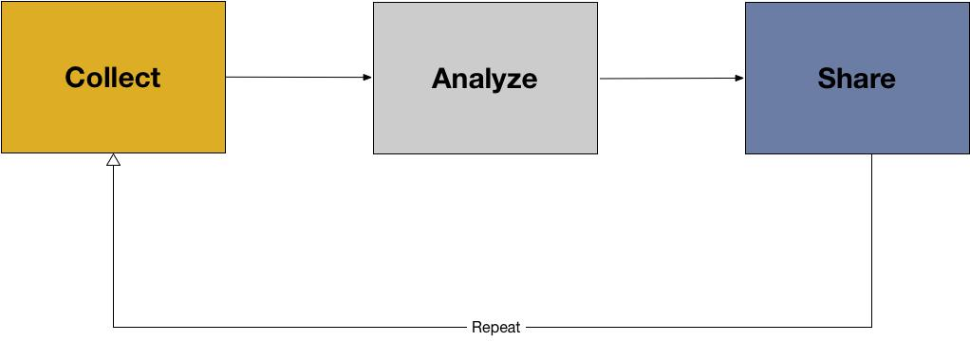
Introducing key concepts
Collecting data
Analyzing data
Sharing data
Notes:
Tell the class that much like living things, data has a lifecycle of its own.
Then, tell the class that this image represents a data life cycle. There are three stages:
Collecting data
Analyzing data
Sharing data
Remind the class that any data lifecycle always begins with a research question or problem that you are trying to solve.

Slide 7
Introducing key concepts
Data collection: data collection is the process of gathering information in a systematic way. Collected data are generally intended to answer questions and/or evaluate outcomes.
Data analysis: data analysis is the process of inspecting, cleansing, transforming, and visualizing data with the goal of discovering its useful information, suggesting conclusions, and supporting decision making.
  Data analysis is made up of many stages:
    Inspecting the data
    Cleaning the data
    Transforming the data
    Visualizing the data (visually)
Notes:
Introduce the above concepts, but make note that will be explained in detail in the next module. Then, provide the definition for the last part of the data lifecycle:
Data analysis definition from Wikipedia

Slide 8
Introducing key concepts
Data sharing: data sharing is the process of making data that are used in problem solving, research, or evaluation available to others.
Notes:
Underscore to the participants the importance of sharing data. Many funding agencies, institutions, and publication venues around the world have policies regarding data sharing because transparency and openness are considered to be key parts of research. In addition to the data themselves, metadata and documentation should also be shared if possible.

Slide 9
Assessment Case Study
Notes:
Provide context by going through these steps in a country specific example and a generic example.
Below, two examples have been provided of applications of the data lifecycle. One is a generic example, and one is a country specific example. If in Myanmar, please feel free to use the country-specific example provided. However, if implanting this curriculum outside of Myanmar, it would be helpful to provided participants with data lifecycle examples in their own countries.
Generic Example: Digital Green, India
The use of information and communications technology (ICT) in agricultural services is becoming increasingly common. These technologies—which include radio, SMS, television, video, and Internet services—have the potential to help smallholder farmers increase their incomes by making it easier for them to learn about and adopt new farming methods, grow higher-value crops, or connect with new markets.
Digital Green, an international non-profit organization based in India, uses locally-produced videos and in-person facilitation to share knowledge about improved agricultural and nutrition practices. The program aims to help rural communities across South Asia and Sub-Saharan Africa understand and adopt better agricultural and nutrition practices, and the ultimate goal of the program is to have a positive impact on individual well-being. Digital Green is currently working in nine states in India, and also in Afghanistan, Ethiopia, Ghana, Niger, Tanzania, Malawi, and Papua New Guinea. Since its start in 2008, Digital Green’s program has produced over 4,000 videos reaching more than 800,000 viewers across more than 9,000 villages.
Digital Green is in the process of measuring the program’s impact on farmer livelihoods and health status using evaluations in both India and Ethiopia and its effect on improving nutrition-related behaviors in India. The organization has also invested in an activity monitoring system that reports data on program implementation and tracks the adoption of Digital Green-promoted practices from remote locations. One challenge in the activity monitoring system is its reliance on data from partner organizations, which varies in quality. Recognizing the issue, Digital Green has instituted a series of data quality checks and procedures to improve quality. The Goldilocks Initiative’s recommendations for Digital Green focus on its agricultural activities, and include refining and consolidating the program’s theory of change and conducting a systematic review of data quality. (Innovations for Poverty Action Lab, 2016)
Myanmar Specific Example: MIMU 3W
In 2008, after Cyclone Nargis, the Myanmar Information Management Unit (MIMU) launched their 3W project to track and share humanitarian and development activities undertaken by all agencies across Myanmar.
3W stands for “Who does What, Where.” By keeping an up to date database on which organizations (who) are conducting certain activities (what) in Myanmar (where), other organizations and donors can better target beneficiaries to ensure humanitarian and development needs are met.
The partnered agencies share their information on planned, ongoing, and recently completed activities every six months using standard sector definitions and MIMU compiles these data. They clean and digitize the data, creating quality baseline data sets on humanitarian and development efforts in Myanmar and on responding agencies in the country. They then make the data publically available for other agencies to use. The intended impact is that agencies and donors can use these data to determine which areas, sectors, and populations to target in their future projects. (http://themimu.info/3w-maps-and-reports)
After each example, take time for discussion with the participants regarding data life cycles. Some guiding discussion questions include: What was the problem the organization was trying to solve? How did the organization collect data? How did they plan to analyze data? How will the use data to make a decision? How can the organization share their data? How does the organization question their data quality?

Slide 10
Activity 3.1
Notes:
See annotated instructor guide for Activity 3.1 for detailed instructions.

Slide 11
Understanding Data Collection Methods
Primary data: information collected by you or your team.
Secondary data: information that is collected by a third party.
Notes:
Transition with the participants by saying that now they have a deeper understanding of the data collection as a whole, the next part of the module will focus on data collection processes, protocols, and concepts.
Review with the class what primary and secondary data are. Solicit answers from the class. Then, provide them with the following simplified definitions:
Primary data: information collected by you or your team.
Secondary data: information that is collected by a third party.
Take time to discuss with the class the benefits and drawbacks of each. Primary data are valuable in that you have control over the collection of the data and direct knowledge of the data have been managed.

Slide 12
Primary Data Sources
Quantitative
  Surveys
  Experiments
  Observation
Qualitative
  Interviews
  Focus groups
  Observation
  Case studies
Notes:
Discuss the different forms of primary research.

Slide 13
Secondary Data Sources
Journals
Books
Newspapers
Records
Previous reports and analyses
Notes:
Then, state that secondary data are also valuable because they can improve your insights, help plan new data collection, or answer existing questions without having to spend time and money collecting data. Walk the class through different sources of secondary data, such as:
Journals
Books
Newspapers
Records
Previous reports and analyses
Ask the class for examples of primary and secondary data at their own organizations. If they collection primary data, what were the benefits of that? What were the disadvantages? What about the benefits and disadvantages of using secondary data for a project?
Underscore to the class that in many cases it is valuable to use a combination of both secondary and primary resources in making a decision with data.

Slide 14
Introducing Key Concepts
Protocols are systematic plans for how a set of operations are to be carried out
Data protocols are systematic plans for how data are to be collected, stored, and described
Notes:
A key part of any data collection plan are data collection protocols. Ask the class what a protocol is. Once they have provided their own definitions, ask the class what they think a data collection protocol might be. Then, provide the following definitions:
Protocols are a systematic plan for how a set of operations are to be carried out
Data protocols are systematic plan for how data are to be collected, stored, and described
Data collection protocols can help save time and resources by specifying the format the data should be collected in, the types of data you want to generate, the instruments you will use to generate and collect data, and how it should be stored, and how it should be shared.

Slide 15
Introducing key concepts
Metadata: information that describes, explains, or gives context for other data. They are provided to make it easier to interpret, use, and manage data.
Notes:
Introduce the concept of “metadata” to the participants. Solicit the participants for their own definition of metadata, then provide the follow:
Metadata: structured information that describes, explains, locates, or otherwise makes it easier to retrieve, use, or manage data. Metadata can also be called data about data, or information about information. (National Information Standards Organization, 2013)

Slide 16
Introducing key concepts
Metadata are important because they are used to add context to data. Metadata are the key for primary data to be used as secondary data. Metadata can be:
  Descriptive metadata (Such as who created the data, what was the data created for, where was the data collected, and when the data was collected)
  Administrative metadata (Why these data were collected)
Notes:
Introduce the concept of “metadata” to the participants. Solicit the participants for their own definition of metadata, then provide the follow:
Metadata: information that describes, explains, or gives context for other data. They are provided to make it easier to interpret, use, and manage data.
Ask the class for examples of metadata.

Slide 17
Key Considerations in Designing a Data Collection Plan
What questions or problems are trying to be addressed?
What do you need to know?
When to collect new data (primary), and when to use existing data (secondary)?
What instruments will you need to create?
Who will be involved in data collection, and for how long?
What documentation will be needed to use the data again?
Notes:
This process Walk through the steps with the participants, taking time for discussion. If possible, have a student volunteer a problem they would like to see solved with data from the “telephone” activity. Then, walk through the steps with the class. Pause and answer any questions.
What questions are trying to be answered?
The first step to collecting data is to clearly understand the problem. Write down a set of questions and potential ways they can be answered with new or existing data.
What do you need to know?
Often when we list the kinds of data we want it can become a wishlist of things that are all “interesting” but may not all be necessary. Make sure everything in your list of “need-to-know” data are necessary for answering the questions or problem you stated. Go back and forth between the data and problems to make sure both match. You may need to remove some data from your wish list if they do not support the problem statements. You may also need to revise your problem statements if the data you list do not support what is there but you feel those data are vital.
When to collect new data (primary), and when to use existing data (secondary)?
This can be answered by exploring existing data sources, writing down explicit questions to be asked and trying to answer those with existing data sources, etc.
What instruments will you need to create?
Collecting new primary data requires significant time developing new instruments, making sure the questions are phrased accurately to get the data you need, and testing them before administering them.
Who will be involved in data collection, and for how long?
Plan to have people involved that can contribute data collection and analysis stages
What documentation will be needed to use the data again?
This should tell the history of the data. Who created it? When was it created? Why was it created? What information does it include?

Slide 18
Introducing key concepts
Sample resources:
Data Management Plan tool: https://dmponline.dcc.ac.uk/
Following best practices in choosing a sample (size, diversity, relevant population, etc.) https://resolutionresearch.com/page/results-calculate/
Searching for secondary data http://datasupport.researchdata.nl/en/start-de-cursus/iv-gebruiksfase/zoeken-naar-data/
What are databases? How to design one? www.dartmouth.edu/~bknauff/dwebd/2004-02/DB-intro.pdf
Notes:
The following section of this module provides participants with sample resources surrounding data management and collection that they can return to in the future. If using a projector, take time to go to each website and click around, providing commentary with participants about the website’s purpose and how they can use the website in the future. If not, provide screen shots of each source that can be passed around to the participants as the instructor describes each data resource.

Slide 19
Lying with Data
Notes:
Include a section here based on BS in Data course. (To be completed once content is shared from UW course)

Slide 20
Lying with Data
The same data can easily be manipulated and used to tell different, opposing, or inaccurate stories participant introductions
Intentional or unintentional misuse
We can face many pressures in our work
Respectfully talk with your colleagues and supervisors if you feel data are being used incorrectly or inappropriately
Notes:
We have noted before and want to again make the strong point that the same data can easily be manipulated and used to tell different, opposing, or inaccurate stories.
This can be intentional or unintentional. Not all bad or misleading storytelling is done with ill-intent.
Using data to mislead can be particularly challenging when there are powers in our work that may want to see certain things from data and directly or indirectly pressure us to find ways to say them.
It is important to always be thoughtful about how you and your peers are using data and be careful of political and other pressures that may lead to inappropriate use of data.
Find ways to respectfully talk with your colleagues and even supervisors if you feel data are being used incorrectly or inappropriately.

Slide 21
Lying with Data
There are many ways data can be used to mislead
Always keep your data radar active!
A few examples:
Notes:
This training will not go into the many ways data can be used poorly. That is an entire course to itself. In fact, many universities now offer courses just on lying with data. However, here are a few of the many things to be careful of. Keep your data radar always active!

Slide 22
Lying with Data
Correlation vs. causation
Misleading visualizations
Using bad data
Selective storytelling

Slide 23
Lying with Data
Correlation vs causation
Misleading visualizations
Using bad data
Selective storytelling

Slide 24
Lying with Data
A correlation describes a relationship between two or more variables. It does not, however, mean that one variable impacts the other.
Causation shows that the change in one variable is the result of a change in the other. In other words, a change in one causes a change in the other.
Notes:
Correlation vs causation
A correlation describes a relationship between two or more variables. It does not, however, mean that one variable impacts the other.
Causation shows that the change in one variable is the result of a change in the other. In other words, a change in one causes a change in the other.
Examples both show how real data trends could be used to show causation. More cheese consumption does not lead to more PhDs in Engineering or more people dying from being tangled in their bedsheets. These are very obviously not true. But it is harder with other your data that are of similar subject matter.

Slide 25
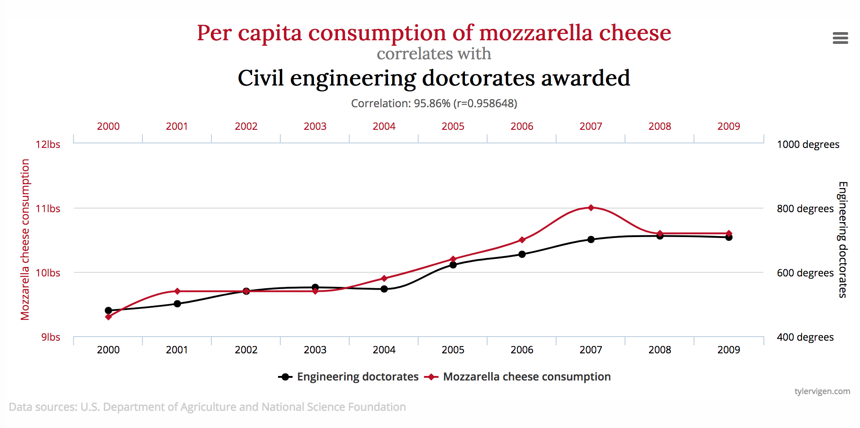
Lying with Data
Source: http://www.tylervigen.com/spurious-correlations
Notes:
Example of correlation without causation

Slide 26
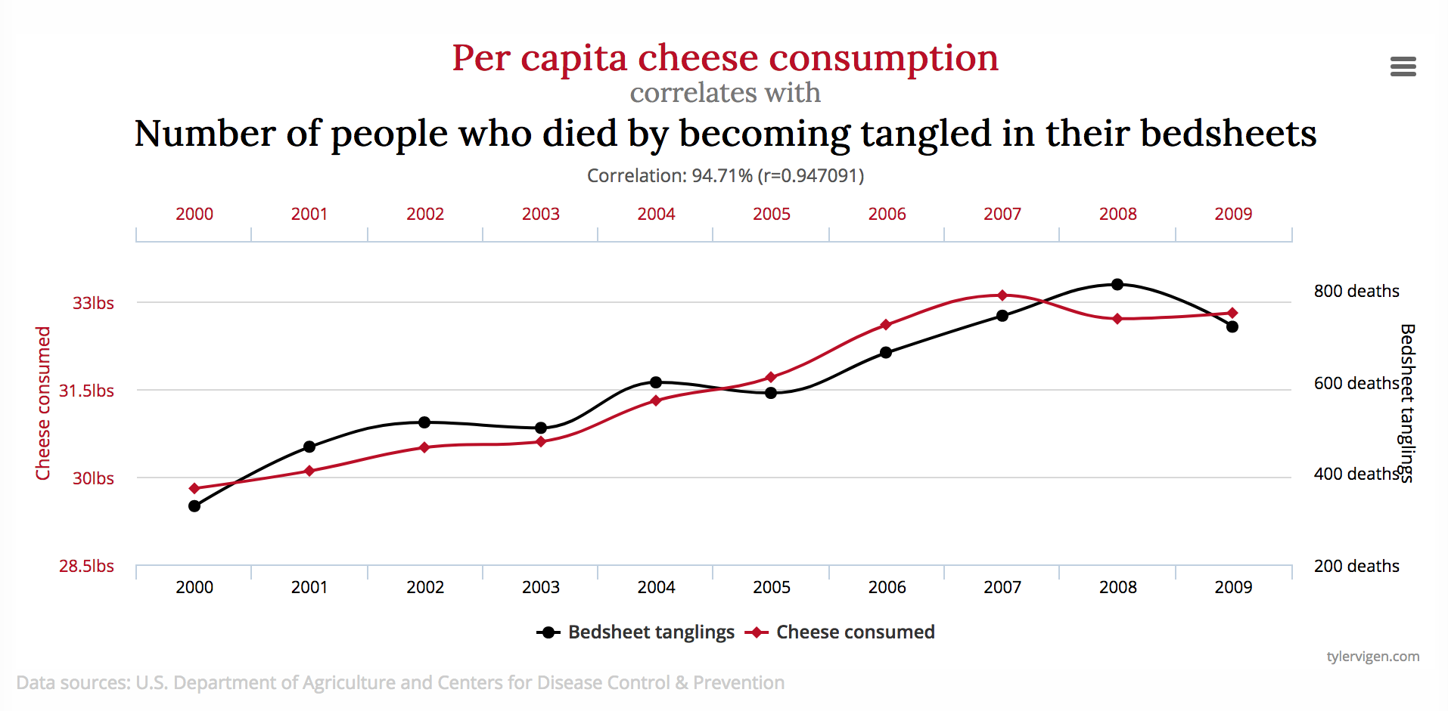
Lying with Data
Source: http://www.tylervigen.com/spurious-correlations
Notes:
Example of correlation without causation

Slide 27
Lying with Data
Correlation vs causation
Misleading visualizations
Using bad data
Selective storytelling
Notes:
Misleading visualizations
There are many ways visualizations can be misleading. Always be skeptical of the visualizations you and others create, even if published in reputable journals, papers, magazines, or other sources. Here are a few examples.
In the examples, the first graph doesn’t include 0. It gives the impression that German workers spend much more time working than workers in other countries. Once 0 is added, this doesn’t seem the case, does it? The differences are much less dramatic.

Slide 28
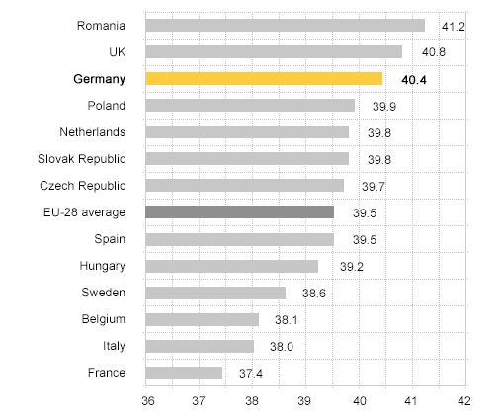
Lying with Data
Average number of weekly hours worked at main job
Source: http://callingbullshit.org/tools/tools_misleading_axes.html
Notes:
Notice there is no 0 on the x axis, giving the appearance that the difference are larger than they actually are.

Slide 29
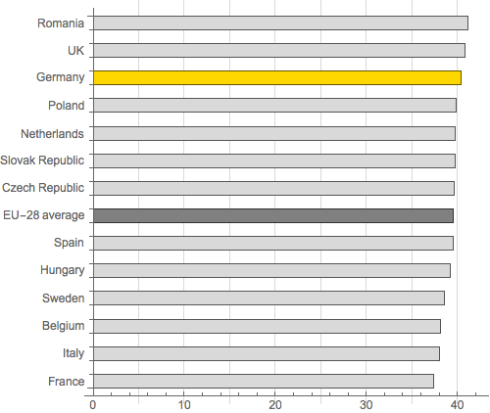
Lying with Data
Source: http://callingbullshit.org/tools/tools_misleading_axes.html
Notes:
See what the data look like when 0 is added

Slide 30
Lying with Data
Misleading visualizations
A good resource is http://callingbullshit.org/tools/tools_misleading_axes.html

Slide 31
Lying with Data
Correlation vs causation
Misleading visualizations
Using bad data
Selective storytelling
Notes:
Using bad data
Sometimes bad data are used to tell stories without clearly indicating the data should not be fully trusted. Know the limitations of your data.

Slide 32
Lying with Data
Correlation vs causation
Misleading visualizations
Using bad data
Selective storytelling
Notes:
Selective storytelling
One can leave out pieces of a dataset that do not fit the “story” they want to tell with the data. You may not know if others do it, but you certainly can know if you do. Always stay honest in your analyses and open to other stories that arise in the data, even if they don’t support what you want to tell.
I

Slide 33
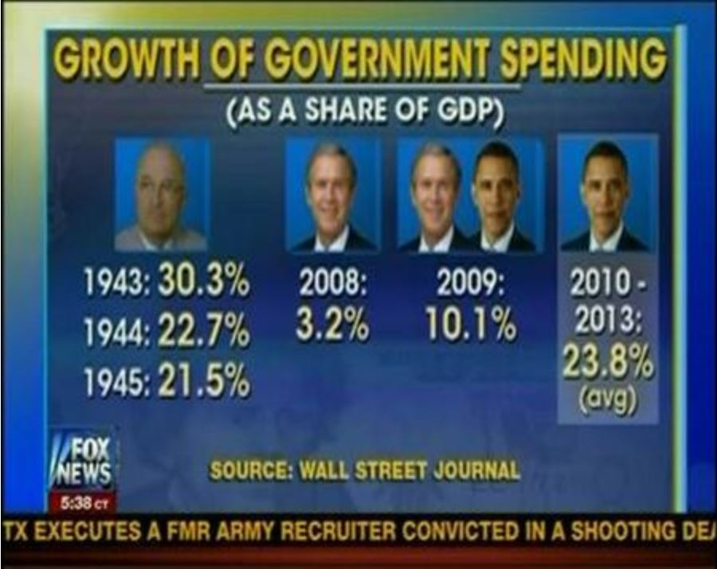
Lying with Data
Notes:
In this picture below, FOX News did an analysis of government spending under recent US presidents, with the conclusion that Obama spent significantly more than others. This was in insinuation that he was reckless with government money. However, the methods they used to calculate the Obama figure was different than the ones for the previous presidents. In fact, Obama’s spending was very close to Bush. None of the data were wrong, but the way they were put together to tell the story were.

Slide 34
Lying with Data
Key takeaways
  Misusing data can be intentional or unintentional
  Be careful with your data and what conclusions you state from it
  Do not manipulate your data to fit the story you want to tell and not be open to other stories
  Be critical of how others use data
  Be honest if you make a mistake
Notes:
Summarize as seems most relevant to the group. Add expansion or other takeaways as needed
With regards to the FOX News slide, note that FOX did apologize by saying "We mixed up the numbers on Wednesday, so we wanted to clear things up.” However, they left it at that and didn’t explain how they mixed up the numbers or what they should have actually been. Humility is very important and we should be prepared to admit our biases and mistakes, and correct any story we may get wrong.

Slide 35
Debrief
Notes:
Take time to answer any questions the participants may have. Then, announce to the participants that the next module will focus on analysis and data sharing. Then, dismiss the participants for lunch.

