Slide 1
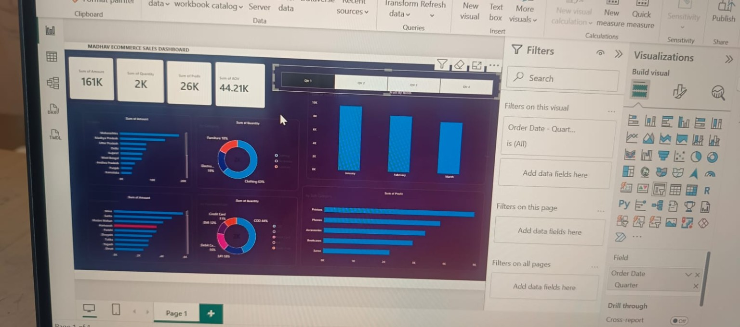
E-COMMERCE
SALES DASHBOARD
A visual analysis of sales, quantity, profit and customer payment patterns
POWER BI PROJECT
Dashboard walkthrough • Key metrics • Trends • Insights
Prepared for classroom presentation
MADHAV E-COMMERCE SALES DASHBOARD
01

Slide 2
01 | Dashboard at a glance
One page brings the main business measures and breakdowns together.
KPI CARDS
Quick snapshot of revenue, quantity, profit and average order value.
CATEGORY CHARTS
Compare product categories and payment methods.
QUARTER SLICER
Filter the dashboard to view different periods.
MADHAV E-COMMERCE SALES DASHBOARD
02

Slide 3
02 | Key performance indicators
The top cards summarise performance for the selected quarter. Values change when the slicer changes.
REVENUE
QUANTITY
PROFIT
AOV
Total sales value
Units/items sold
Profit or loss indicator
Average order value
How to explain these in a viva
Important interpretation note
• Revenue shows the value generated from sales.
• Quantity shows the volume sold.
• Profit helps assess business performance.
• AOV means average order value: revenue ÷ number of orders.
A negative profit value can indicate a loss in the selected period. Always check the quarter filter and the underlying data before drawing conclusions.
MADHAV E-COMMERCE SALES DASHBOARD
03

Slide 4
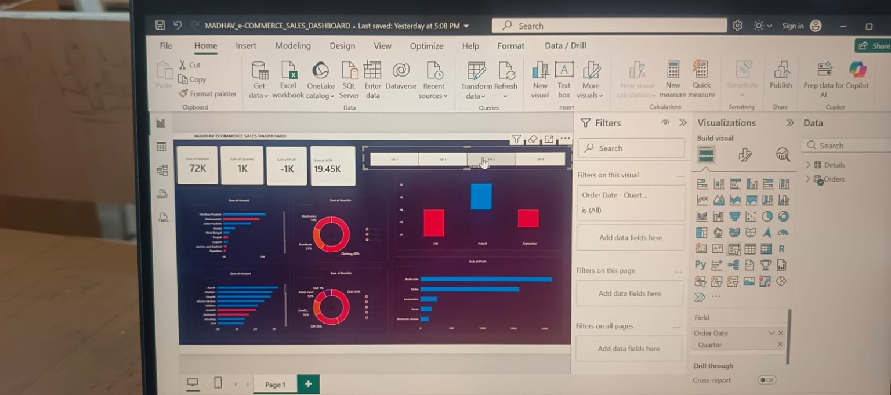
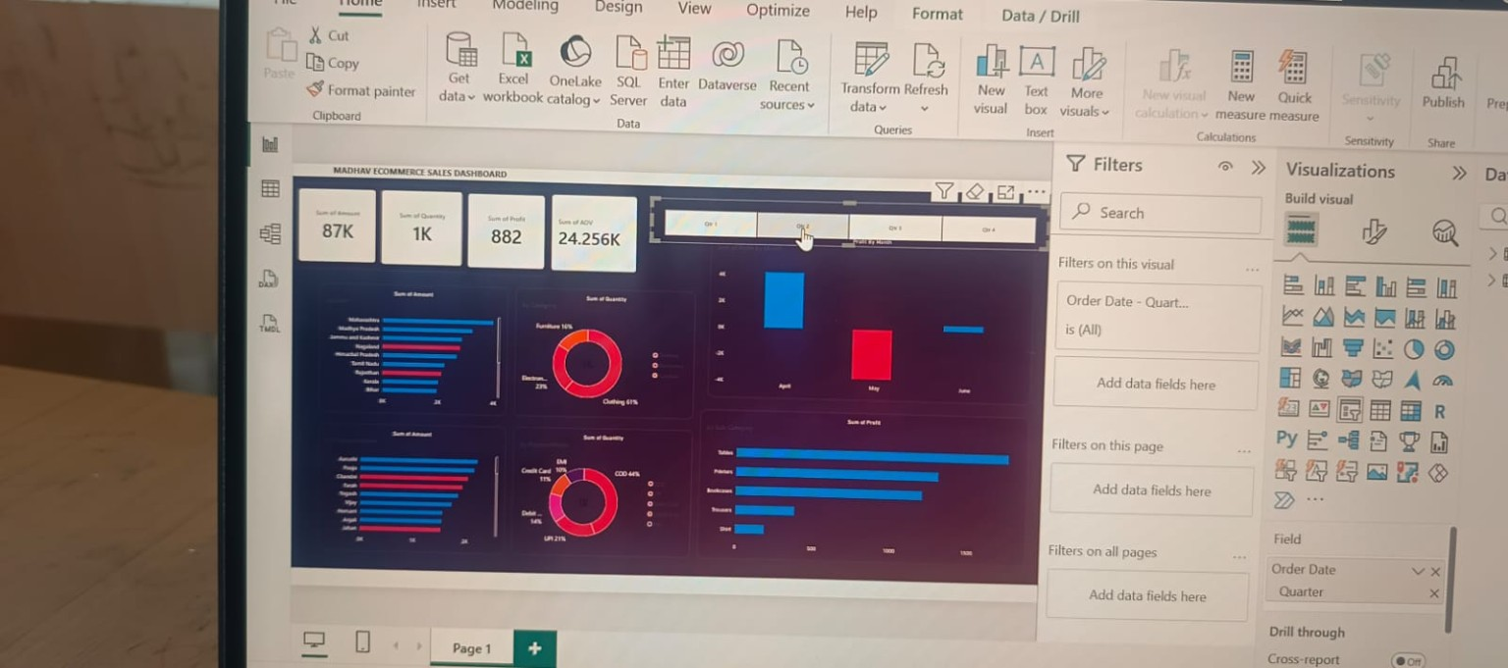
03 | Product and payment analysis
Bar charts rank categories; donut charts show each category's share of the total.
Read the longest bars as the largest values; use the donut labels/legend to compare category shares.
MADHAV E-COMMERCE SALES DASHBOARD
04

Slide 5
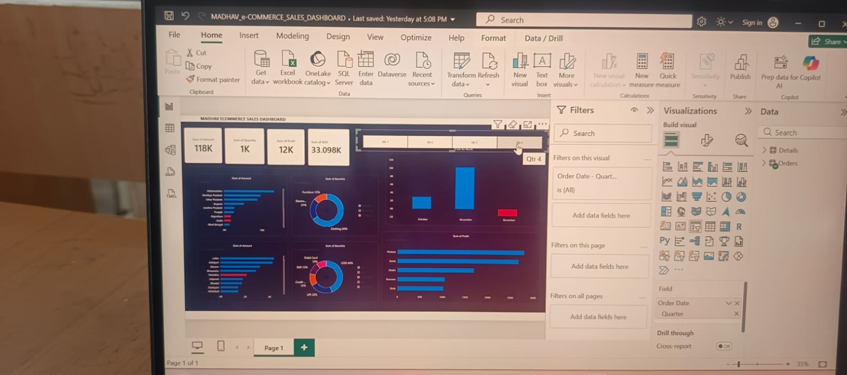
04 | Quarter-wise trend analysis
The quarter slicer makes the report interactive: selecting a quarter updates the cards and charts.
How to present it
1. Select Qtr 1, Qtr 2, Qtr 3 or Qtr 4.
2. Observe how the KPI cards change.
3. Compare monthly bars and category charts.
4. Explain which period appears stronger and verify why.
Use the same scale and check filters before comparing quarters.
MADHAV E-COMMERCE SALES DASHBOARD
05

Slide 6
05 | Key takeaways
A dashboard turns raw transaction data into information that supports decisions.
MONITOR
COMPARE
Track revenue, quantity, profit and AOV together.
Use product and payment breakdowns to identify high-contributing categories.
FILTER
INVESTIGATE
Use quarter selection to examine performance across periods.
Review negative profit or unusual changes before making decisions.
Conclusion: Interactive visuals make e-commerce performance easier to understand and explain.
MADHAV E-COMMERCE SALES DASHBOARD
06

