Slide 1
ROBOTICS PROJECT
DRONE PROGRAMMING

Slide 2
INTRODUCTION
Purpose of the work
In this project we study the DJI TELLO Drone through its simulation and programming. For the simulation of the drone we used FCND-Simulator and the programming was done using python programming language. The aim of this work is to deepen the practical use of programming for automatic devices and to understand the difficulties and deviations that are created through the experiments we will conduct.

Slide 3
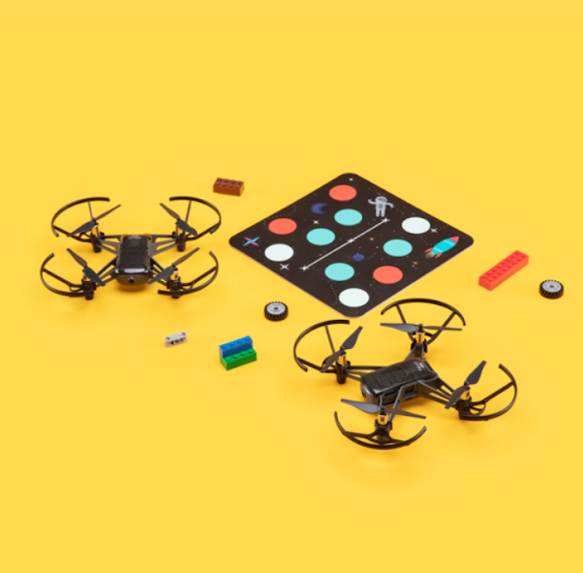
DJI TELLO
In our work we used the DJI TELLO Drone provided by the University. It is an educational drone from Ryze in collaboration with DJI which was specifically designed to introduce its users to the world of programming by enabling programming in languages such as Scratch, Swift and Python. We also had mission pads available where they are special mats with a separate I.D. number that can be read with the lower pusher.

Slide 4
Programming Language - Python
We chose to use the Python programming language for the following reasons:
  Flexibility of programming capacity
  Easy to use and learn (similar format to C)
  Ability to handle more complex drone manipulations (rotor speed, etc.)
  Wide use by the programming community

Slide 5
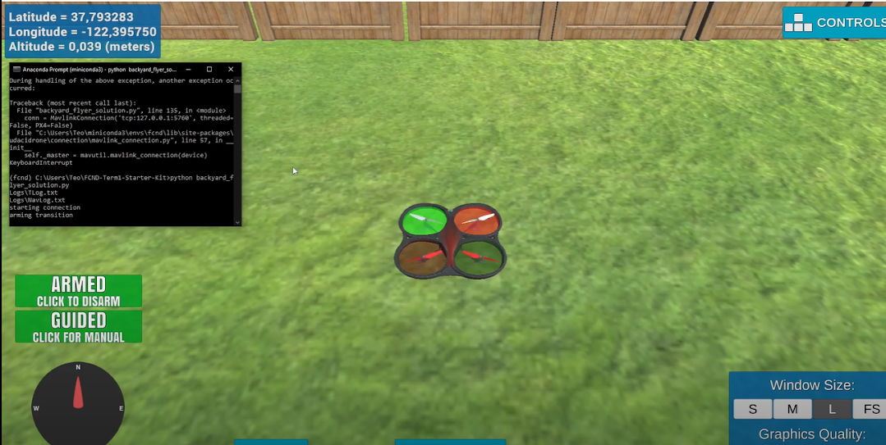
Simulation
For the simulation, we executed simple commands whereby the drone follows basic paths (moving from point a to b, squaring on various axes, etc.). We did this so that we could familiarize ourselves with how the drone works before moving on to the actual programming. What we noticed is that the drone works like the simulations we did, the only difference being the deviations we had in reality (shown below). Unsurprisingly, we found it much easier to work with the drone in the lab after using the simulator.

Slide 6
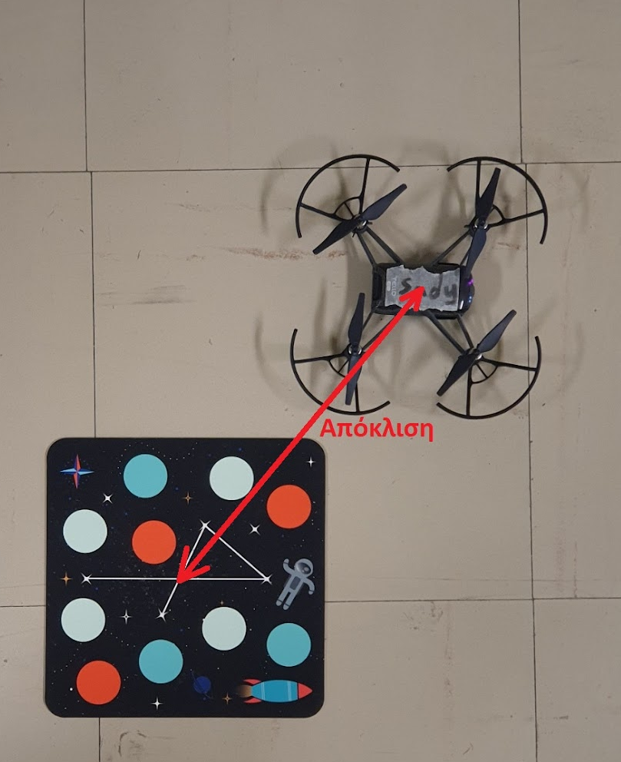
Drone Programming
Experimental procedure
For our work we conducted experiments for different trajectories in order to study the drone. The trajectories which we studied are as follows:
Takeoff-Propulsion
Flight from point A to point B
Flight from point A to point B and back
Flight in a square or rectangle in the X-Y, X-Z, Y-Z planes

Slide 7
Take-off - Pre-landing
When the code was executed, the drone took off and stayed in the air for 2 seconds and then landed. We repeated the code 5 times and measured the deviation in each iteration, and also recorded the battery percentage. The average deviation is 20cm.
Number of repetitions | Battery | Deviation (cm)
1 | 68% | 31
2 | 68% | 23
3 | 68% | 12
4 | 68% | 22
5 | 68% | 12

Slide 8
Flight from point A to point B
In this trajectory we programmed the drone to take off at point A(0,0), then go straight to point B(100,0) and finally land. We repeated the code 6 times and the average deviation is 32.66 cm. However, we notice that the battery plays a significant role in the deviation as for 61% the deviation we obtained is much larger than the other.
Number of repetitions | Battery | Deviation (cm)
1 | 61% | 82
2 | 100% | 35
3 | 100% | 15
4 | 100% | 25
5 | 100% | 15
6 | 100% | 24

Slide 9
Flight from point A to point B and back
Similarly to the previous flight the drone will reach point B but then return to point A and then land. We repeated the code 5 times and the average deviation was 49cm. We notice that the deviation in this trajectory is quite increased compared to the 2 previous trajectories, and the battery does not seem to play a significant role.
Number of repetitions | Battery | Deviation (cm)
1 | 94% | 83
2 | 91% | 11
3 | 88% | 54
4 | 86% | 57
5 | 83% | 40

Slide 10
Course in 100x100 square in X-Y plane
With sleep 1
With sleep 2
Speed 50cm/s with sleep(2)
Number of repetitions​ | Battery | Deviation (cm)
1 | 84% | 28
2 | 71% | 45
3 | 100% | 94
4 | 100% | 145
5 | 100% | 65
6 | 83% | 61
Speed 50cm/s in x,y and sleep(1) ​
Number of repetitions​ | Battery ​ | Deviation (cm)
1​ | 80%​ | 140​
2​ | 75%​ | 74​
3​ | 100%​ | 52​
4​ | 100%​ | 93​
5​ | 100%​ | 80​

Slide 11
Course in 100x60 rectangle in X-Y plane with sleep 2
Here we came quite close to a situation with an M.O. of deviation = 68.8 cm
But still the drone was flying very close to the walls.
In some circumstances it was also coming into contact with it which made it an unsafe choice.
Speed 50cm/s in x and 30 cm/s in y
Number of repetitions | Battery | Deviation (cm)
1 | 100% | 78
2 | 89% | 100
3 | 77% | 55
4 | 100% | 46
5 | 91% | 65

Slide 12
Course in 60x60 square in X-Y plane with sleep 2
But in the end we chose to use speeds of 30cm/s
On average they showed the smallest deviation at 67.8 cm
With a lower speed we had less influence of inertia
As a result the drone stopped more easily without the presence of "drifting"
Speed 30cm/s with sleep(2)
Number of repetitions | Battery | Deviation (cm)
1 | 79% | 41
2 | 100% | 100
3 | 93% | 103
4 | 89% | 74
5 | 85% | 21

Slide 13
Course in a 100x100 square in the X-Z plane
In this case we repeated our experiment 5 times and the average deviation was 72.6.We can see that in this case the battery played a significant role in the deviation, as shown in the table.
Deviation in X-Z
Number of repetitions | Battery | Deviation (cm)
1 | 69% | 92
2 | 66% | 107
3 | 100% | 26
4 | 100% | 58
5 | 100% | 12

Slide 14
Course in 100x100 square in the Y-Z plane
In this case, we encountered a significant problem that arose during the Y-axis movement.We repeated the experiment 7 times to get a larger sample of results so that we could draw a conclusion. The deviations we obtained are quite large and have an average of 112.5cm.
Deviation in Y-Z
Number of repetitions | Battery | Deviation (cm)
1 | 93% | 61
2 | 100% | 126
3 | 100% | 156
4 | 90% | 217
5 | 84% | 48
6 | 82% | 90
7 | 78% | 90

Slide 15
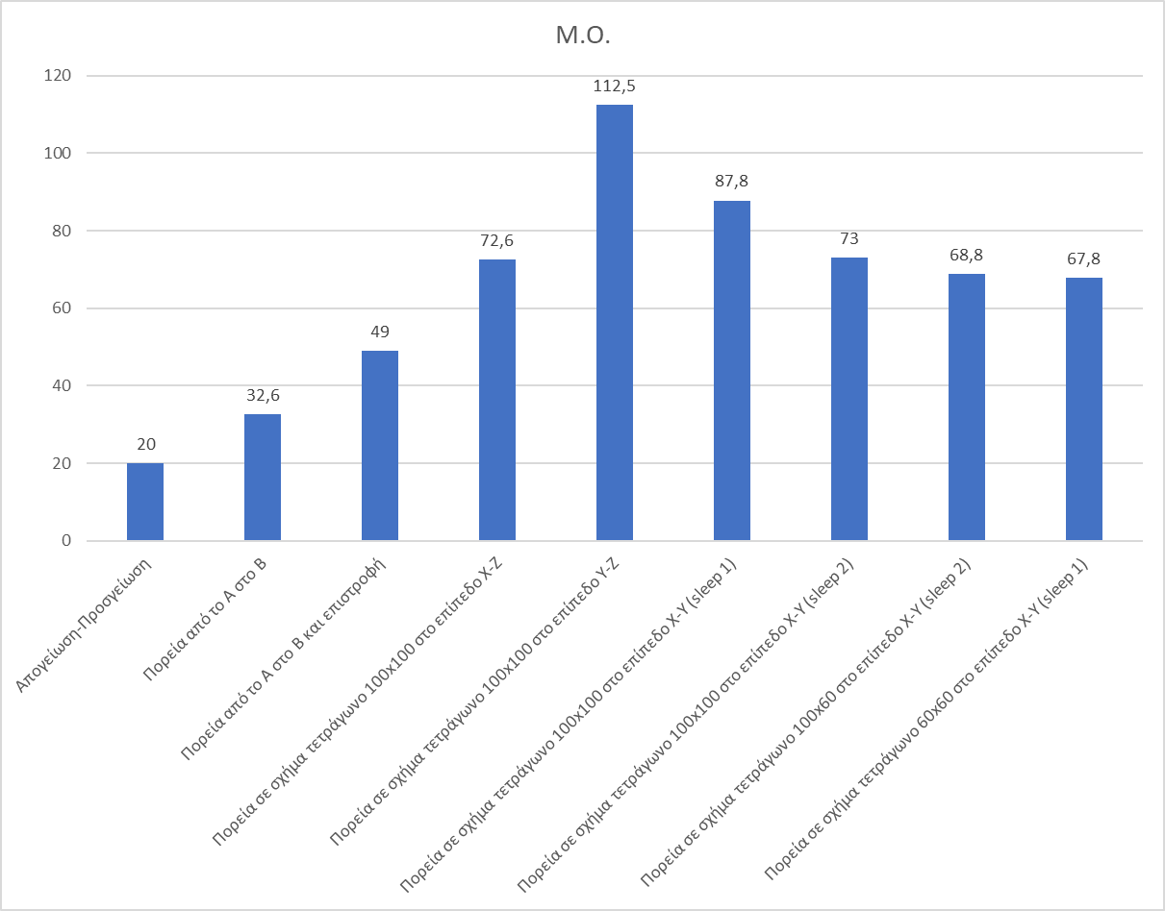
Graph of averages for each flight category

Slide 16
Conclusion
Gyroscopes show no significant difference in the drifting effect
Battery drop is most noticeable in square movements
There is a significant deviation in motion in the y-z plane compared to the x-z plane
Space limits our drone movements
Human error is of course present in the accuracy of the measurements

