Slide 1
DDB introduce
马进 @马进app
www.majin163.com

Slide 2
DDB outline
Application scenarios
Technology decides
System architecture
System design
Applications and Users

Slide 3
application scenarios
Applications
Netease Blog, yixin, cloud music, cloud reader
Database demands
Scalability
TB,PB level；
Cluster database nodes: less than 1000；
Availability
take over in one minute when data nodes failed
take over in seconds when sql proxy failed
Reliablility
Data never lose

Slide 4
application scenarios
Operation types
OLTP: mainly CRUD
Some complex query: join, group, agg etc.
Distributed transactions
Application demands
Usability
Drived from java jdbc, easy to use
Sql proxy 100% compatible with mysql
Fast iteration to meet app needs

Slide 5
Related tech.
Solutions
Oracle RAC
cost：commercial prods
functions：too much for us
Middleware
No mature solutions
NoSQL products
Lack availability, reliability.
Lack support for join, complex query and transactions

Slide 6
Technology decides
Independent development
DDB: Middleware based on MySQL
core：data sharding on MySQL for availability.
Derived from stardard jdbc for usability.
Sql parser and planner in middleware, app has no concern for sharding, just like using MySQL.
Optionly, app use connector/J and DDBProxy to acess DDB

Slide 7
DBI Architecture
DBA
App
isql
Control flow
DDL，metadata sync
DBI Module（JDBC）
DBAdmin
Master
Data flow
DML，metadata flush
DBN1
MySQL
DBN2
MySQL
DBN3
MySQL
sysdn
MySQL

Slide 8
Proxy Architecture
App
App
MySQL Client
standard jdbc connector
DBA
QueryServer(DDBProxy)
Control flow
DDL，metadata sync
Decoder
Encoder
DBAdmin
DBI Module（JDBC）
Master
Data flow
DML，metadata flush
DBN1
MySQL
DBN2
MySQL
DBN3
MySQL
MetaStore
MySQL

Slide 9
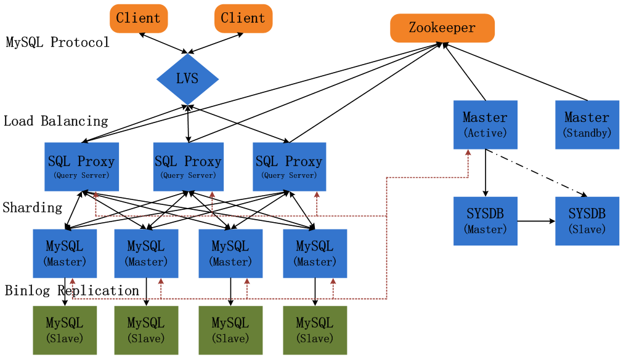
Entire Architecture

Slide 10
Entire architecture
DBI(Query Server)
Distributed SQL parser, planner.
Node connection pool.
Distributed transaction manager.
Sql, node connection Statistics collecting.
Master & SYSDB
Metadata(table, column……), Configuration management and notification
Data migration, xa, dbn monitoring
DBN
Master and slave
DDB master is response for failing over(notify switching dbn url)

Slide 11
System design
Data Sharding
Availability and reliability
Distributed transaction processing
online scale out and data migration
Global incremental ID

Slide 12
Sharding
Two mapping layer: hash, policy
Hash is immutable, policy is mutable
Change policy to implement data migration

Slide 13
Availability and reliability
Atomic fail over
Master keep heartbeat from each dbn
Pick a slave to switch on dbn failing
No data loss
VSR from innosql
Mater high availability
Use zookeeper to pick one leader and auto take over

Slide 14
Distributed transaction
Distributed transaction processing
core： 2-Phase-Commit implemention
DBI or QS as transaction coordinator；
Sql parser and planner, dectect if trasaction cross multiple dbns
Use mysql xa interfaces
Dbi and qs have xa logs (mainly prepare events)
What if : dbi or qs crashed or restarted ?
Transaction recovery based on local xa logs
What if ： dbi or qs is removed ?
Master asked about all suspended xa transactions from each DBN at a interval
For those suspended time > xx min, auto commit and report to DBA

Slide 15
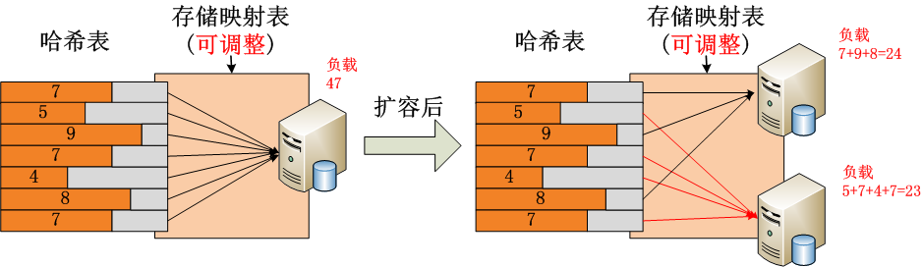
online scale out and data migration
online scale out and data migration
Core one：full copy and incremental replication
Core two : incremental replication based on binlog (tungsten and ddb filter)
full copy and incremental rep both depend on policy changing
We develop a single tool “hamal” to implement full copy and incremental rep

Slide 16
Global incremental ID
Support global auto_increment id
MSB: master allocate batch ids, default:1000
easy to implement and comprehend
Master dependent, insert could be blocked.
Bad incremental quality, Most apps use this implemention
TSB：based on local and master timestamp
Complex to implement, take care when changing master clock
No master dependent, support multiple masters (versions) in one cluster
For those need higher availability or incremental quality (NOS)

Slide 17
Apps and Users
Appications
apps > 50
DBN Servers > 300 (DBN > 1000)
Data > 100TB
Request in one app per day > 16 billion
Users
Hangzhou：yixin, cloud music, cloud reader
Mail，file center
Beijing: youdao cloud apps
Guangzhou: Webs and games

