Slide 1
Intro to Crank
ArcMind Inc.
info@arc-mind.com 
w w w . A r c - M i n d . c o m 
Tech Producer: Rick Hightower, CTO of ArcMind
Author: Professional Struts, Java Tools for Extreme Programming, Struts Live, Spoke at XP Universe, JavaOne, JDJ Editor, IBM DeveloperWorks contributor
Speaker: TheServerSide Symposium, JDJ Edge, SDWest
Trainer: Struts, Spring, Hibernate, J2EE, JDO, XML, .NET, RUP, UP and Web Services, TDD and Agile development
Rick is one of the primary programmers on the Crank project
©ArcMind, Inc. “Know The Next” 2004-2007

Slide 2
JPA QuickStart Overview
What is Crank
Understand how to use Crank
©ArcMind, Inc. “Know The Next” 2004-2007

Slide 3
Crank Introduction
Crank: “Crank the project out”
Idiomatic Java GUI development
  POJO Based
GUI support for JPA projects
Allows easy creation of CRUD listings and Master Detail pages to edit JPA based objects
Uses JPA/JavaBean constructs to develop GUI
Currently support JSF as GUI
©ArcMind, Inc. “Know The Next” 2004-2007

Slide 4
Why Crank?
CRUD = Create Read Update and Delete
CRUD has been done before
CRUD is not the interesting part of the application
Make CRUD easier
Allows developers to focus on interesting parts of application
©ArcMind, Inc. “Know The Next” 2004-2007

Slide 5
Crank has many parts
core
  Core crank support
validation
  Annotation/meta-data driven validation framework with Ajax bindings
  Not tied to JSF or Spring MVC
crud
  Support event driven CRUD development, paginators, selectMany support, etc.
  Not tied to JSF
jsf-support
  Bind crank-crud to JSF
jsf-validation
  Bind crank-validation to JSF
springmvc-validation
  Bind crank-validation to Spring mvc
crank-test-support
  Support for testing in JSF, Spring, Crank environment
©ArcMind, Inc. “Know The Next” 2004-2007
Notes:
The above make up the core projects of Crank. Here are the core projects:
crank-core
crank-crud
crank-jsf-support
crank-jsf-validation
crank-springmvc-validation
crank-test-support
crank-validation

Slide 6
Crank examples
blank-project
  Blank starter project for creating new crank projects
crank-crud-webapp
  Project to show all of crank features (also project we use to test new features)
crank-validation-jsf-webapp
  Project to show how to use crank validation with JSF
crank-validation-springmvc-webapp
  Project to show how to use crank validation with Spring MVC
todo-example
  Simplest crank crud example that implements a simple TODO list
©ArcMind, Inc. “Know The Next” 2004-2007

Slide 7
Using Crank
Define Persistent Tier in Java/JPA
Use Facelets/JSF composition components to map persistence tier to GUI
©ArcMind, Inc. “Know The Next” 2004-2007

Slide 8
Getting started with Crank (1 of 2)
Check out crank project
Build Crank
Copy the blank-project from examples
  Use Beyond Compare or Araxis (don’t copy .svn folders)
Edit pom.xml file and rename project
Create Eclipse projects or IntelliJ, import project into IDE
©ArcMind, Inc. “Know The Next” 2004-2007

Slide 9
Getting started with Crank (2 of 2)
Refactor/Rename CrankCrudExampleApplicationContext
Create JPA enabled Task class
Add entry in new App context for Task
Add persistence.xml entry for Task persistence object
Add form and listing to home.xhtml
©ArcMind, Inc. “Know The Next” 2004-2007

Slide 10
Check out crank project
Using subversion, you need to check out crank
We created a tag called good, which is the last known good build
Create a new directory, in the new directory run the following command from the command line:
svn checkout http://krank.googlecode.com/svn/tags/good crank
©ArcMind, Inc. “Know The Next” 2004-2007
Notes:
The above checks out the good tag from the svn repository. This will check out all of crank. Once you have it checked out you can build it.

Slide 11
Build Crank
Crank uses maven for builds
Before you can use an example Crank project you need the Crank jar files
The easiest way to get the Crank jar files is to build Crank as follows from the command line:
cd crank
mvn clean install -Dmaven.test.skip=true
©ArcMind, Inc. “Know The Next” 2004-2007
Notes:
The above puts you into the directory that svn just created in the last step. Since this is the “good” verified build there is no reason to run the time consuming tests.

Slide 12
Copy the blank-project from examples
Copy the blank-project from examples
Crank ships with a blank-project
The blank-project is everything you need to create your first crank project
JSF, Facelets, Ajax4JSF, Spring and JPA are preconfigured
Copy examples\blank-project (in the crank directory) to a new location
©ArcMind, Inc. “Know The Next” 2004-2007
Notes:
If you have Araxis or Beyond Compare, copy the files without the .svn files.

Slide 13
Edit pom.xml file and rename project (1 of 2)
In the new folder, edit the pom.xml file
Change the artifact-id from blank-project to todo-example
<artifactId>todo-example</artifactId>
DO NOT MODIFY THE PARENT artifactId
©ArcMind, Inc. “Know The Next” 2004-2007

Slide 14
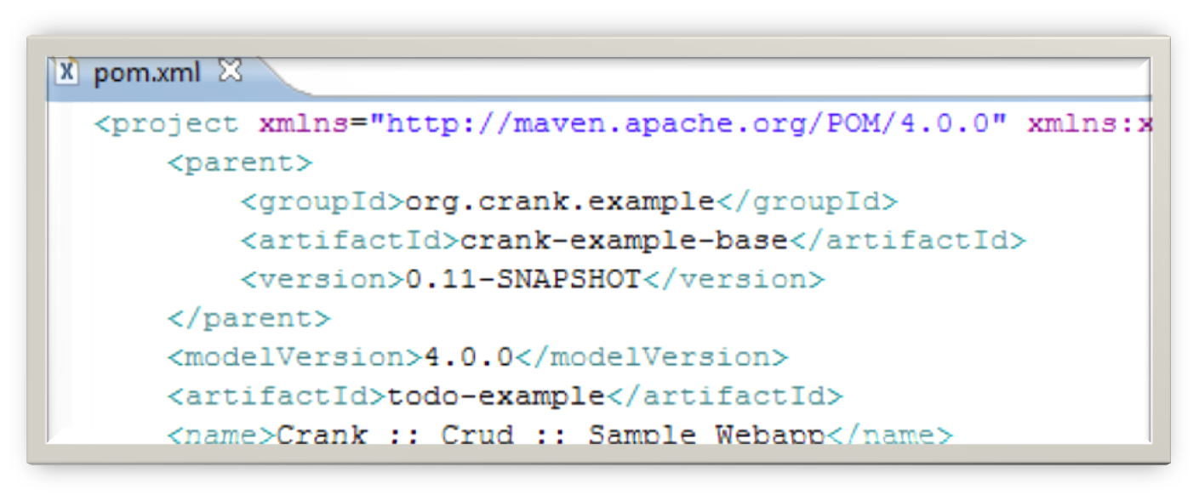
Edit pom.xml file and rename project (2 of 2)
Edit the artifact Id
©ArcMind, Inc. “Know The Next” 2004-2007

Slide 15
Create Eclipse projects or IntelliJ
IDE support
To create Eclipse project files run:
mvn eclipse:eclipse
To create InteliJ project files run:
mvn idea:idea
Now import the project into your favorite IDE
©ArcMind, Inc. “Know The Next” 2004-2007
Notes:
For more information on the maven Idea plugin go to:
http://maven.apache.org/plugins/maven-idea-plugin/
For Eclipse go to:
http://maven.apache.org/plugins/maven-eclipse-plugin/

Slide 16
Using IDE rename CrankCrudExampleApplicationContext (1 of 2)
Using IDE rename/refactor CrankCrudExampleApplicationContext to org.crank.todo.TodoApplicationContext
Make sure IDE scans xml files when refactoring
Ensure name changes in \src\main\resources\applicationContext.xml
©ArcMind, Inc. “Know The Next” 2004-2007

Slide 17
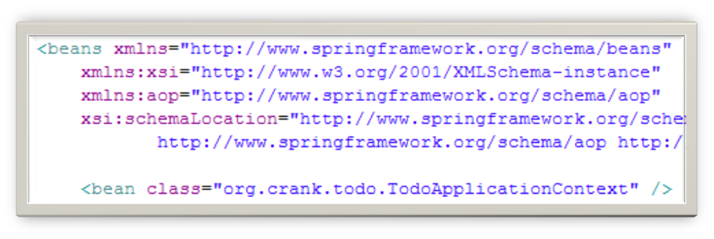
Using IDE rename CrankCrudExampleApplicationContext (2 of 2)
Ensure change in \src\main\resources\applicationContext.xml as follows:
©ArcMind, Inc. “Know The Next” 2004-2007

Slide 18

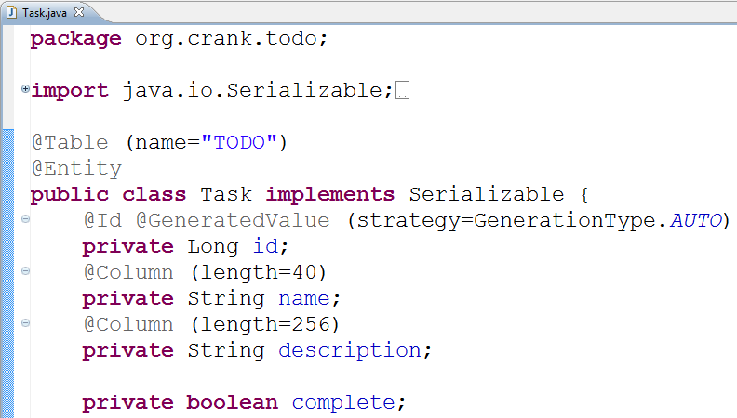
Create JPA enabled Task class
©ArcMind, Inc. “Know The Next” 2004-2007
Notes:
The above is just a vanilla JPA class nothing special.

Slide 19
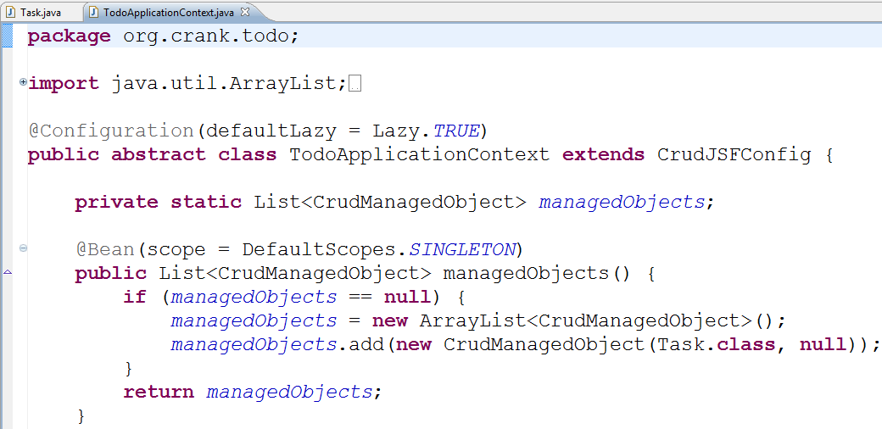
Add entry in new App context for Task
©ArcMind, Inc. “Know The Next” 2004-2007
Notes:
You just need to add a new CrudManagedObject to the managedObject list. The base class, CrudJSFConfig will use this to setup everything needed for a Crud listing.

Slide 20
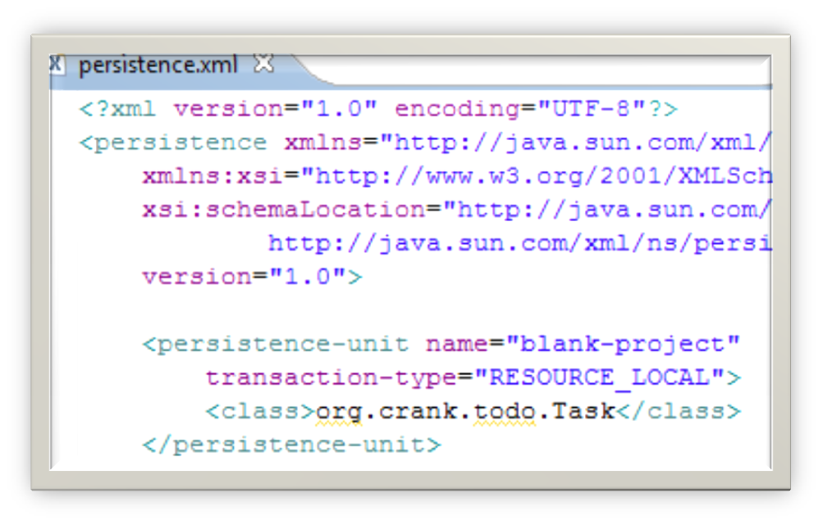
Add persistence.xml entry for Task persistence object
src/resources/META-INF/persistence.xml
©ArcMind, Inc. “Know The Next” 2004-2007
Notes:
Strictly speaking, Hibernate will find the Task class without the above entry.
However, OpenJPA will not so to be JPA compliant please follow the rules.

Slide 21
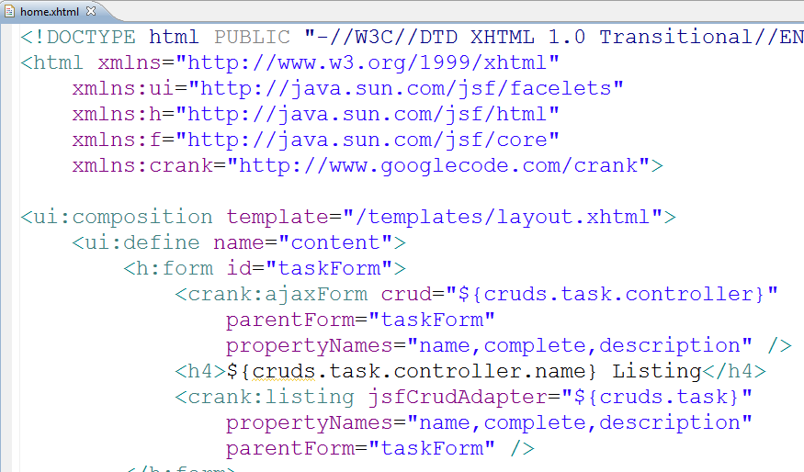
Add form and listing to home.xhtml
©ArcMind, Inc. “Know The Next” 2004-2007
Notes:
In order to use the crank facelet taglib you must import it.
There is a tag for ajaxForms and a tag for the listing.

Slide 22
Running the example
To run the example, run mvn jetty:run from the command line:
mvn jetty:run
©ArcMind, Inc. “Know The Next” 2004-2007

Slide 23
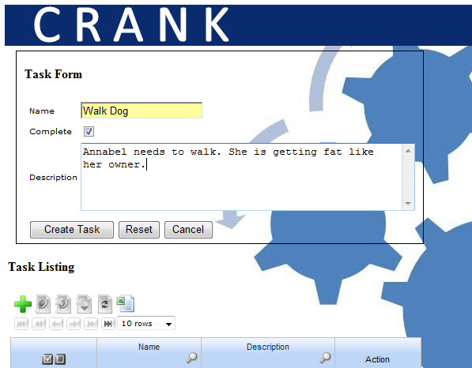
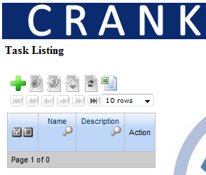
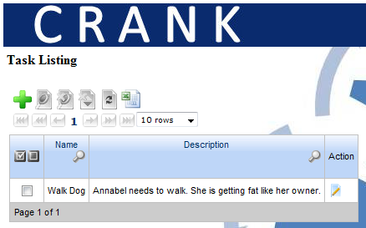
Using Crank Todo App
©ArcMind, Inc. “Know The Next” 2004-2007

Slide 24

LAB: Create first Crank/CRUD listing
Follow instructions in the last lesson
Please enjoy a brief lab break
Instructor will review instructions with you and assist you if needed
©ArcMind, Inc. “Know The Next” 2004-2006

Slide 25
Where to go from here
Crank home page
  http://code.google.com/p/krank/
Crank Crud Design Document
  http://code.google.com/p/krank/wiki/CrankCrudDesignDocs
  If the instructor has time, go through the design document
Crank Crud Intro
  http://code.google.com/p/krank/wiki/CrankCrudIntro
More involved Crank Crud Tutorial
  http://code.google.com/p/krank/wiki/CrankCrudTutorial
©ArcMind, Inc. “Know The Next” 2004-2007

Slide 26
LAB: Elaborate Tutorial
  Use http://code.google.com/p/krank/wiki/CrankCrudTutorial
as a guide
Create Employee and Department listings
Instructor will review instructions with you and assist you if needed
©ArcMind, Inc. “Know The Next” 2004-2006
Notes:
http://code.google.com/p/krank/wiki/CrankCrudTutorial

