Slide 1
Collector – Android & Backend
Natalya Hankewych
CIS4914 Senior Project
3/27/2014

Slide 2
Summary
Motivation
All aspects of app: Android + Backend
Problem
Keeping track of items in collections
Sharing with other enthusiasts
Solution
App to store collections
View other people’s collections

Slide 3
Literature Sources
Android Open Source Project. “Android API Guides”, http://developer.android.com/guide/index.html, Google, Inc. (as-of 2014)
Hellkamp, M. “Bottle: Python Web Framework”, http://bottlepy.org/docs/dev/index.html, Bottle (as-of 04 Feb 2014)
MongoDB. “PyMongo Documentation”, http://api.mongodb.org/python/current/, MongoDB, Inc. (as-of 2014)
Shalloway, A. and Trott, J.R. Design Patterns Explained, 2nd Edition Boston, MA: Pearson Education, Inc (2005).

Slide 4
Work Performed
Backend
MongoDB “Schema”
Login + Signup Routes using Bottle
Android
Login / Signup
Profile and Add Collection Activity
SQLite Database – Collections Table

Slide 5
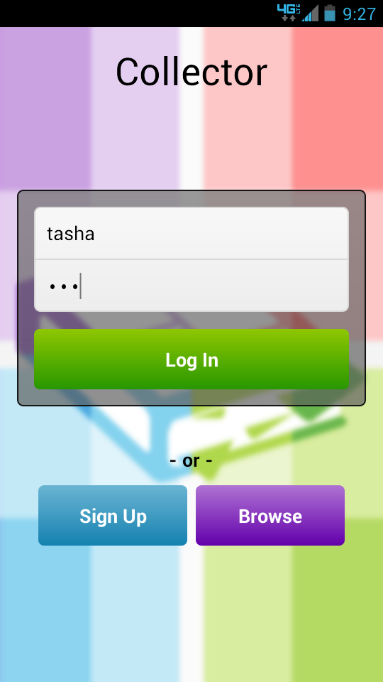
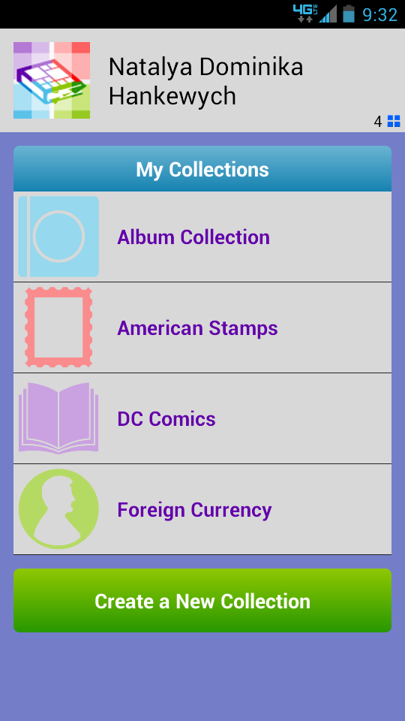
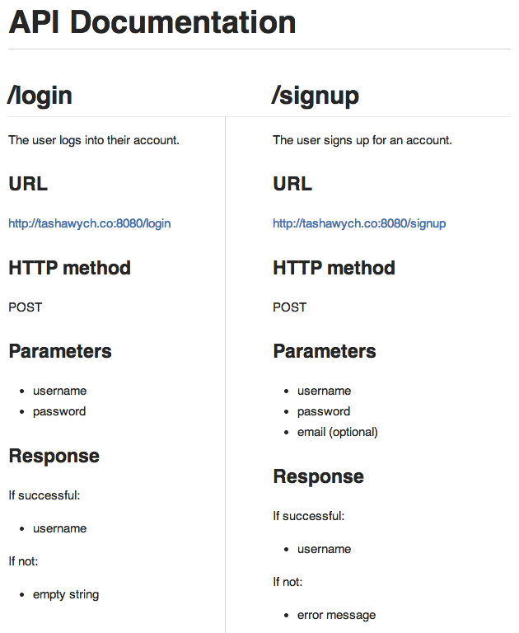
Work Performed

Slide 6
Work to Complete
Backend
Remainder of routes
Android
Remainder of screens (Browse, Edit)
SQLite Database – Items, Users Table
Problems
Connecting backend routes to website

