Slide 1
Small Talk
Team Members:
Garv Bhaskar 22BAI1371(VIT Chennai)
Aviral Srivastava 22BAI1187(VIT Chennai)
Tashadur Rahman 22BRS1304(VIT Chennai)
Aditya 22BAI1235(VIT Chennai)

Slide 2
Summary
Problem Statement:
In today's competitive job market, candidates often struggle to adequately prepare for interviews due to a lack of realistic, in-person mock interview environments. This lack of preparation can lead to increased anxiety and decreased performance during actual interviews. Our metaverse app, SmallTalk, addresses this gap by providing a simulated environment where candidates can practice real-time, in-person interviews, receive instant feedback, and improve their interview skills.
Expected Result:
Through SmallTalk, we expect to empower candidates with enhanced interview skills and confidence. This app is designed to revolutionize the way candidates prepare for interviews in the digital age.

Slide 3
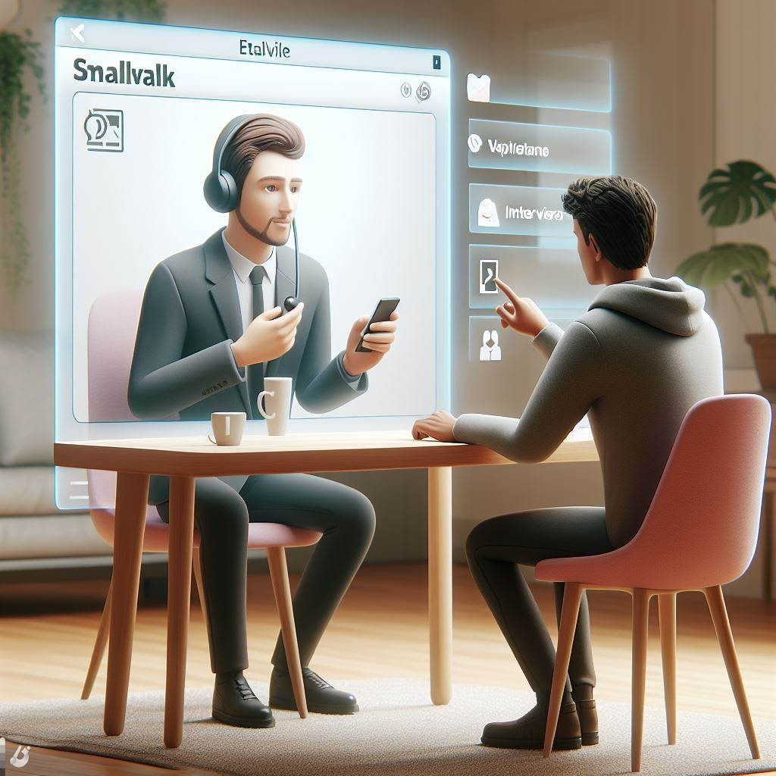
Concept Diagram
*Note: This concept image was created using Microsoft Designer!

Slide 4
Impact
Innovation :
SmallTalk leverages advanced AI and metaverse to simulate real-time interviews, offering instant feedback and opportunities for improvement. This innovative approach transforms the way candidates prepare for interviews, making the process more engaging and effective.
Business Value :
SmallTalk offers significant business value by addressing a critical gap in the job market. It enhances candidates' interview skills, leading to better job placements and higher success rates. For businesses, this means access to better-prepared candidates, reducing the time and resources spent on the hiring process.
Target Audience :
Our primary target audience is job and internship seekers who are preparing for interviews. This includes recent graduates, career changers, and young professionals seeking advancement. SmallTalk is also valuable for HR departments and recruitment agencies looking to streamline their hiring process and improve candidate quality.

Slide 5
Viability
Development plan/ Timeline:
Month 1: Research and Planning
Week 1: Market research and Defining App features
Month 2: Development Phase I
Week 1 & 2: Develop Core features (Real-Time interview simulation and feedback mechanism)
Week 3 & 4: Develop Secondary features(User profiles & Progress Tracking)
Month 3: Development Phase II & Testing
Week 1 & 2: Finalise feature Development
Week 3: Conduct alpha testing and bug –fixing.
Month 4: Launch preparation
Week 2, 3 & 4: Training by Samsung
Week 4: Start Beta testing with a small group of users.
Week 1: Incorporate feedback from beta testing and finalise product for launch.
Week 2: Develop marketing and launch plan.
Week 3 & 4: Submit the app to the marketplace with the guidance of Samsung R&D team.

