Slide 1

Cyberbullying
Cassidy Campbell, Devin Hite, Tanya Shapiro

Slide 2
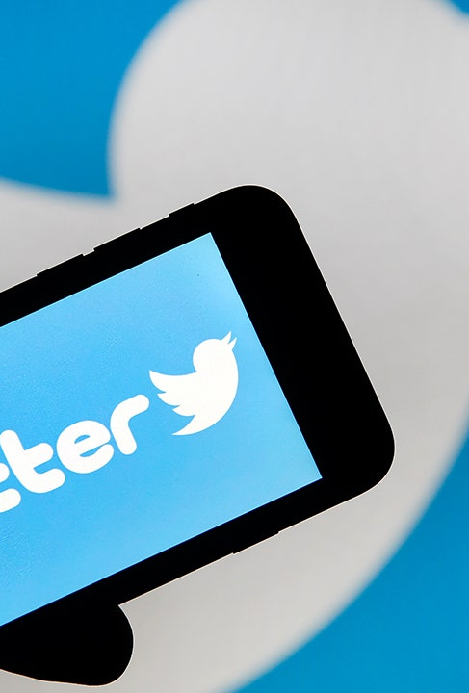
Problem Statement
Twitter’s CEO, Parag Agrawal, is invested in making Twitter a safe space for users to express themselves and connect with others. In the past decade, there has been an increase in offensive tweets
Agrawal has asked you and a team of Data Scientists to develop an algorithm to detect inappropriate Tweets and flag them for cyberbullying.
The objective is to not only classify which tweets are offensive, but what type of cyberbullying (gender, race, age, etc). Although the baseline accuracy is ~17%, Agrawal will not implement the alogirithm unless it can classify tweets with at least 70% accuracy.

Slide 3
Background
Data collected from Kaggle
Contains 47K text tweets
Consists of 6 Classes
religion, gender, age, ethnicity, other, & not cyberbullying
Balanced dataset (8K per class)

Slide 4
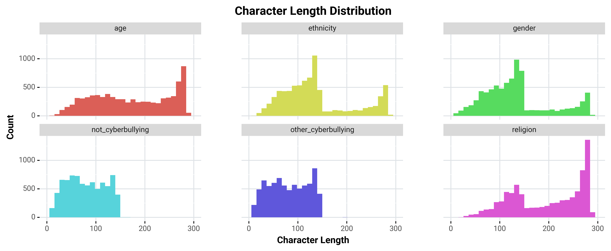
Verbosity : Character Length
Not Cyberbullying and Other Cyberbullying tweets less verbose compared to tweets in other classes.
Age and Gender tweets more verbose compared to tweets in other classes.

Slide 5
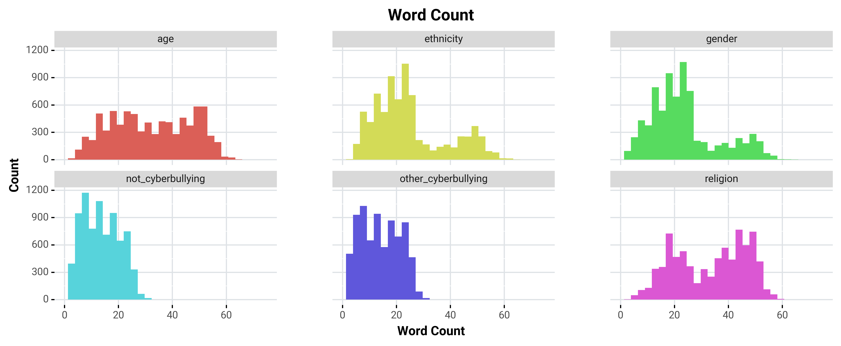
Verbosity: Word Count
Word Count comparison supports similar observations
noted about character length distribution.

Slide 6
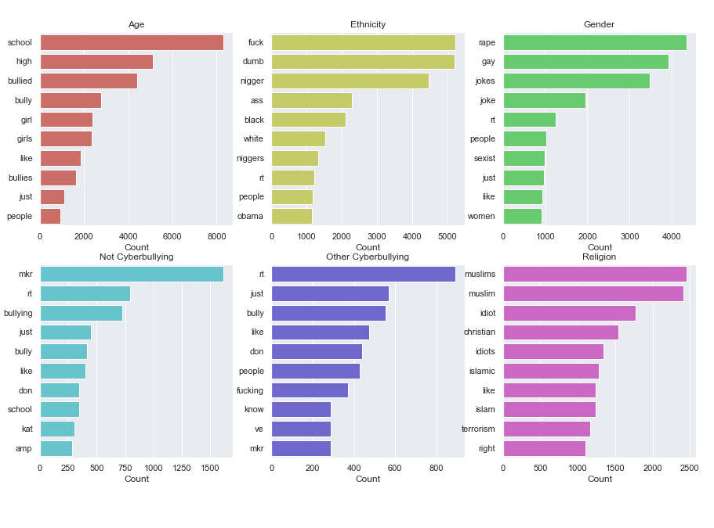
Common Words
Age language specific to schools
Ethnicity top words contain several offensive racial slurs aimed at African Americans
Gender tweets contains words that are also homophobic
Religion cyberbullying tweets targeted mostly at Islamic communities
Difficult to discern patterns for not or other cyberbullying

Slide 7
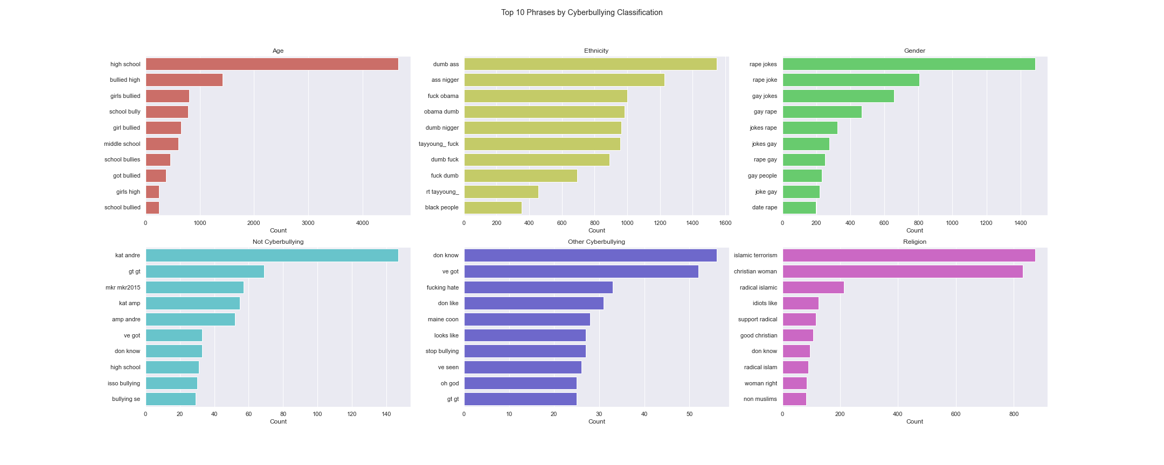
Common Phrases

Slide 8
Models

Slide 9
Notes & Conclusions

Slide 10

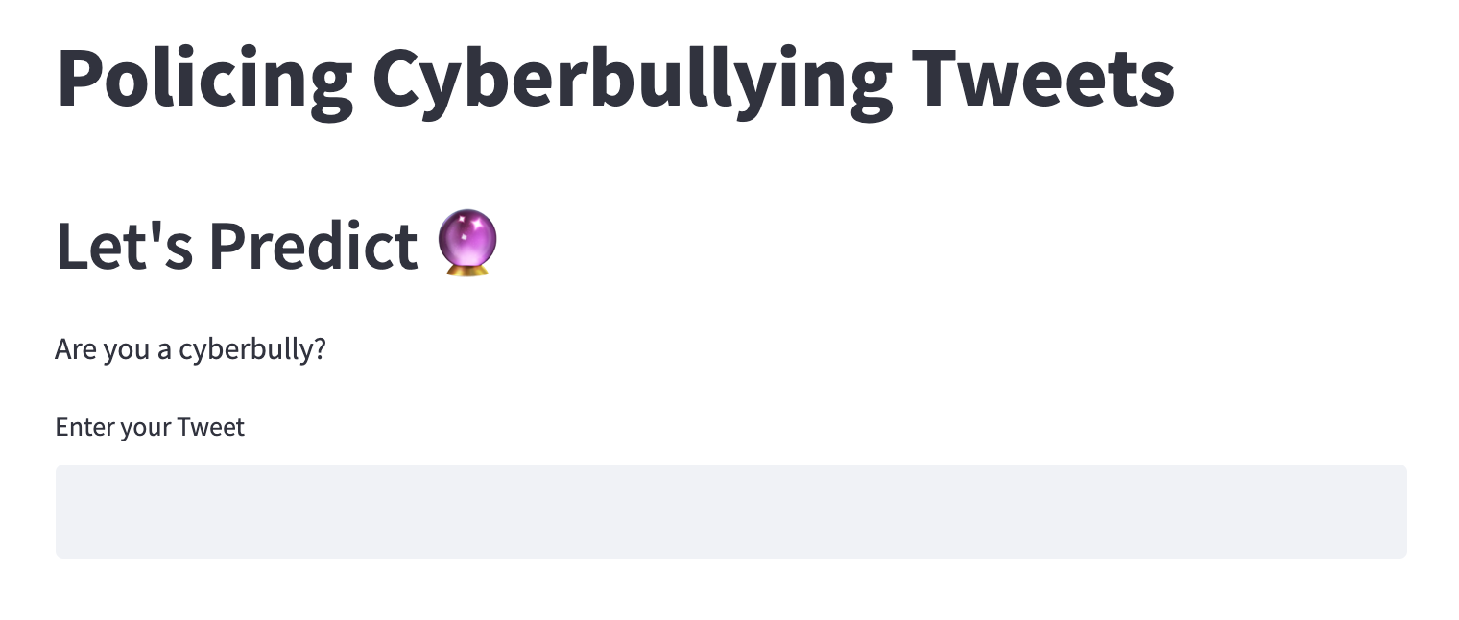
Proof of Concept

