Slide 1

That’s Rotten Predicting Good & Bad Movie Reviews from Rotten Tomatoes using Natural Language Processing & Classification Models
Tanya Shapiro

Slide 2

What’s The Problem?
The executives at a well-known movie production company are trying to determine which movies they’ve released are hits or flops.
Unfortunately, they don’t have time to read and synthesize all the online buzz in their own time.
They’ve hired you to produce an algorithm that will them determine which movies received praise and which ones tanked according to critics.

Slide 3
Behind The Curtain
Source. Data from Kaggle, 10K+ movie reviews
Balanced. Even split between classes (50% Rotten, 50% Fresh)
Objective. Build a classification model that beats the baseline accuracy (+50%)

Slide 4
How verbose are the critics?
No discernable difference between “Rotten” and “Fresh” reviews when it comes to wordiness.
Avg ~21 words
Avg ~115 characters

Slide 5
Common Words
Not surprising, “Fresh” reviews commonly contain positive affinity words like “good”, “best” and “love” while “Rotten reviews” commonly contain negative affinity words like “bad” or “little.”

Slide 6
Common Phrases
“Fresh” movies are a “good time” and “thought provoking.”
Both reviews contain language specific to film, e.g. “special effects”, “sci fi”, “writer director.”

Slide 7
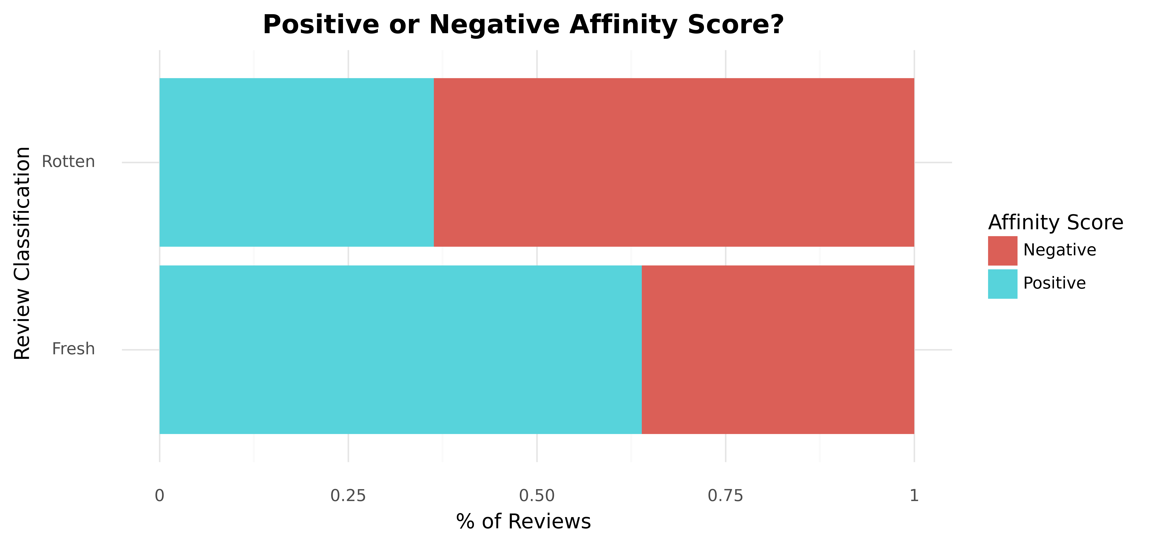
Sentiment Analysis
Majority of Rotten reviews generated negative affinity scores.
Majority of Fresh reviews generated positive affinity scores.

Slide 8
And The Award for Best Model Goes To…
Model | Train Accuracy | Test Accuracy | TP | FP | TN | FN | Precision | Sensitivity | Specificity | Recall
SVM with TFV | 93.6% | 78.5% | 645 | 189 | 611 | 155 | 79.8% | 80.6% | 76.4% | 76.4%
Logistic Regression with TFV | 94.1% | 78.2% | 630 | 179 | 621 | 170 | 78.5% | 78.8% | 77.6% | 77.6%
MultiNomial NB with TFV | 92.7% | 77.4% | 637 | 198 | 602 | 163 | 78.7% | 79.6% | 75.3% | 75.3%
Logistic Regression with CV | 93.5% | 77.3% | 623 | 187 | 613 | 177 | 77.6% | 77.9% | 76.6% | 76.6%
KNN with TFV | 82.6% | 70.8% | 557 | 224 | 576 | 243 | 70.3% | 69.6% | 72.0% | 72.0%
Random Forest with CV | 100.0% | 70.2% | 574 | 251 | 549 | 226 | 70.8% | 71.8% | 68.6% | 68.6%
Random Forest with TFV | 98.3% | 69.6% | 567 | 253 | 547 | 233 | 70.1% | 70.9% | 68.4% | 68.4%
SVM model yields best accuracy results (78.5%).
Better at predicting “fresh” reviews than “rotten reviews.”

Slide 9
Plot Twists: Misclassification Analysis Rotten? It’s Actually Fresh!
“It’s maker , Steven Spielberg , hasn't had so much fun in two decades , since he was schlepping Indiana Jones around the globe in search of a giant misplaced ashtray.”
“Even during the climactic hourlong cricket match , boredom never takes hold”
“Without [De Niro] , City By The sea would slip under the waves . He drags it back , single-handed.”

Slide 10
Plot Twists: Misclassification Analysis Fresh? It’s Actually Rotten!
“However stale the material , Lawrence's delivery remains perfect ; his great gift is that he can actually trick you into thinking some of this worn-out , pandering palaver is actually funny .”
“Despite terrific special effects and funnier gags , harry potter and the chamber of secrets finds a way to make J . K . Rowling's marvelous series into a deadly bore.”

Slide 11
Closing Credits: Notes & Recommendations
Improving the model – more hyperparameter tuning with GridSearch to find best model parameters for SVM
Testing other models – would a Neural Network classifier or XGBoost yield higher accuracy scores?
Increasing sample size – collect more reviews to train the model, changing train/test split from 80/20 to 85/15 improved performance slightly.
Defining “Rotten” – model is for binary-classification, but Rotten Tomatoes reviews are typically scaled (1-4 or %). Problem better suited for multi-class?
Sarcasm – text classification analysis doesn’t seem to perform well on sarcasm or text with mixed sentiments (good and bad remarks)

Slide 12

Epilogue: Applying The Model
APPLIED TO Siskel & Ebert reviews – 66% accuracy
Developed a Streamlit app

