Slide 1

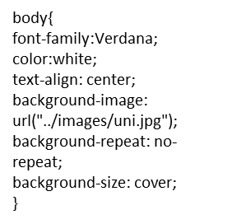


Header
Background Colour - #800000
Colour – white
Padding – 15px
Home
Heading
<h2>
Experience
Image
"width:100%"
Education
Content
<p>
Skills
Contact
float:left;
width:20%;
text-align:center;
Content

Slide 2













body{
font-family:Verdana;
color:white;
text-align: center;
background-image: url("../images/uni.jpg");
background-repeat: no-repeat;
background-size: cover;
}

