Slide 1
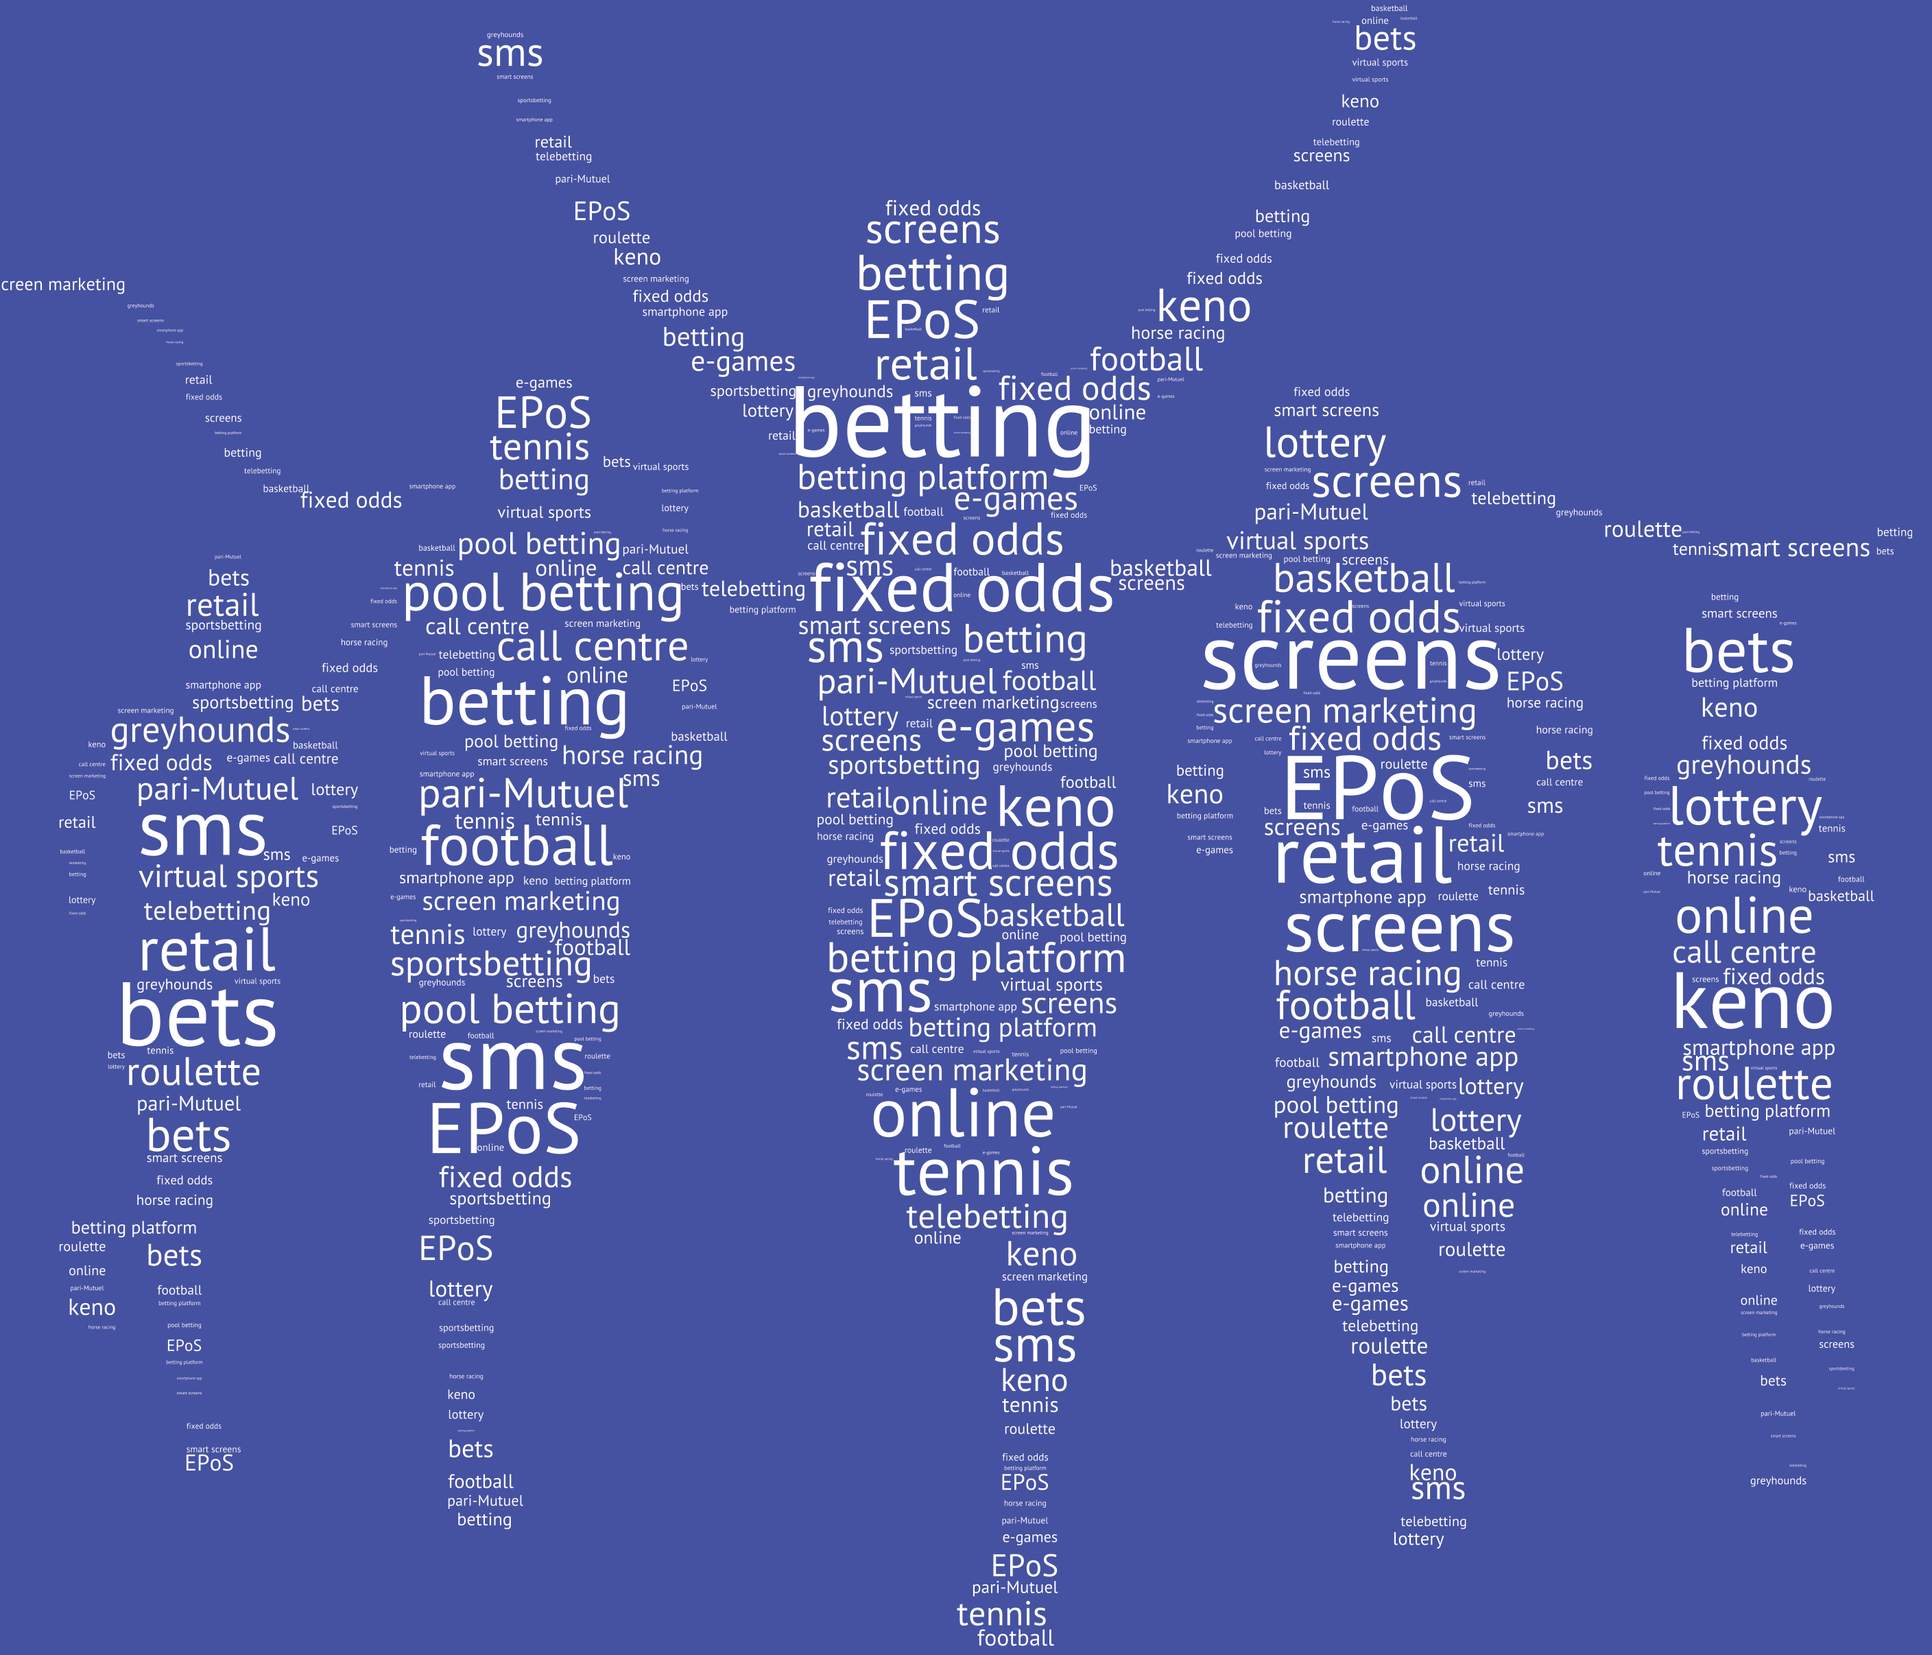
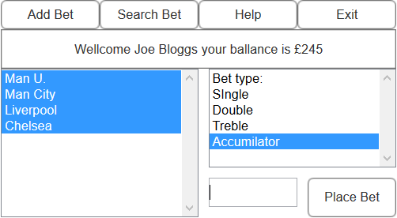
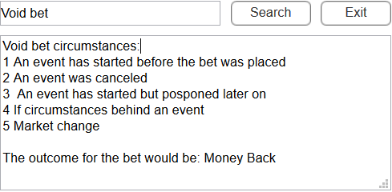

Java BETING SYSTEM
Bozhidar tashev– supervised by Dr michael crabb
Current Betting Systems
Betting is an action of gambling and predicting the outcome of a race, game or any other event. Betting systems are created in order to achieve and manage any bets placed my people. They are design to support and improve the experience of the person using them. The overall aim is to make betting accessible for anyone, age over 18, that would be people with experience in betting and people without.
Most current betting system do achieve some of these criteria's, they do still fail to meet modern system requirements. In the past some improvements have been made to approach these problems, but future improvements are still required.
The solution
What are the current problems?
Some of the system, in used today, cannot cope with the traffic and commands used.
The user interface is outdated .
There is a lack in assisting new users starting to use the interface.
What could be the solution to this problem, simplify the system. Removing unnecessary components from the system will have an affect in the overall system response time.
Designing a system which is up to date with modern user interface standards, will improve the experience of the people interacting with the system and create a better environment for them to enjoy.
Improving users learning
Going with the idea of simple design, what would be the best way to support new users?
One way would be to have a simple, but effective help navigation. Which would help new users, with no experience in using a betting system, find pieces of information.
Current systems do have some level of support for new users, but some pieces of data are missing and people need to spend extra time searching them. By having all information in one place, not only does it have a great impact on users but also on businesses. Because support teams will not need to spend extra time and resources in answering users questions about certain bets.
What does it all mean for the user?
Having a system where people are able to enjoy betting without any confusion would mean it would be more available to new users. With the same time, adapting a modern user interface design would mean that users with or without experience of using the system will improve significantly. Simplifying the system will improve the response time significantly . And doing so not only helps the users, but also the designers and developers because a simpler system would be easier to manage and service. From a company perspective, these changes will resolve in less time and recourse spend into maintaining the system.

