Slide 1



Lecture 02:
Introduction to Python

Slide 2




What is Anaconda?
Python Distribution
Pre-installed Tools
Anaconda is a comprehensive Python distribution for data science and programming.
Includes Jupyter Notebook and essential libraries like NumPy and pandas.
Quick Start
Enables rapid setup for Python programming and data analysis projects.

Slide 3




Installing Anaconda
Download
Visit the official Anaconda website and download the installer.
Run Installer
Launch the downloaded file and follow the installation wizard.
Configure
Set up the environment variables and choose installation options.
Finish
Complete the installation and verify Anaconda is working correctly.

Slide 4
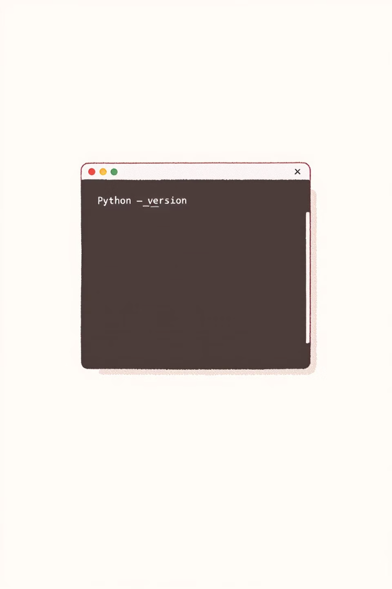
Checking Python Version
Command Prompt
Enter Command
Open your terminal or command prompt.
Type 'python --version' or 'python3 --version'.
View Result
The installed Python version will be displayed.

Slide 5
What is an IDE?
Definition
Benefits
An IDE (Integrated Development Environment) is a software suite that consolidates basic tools for software development.
IDEs offer code writing, debugging, and execution in one place. Examples include VS Code and PyCharm.

Slide 6




Introduction to VSCode
Ideal for Python
Extensions
Customization
Install Python extensions in VSCode for enhanced functionality.
Customize VSCode settings for optimal Python development.
VSCode is an excellent choice for Python programming.

Slide 7
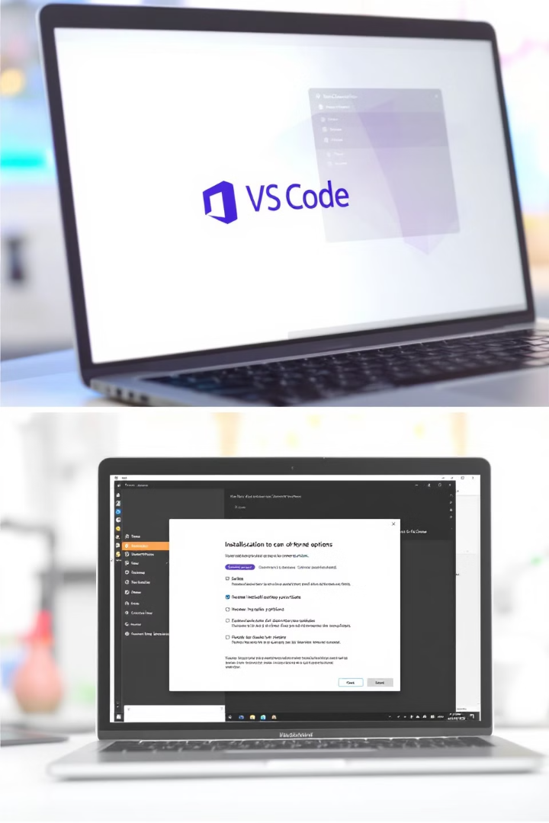
Installing VS Code
1
Download
Visit the official VS Code website.
2
Install
Run the installer and follow the setup wizard.
3
Configure
Choose your preferred settings and extensions.

Slide 8
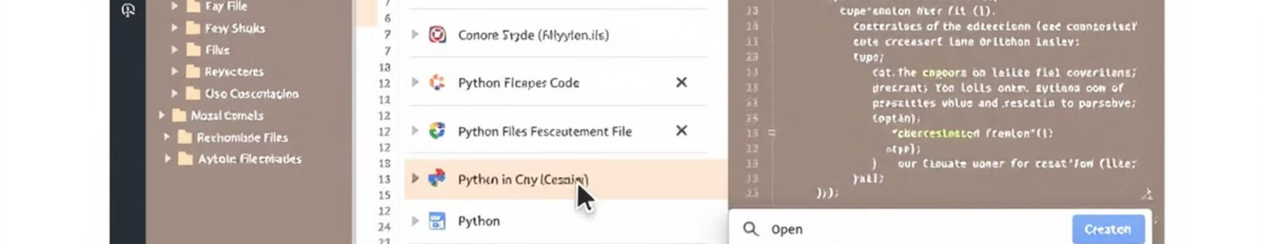
Creating a Folder and Python File in VS Code
1
Open VS Code
2
Create Folder
Launch Visual Studio Code on your computer.
Use File > Open Folder to create a new project folder.
3
New File
4
Name File
Right-click in the explorer and select 'New File'.
Name your file with a .py extension (e.g., 'hello_world.py').

Slide 9
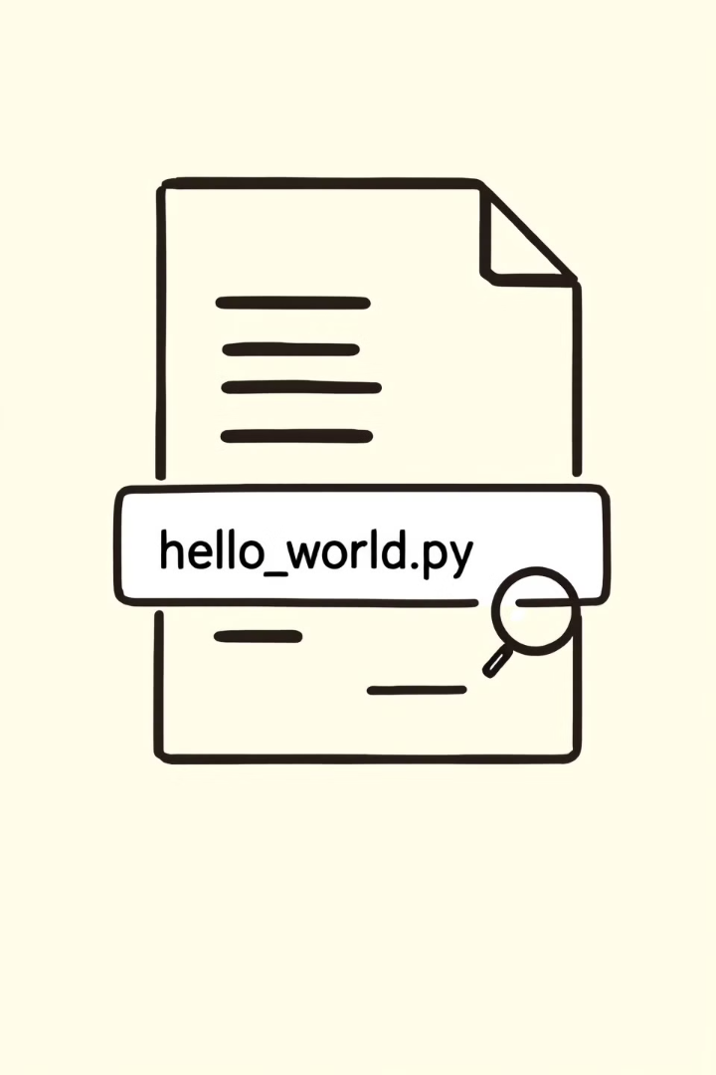



Python Program File Extension
.py Extension
Identification
Python files use the .py extension.
The .py extension helps identify executable Python scripts.
Example
Common examples include 'hello_world.py' or 'script.py'.

Slide 10




Installing the Python Extension in VS Code
Open Extensions
Search Python
Install
Click on the Extensions icon in the VS Code sidebar.
Type 'Python' in the search bar.
Click 'Install' on the official Python extension by Microsoft.

Slide 11

Writing Your First Python Script
Open Editor
1
Launch VSCode or your preferred text editor.
Write Code
2
Type print("Hello, World!") in the editor.
Save File
3
Save the script with a .py extension.

Slide 12
Executing Python Scripts
Command Line
VSCode Execution
Run Python scripts from the command line interface.
Execute scripts directly within the VSCode environment.

Slide 13
Running Python Code from the Command Line
1
Open Terminal
Launch your command line interface.
2
Navigate
Use cd command to reach your script's directory.
3
Execute
Run python filename.py to execute your script.

Slide 14
Running Python Code in VSCode
1
Open Script
2
Click Run
3
View Output
Load your Python file in VSCode.
Use the "Run" button in VSCode to execute the script.
Check the integrated terminal for your script's output.

Slide 15
Summary
1
Install Python
2
Configure VS Code
Download and set up your Python environment.
Install Python extension and set up development environment.
3
Create Python Files
4
Execute Programs
Create folders and write your first Python scripts.
Run Python scripts from command line and VS Code.

