Slide 1



Lecture 10: Local vs Global Variables & is vs equality operator in Python

Slide 2
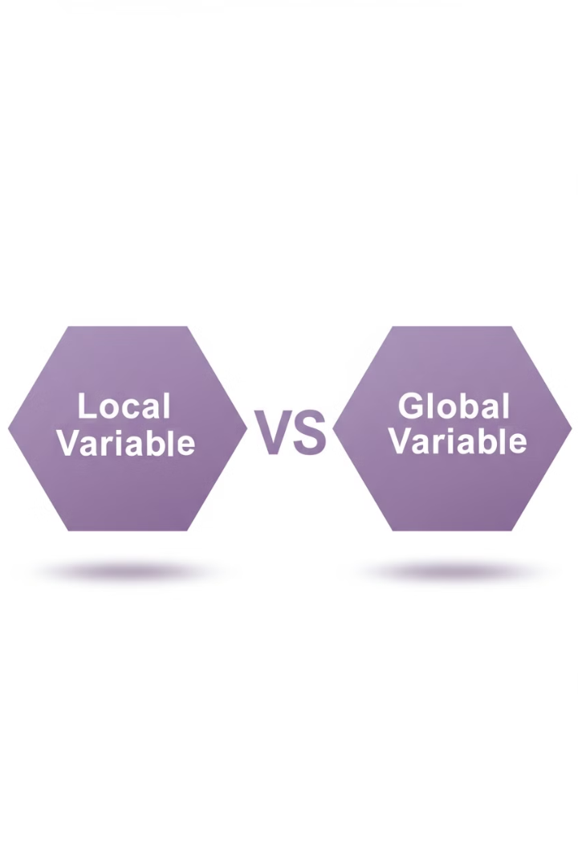


Understanding Local and Global Variables
Local Variables
Global Variables
Defined inside a function and cannot be accessed outside.
Defined outside functions and can be accessed anywhere.

Slide 3
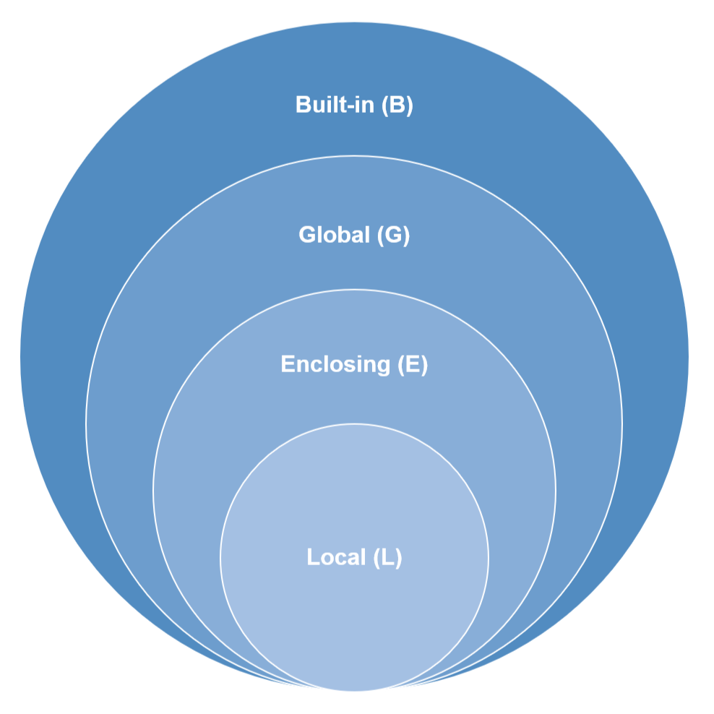

How Python Handles Variable Scope?
Python uses the LEGB rule to determine variable scope.
Local (L)
Variables declared inside a function.
Enclosing (E)
Variables in enclosing functions (nested functions).
Global (G)
Variables declared at the top level of a script.
Built-in (B)
Predefined variables in Python.

Slide 4

Modifying Global Variables Inside Functions
Use the global keyword
To modify a global variable inside a function, use the global keyword.
Access and modify
The global keyword gives you permission to modify the variable.
Changes persist
Changes to the global variable remain after the function exits.
Example: Using the global keyword to update a global counter.

Slide 5

Best Practices for Using Global and Local Variables
Use local variables
Minimize global variables
To avoid unintended side effects.
Keep code modular by limiting global variable usage.
Use function arguments
Pass values instead of relying on global variables.

Slide 6
Understanding is (Identity Comparison)
Object Identity
The is operator compares whether two variables refer to the same object in memory.
It checks if both variables point to the exact same memory location.
Example: is checking object identity.
a = [1, 2, 3] b = a c = [1, 2, 3] print(a is b) # True - same object print(a is c) # False - different objects

Slide 7
Understanding == (Value Comparison)
Value Equality
The == operator compares the values of two objects.
It checks if both objects contain the same data, regardless of where they are stored in memory.
Example: == checking value equality.
a = [1, 2, 3] b = a c = [1, 2, 3] print(a == b) # True - same values print(a == c) # True - same values

Slide 8
Key Differences Between is and ==
Operator
Purpose
is
Checks if two objects occupy the same memory location
==
Checks if two objects have the same values

Slide 9
Real-World Scenarios Where is and == Matter
Comparing Immutable Objects
Working with None
Python caches small integers (-5 to 256) and short strings. This affects "is" comparison results.
Always use "is None" instead of "== None" for clarity and performance.
Example: a = 5; b = 5; a is b returns True, but a = 500; b = 500; a is b returns False.
Example: if result is None:

Slide 10
Real-World Scenario: Checking for None
Preferred Method
Correct Syntax
Avoid == with None
The is operator is the recommended way to check if a variable is None because it verifies identity, not just equality.
if variable is None: ensures you're checking for the exact None object, not just a value that might be equivalent.
Using == for None checks is discouraged as it relies on the __eq__ method which could be overridden in custom classes.
Example: Properly checking for None in a function.
def process_data(data=None): if data is None: return "No data provided" return "Processing: " + str(data)

Slide 11

Practice Exercise – Local vs Global Variables
Exercise 1
Write a function that modifies a global variable inside a function using global.
Exercise 2
Implement a nested function that accesses an enclosing variable using nonlocal.
Test Your Code
Run your functions and observe how the variables change.

Slide 12
Practice Exercise – is vs ==
Exercise 1
Exercise 2
Write a program that creates two identical lists and compares them using is and ==.
Check if Python caches small integers (-5 to 256) using is.
Verify Results
Explain the output of your comparisons.

Slide 13
Summary of Key Concepts
Variable Scope
Comparison Operators
Global variables can be accessed everywhere, local variables are function-specific.
is compares object identity, == compares values.
Modifying Globals
Best Practices
Use global to modify global variables inside a function.
Prefer local variables, minimize global ones.

Slide 14



Conclusion & Next Steps
Master the Concepts
Practice Makes Perfect
Keep Experimenting
Master variable scope and comparison operators in Python.
Next Step: Practice writing code using is, ==, and managing variables.
Keep experimenting with Python!

