Slide 1



Lecture 09:
User-Defined Functions in Python

Slide 2
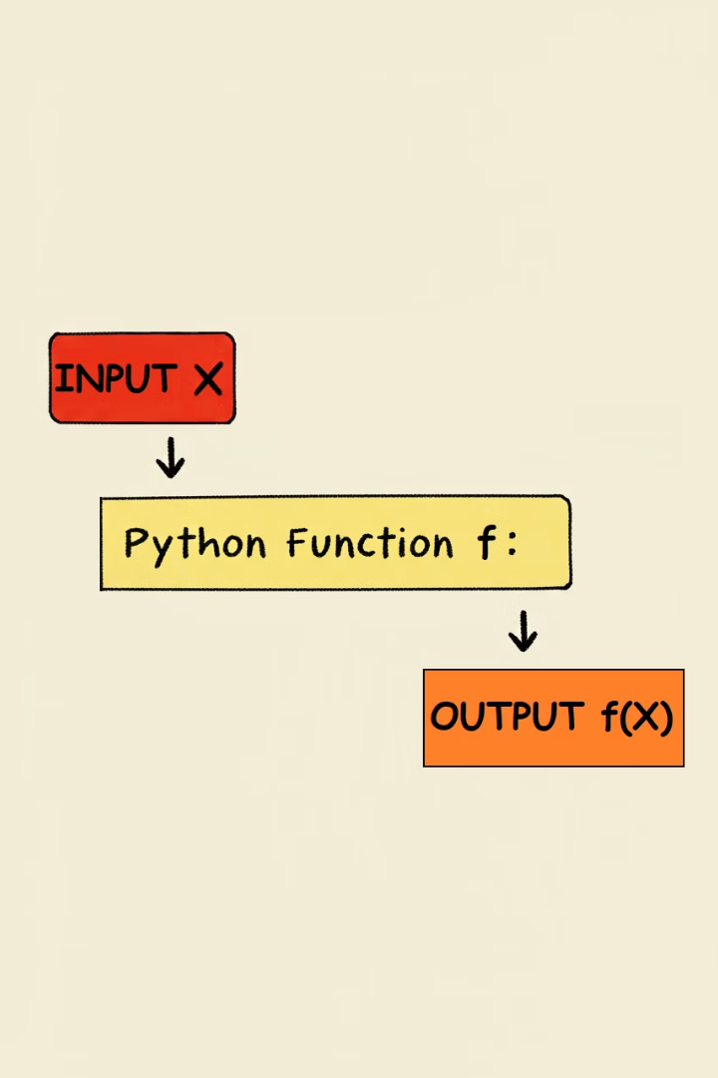
What is a Function?
1
A function is a reusable block of code designed to perform a specific task.
2
Functions help reduce repetition and make code organized.
3
They can take inputs (parameters) and return outputs (results).

Slide 3
How to Define a Function in Python
def
Function Name
Defines the function.
Unique identifier for the function.
Parameters (optional)
Function Body
Inputs to the function.
Instructions inside the function.
Return Statement (optional)
Sends data back to the caller.

Slide 4




Example – Defining a Function
Function Name
Parameters
Operation
Return
Define function "add" as our reusable logic block
Accept two inputs: num1 and num2
Add num1 and num2 together
Output the sum of the numbers
Use case: Reusable logic for addition operations

Slide 5
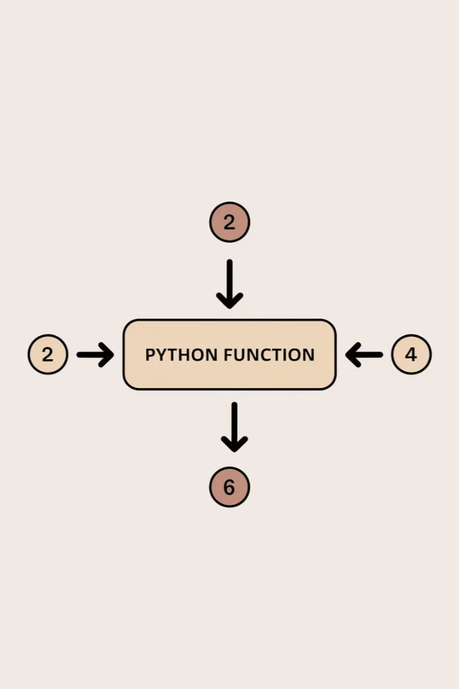
Calling a Function
Calling a function executes its code.
Example: add(2, 4) → Returns 6.
Helps in reducing redundant code.
Use case: Simplifies large programs.

Slide 6



Functions Without Parameters
Functions can be defined without parameters.
Example: greet() → Prints a welcome message.
Use case: Standard greetings, notifications.

Slide 7
Function Arguments
Arguments allow functions to be dynamic.
1
Default Arguments
2
Keyword Arguments
Have preset values.
Passed by name.
3
Required Arguments
4
Variable-Length Arguments
Must be provided.
Accept multiple values.
Use case: Flexibility in function calls.

Slide 8


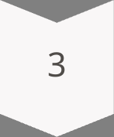
Default Arguments
Function Definition
Example: name(fname, mname="John", lname="Whatson").
Default Value
If mname is not provided, defaults to "John".
Benefit
Use case: Avoids errors due to missing arguments.

Slide 9
Keyword Arguments
1
Function Call
Example: Calling name(mname="Peter", lname="Wesker", fname="Jade").
2
Argument Order
Arguments are provided in any order using their names.
3
Advantage
Use case: Improves readability and avoids mistakes.

Slide 10
Variable-Length Arguments (*args)
Allows passing multiple values as a tuple.
Example: name("James", "Buchanan", "Barnes").
Use case: Useful for handling unknown numbers of inputs.
Stores values as a tuple and accesses them inside the function.

Slide 11
Returning Values from Functions
1
Function Definition
2
Example
3
Benefit
A function can send data back using return.
name(fname, mname, lname) → Returns full name.
Use case: Stores results for further processing.

Slide 12

Practice Exercise - Beginner Level
Display a Simple Greeting Message
Define a function welcome_message() that prints a welcome message.

Slide 13
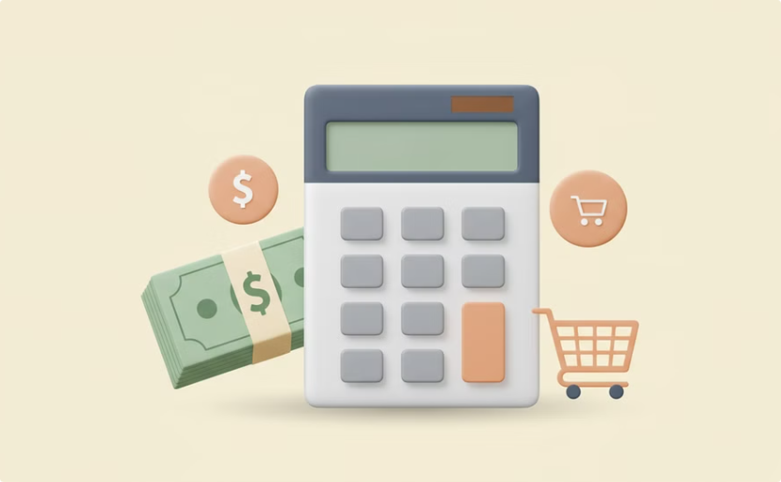

Practice Exercise - Intermediate Level
Calculate the Total Cost of an Order
Convert Temperature
Define calculate_total(price_per_item, quantity).
Define convert_temperature(temp_value, unit).
Return the total cost.
Convert between Celsius and Fahrenheit.

Slide 14

Practice Exercise - Advanced Level
Create a Discount Calculator
Implement a Grade Calculator
Define apply_discount(original_price, discount_percentage).
Define calculate_grade(score1, score2, score3).
Return average score and letter grade.
Return final price after applying discount.

Slide 15
Summary
Modularity
Flexibility
Functions reduce repetition and make code modular.
Arguments make functions flexible.
Results
Control
Return statements allow functions to send back results.
Different argument types provide greater control.

Slide 16
Conclusion & Next Steps
1
Functions
2
Practice
3
Keep Going
Functions are fundamental to programming.
Next Step: Practice writing custom functions.
Keep coding and experimenting!

