Slide 1
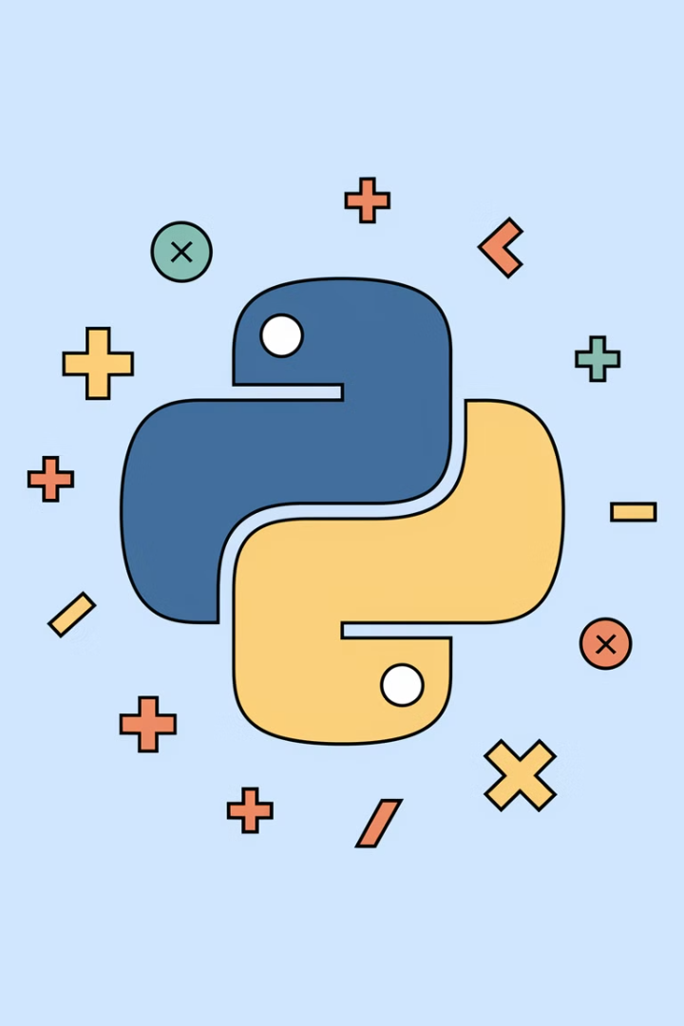


Lecture 05:
Operators in Python

Slide 2
Boolean Values
True and False
Usage
Example
Boolean data type represents True or False values.
Commonly used in comparisons and conditional expressions.
print(True)
print(False)

Slide 3



Assignment Operators
Basic Assignment
= assigns a value to a variable
Compound Assignment
+= adds and assigns in one step
Example
x = 5
x += 3 # Equivalent to x = x + 3

Slide 4




Arithmetic Operators
Addition (+)
Subtraction (-)
Multiplication (*)
Division (/)
Other operators: % (Modulus), // (Floor Division), ** (Exponentiation)
a, b = 10, 3
print(a + b) # Addition
print(a - b) # Subtraction
print(a * b) # Multiplication
print(a / b) # Division
print(a % b) # Modulus
print(a // b) # Floor Division
print(a ** b) # Exponentiation

Slide 5
Comparison Operators
Greater than
>
Less than
<
Equal to
==
Not equal to
!=
Greater than or equal to
>=
Less than or equal to
<=
x, y = 5, 10
print(x > y) # False
print(x < y) # True
print(x == y) # False

Slide 6
Logical Operators
and
or
not
Combines conditions, returns True if all are True
Returns True if at least one condition is True
Inverts the boolean value
a, b = True, False
print(a and b) # False
print(a or b) # True
print(not a) # False

Slide 7
Type
Operators
Examples
Usage
Arithmetic
+ - * / % // **
a + b, a * b
Basic math operations (addition, multiplication, division, modulus, etc.).
Assignment
= += -= *= /= %= //= **=
x = 5, x += 3
Assign or update variable values in place (e.g., x += 3 is x = x + 3).
Comparison
> < == != >= <=
x > y, x == y
Compare two values and return True or False (e.g., x > y).
Logical
and or not
a and b, not a
Combine or invert Boolean expressions (e.g., a and b is True only if both a and b are True).

Slide 8
Summary
Arithmetic & Assignment
Comparison
Logical
Math: +, -, *, /, %, //, **
Equality: == and !=
and: Requires both True
Assignment: =, +=, -=
Comparison: <, >
or: Needs one True
Combined (+=) for one-step operations
Inclusive: >=, <=
not: Inverts boolean
These operators enable comparisons, calculations, and logic control in Python.

