Slide 1



Lecture 11: Higher-Order Functions in Python

Slide 2
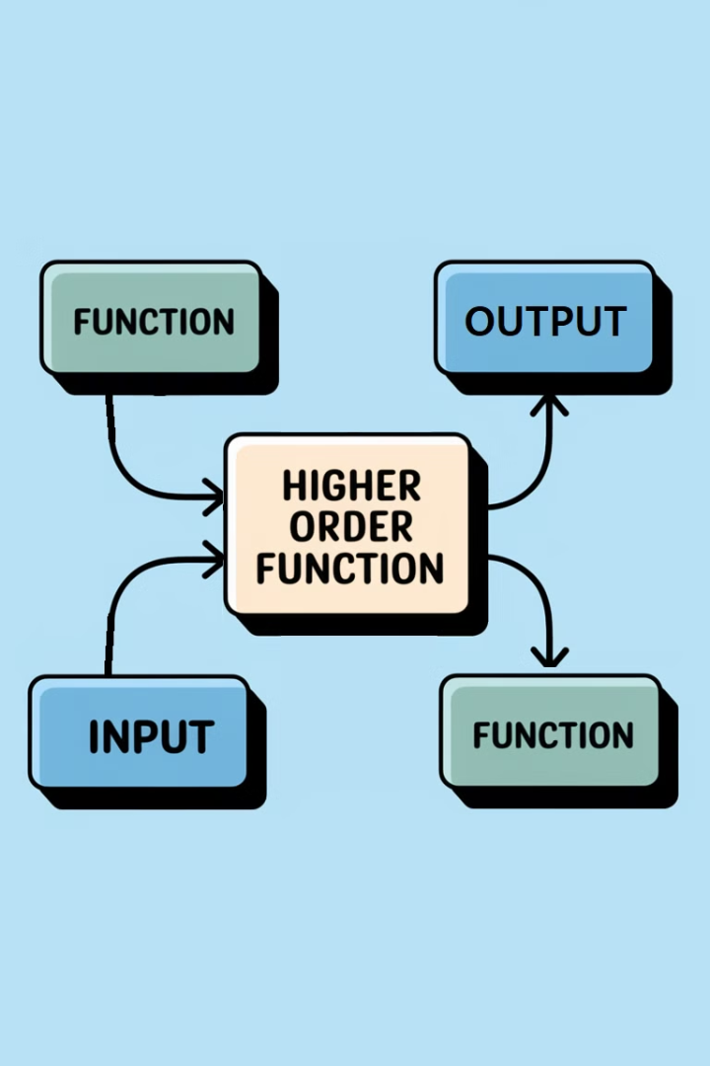
What are Higher-Order Functions?
Functions that take another function as an argument or return a function as output
Common Higher-Order Functions
map(): Applies a function to every item in an iterable
filter(): Filters elements based on a condition
reduce(): Reduces a sequence to a single value
zip(): Combines multiple iterables into tuples
enumerate(): Adds an index to an iterable

Slide 3
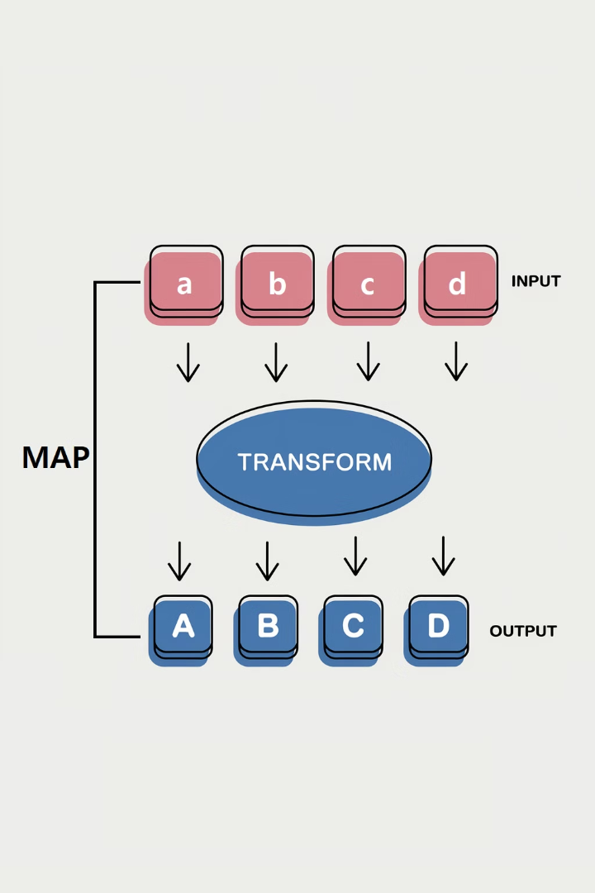



Understanding map() Function
map() applies a function to every item in an iterable
Syntax: map(function, iterable)
Example: Use map() to double numbers in a list

Slide 4
Understanding filter() Function
1
filter() filters elements based on a given condition
2
Syntax: filter(function, iterable)
3
Example: Use filter() to extract even numbers from a list

Slide 5
Understanding reduce() Function
1
Single Value Result
2
reduce() reduces a sequence to a single value
3
Syntax: reduce(function, iterable)
4
Example: Use reduce() to find the product of all numbers in a list

Slide 6
Understanding zip() Function
zip() combines multiple iterables into tuples
Syntax
Example
Use zip() to pair names with ages:
The zip() function takes multiple iterables and returns an iterator of tuples, where each tuple contains the corresponding elements from the input iterables.
zip(iterable1, iterable2, ...)
names = ["Alice", "Bob", "Charlie"]
ages = [25, 30, 35]
pairs = zip(names, ages)
# Result: [("Alice", 25), ("Bob", 30), ("Charlie", 35)]

Slide 7
Understanding enumerate() Function
enumerate() adds an index to an iterable
This function adds a counter to each item in the iterable, returning an enumerate object.
Syntax: enumerate(iterable, start=0)
The start parameter allows you to specify the starting value for the counter (default is 0).
Example: Use enumerate() to create an indexed list of fruits
This helps when you need both the index and value during iteration.

Slide 8

Best Practices for Using Higher-Order Functions
Use map() and filter() for simple tasks
but prefer list comprehensions for readability.
Use reduce() when necessary
loops may be more readable.
zip() is useful for multiple lists
zip() is useful when working with multiple lists.
enumerate() for indices in loops
enumerate() is great for adding indices in loops.

Slide 9
Practice Exercises – Beginner Level
1
Temperature Conversion
2
Word Filtering
Use map() to convert a list of temperatures from Celsius to Fahrenheit.
Use filter() to extract words longer than 5 characters from a list of words.

Slide 10
Practice Exercises – Intermediate Level
Find the Largest Number: Use reduce() to find the largest number in a list.
Create a Dictionary: Use zip() to combine two lists and create a dictionary.

Slide 11


Practice Exercises – Advanced Level
Numbered Shopping List
Use enumerate() to create a numbered shopping list from a list of items.
Combined Functions
Combine map(), filter(), and reduce() to process a list of numbers.

Slide 12
Summary of Key Concepts
Efficiency
Useful Operations
Best Practices
Higher-order functions make code more efficient and readable.
map(), filter(), reduce(), zip(), and enumerate() perform useful operations on iterables.
Best practices include using higher-order functions appropriately for modular and readable code.

Slide 13

Conclusion & Next Steps
Practice
Explore
Practice using higher-order functions in your projects.
Explore combining higher-order functions in more complex scenarios.
Experiment
Keep experimenting with Python!

