Slide 1
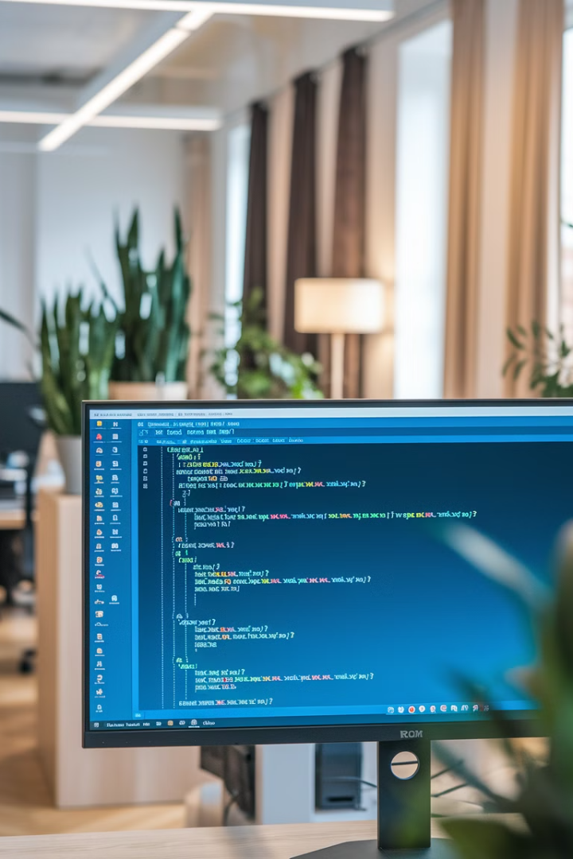


Lecture 06:
Python Loops

Slide 2
Introduction to Loops
1
Repeated Execution
2
Use Cases
3
Benefits
Loops enable repeated execution of code blocks.
Used for processing collections and automating tasks.
Enhances efficiency, simplicity, and flexibility in programming.

Slide 3
For Loops
Basic Syntax
Enumerate()
Dictionary Iteration
Iterates over sequences like lists, strings, and dictionaries.
Provides an index automatically in for loops.
Loop over keys or key-value pairs in dictionaries.

Slide 4
While Loops
Condition-Based
Unknown Iterations
Example
Repeats execution while a condition is True.
Used when the number of iterations is unknown.
count = 0 while count < 5: print(count) count += 1

Slide 5
Loop Control Statements
Break
Continue
Else
Exits loop immediately.
Skips current iteration.
Executes if loop completes normally.

Slide 6
Advanced Looping Techniques
1
List Comprehensions
Concise way to process data in one line.
2
Zip()
Iterate over multiple lists simultaneously.
3
Itertools.cycle()
Cycles through a sequence indefinitely.

Slide 7
Feature
Syntax
Purpose
Notes
for Loop
for item in iterable:
Iterate over elements in a sequence
Ideal when the number of iterations is known.
while Loop
while condition:
Repeat until the condition becomes False
Watch out for infinite loops if the condition never becomes false.
break
(inside loop) if condition: break
Immediately exit the current loop
Only affects the innermost loop in nested loops.
continue
(inside loop) if condition: continue
Skip the current iteration and continue the loop
Moves on to the next iteration immediately.
else (Loop End)
for/while loop ...
Executes when the loop finishes without a break statement
Useful for confirming if a loop ran completely.
else:

Slide 8



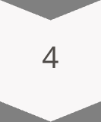

Best Practices for Loops
Simplicity
Keep loops simple and readable.
Naming
Use meaningful variable names.
Comment Your Code
Document complex loop logic and conditions.
Built-in Functions
Utilize enumerate(), zip(), and itertools.
Safety
Guard against infinite loops.

Slide 9
Mastering Python Loops
1
Understand
Grasp loop concepts and syntax.
2
Practice
Implement various loop types in your code.
3
Optimize
Refine your loops for efficiency and readability.
4
Innovate
Explore advanced techniques for complex problems.

Slide 10
Summary
Loop Types
Control Mechanisms
For loops iterate sequences, while loops repeat on conditions
Break and continue statements control loop execution flow
Advanced Features
Best Practices
List comprehensions, enumerate(), and zip() optimize coding
Write simple, well-named loops with proper safety checks

