Slide 1
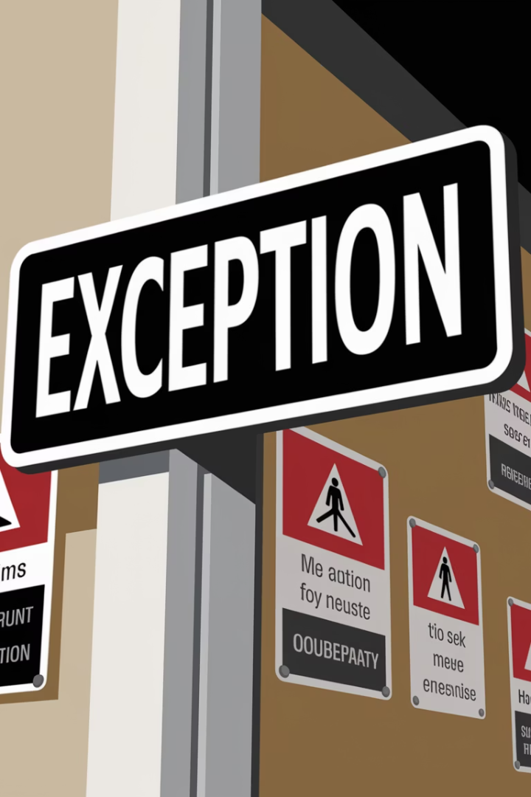



Lecture 14:
Exception Handling in Python

Slide 2










Topics We'll Learn Today
What is Exception Handling?
Why Do We Need Exception Handling?
Types of Errors in Python
Basic try-except Structure
Handling Multiple Exceptions
Handling Generic Exceptions
Using finally Block
Raising Custom Exceptions
Best Practices
Practice Exercises

Slide 3
Exception Handling
Allows programs to handle errors gracefully
Helps to continue the program flow
Uses keywords like try, except, finally
Prevents crashes when something goes wrong
Very useful for catching unexpected events
Maintains program stability during execution

Slide 4
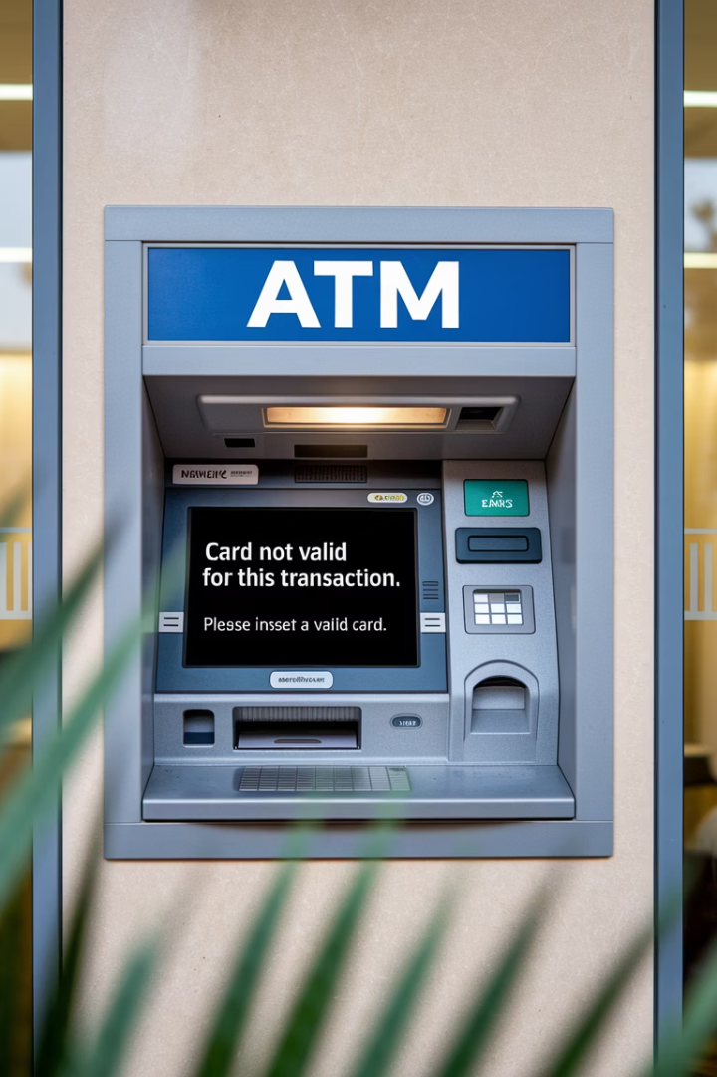
Real-Life Example – ATM
1
System should not crash on invalid input
2
If you enter a negative amount, you get a message, not a crash
3
Shows a helpful message like 'Invalid amount!'
4
Helps in building user-friendly software
5
Prevents program termination in such scenarios

Slide 5
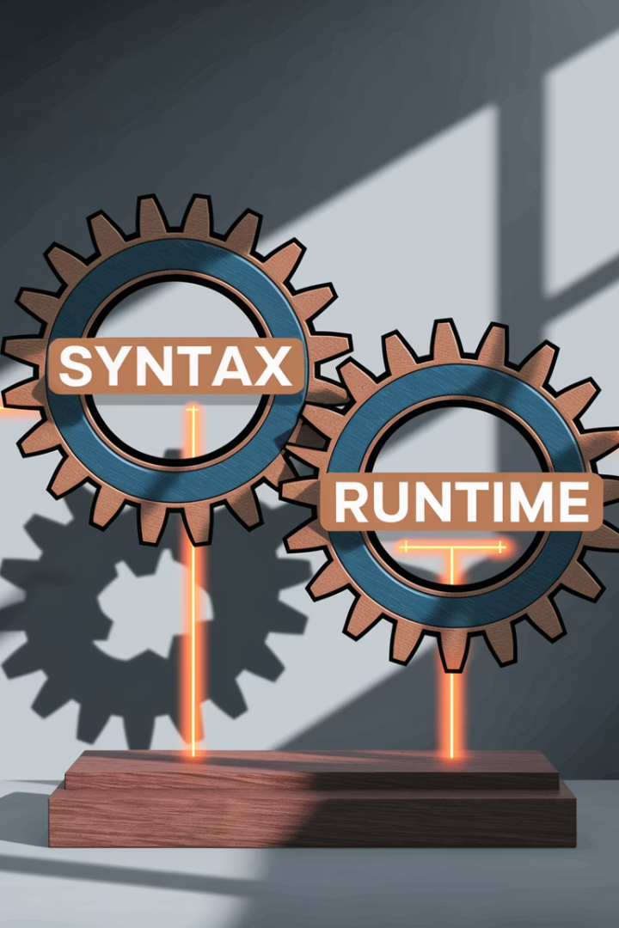
Python Errors – 2 Types
Syntax Errors
Runtime Errors (Exceptions)
Errors in the structure of code
Caught before the code is executed
Occur while code is running
E.g., division by zero or variable not defined
Like missing ) or bad indentation
Can be caught using try-except

Slide 6
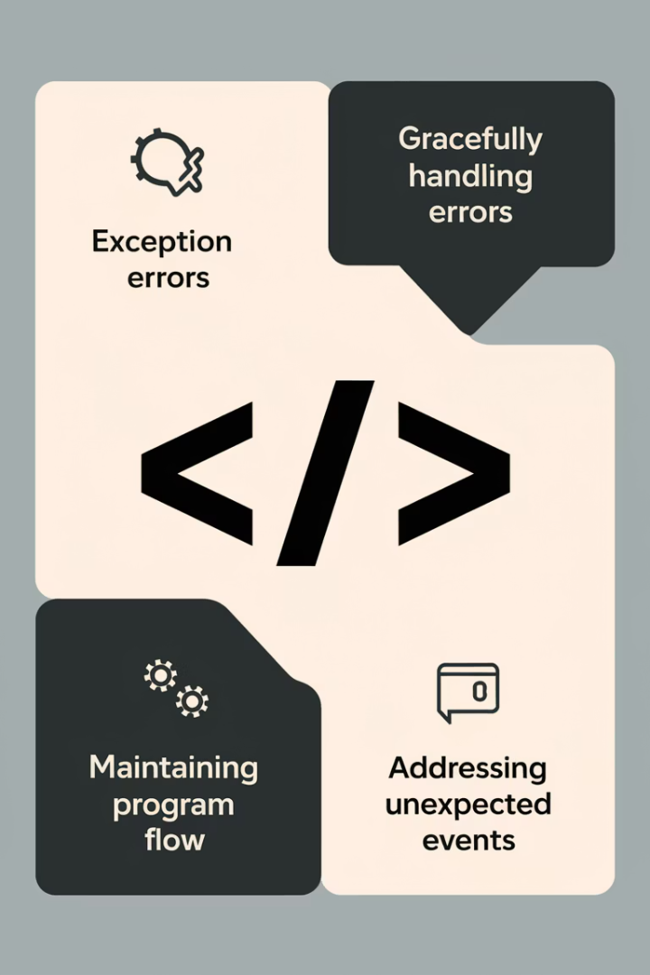



Syntax Error Example
Common mistakes: missing ), :, or indentation.
These must be fixed manually.
Cannot be handled with try-except.
print('Hello' # Syntax Error
Python throws a SyntaxError
Happens before the program runs

Slide 7




Runtime Error Example
num = 10 / 0
Results in ZeroDivisionError
Syntax is correct, but logic fails
This can be caught and handled
Program would crash without exception handling.
Perfect use case for try-except.

Slide 8
Generic Exception Handling: try, except
try: risky code
except: runs if error happens
try:
num = int(input())
print(10 / num)
except ZeroDivisionError:
print("Error! You cannot divide by zero.")
Handles specific exception
Prevents crash
Improves user experience

Slide 9
Generic Exception Handling: multiple try & except
Use multiple except blocks
try:
num1 = int(input())
num2 = int(input())
print(num1 / num2)
except ZeroDivisionError:
print('Cannot divide by zero!')
except ValueError:
print('Please enter valid numbers!')
Each block handles a different error
Clear separation of concerns
Keeps code clean
Each exception is treated differently

Slide 10
Generic Exception Handling (Contd.)
Exception is the base class for all errors
Use when you're unsure what might fail
try: num = int(input()) print(10 / num) except Exception as e: print("An error occurred:", e)
Always display e to understand the error
Don't overuse – hides bugs!
Good for logging, bad for debugging

Slide 11
Exception Handling: Always Executes
Runs no matter what (success or error)
The finally block executes regardless of what happens in the try-except blocks
try: file = open("example.txt", "r") content = file.read() except FileNotFoundError: print("File not found!") finally: print("Closing file...") file.close()
Great for clean-up tasks (e.g., close file)
Ensures resources are properly released even if exceptions occur
Prevents resource leaks
Critical for managing system resources like files, network connections, and database connections
Useful in real-world applications
Completes the exception handling structure

Slide 12
Exception Handling: Make Your Own Errors
Use raise
Use raise to throw your own errors
Enforce Rules
def withdraw(amount):
if amount < 0:
raise ValueError("Amount cannot be negative!")
Helps enforce rules in your program
Clear Communication
Clearly communicates what went wrong
Reliability
Makes your code more reliable

Slide 13
Using Custom Exception in try-except
Catch the error you raised.
try:
withdraw(-100)
except ValueError as e:
print(f"Error: {e}")
Useful for validating inputs.
Helps in large applications (banking, APIs).
Separates error logic from main logic.
Avoids unexpected results.

Slide 14
Tips to Follow
1
Always use specific exceptions
2
Keep try blocks as small as possible
3
Use finally for clean-up like closing files
Target exactly what might go wrong
Only include code that might raise exceptions
Ensure resources are properly released
4
Avoid except: without exception type
5
Use logging instead of print() for errors
Don't catch errors blindly
Better for production environments

Slide 15
What Did We Learn?
1
What exceptions are and why they happen
2
How to handle them gracefully using try-except
3
How to handle multiple or generic exceptions
4
The role of the finally block
5
How to create and use custom exceptions

Slide 16
Safe List Indexing
Get User Input
Access List Element
Handle Missing Index
Collect and convert user's index number to integer.
Retrieve the item at specified position using bracket notation.
Catch IndexError exceptions to prevent program crashes.
Display Friendly Messages
Implement try-except
Show error message instead of crashing.
Use try-except structure for error handling.

Slide 17

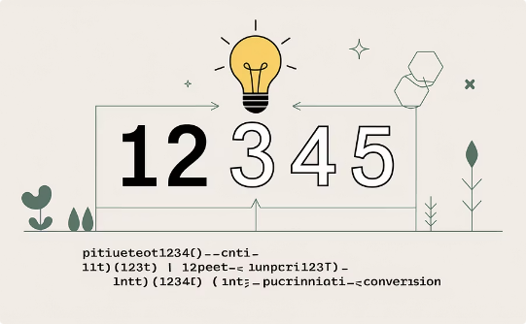
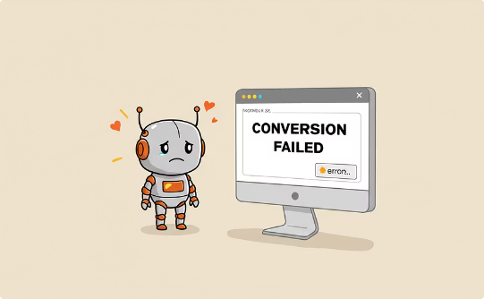
String to Integer Conversion
Take input as a string
Try to convert it to an integer
Handle the case using ValueError
Get user input in string format
Use int() function for conversion
Print friendly error messages

Slide 18
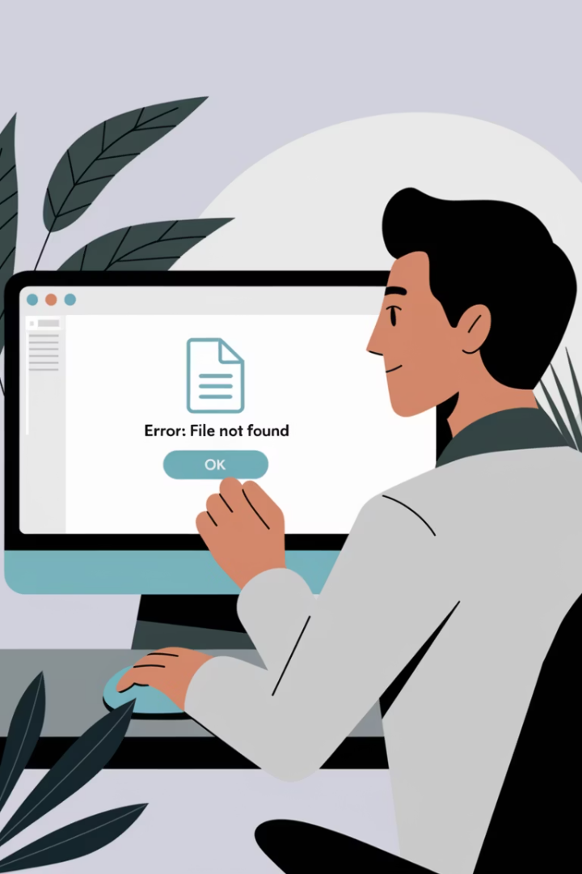




Read a File Safely
Prompt user for a filename
Try to open and read the file
Handle FileNotFoundError
Print appropriate error if not found

Slide 19

User Age Validator
Ask the user for their age.
If age < 0 or > 120, raise ValueError.
Catch the error and print the message.
Demonstrates custom condition checks.
Practical validation practice.

Slide 20

Bank Withdrawal System
Define withdraw(amount, balance)
Create a function that handles withdrawals
Raise exception if:
Amount > balance
Amount < 0
Else, deduct and print new balance
Complete the transaction if all conditions are met
Good use of raise, try-except
Simulates real banking logic

Slide 21




Ensure Cleanup with finally
Try to simulate database connection
Print error if connection fails
Use finally to "close" the connection
Even if error happens, connection closes

Slide 22





Try These Exercises!
Apply what you've learned today
Practice catching real-world errors
Write clean, readable, and safe code
Improve user experience with graceful error handling
Become confident with exception handling!

Slide 23




Summary: Exception Handling
We've explored how to write robust Python code that handles errors gracefully.
Exception Fundamentals
Try-Except Techniques
Learned about syntax vs. runtime errors and how exceptions disrupt normal program flow
Explored handling specific, multiple, and generic exceptions to prevent program crashes
Custom Exceptions
Resource Management
Created and used custom exception classes for application-specific error handling
Implemented finally blocks to ensure proper cleanup regardless of exceptions
By implementing these practices, you'll write more reliable, user-friendly, and maintainable Python applications.

