Slide 1
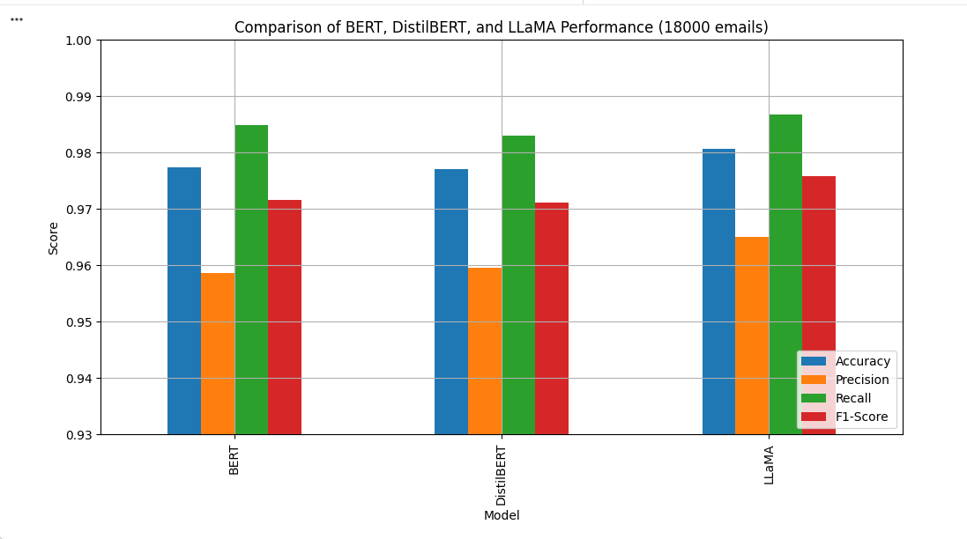
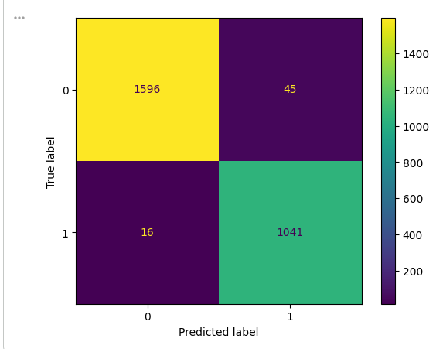
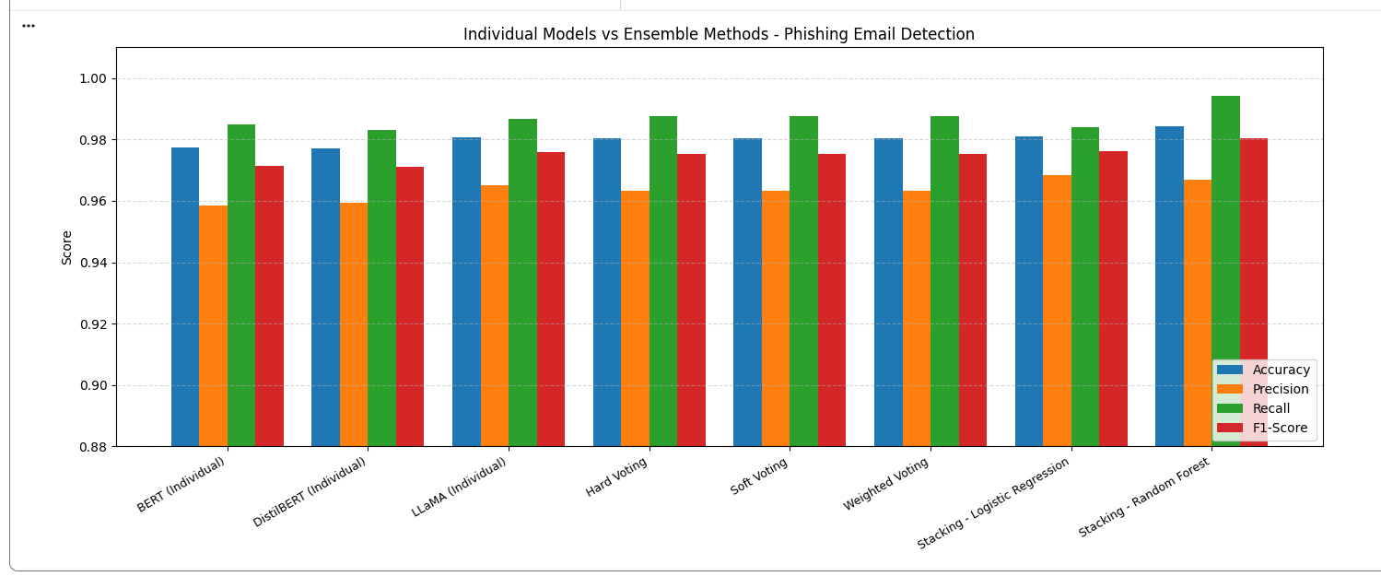
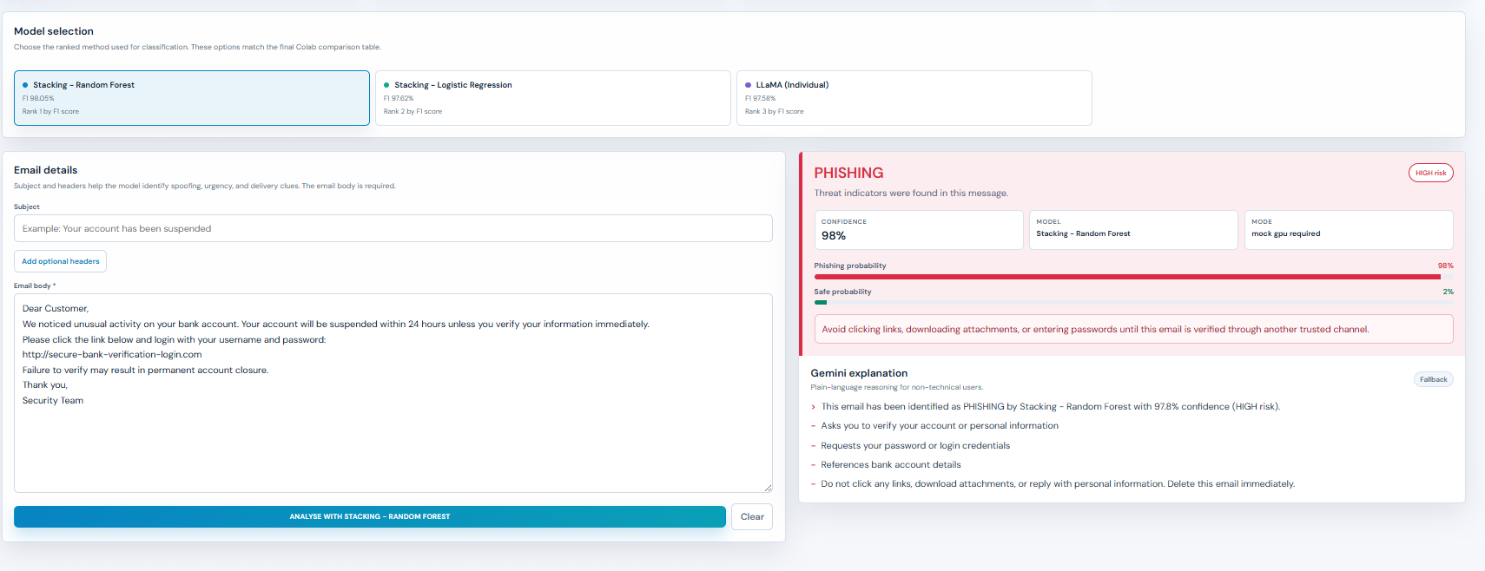
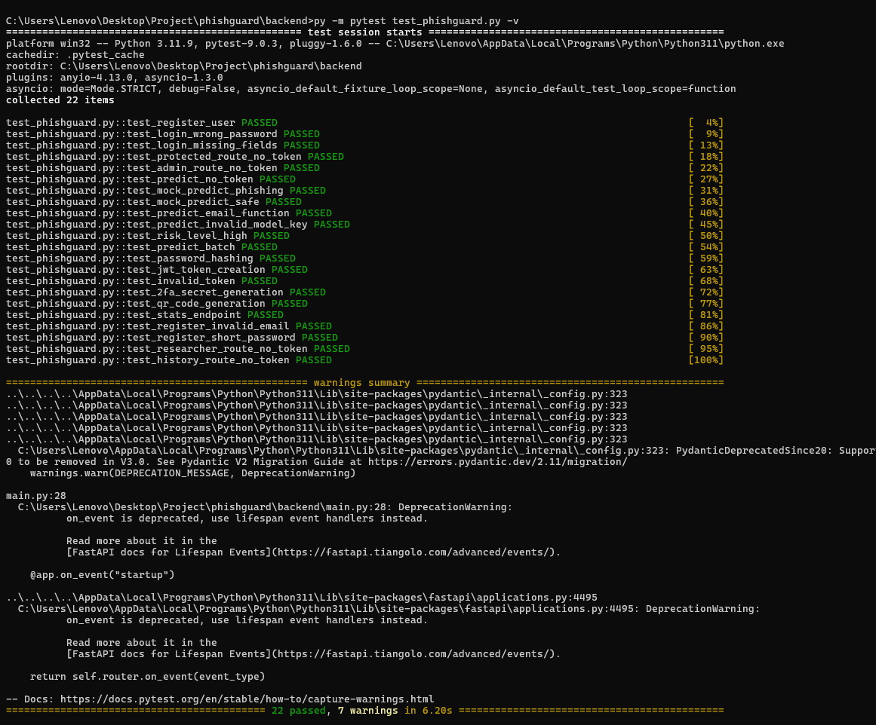
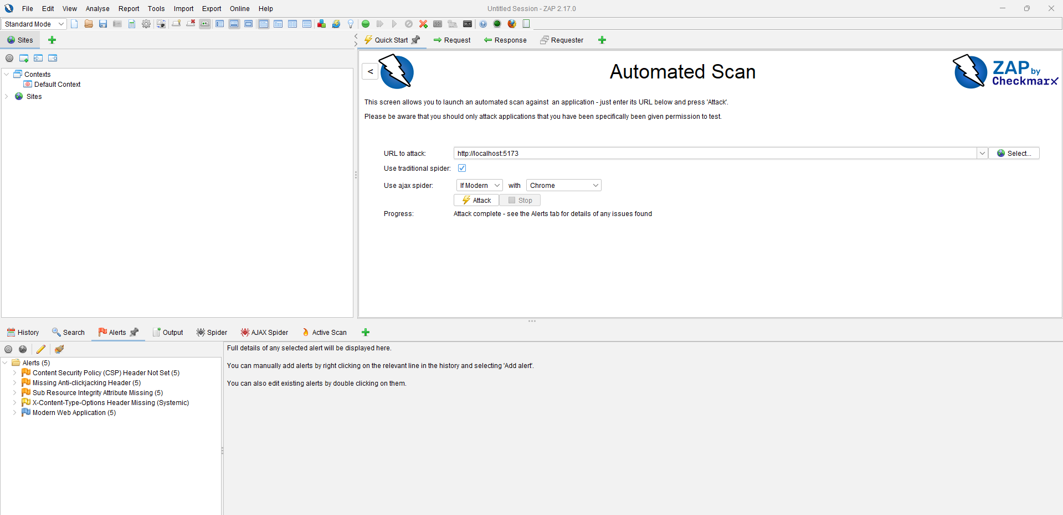
PHISHGUARD
60
0-100
DevSecOps-Based Phishing Email Detection System
automated tests passed
explainable risk score
Detect · Analyse · Protect
RED
YELLOW
GREEN
Tashi Namgay (CIHE241207) · Giovanni · Masaba · Aditi
Crown Institute of Higher Education | ICT932 Cybersecurity Testing and Assurance | S1 2026
THE PROBLEM
SYSTEM ARCHITECTURE
TESTING & VALIDATION
• Phishing emails exploit trust, urgency and hidden malicious links.
• Simple filters struggle with changing wording, attachment tricks and sender mismatch.
• Users need risk explanation, not only a safe/phishing label.
Browser / Frontend
HTML, CSS, JS, Jinja2
5
PDF + CSV
RBAC
Flask Backend
routes, auth, CSRF, middleware
testing layers
report export
access control
Analysis Engine
URL, keyword, header, attachment
• Unit tests: parser, URL, attachment, scoring and keyword matching.
• Auth tests: login, protected routes, approval flow and sessions.
• Security regression: CSRF, 2FA, export controls and upload extraction.
OBJECTIVES
MongoDB
users, sessions, results, quarantine
• Build a browser-based phishing email detector.
• Analyse URLs, keywords, headers and attachments.
• Show RED / YELLOW / GREEN risk level with reasons.
• Secure access with bcrypt, RBAC, CSRF protection and optional 2FA.
• Provide PDF/CSV report export and quarantine review workflow.
ML / MODEL EVIDENCE
EMAIL ANALYSIS PIPELINE
URL
Keyword
IP links, shorteners, phishing-word domains
urgency, finance and password request language
SECURITY CONTROLS
Header
Attach
reply-to mismatch and sender anomalies
dangerous or double-extension files
AUTH
bcrypt + Flask-Login sessions
The four modules combine into a scored, explainable risk output.
Colab evidence compares BERT, DistilBERT, LLaMA and ensemble approaches behind the detection prototype.
RBAC
admin and analyst route protection
APPLICATION INTERFACE
2FA
PyOTP TOTP optional per user
RESULTS & IMPROVEMENTS
CSRF
WTForms tokens on browser forms
• Manual input and .txt/.eml/.docx upload are working.
• Risk score returns a colour level and plain-language reasons.
• PDF and CSV report downloads are functional.
• CSV export now checks for existing records before creating files.
• Analysis results display on the same Analyse Email page.
• UI labels and colour system were redesigned for clarity.
INPUT
.txt, .eml and .docx upload controls
AUDIT
login attempts saved for review
DEVELOPMENT EVIDENCE
LIMITATIONS & FUTURE WORK
DEVSECOPS LIFECYCLE
• Rule-based detection can miss new phishing styles.
• ML classifier depends on dataset quality.
• Production HTTPS, Docker and CI/CD scanning remain future work.
• Add URL reputation, SPF/DKIM/DMARC checks and monitoring.
PyTest, Bandit, pip-audit and OWASP ZAP were used to make security evidence part of development, not an afterthought.
1
→
2
→
3
→
4
→
5
Plan
Build
Secure
Test
Evaluate
Threat modelling, secure coding and automated testing produced repeatable project evidence.
CONCLUSION
Technology Stack
PhishGuard demonstrates a complete academic cybersecurity prototype: secure access control, explainable phishing risk analysis, analyst/admin workflows, and repeatable DevSecOps testing evidence.
Python Flask · MongoDB · Jinja2 · PyOTP
PyTest · Bandit · pip-audit · OWASP ZAP
Detect threats. Explain risk. Protect users.
Source evidence: project presentation, screenshot report, Colab/model evidence and PhishLens final material. Poster prepared for academic print submission.

