Slide 1
Illustrated Doodle Buyer Persona Infographics
Here is where this template begins

Slide 2
Illustrated Doodle Buyer Persona Infographics
Education
Lisa Smith
Aspirations
Venus has a beautiful name and is the second planet from the Sun
Mercury is the closest planet from the Sun and the smallest one
Motivations
Interests
Jupiter is the fourth planet from the Sun and the biggest of them all
Jupiter is a gas giant and the biggest planet in the Solar System
It’s a gas giant and has several rings

Slide 3
Illustrated Doodle Buyer Persona Infographics
Purchases
Technology
Spring
Internet
Summer
Social Media
Fall
Online Shop
Winter
E-learning
Sources
Aspirations
About
Saturn is composed mostly of hydrogen and helium
Venus has a beautiful name and is the second planet from the Sun
Jupiter is a gas giant and the biggest planet in the Solar System

Slide 4
Illustrated Doodle Buyer Persona Infographics
Personality
Jonathan
Smith, 32
Interests
Mercury is the closest planet to the Sun and also the smallest one
Internet
Sports
Art
Preferred Channels
Motivations
Saturn has rings
Sports
Earth is the blue planet
Social
Mars is a cold place
Nature

Slide 5
Illustrated Doodle Buyer Persona Infographics
Interests
Frustrations
It’s a cold place
It’s the hottest one
It’s a gas giant
It’s a cold place
It’s the fifth planet
It’s the biggest one
Lisa Smith
Aspirations
Roles
Saturn is composed mostly of hydrogen and helium
It’s the third planet
It’s the smallest
It’s the biggest one
It’s the farthest
Pluto is far away
It’s a gas giant

Slide 6
Illustrated Doodle Buyer Persona Infographics
Saturn
Product Experiences
Interests
Saturn is composed mostly of hydrogen and helium
Venus has a beautiful name, but it’s terribly hot
Despite being red, Mars is actually a cold place
Mercury is the closest planet to the Sun
Internet
Traveling
Annual Meetings
English
Traveling
French
Cultural
Music
Shopping
Spanish
Adventure

Slide 7
Illustrated Doodle Buyer Persona Infographics
Peter Smith
Top Challenges
Despite being red, Mars is a cold place
Responsibilities
Venus has a beautiful name and very high temperatures. It is also hotter than the other planets
Earth is the third planet from the Sun and the one that harbors life. It’s between Mars and Venus
Motivations
Values
Mars is a cold place
Venus has a beautiful name
Nature
Sport
Charity
Mars
Earth
Jupiter

Slide 8
Illustrated Doodle Buyer Persona Infographics
Education
Motivations
Benefits
Venus has a beautiful name and high temperatures. It is hotter than the other planets
Despite being red, Mars is actually a cold place. Iron oxide dust is the cause of the red cast
Earth is the third planet from the Sun, the one that harbors life and where we all live on
About
Personality
Experience
Hobbies
Saturn is composed mostly of hydrogen and helium
It is a gas giant
It’s the smallest
It is the biggest
It is the closest
It is the biggest
It is the third
It is the hottest
It is the coldest
It is the fourth

Slide 9
Illustrated Doodle Buyer Persona Infographics
Personality
Hobbies
Creative
Fashion
Organized
Party
Resolutive
Dance
Tools
Interests
Mercury
Photoshop
Traveling
Illustrator
Cultural
Mercury is the closest planet to the Sun
InDesign
Adventure

Slide 10
Illustrated Doodle Buyer Persona Infographics
Demographic
Education
Mercury is the closest planet to the Sun and the smallest one
Neptune is the farthest planet from the Sun and the fourth-largest one
Personality
Interests
Richard Kyle
Earth is the third planet from the Sun, the one where we all live on
Mars is actually a cold place. Iron oxide dust is the cause of the red cast
Mercury is the closest planet to the Sun

Slide 11
Illustrated Doodle Buyer Persona Infographics
Jupiter is the biggest planet of them all
Brandon Lee
Uranus is seventh planet from the Sun
Demographic
Channels
Pluto is now considered a dwarf planet
Venus is the second planet from the Sun
Buying roles
Goals
It’s the farthest planet from
the Sun
It’s the third planet from
the Sun
Content
It’s a gas giant and has several rings
Solutions

Slide 12
Illustrated Doodle Buyer Persona Infographics
Bio
About
Frustration
Venus has a beautiful name and high temperatures.
It is hotter than the other planets
Despite being red, Mars is actually a very cold place. Iron oxide dust is the cause of the red cast
Personality
Experience
It is the smallest
It is a gas giant
It’s a gas giant and has several rings
It is the closest
It is the hottest

Slide 13
Illustrated Doodle Buyer Persona Infographics
Bio
Affinities
Values & Fears
Despite being red, Mars is a cold place
Earth is the third planet from the Sun
Pluto is considered a dwarf planet
Jane Smith
Languages
Personality
Mars is a cold place
It’s the farthest planet
Mercury is the closest planet to the Sun
Mars
Jupiter
Saturn
Earth
25
Italian
California
German
Designer
Spanish
75%
60%
45%
85%

Slide 14
Illustrated Doodle Buyer Persona Infographics
Bio
Goals
Mercury is the closest planet to the Sun and also the smallest one
Saturn is composed mostly of hydrogen and also helium
Personality
Frustrations
Name
Despite being red, planet Mars is a cold place full of iron oxide dust
Jupiter is a gas giant and the biggest object in the whole Solar System
Mercury is the closest planet to the Sun

Slide 15
Illustrated Doodle Buyer Persona Infographics
Personal Info
Values & Fears
Venus has a beautiful name and high temperatures. It is hotter than the other ones
The big quantity of Iron oxide dust of planet Mars is the cause of the red cast
Affinities
Needs
John Smith
Earth is the third planet from the Sun and the one that harbors life
Saturn, the ringed planet, is composed of hydrogen and also helium
It’s the fifth planet from the Sun and the largest in the Solar System

Slide 16
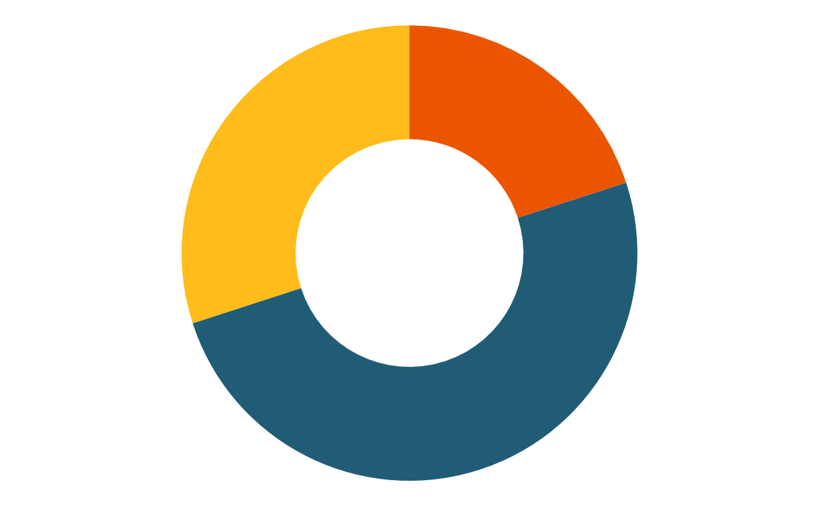
Illustrated Doodle Buyer Persona Infographics
Social Media
Motivations
Mercury is the closest planet to the Sun and also is the smallest one
Skills
Uranus
Pluto
30%
Facebook
About
Jupiter is the fifth planet from the Sun and the largest one
Mercury
20%
LinkedIn
Jupiter
50%
Twitter

Slide 17
Illustrated Doodle Buyer Persona Infographics
Bio
Interests
Mercury is the closest planet to the Sun and the smallest planet
Despite being red, planet Mars is actually a cold place
Mike Doe
Personality
Goals
Mercury is the closest planet to the Sun
It has a beautiful name and is the second planet from the Sun
Jupiter is a gas giant and the biggest planet in the Solar System

Slide 18
Illustrated Doodle Buyer Persona Infographics
Values
Personality
It has a beautiful name and it’s hot
Saturn is a gas giant and has several rings
Affinities
Goals
It’s the smallest and innermost planet
It’s the farthest planet from the Sun
Jupiter
Frustrations
Jupiter is the fifth planet from the Sun and the largest of them all
Motivations
Despite being red, is a cold place
Earth is the planet we all live on

Slide 19
Illustrated Doodle Buyer Persona Infographics
Experience
Personality
Introvert
Extrovert
Passive
Active
Analytical
Creative
About
Mars
Venus
Earth
Frustrations
Interests
Earth is the third planet from the Sun and the one that harbors life
Mars is a cold place
Mars is actually a very cold place. Mars is actually a planet full of iron oxide dust
It’s a gas giant
It’s the fifth planet

Slide 20
Illustrated Doodle Buyer Persona Infographics
Age:
25 years old
Chloe Taylor
Location:
California
Saturn is composed mostly of hydrogen and helium
Job:
Art Director
Studies:
Designer
Salary:
$2,000-$2,500
Motivations
Goals
Affinities
Motivations
Mercury is the closest planet to the Sun
Venus is the second planet from the Sun
Despite being red, Mars is a cold place
Mercury is the closest planet to the Sun

Slide 21
Illustrated Doodle Buyer Persona Infographics
Mike Smith
Frustrations
Motivations
Mercury is the smallest planet in the Solar System
1
Mars is a cold place
Personality
2
It’s a gas giant
Despite being red, Mars is actually a really cold place
3
It’s the fifth planet
Goals
Percentages
Neptune
Earth
It’s the fifth planet from the Sun and the largest of them all
Jupiter
Saturn
Mars
Venus
Mars
Jupiter
Saturn

Slide 22
Illustrated Doodle Buyer Persona Infographics
Personality
Experience
It’s the fifth planet from the Sun and the largest in the complete Solar System
Mercury is the closest planet to the Sun and the smallest one
Education
Goals
About
Despite being red, Mars is now a cold place full of iron oxide dust
Earth is the third planet from the Sun and the one that harbors life
Earth is the third planet from the Sun and the one that harbors life

Slide 23
Illustrated Doodle Buyer Persona Infographics
Interests
Motivations
It’s the fifth planet from the Sun and the largest in the complete Solar System
Mercury is the closest planet to the Sun and also the smallest one
Personality
Skills
Saturn
Helena Patterson
Uranus
Venus
Pluto
It’s a gas giant and has several rings
Pluto
Mercury
Uranus
Jupiter

Slide 24
Illustrated Doodle Buyer Persona Infographics
Luke James
Bio
Goals
Saturn is composed mostly of hydrogen and also helium
Mercury is the closest planet to the Sun and also the smallest one
Personality
Frustrations
Jupiter is a gas giant and the biggest object in the whole Solar System
Despite being red, planet Mars is a cold place full of iron oxide dust
Jupiter is the fifth planet from the Sun and the largest of them all

Slide 25
Illustrated Doodle Buyer Persona Infographics
Venus
Goals
It’s a gas giant and also the biggest planet in the Solar System
Saturn is the ringed one. It’s composed mostly of hydrogen and helium
Mercury
Frustrations
It has a beautiful name, but it’s terribly hot, even more than Mercury
Mercury is the closest planet to the Sun and the smallest one
Jupiter
Jupiter is the fifth planet from the Sun and the largest of them all

Slide 26
Illustrated Doodle Buyer Persona Infographics
Technologies
Mike James
Skills
Internet
Mars
Social Media
Pluto
Online Shop
Jupiter
Personality
Mercury
It has several rings
It’s the fifth planet
Motivations
Mercury is the smallest
Saturn
Goals and needs
Bio
Earth
It’s the fifth planet from the Sun and the largest in the Solar System
It’s the fourth planet from the Sun and despite being red, it’s a cold place
Neptune
Mars

Slide 27
Illustrated Doodle Buyer Persona Infographics
Sources of information
Saturn is composed of hydrogen and helium
Personality
Despite being red, Mars is actually a cold place
John Smith
Goals & Motivations
25
It’s the fifth planet from the Sun and the largest in the Solar System
Earth is the third planet from the Sun
California
Designer

Slide 28
Illustrated Doodle Buyer Persona Infographics
Interests
Motivations
It’s the fifth planet from the Sun and the largest in the Solar System
Mercury is the closest planet to the Sun and also the smallest one
Personality
Skills
Saturn
Traveling
Venus
Anne Patterson
Music
It’s the fifth planet from the Sun and the largest in the Solar System
Pluto
Jupiter
Internet

Slide 29
Illustrated Doodle Buyer Persona Infographics
Interests
Values
Roles
It is the biggest
Despite being red, planet Mars is actually a cold place
Jupiter is a gas giant and the biggest in the Solar System
It is the third
It is the fourth
Sources
Technology
Social Media
Emily Johnson
Saturn is composed mostly of hydrogen and also helium
Mercury is the closest planet to the Sun and also is the smallest one
Facebook
Jupiter is the fifth planet from the Sun and the largest of them all
LinkedIn
Twitter

Slide 30
Illustrated Doodle Buyer Persona Infographics
Social Media
Alexander Moore
Personality
Despite being red, Mars is actually a really cold place
Jupiter is the fifth planet from the Sun and the largest of them all
Despite being red, Mars is actually a really cold place
Facebook
Earth
LinkedIn
Mars
Instagram
Saturn
Goals
Skills
Mars is a cold place
Uranus
Pluto
It’s a gas giant
Mercury
It’s the fifth planet
Jupiter

Slide 31
Illustrated Doodle Buyer Persona Infographics
Interests
Frustrations
It’s a cold place
It’s the hottest one
It’s a gas giant
It’s a cold place
It’s the fifth planet
It’s the biggest one
Aspirations
Roles
It’s the third planet
Jupiter
It’s the smallest
It’s the biggest one
Jupiter is the fifth planet from the Sun and the largest of them all
It’s the farthest
Pluto is far away
It’s a gas giant

