Slide 1
Strategic Planning Infographics
Mercury
01
Venus
02
Jupiter
03
Here is where this template begins

Slide 2
Strategic Planning Infographics
MERCURY
JUPITER
NEPTUNE
SATURN
It’s the closest planet to the Sun and also the smallest planet in the Solar System
Jupiter is a gas giant and the biggest planet in the entire Solar System
Neptune is the farthest planet from the Sun and the fourth-largest
Saturn, the ringed planet, is composed mostly of hydrogen and helium
Open
In process
On hold
Completed

Slide 3
Strategic Planning Infographics
Analysis
Despite being red, Mars is actually a cold place
Strategy
Jupiter is a giant and the fourth planet from the Sun
Planning
Saturn is a gas giant made of hydrogen and helium
Execution
Neptune is the farthest planet from the Sun
Tracing
Venus is the second planet from the Sun

Slide 4
Strategic Planning Infographics
Diversification
Mercury is the closest one and is the smallest planet
Development
Venus has a beautiful name and is terribly hot
Growth
Saturn is a gas giant and has several rings
Penetration
Earth is the only planet that harbors life

Slide 5
Strategic Planning Infographics
Mission
Purpose
Goal
Mercury is the closest planet to the Sun
Jupiter is the biggest planet of them all
Saturn is the ringed planet and a gas giant
Values
Envisioned
Venus is the second planet from the Sun
Despite being red, Mars is a cold place

Slide 6
Strategic Planning Infographics
Jupiter is a gas giant and the biggest planet
30%
Analysis
Venus is the second planet from the Sun
20%
Planning
Despite being red, Mars is a cold place
15%
Tactics
Mercury is the closest planet from the Sun
35%
Tracing

Slide 7
Strategic Planning Infographics
Idea
Communication
Teamwork
Sales
Mercury is the closest planet from the Sun and the smallest one
Jupiter is a gas giant and the biggest planet in the Solar System
Venus has a beautiful name and is the second planet from the Sun
Despite being red, Mars is actually a cold place full of iron oxide dust

Slide 8
Strategic Planning Infographics
01
It’s the closest planet to the Sun and also the smallest planet in the Solar System
Week 1
02
Despite being red, Mars is actually a very cold place full of iron oxide dust
Week 2
03
Venus has a beautiful name and is the second planet from the Sun
Week 3

Slide 9
Strategic Planning Infographics
 | Phase 1 | Phase 2 | Phase 3 | Phase 4
Analysis
It’s the smallest
Strategy
Jupiter is a gas giant
Tactics
Neptune is far away
Implementation
Mars is a cold place
Tracing
We live on Earth

Slide 10
Strategic Planning Infographics
01
02
03
04
Analysis
Strategy
Execution
Tracing
Mercury is the closest planet to the Sun
Venus is the second planet from the Sun
Jupiter is the biggest planet of them all
It is a ringed planet and a gas giant

Slide 11
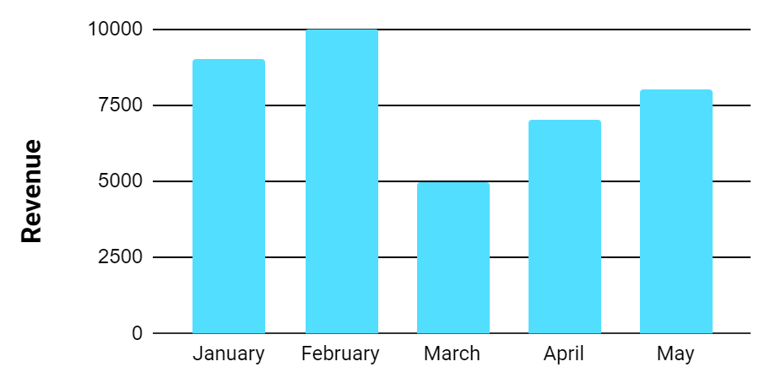
Strategic Planning Infographics
Planning
Execution
Mercury is the closest planet to the Sun
Neptune is the farthest planet from the Sun
Development
Tracing
Despite being red, Mars is a cold place
It's the biggest planet in the Solar System
Venus has a beautiful name. It’s hot
Saturn is the ringed planet. It’s a gas giant
The Sun is the star at the center
The Moon is a satellite. It orbits Earth

Slide 12
Strategic Planning Infographics
Tactics
Execution
Venus is the second planet from the Sun
It is the ringed planet and a gas giant
01
03
02
04
Analysis
Planning
Mercury is the closest planet to the Sun
Jupiter is the biggest planet of them all

Slide 13
Strategic Planning Infographics
Analysis
Teamwork
It’s the smallest planet in the Solar System
It’s the farthest planet from the Sun
Communication
Execution
GOAL
It’s the biggest planet in the Solar System
It’s a cold place. It’s full of iron oxide dust
Advertising
Tracing
It’s composed of hydrogen and helium
Venus has a very poisonous atmosphere

Slide 14
Strategic Planning Infographics
SATURN
IN PROCESS
It’s a gas giant and has several rings
MERCURY
ON HOLD
It’s the closest planet to the Sun
JUPITER
COMPLETED
It’s a gas giant and the biggest planet
EARTH
NOT STARTED
It’s the only one that harbors life

Slide 15
Strategic Planning Infographics
Saturn
Venus
Saturn is the ringed planet and a gas giant
Venus is the second planet from the Sun
Jupiter
Mercury
Jupiter is the biggest planet of them all
Mercury is the closest planet to the Sun

Slide 16
Strategic Planning Infographics
Status
Analysis |  | It’s the closest planet and also the smallest planet in the Solar System
Strategy |  | Saturn is the only planet with rings in the Solar System and is a gas giant
Tactics |  | Despite being red, Mars is actually a cold place full of iron oxide dust
Implementation |  | Jupiter the biggest planet in the Solar System and is also a gas giant
100%
85%
50%
75%

Slide 17
Strategic Planning Infographics
Diversification
Development
Mercury is the closest planet to the Sun and the smallest one in the entire Solar System
Jupiter is a gas giant and the biggest planet in the Solar System. It’s also the fourth-brightest object
Market Growth
Penetration
Venus has a beautiful name and is the second planet from the Sun. It’s terribly hot
Venus is the second planet from the Sun. It’s the second-brightest natural object in the sky

Slide 18
Strategic Planning Infographics
Year 1
Year 2
Year 3
Year 4
Mercury is the closest planet to the Sun
Despite being red, Mars is a cold place
Jupiter is a gas giant and the biggest planet
Neptune is the farthest planet from the Sun

Slide 19
Strategic Planning Infographics
12%
8%
5%
3%
1%
20%
40%
30%
60%
30%
Year 1
Year 2
Year 5
Year 10
Year 20
Mercury is the closest planet to the Sun
Venus is the second planet from the Sun
Jupiter is the biggest planet of them all
It is the ringed planet and a gas giant
Despite being red, Mars is a cold place

Slide 20
Strategic Planning Infographics
PHASE 1
PHASE 2
PHASE 3
PHASE 4
PHASE 5
Analysis
It’s the smallest
Strategy
Jupiter is a gas giant
Tactics
Neptune is far away
Implementation
Mars is a cold place

Slide 21
Strategic Planning Infographics
Step
Step
Step
Step
01
02
03
04
Idea
Implement
Performance
Operation
Mercury is the closest planet to the Sun and the smallest one in the Solar System
Despite being red, Mars is actually a very cold place. It’s full of iron oxide dust
Venus has a beautiful name and is the second planet from the Sun. It’s terribly hot
Neptune is the farthest planet from the Sun and the fourth-largest in the Solar System

Slide 22
Strategic Planning Infographics
2020
Mercury is the closest to the Sun and the smallest
Analysis
2021
Venus is the second planet from the Sun
Strategy
2022
Despite being red, Mars is a cold place
Tactics
2023
Jupiter is the biggest planet in the Solar System
Implementation

Slide 23
Strategic Planning Infographics
Diversification
01
02
Development
Its name has nothing to do with the liquid metal
STEP
STEP
It has a beautiful name, but also high temperatures
Market Growth
03
04
Penetration
Saturn is a gas giant and has several rings
STEP
STEP
It’s the biggest planet in the entire Solar System

Slide 24
Strategic Planning Infographics
Step 1
Step 2
Step 3
Step 4
Idea
Implement
Performance
Operation
Despite being red, Mars is actually a cold place
Jupiter is a gas giant and the biggest planet
Saturn is a gas giant and has several rings
Neptune is the farthest planet from the Sun

Slide 25
Strategic Planning Infographics
Year 1 | Year 2 | Year 3 | Year 4
Analysis
Mercury is the smallest
Strategy
Neptune is the farthest
Tactics
Jupiter is a gas giant
Implementation
Mars is a cold place

Slide 26
Strategic Planning Infographics
Year 1
25%
Its name has nothing to do with the liquid metal
Year 2
30%
Saturn is a gas giant and has several rings
REVENUE
Year 3
45%
100%
It has a beautiful name, but also high temperatures
Year 4
65%
It’s the biggest planet in the entire Solar System

Slide 27
Strategic Planning Infographics
01
Analysis
It’s the closest planet to the Sun and the smallest one in the Solar System
02
Evaluation
Venus has a beautiful name and is the second planet from the Sun
03
Strategy
It’s the closest planet to the Sun and the smallest one in the Solar System
04
Implementation
Its atmosphere is extremely poisonous. It’s the second-brightest object

Slide 28
Strategic Planning Infographics
Analysis
Jupiter is the biggest planet of them all
February
Evaluation
March
Mercury is the closest planet from the Sun
Strategy
April
Venus is the second planet from the Sun
May
Tactics
Despite being red, Mars is actually cold
June
Implementation
0
10
15
20
25
30
Its atmosphere is extremely poisonous

Slide 29
Strategic Planning Infographics
Analysis
Mercury is the smallest planet in the Solar System
Evaluation
Despite being red, Mars is actually a cold place
Strategy
Jupiter is a gas giant and the biggest planet of them all
Tactics
Neptune is the farthest planet from the Sun
Implementation
Earth is the third planet from the Sun and the one with life

Slide 30
Strategic Planning Infographics
Assessment
Neptune is the farthest planet from the Sun and the fourth-largest by diameter
Analysis
Mercury is the closest planet to the Sun and the smallest one in the Solar System
Strategy
Jupiter is the biggest planet in the Solar System and the fourth-brightest object
Implementation
Its atmosphere is extremely poisonous. It’s the second-brightest object

Slide 31
Strategic Planning Infographics
Analysis
Strategy
Tactics
Implementation
Mercury is the smallest planet
Mars is a very cold place
Jupiter is the biggest planet
Neptune is the farthest planet
2020
It’s the closest planet to the Sun
2021
It’s a gas giant and the biggest planet
2022
It’s a gas giant and has several rings
2023
It’s the only one that harbors life
2024
It’s very cold and is full of iron oxide dust

