Slide 1
Market Segmentation
Capstone Project
Data Science Intensive - Springboard
Tashlin Reddy

Slide 2
“in both developed and emerging markets, there is a wider variety among consumers now than at any time in the recent past.”
PwC’ research Fragmentation and Simplification

Slide 3
Problem
How can the consumer base be targeted in the most efficient possible manner?

Slide 4
4 Step Solution
Identify the market
Actual and potential buyers of the product
Market Segmentation
Divide the market into subgroups of customers with similarities
Understanding the Market Segments
Learning about the similarities
Why do the customers value those?
Target Markets
Decide which of the market segments to target

Slide 5
Identify the Market
COOP Italia’s customers
85.8% of customers purchased at 1-3 stores instead of all 5
Accounts for 79.2% of total revenue
40% of use 2 stores
70% of the customer transactions occur at either shop 1 or shop 2

Slide 6
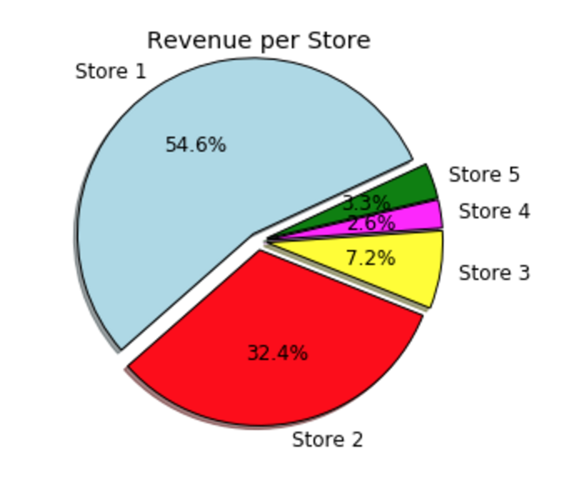
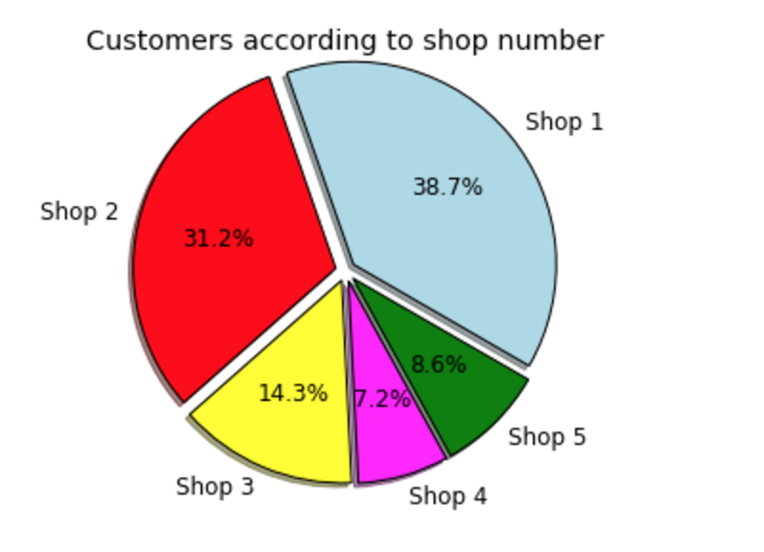
Identify the Market
COOP Italia’s Stores

Slide 7
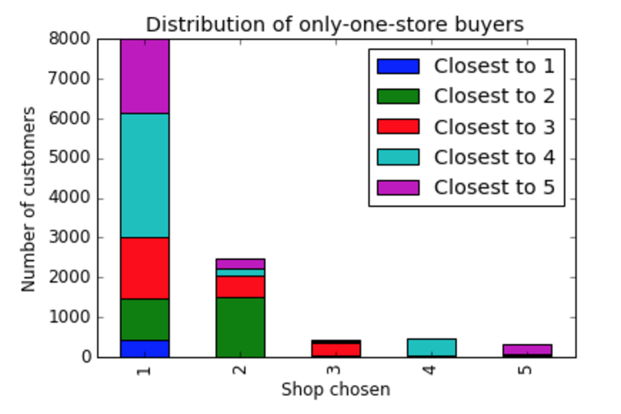
Identify the Market

Slide 8
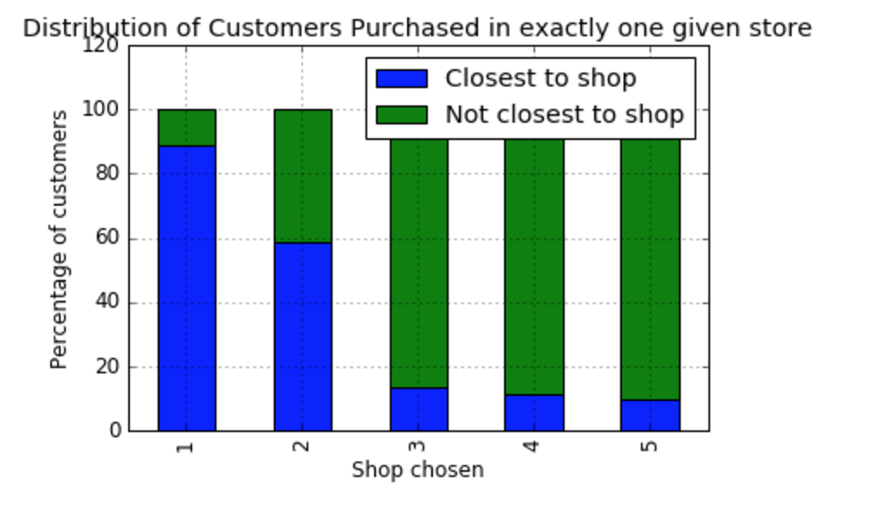
Identify the Market

Slide 9
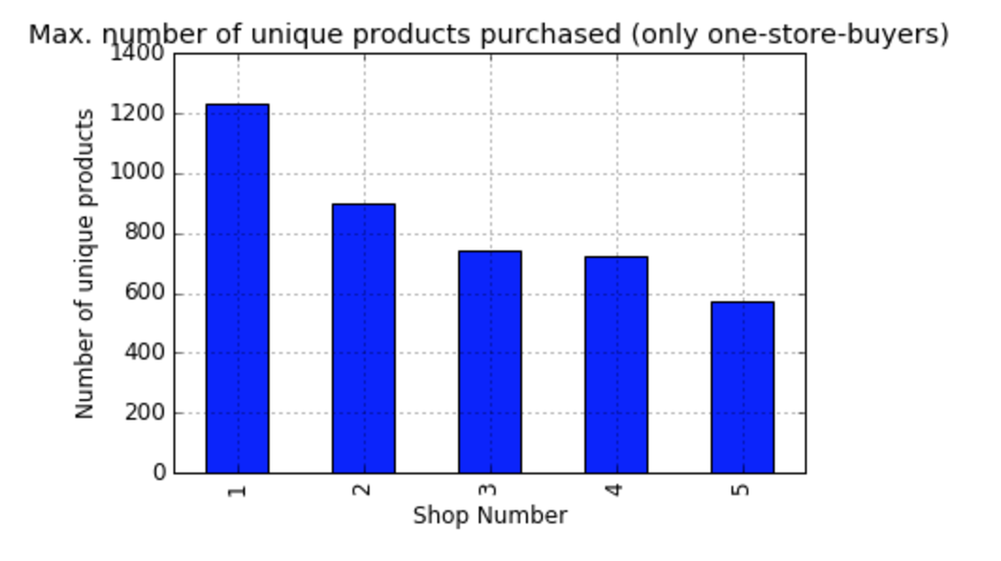
Identify the market

Slide 10
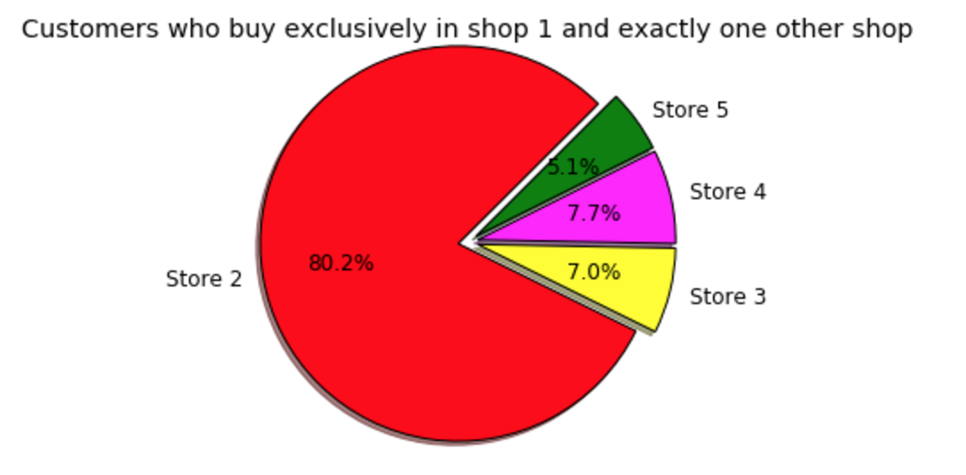
Identify the Market

Slide 11
Identify the Market
Shops Used
Unique Products Purchased
Major factor in customer’s choices
Distance
Minor factor
Willing to choose farther store over closer depending on variety offered

Slide 12
2. Market Segmentation
Machine Learning
K-means Clustering
Segment first into Shops Used
Cluster based on unique products purchased

Slide 13
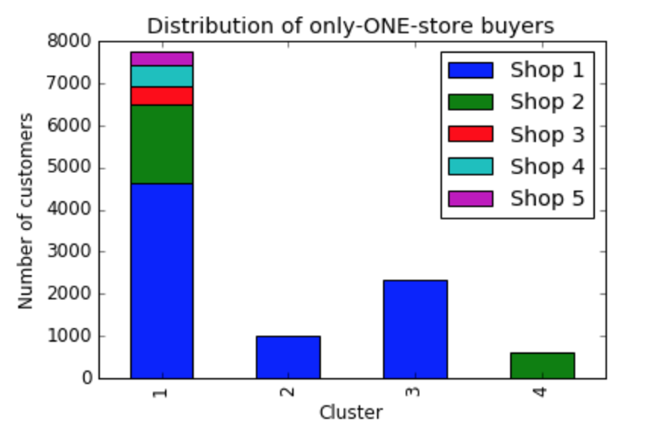
2. Market Segmentation

Slide 14
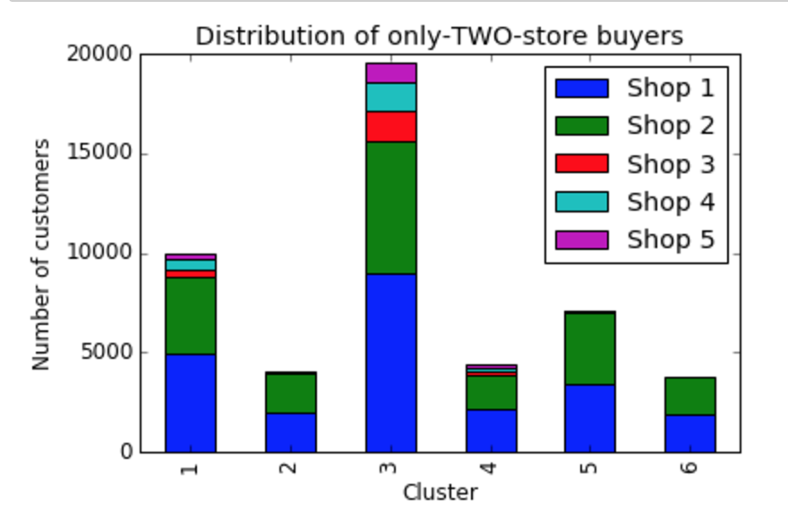
2. Market Segmentation

Slide 15
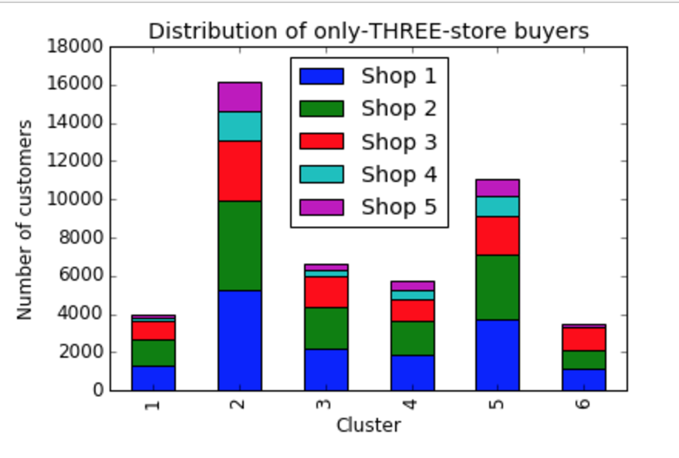
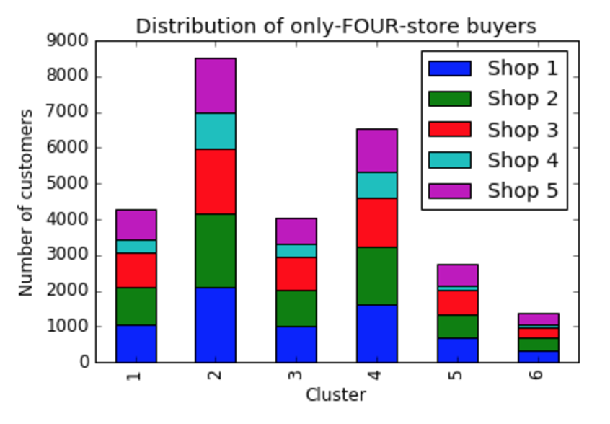
2. Market Segmentation

Slide 16
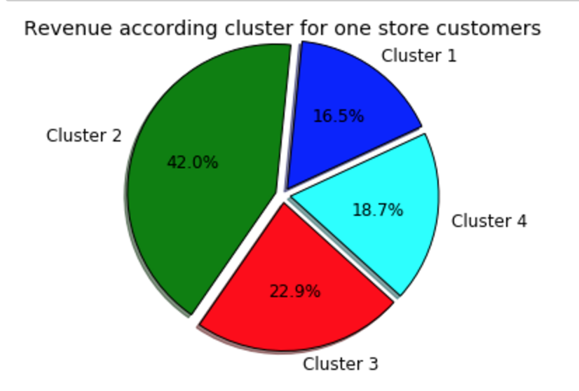
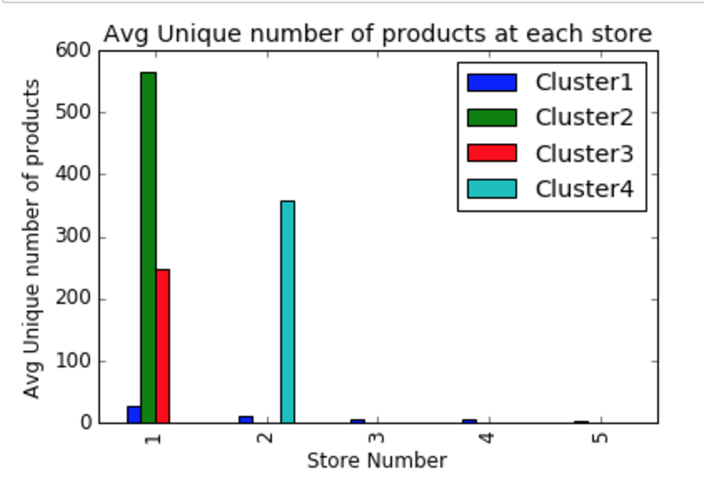
3. Understanding the Market Segments

Slide 17
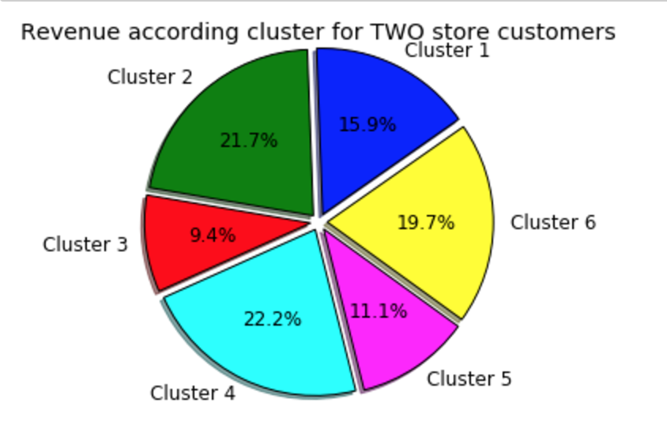
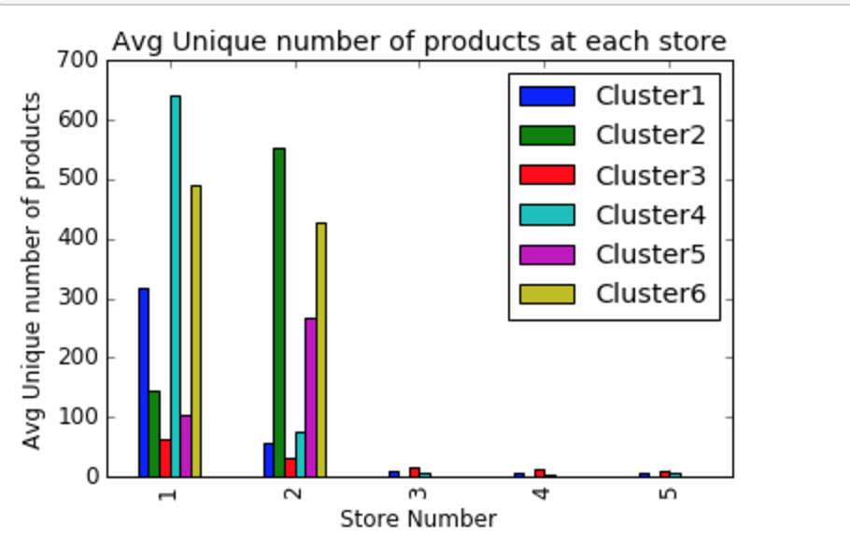
3. Understanding the Market Segments

Slide 18
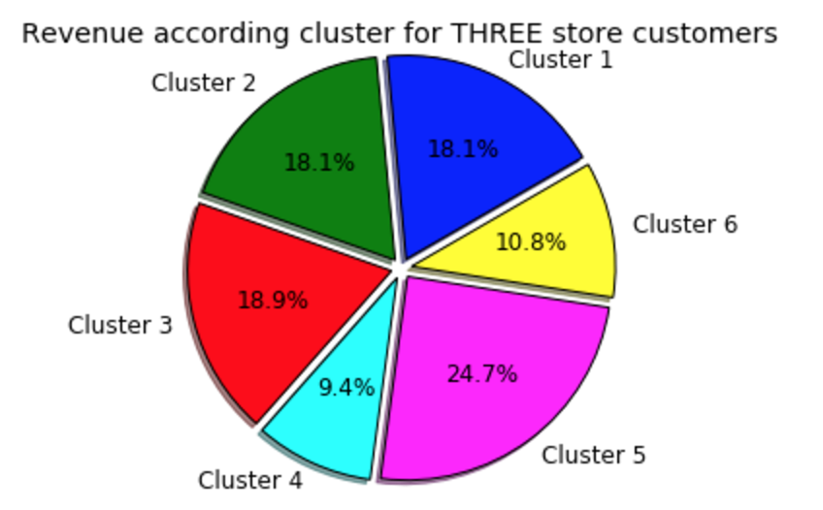
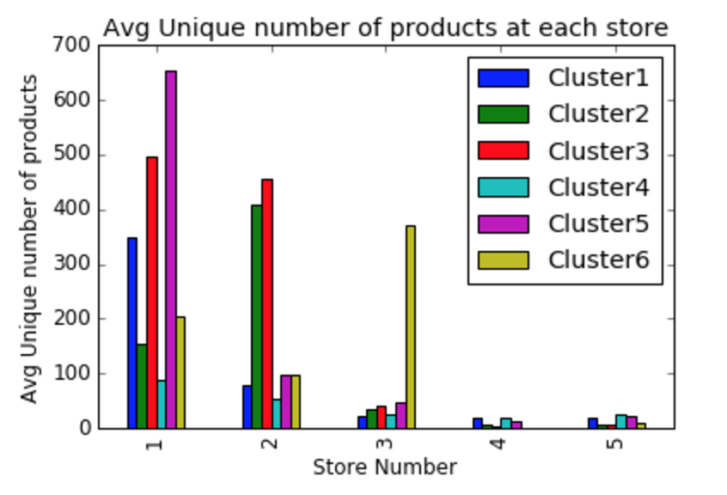
3. Understanding the Market Segments

Slide 19
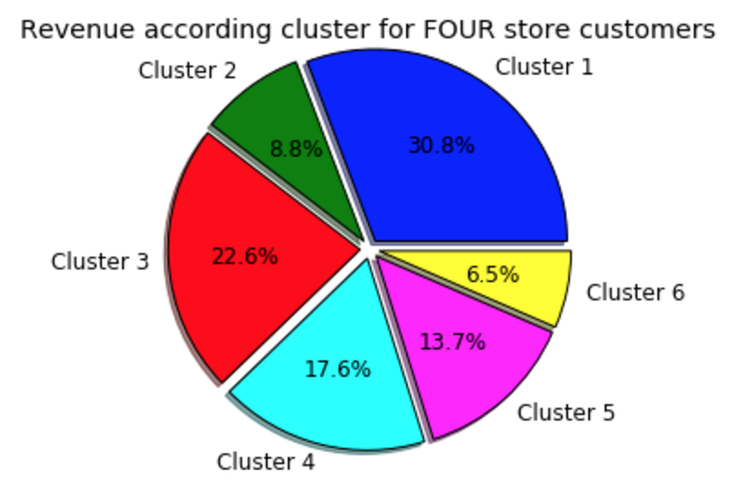
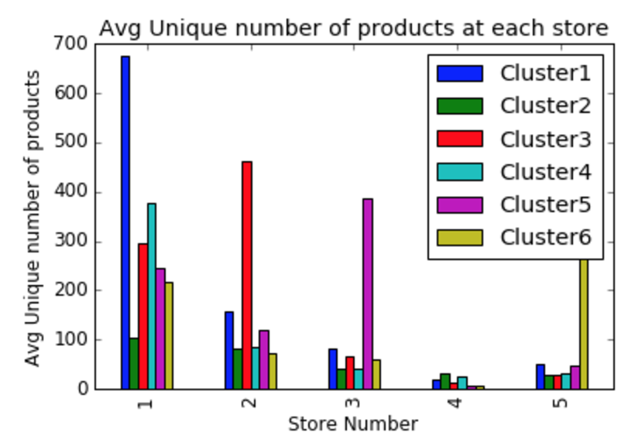
3. Understanding the Market Segments

Slide 20
4. Target Markets
Target Markets are segments that bring in the most revenue.
Trend to looks for that correlate to high revenue segments.
Segments with:
Large # of unique products purchased
Primarily purchases at store 1, secondarily store 2
Fewer shops used
Even in the segments with 3 or more shops
Purchasing concentrated on one store

