Slide 1


Finora Flow
CLIENT WALKTHROUGH
From estimate
to payment, in flow.
A guided tour of the unified platform for intake, approvals, invoices, payments, reconciliation, reporting, audit and administration.
Controls first
Every decision audited
AI assistive, never in charge
Product demonstration · 2026

Slide 2

THE CLIENT JOURNEY
What we will walk through today
Nine stops, in the order money actually moves through your organisation.
01
The problem
04
Intake to record
07
Reconcile and close
Why finance operations stall today
Email and uploads become checked data
Credit cards and month-end accruals
02
The platform
05
Approve spend
08
Control and oversight
One flow from estimate to payment
Estimates, approvals and purchase orders
Segregation, audit and operations
03
People and roles
06
Invoice to payment
09
Visibility and admin
Who does what, and who may not
Receipt, approval, bank and supplier
Reporting, configuration and value
Finora Flow · Client walkthrough · Agenda
2

Slide 3
01 · THE BUSINESS PROBLEM
Finance work is scattered, slow and hard to prove
Most accounts-payable teams run on inboxes, spreadsheets and chasing. That costs time, control and confidence.
INTAKE
APPROVALS
RECEIPT
Documents arrive everywhere
Approvals stall
Paying before receiving
Quotes and invoices land in personal inboxes, get re-keyed by hand and lose their provenance on the way.
Nobody can see who holds a request, how long it has waited, or whether the right level signed it.
Invoices get paid without anyone outside finance confirming the goods or services actually arrived.
CONTROLS
CLOSE
AUDIT
Duplicates and overruns slip through
Month-end is a scramble
Hard to prove to an auditor
The same invoice paid twice, or spend quietly exceeding what was approved or ordered.
Card statements, accruals and unpaid commitments are reconciled in spreadsheets under deadline.
Decisions live in emails and memories; a change of amount or approver cannot be reconstructed.
Finora Flow · Client walkthrough · The business problem
3

Slide 4
02 · THE PLATFORM
One governed flow, from the first email to the audited payment
Finora Flow replaces fragmented tools with a single system of record for every stage of accounts payable.
UNIFIED
GOVERNED
AUDITABLE
ASSISTIVE
One view, end to end
Controls enforced by the system
Every decision on the record
AI that assists and never decides
Estimate, purchase order, invoice, payment package, supplier confirmation and accrual are linked records, not separate spreadsheets.
Approval routes, receipt confirmation, duplicate and overrun checks and segregation of duties are enforced on the server, not by hiding buttons.
A tamper-evident, hash-chained audit trail records who did what, when, why, and from where.
Readings and suggestions are grounded in the document and always reviewed by a person. It can be switched off at any time and every workflow still completes.
Built for your infrastructure: runs in Linux containers on your own network, reads a mailbox you control over IMAPS, sends through your SMTP, and signs users in with your identity provider (OIDC). No dependency on Microsoft Graph or Outlook add-ins.
Finora Flow · Client walkthrough · The platform
4

Slide 5
02 · THE END-TO-END WORKFLOW
How money moves through Finora Flow
Ten stages, each with a named owner and a control that has to be satisfied before work moves on.
01
02
03
04
05
Capture
Read & review
Estimate
Approve
Commit (PO)
Email or upload, malware-scanned, stored immutably
Values extracted with evidence; a person accepts
Request to spend, routed by amount
Matrix-driven route, oldest first
Purchase order above the threshold
06
07
08
09
10
Invoice
Confirm receipt
Pay
Confirm payment
Close & report
Validated, linked, duplicate-checked
Named person outside finance signs off
Package, manifest, bank reference
Supplier asked; a person concludes
Cards coded, accruals locked, audit
Intake
Spend approval
Invoice control
Payment
Close & assurance
Finora Flow · Client walkthrough · End-to-end workflow
5

Slide 6
03 · PEOPLE AND ROLES
Seven roles, each with a clear job and clear limits
Access is deny-by-default and granted per role. Every screen shows only what that person may do.
ROLE
WHAT THEY DO
WHERE THEY WORK
Requester
Raises estimates, confirms goods and services were received.
My work · Estimates · Invoices
Approver
Decides requests routed to their level; arranges cover while away.
Approvals · Dashboard · Cover
Finance
Reviews documents, records and codes invoices, manages POs, cards and accruals.
Documents · Invoices · Cards · Accruals
Payment coordinator
Assembles and submits payment packages; asks suppliers to confirm.
Payment packages · Vendor confirms
Operations
Keeps intake and services healthy; retries failures; manages quarantine.
Inbox · Operational health
Administrator
Configures users, routing, thresholds, reference data and retention. Cannot approve.
Settings
Auditor
Reads everything, changes nothing, verifies the audit chain.
Audit trail · Reports · Registers
Finora Flow · Client walkthrough · People and roles
6

Slide 7
03
The everyday experience
Sign in once, see what needs you, and find anything in seconds.
Sign-in · Home dashboard · My work · Global search
Finora Flow · Client walkthrough · The everyday experience
7

Slide 8
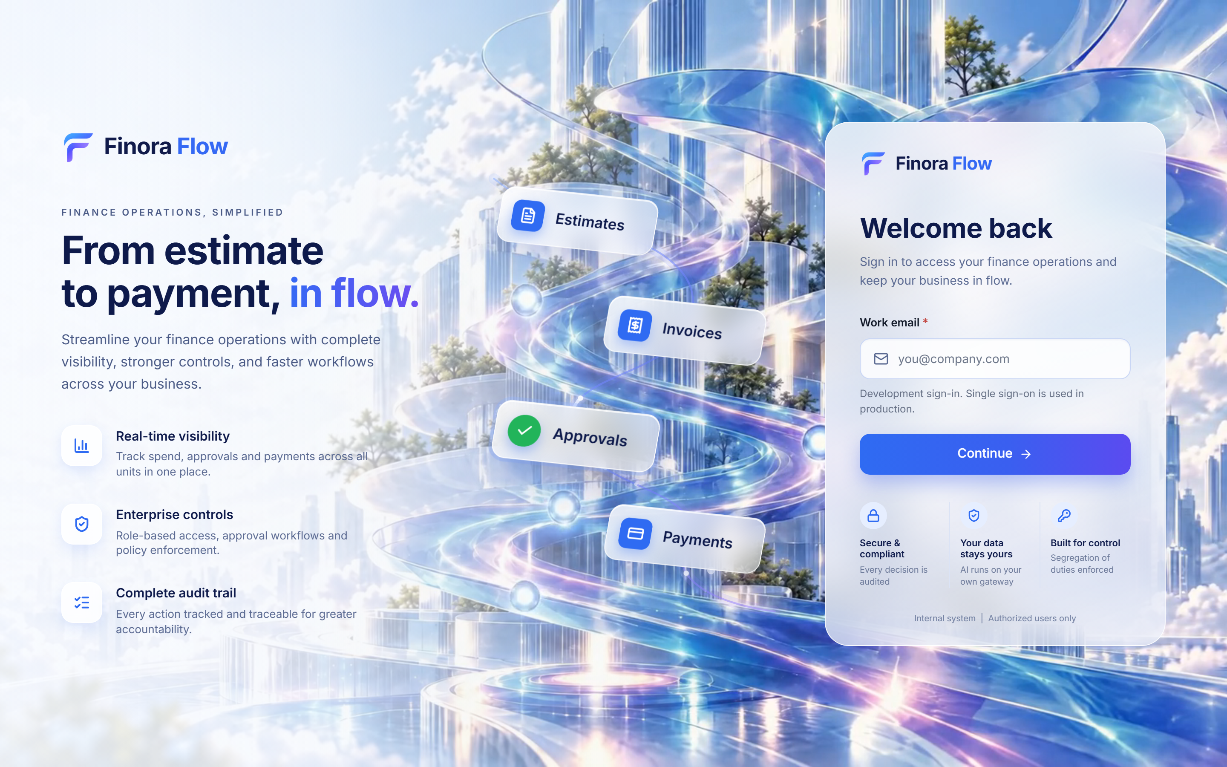
SECURE ACCESS
A calm, branded front door with enterprise sign-in
The workflow the platform runs is shown right on the sign-in page, and it moves.
1
The whole flow at a glance
Estimates, Invoices, Approvals and Payments light up in sequence as the flow runs through them.
1
2
Enterprise sign-in
Work-email sign-in for development; single sign-on through your identity provider in production.
3
Trust, stated plainly
4
2
Every decision audited, AI on your own gateway, segregation of duties enforced.
3
4
Why it exists, in three lines
Real-time visibility, enterprise controls and a complete audit trail.
WHY IT MATTERS
First impressions set expectations: a professional, accessible entry point that respects reduced-motion settings and works on any device.
Finora Flow · Client walkthrough · Everyday experience
8
Notes:
A calm, branded front door with enterprise sign-in
The workflow the platform runs is shown right on the sign-in page, and it moves.
Walk through:
1. The whole flow at a glance: Estimates, Invoices, Approvals and Payments light up in sequence as the flow runs through them.
2. Enterprise sign-in: Work-email sign-in for development; single sign-on through your identity provider in production.
3. Trust, stated plainly: Every decision audited, AI on your own gateway, segregation of duties enforced.
4. Why it exists, in three lines: Real-time visibility, enterprise controls and a complete audit trail.
Why it matters: First impressions set expectations: a professional, accessible entry point that respects reduced-motion settings and works on any device.

Slide 9
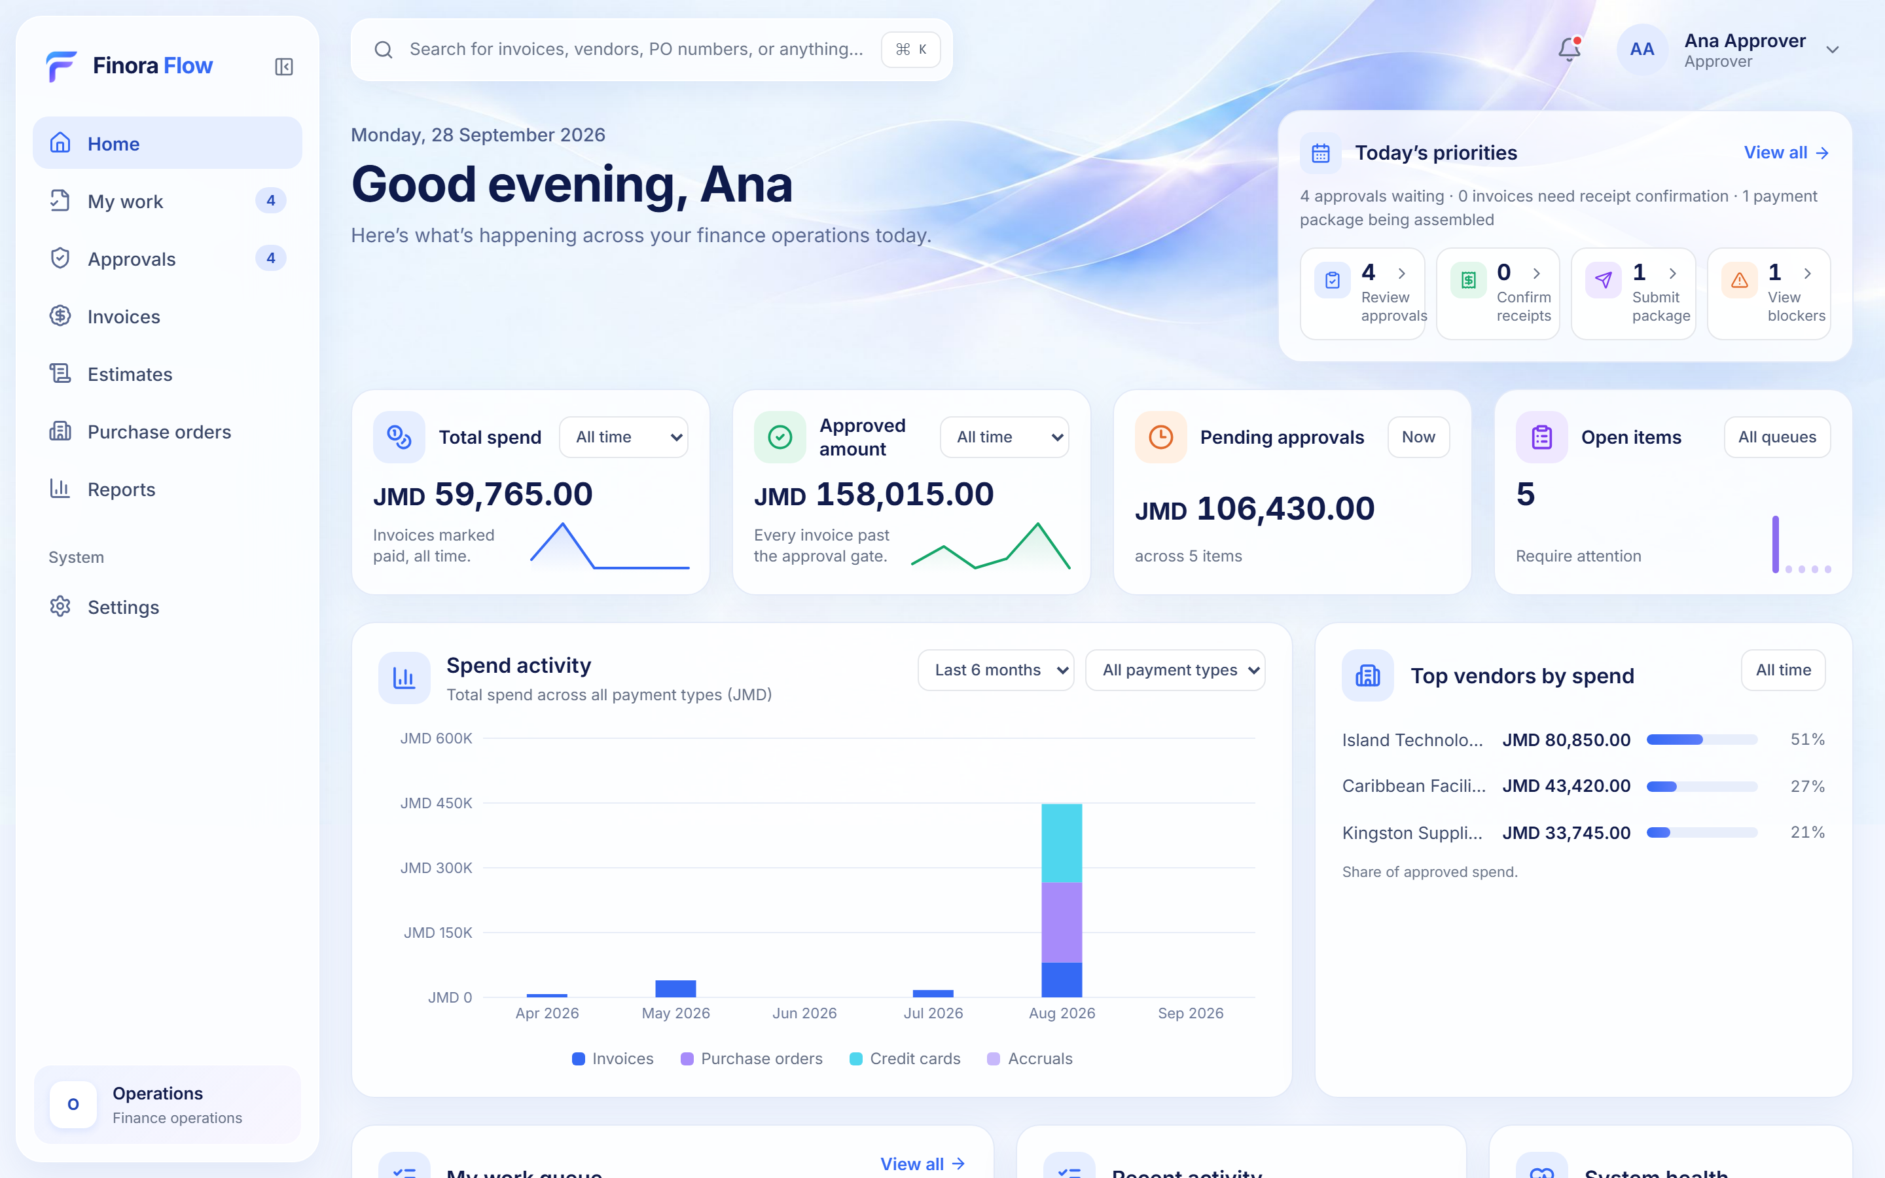
HOME DASHBOARD
Everything that matters today, on one screen
Every figure is counted from live records and opens the register behind it. Nothing is projected or invented.
1
Today's priorities
1
Approvals waiting, receipts to confirm, packages to submit and blockers, each one click from the work.
2
Spend headlines
2
Total, approved and pending spend with honest month-over-month change and a monthly trend line.
3
Spend by payment type
3
4
Invoices, purchase orders, credit cards and accruals per month, filterable over 6 or 12 months.
4
Top vendors
Where approved spend is concentrated, as a share of the total.
WHY IT MATTERS
Leaders see the state of the ledger without asking for a report, and every number can be traced back to a record.
Finora Flow · Client walkthrough · Everyday experience
9
Notes:
Everything that matters today, on one screen
Every figure is counted from live records and opens the register behind it. Nothing is projected or invented.
Walk through:
1. Today's priorities: Approvals waiting, receipts to confirm, packages to submit and blockers, each one click from the work.
2. Spend headlines: Total, approved and pending spend with honest month-over-month change and a monthly trend line.
3. Spend by payment type: Invoices, purchase orders, credit cards and accruals per month, filterable over 6 or 12 months.
4. Top vendors: Where approved spend is concentrated, as a share of the total.
Why it matters: Leaders see the state of the ledger without asking for a report, and every number can be traced back to a record.

Slide 10
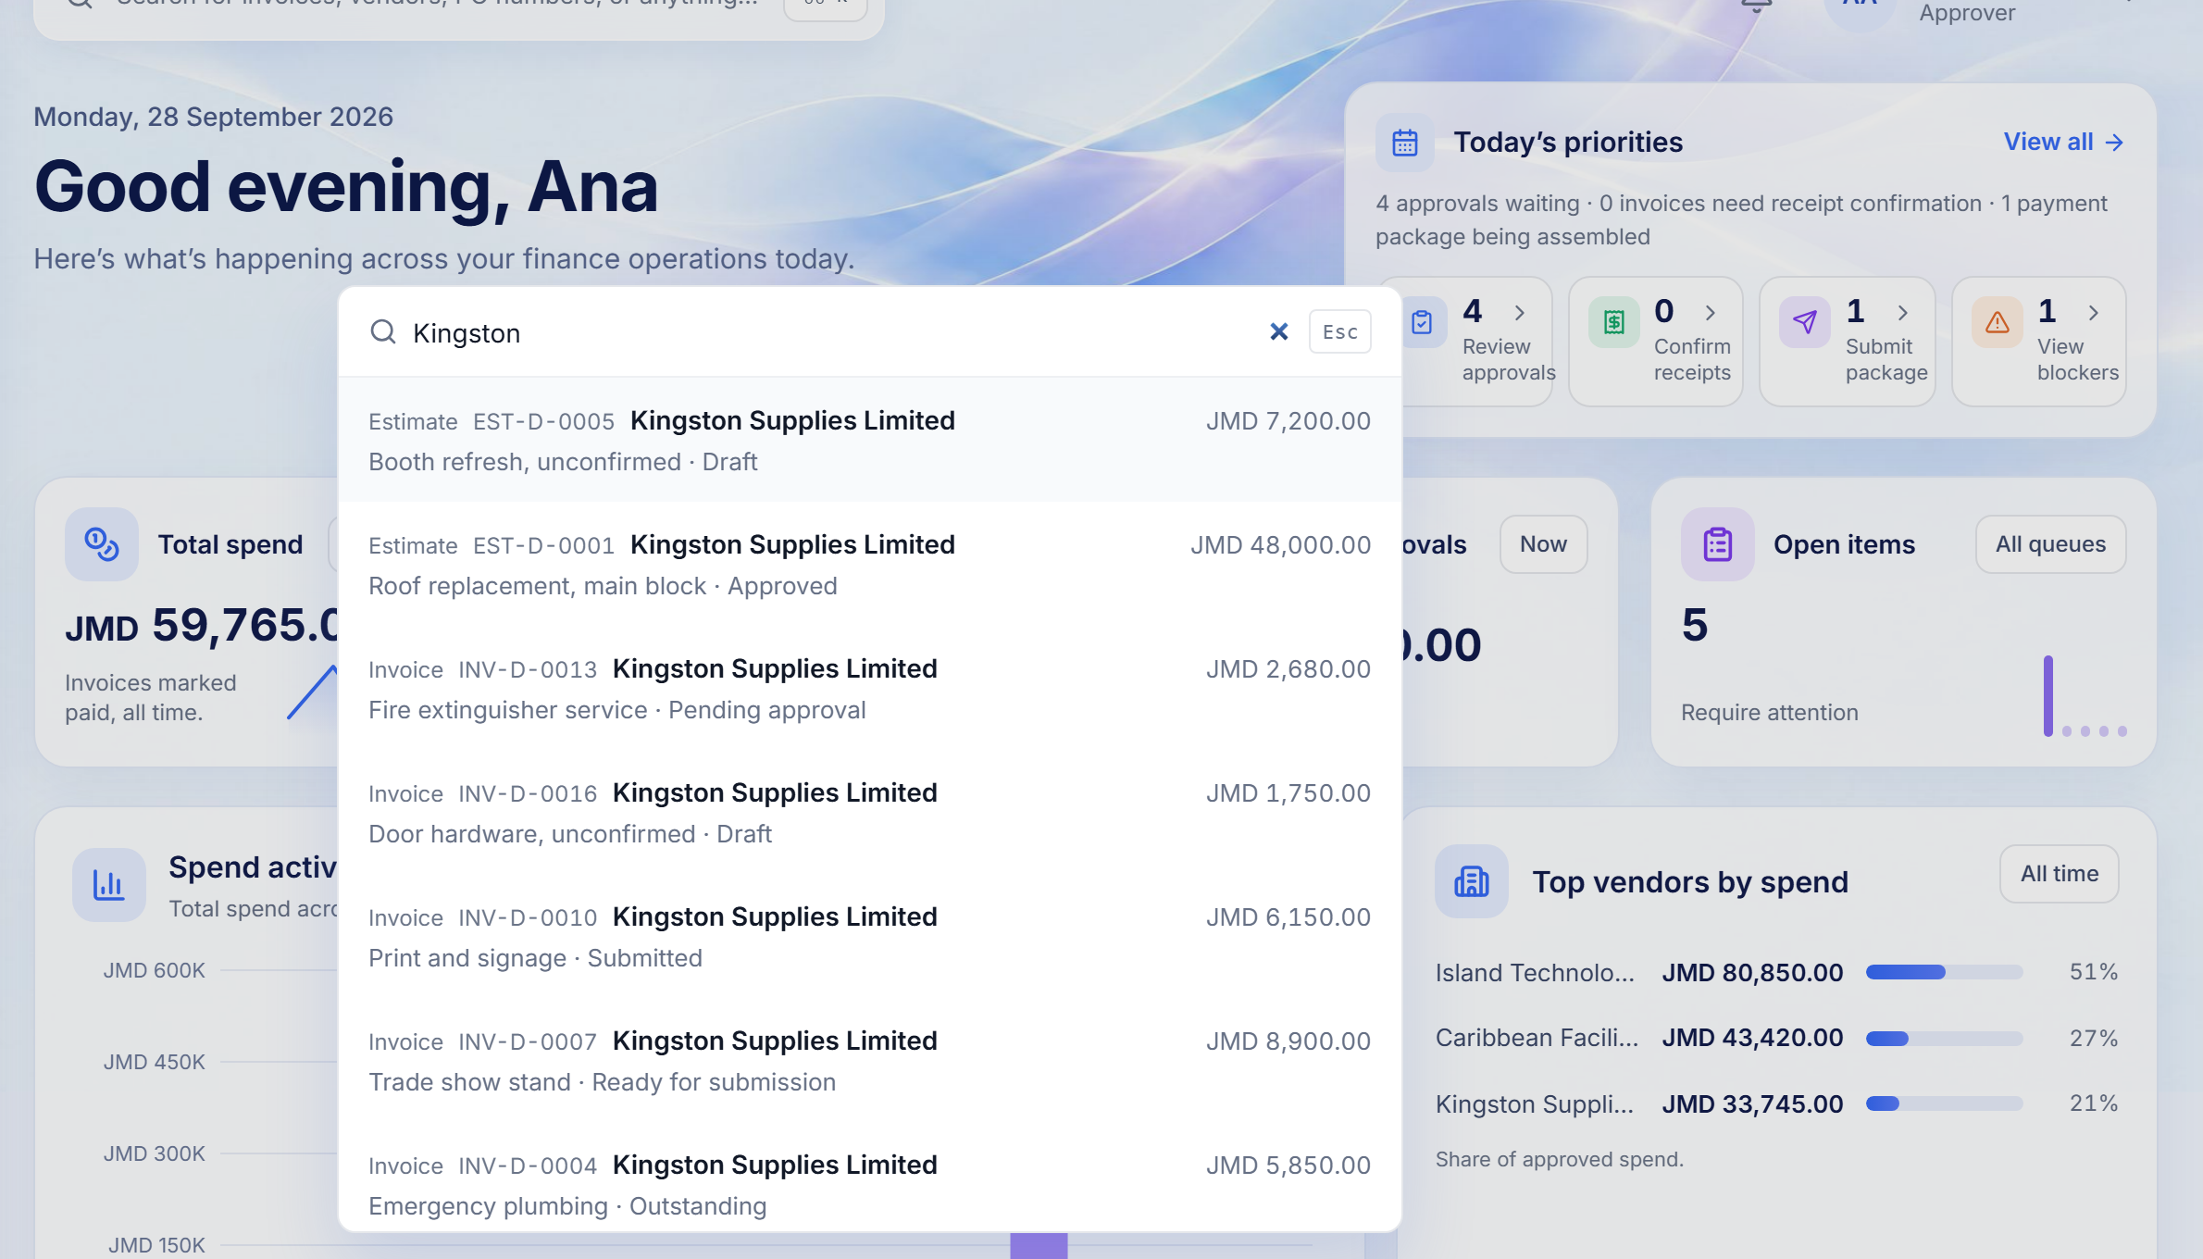
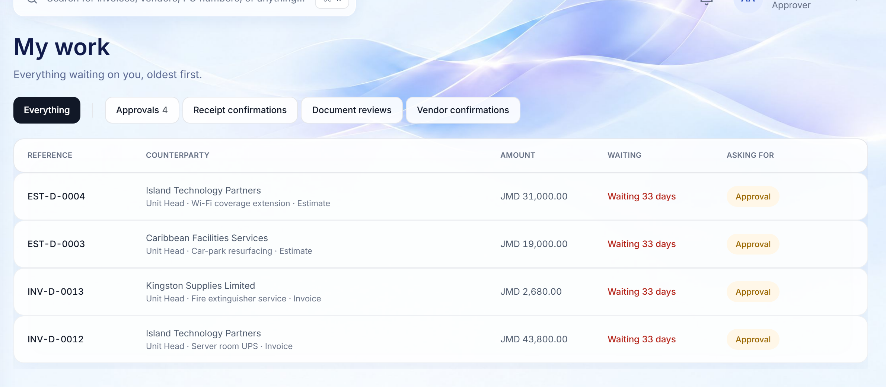
MY WORK AND SEARCH
One queue for each person, and a search that finds anything
Nothing hides in a register someone visits less often.
MY WORK · APPROVER
GLOBAL SEARCH · CTRL/⌘ + K
3
2
1
1
Oldest first, always
2
Named saved views
3
Federated search
WHY IT MATTERS
Approvals, receipt confirmations, document reviews and supplier answers in one list that cannot be re-sorted to bury awkward items.
Filters subtract kinds of work and can be saved per person.
Estimates, invoices, POs, packages, documents and suppliers in one palette, with state and amount.
Faster turnaround comes from making waiting work impossible to miss, for the person who has to act on it.
Finora Flow · Client walkthrough · Everyday experience
10
Notes:
One queue for each person, and a search that finds anything
Nothing hides in a register someone visits less often.
Walk through:
1. Oldest first, always: Approvals, receipt confirmations, document reviews and supplier answers in one list that cannot be re-sorted to bury awkward items.
2. Named saved views: Filters subtract kinds of work and can be saved per person.
3. Federated search: Estimates, invoices, POs, packages, documents and suppliers in one palette, with state and amount.
Why it matters: Faster turnaround comes from making waiting work impossible to miss, for the person who has to act on it.

Slide 11
04
Intake to record
Supplier email and uploads become checked, evidenced data, safely.
Inbox · Malware scanning · Immutable originals · Document review
Finora Flow · Client walkthrough · Intake to record
11

Slide 12
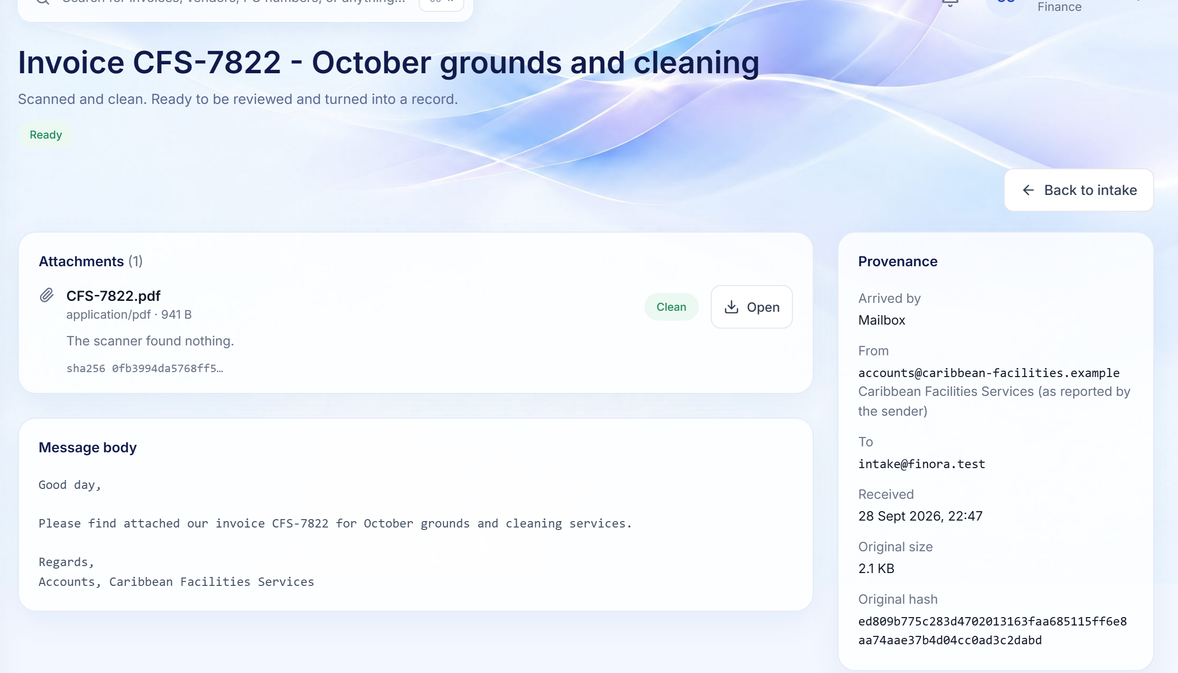
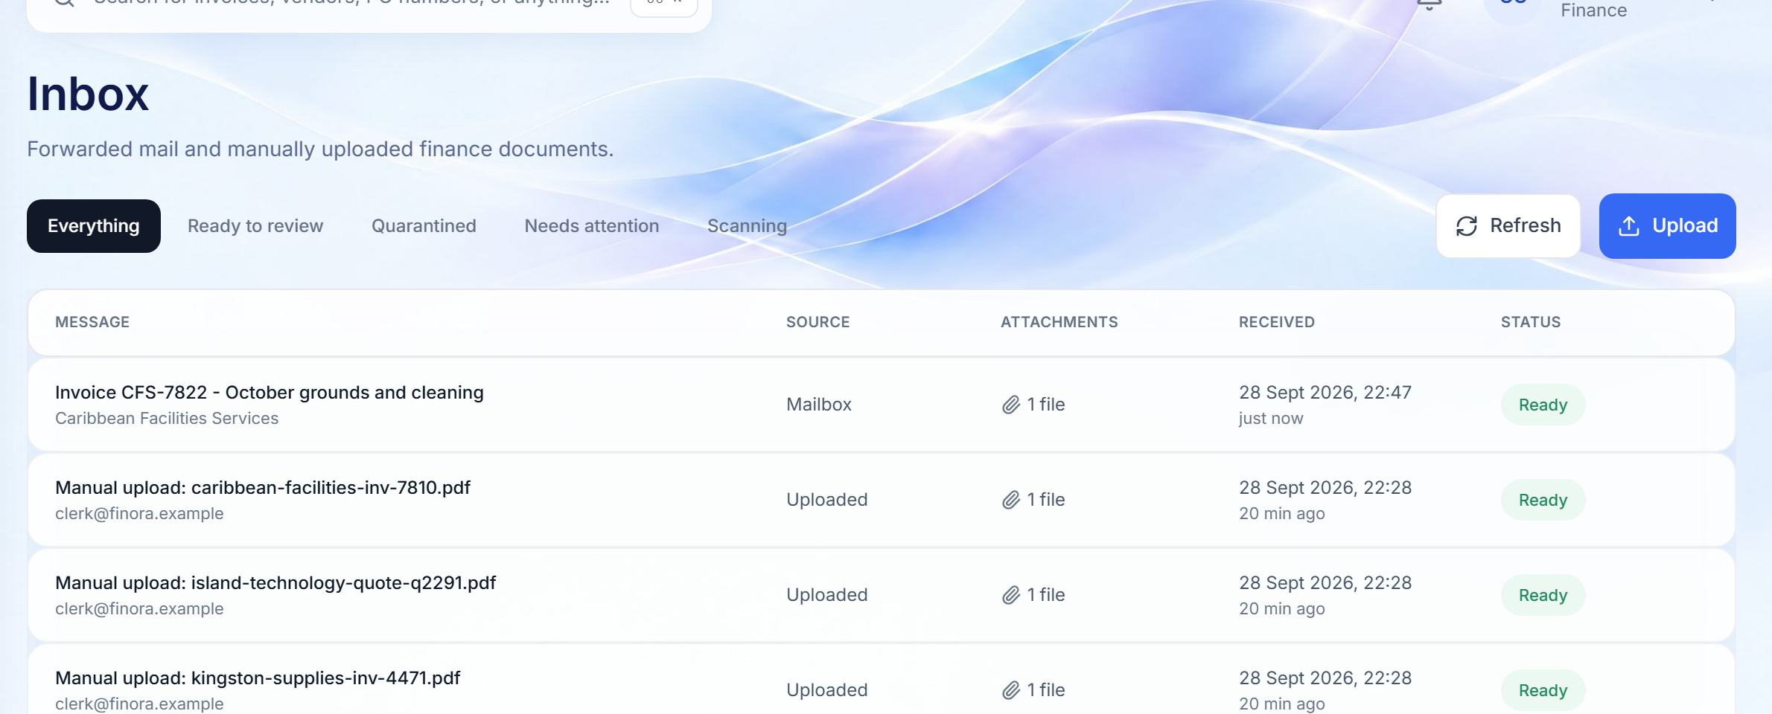
SECURE INTAKE
Supplier email and uploads, scanned and stored as evidence
The platform reads a mailbox you control over IMAPS. Manual uploads follow exactly the same path.
INBOX
AN EMAILED SUPPLIER INVOICE
1
2
3
1
Every arrival accounted for
2
Scanned before anyone opens it
3
Provenance and fingerprints
WHY IT MATTERS
Mailbox and uploads side by side; filter by ready, quarantined, needs attention or scanning.
Each attachment is malware-scanned; anything suspicious is quarantined and never previewed.
Sender, recipient, sizes and a SHA-256 hash of the original, recorded and immutable.
Untrusted documents are handled as untrusted data, and you can always prove what arrived, when, and from whom.
Finora Flow · Client walkthrough · Intake to record
12
Notes:
Supplier email and uploads, scanned and stored as evidence
The platform reads a mailbox you control over IMAPS. Manual uploads follow exactly the same path.
Walk through:
1. Every arrival accounted for: Mailbox and uploads side by side; filter by ready, quarantined, needs attention or scanning.
2. Scanned before anyone opens it: Each attachment is malware-scanned; anything suspicious is quarantined and never previewed.
3. Provenance and fingerprints: Sender, recipient, sizes and a SHA-256 hash of the original, recorded and immutable.
Why it matters: Untrusted documents are handled as untrusted data, and you can always prove what arrived, when, and from whom.

Slide 13
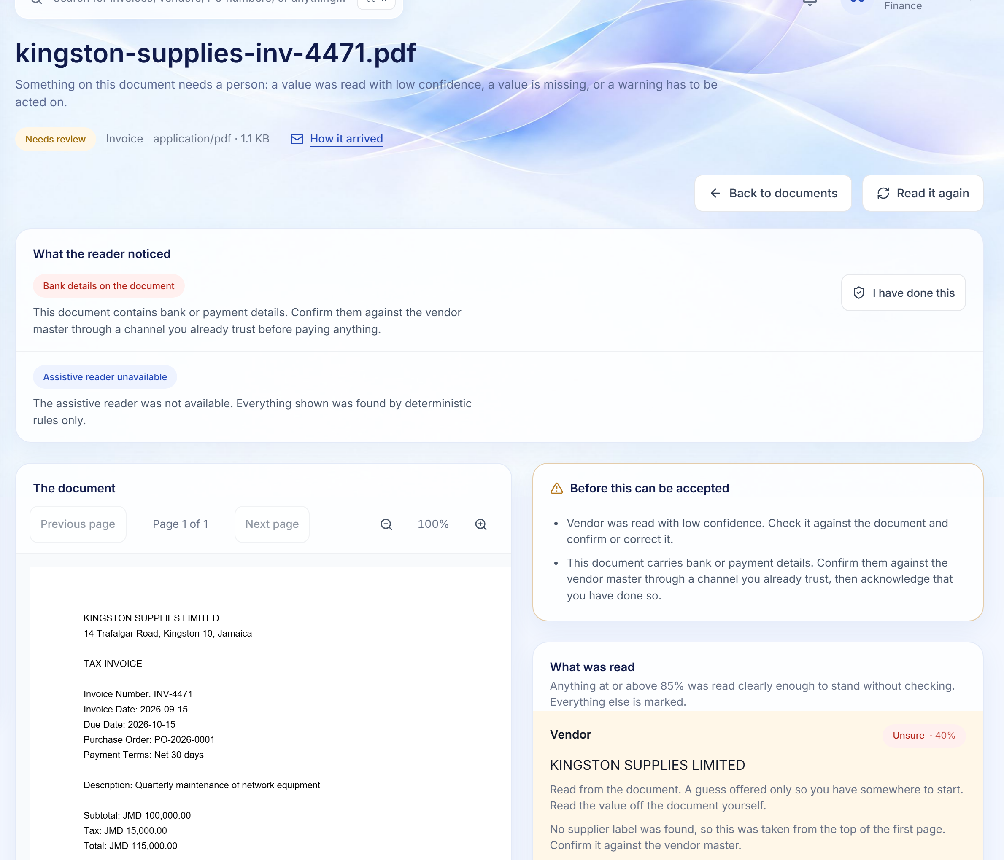
DOCUMENT REVIEW
Values read from the document, checked by a person
Every value carries its evidence, a confidence level and a one-click way to confirm or correct it.
1
Warnings that need a human
Bank details on a document and other risk signals are flagged and must be acknowledged by a person.
1
2
The original, side by side
A safe in-browser preview with scripting disabled, served by short-lived signed links.
3
Blockers before acceptance
Everything that stops the reading being accepted, listed in plain language.
2
3
4
Confidence and evidence per field
Show on the document, mark as correct, or change it with a reason.
4
WHY IT MATTERS
Automation removes re-keying, but a named person still accepts the reading, so nothing a model proposes reaches the ledger unchecked.
Finora Flow · Client walkthrough · Intake to record
13
Notes:
Values read from the document, checked by a person
Every value carries its evidence, a confidence level and a one-click way to confirm or correct it.
Walk through:
1. Warnings that need a human: Bank details on a document and other risk signals are flagged and must be acknowledged by a person.
2. The original, side by side: A safe in-browser preview with scripting disabled, served by short-lived signed links.
3. Blockers before acceptance: Everything that stops the reading being accepted, listed in plain language.
4. Confidence and evidence per field: Show on the document, mark as correct, or change it with a reason.
Why it matters: Automation removes re-keying, but a named person still accepts the reading, so nothing a model proposes reaches the ledger unchecked.

Slide 14
05
Approve spend
Requests are routed by amount to the right people, and nobody approves their own.
Estimates · Approval queue · Decisions · Purchase orders
Finora Flow · Client walkthrough · Approve spend
14

Slide 15
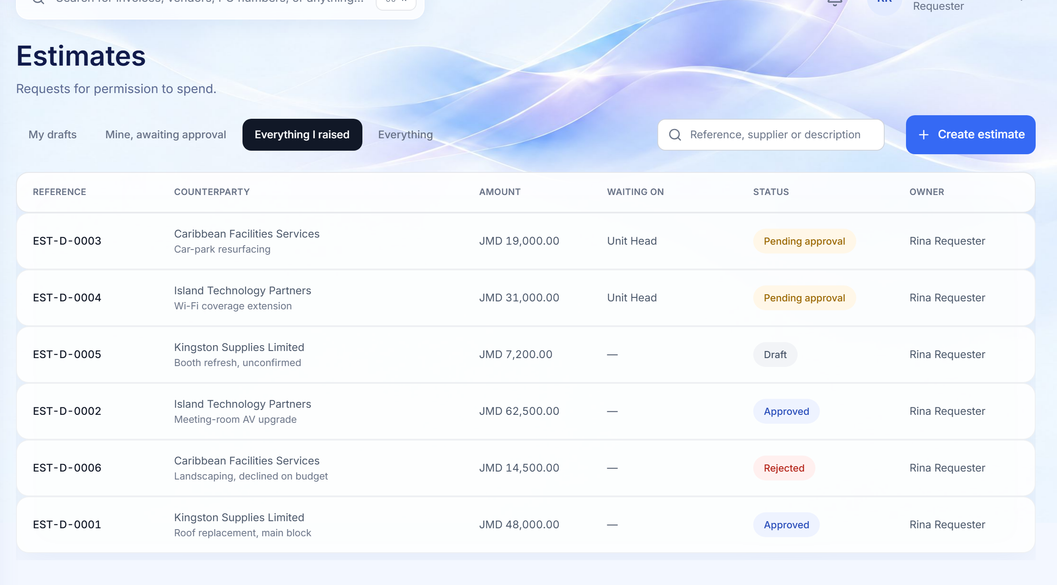
ESTIMATES
Permission to spend, requested before the money is committed
A requester raises an estimate blank or from an accepted document and sees its route before sending it.
1
Views built around the job
My drafts, mine awaiting approval, everything I raised.
1
4
2
Who it is waiting on
2
3
The live approval step for every request that is still moving.
3
Clear status
Draft, pending approval, approved, rejected, always as a labelled pill.
4
Raise in one click
Start blank, or from a quotation already read and accepted in Documents.
WHY IT MATTERS
Requesters stop chasing approvers by email, because the request itself says where it is and what it is waiting on.
Finora Flow · Client walkthrough · Approve spend
15
Notes:
Permission to spend, requested before the money is committed
A requester raises an estimate blank or from an accepted document and sees its route before sending it.
Walk through:
1. Views built around the job: My drafts, mine awaiting approval, everything I raised.
2. Who it is waiting on: The live approval step for every request that is still moving.
3. Clear status: Draft, pending approval, approved, rejected, always as a labelled pill.
4. Raise in one click: Start blank, or from a quotation already read and accepted in Documents.
Why it matters: Requesters stop chasing approvers by email, because the request itself says where it is and what it is waiting on.

Slide 16
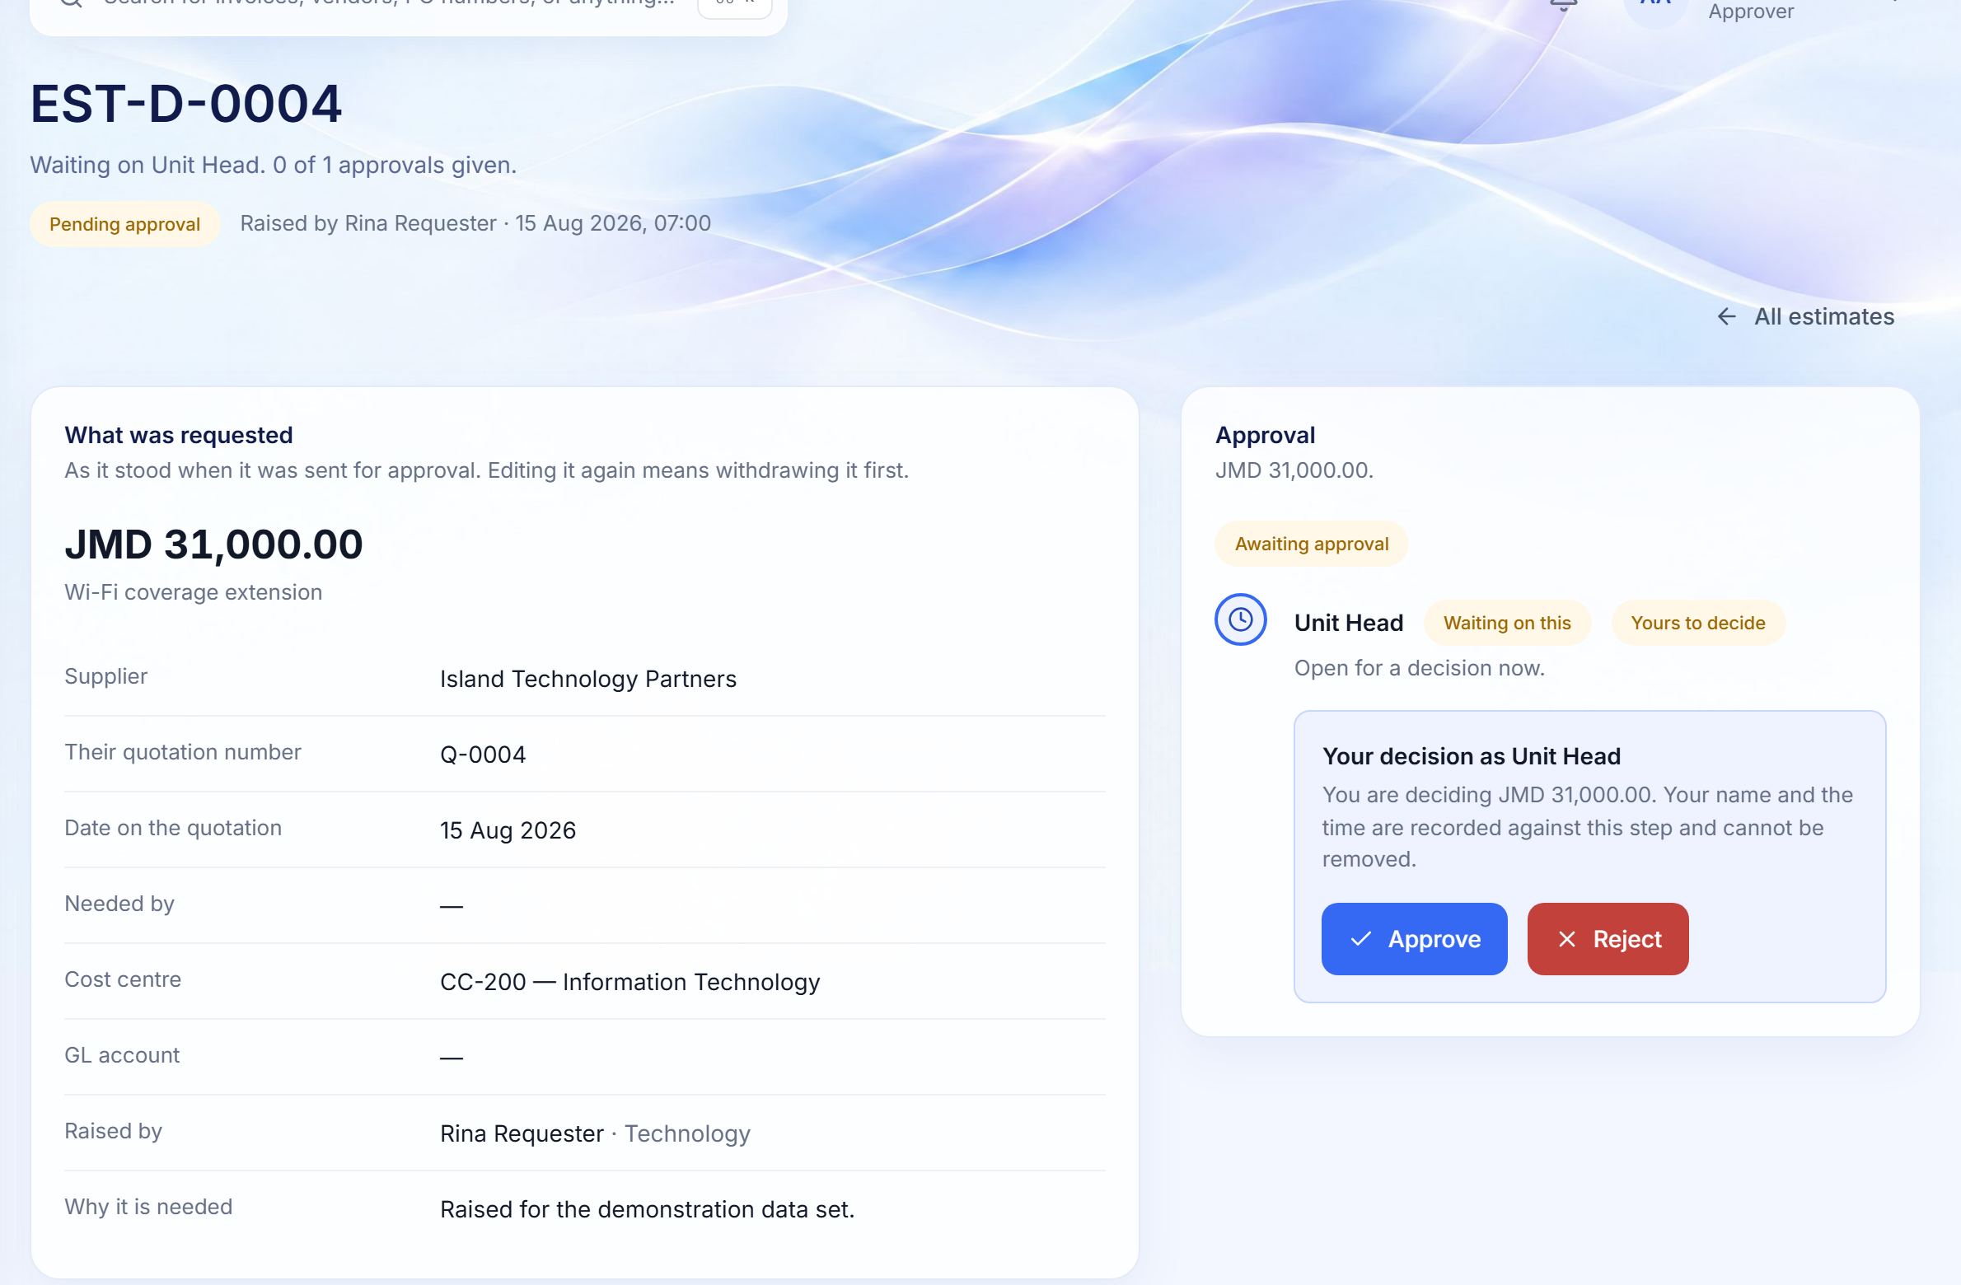
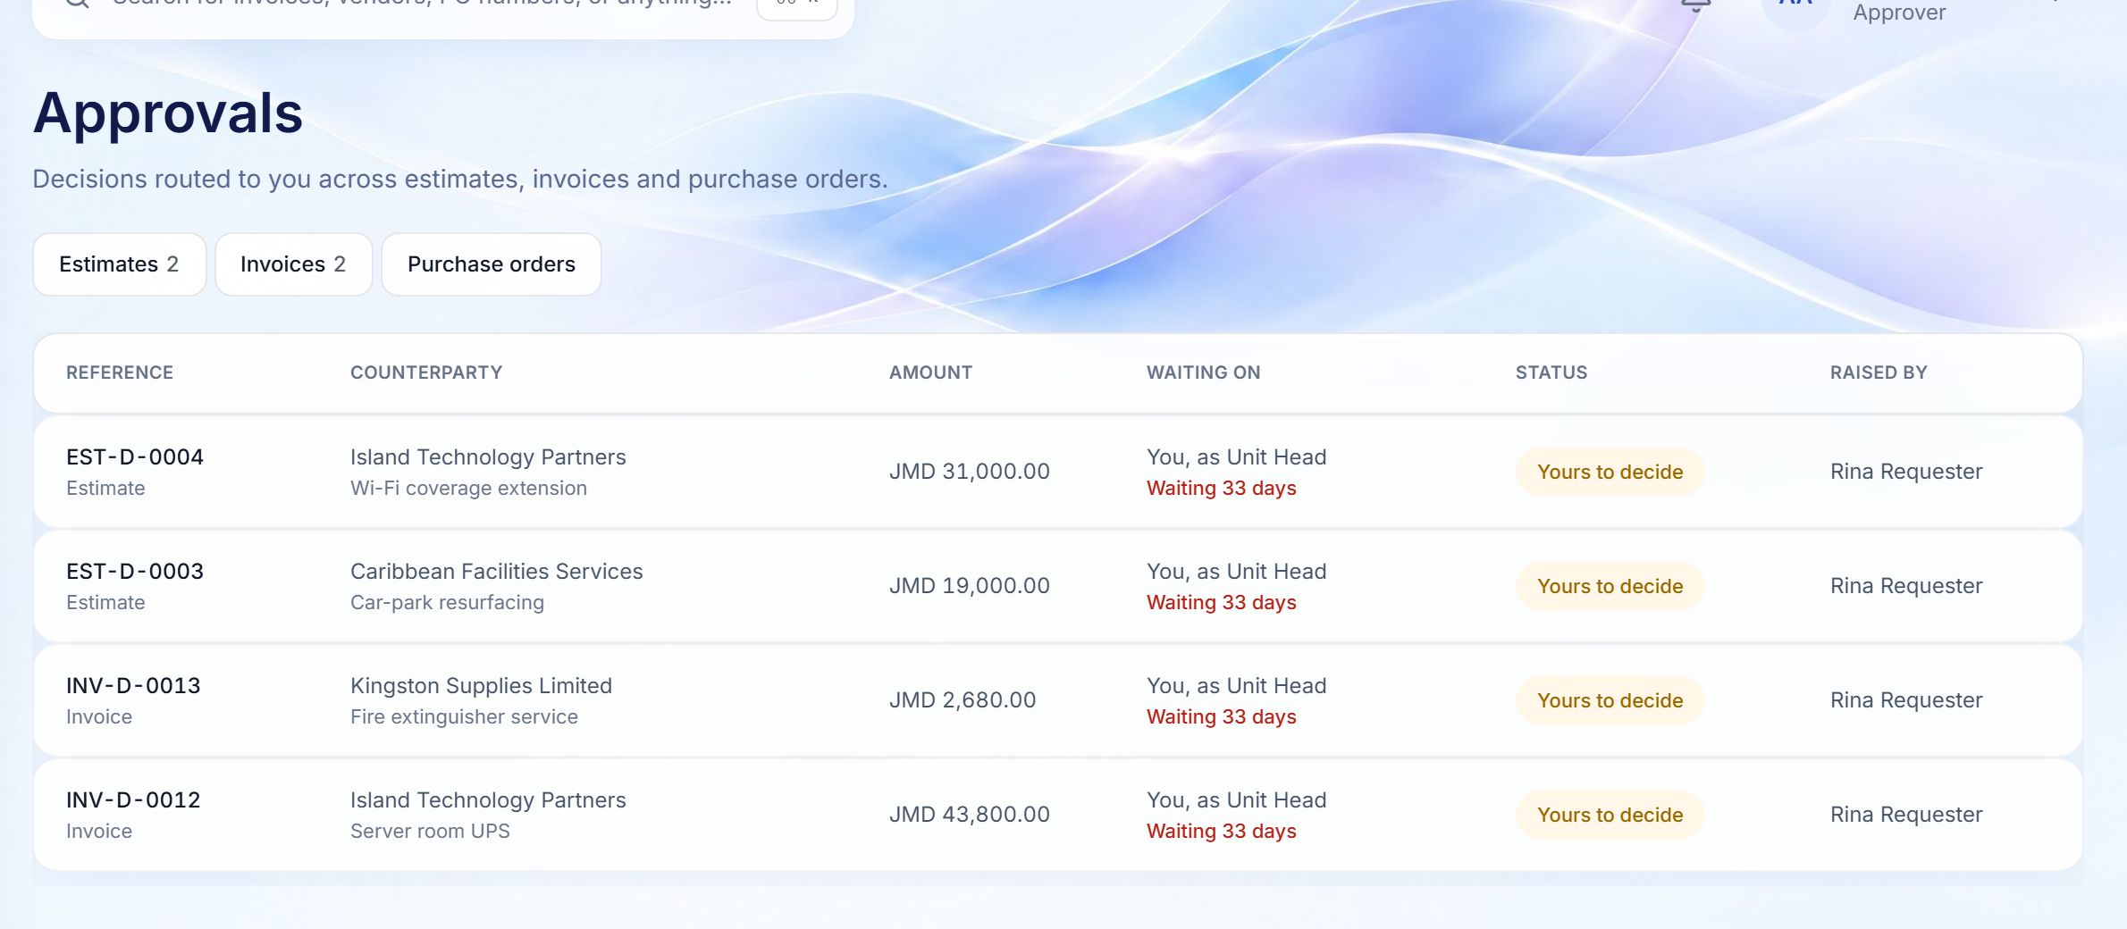
APPROVALS
A single queue for approvers, and a decision with context
Estimates, invoices and purchase orders routed to this approver, oldest first.
APPROVAL QUEUE
DECIDING AN ESTIMATE
2
1
3
1
Only what is theirs now
2
The route, visible
3
A recorded decision
WHY IT MATTERS
A step whose turn has not come is not offered, so the queue is always actionable.
Each level in order, who is waiting, and whose turn it is.
Approve or reject; a rejection needs a reason. Name and time are fixed to the step.
Approvers act faster and with less risk: the right person, at the right level, with the record in front of them.
Finora Flow · Client walkthrough · Approve spend
16
Notes:
A single queue for approvers, and a decision with context
Estimates, invoices and purchase orders routed to this approver, oldest first.
Walk through:
1. Only what is theirs now: A step whose turn has not come is not offered, so the queue is always actionable.
2. The route, visible: Each level in order, who is waiting, and whose turn it is.
3. A recorded decision: Approve or reject; a rejection needs a reason. Name and time are fixed to the step.
Why it matters: Approvers act faster and with less risk: the right person, at the right level, with the record in front of them.

Slide 17
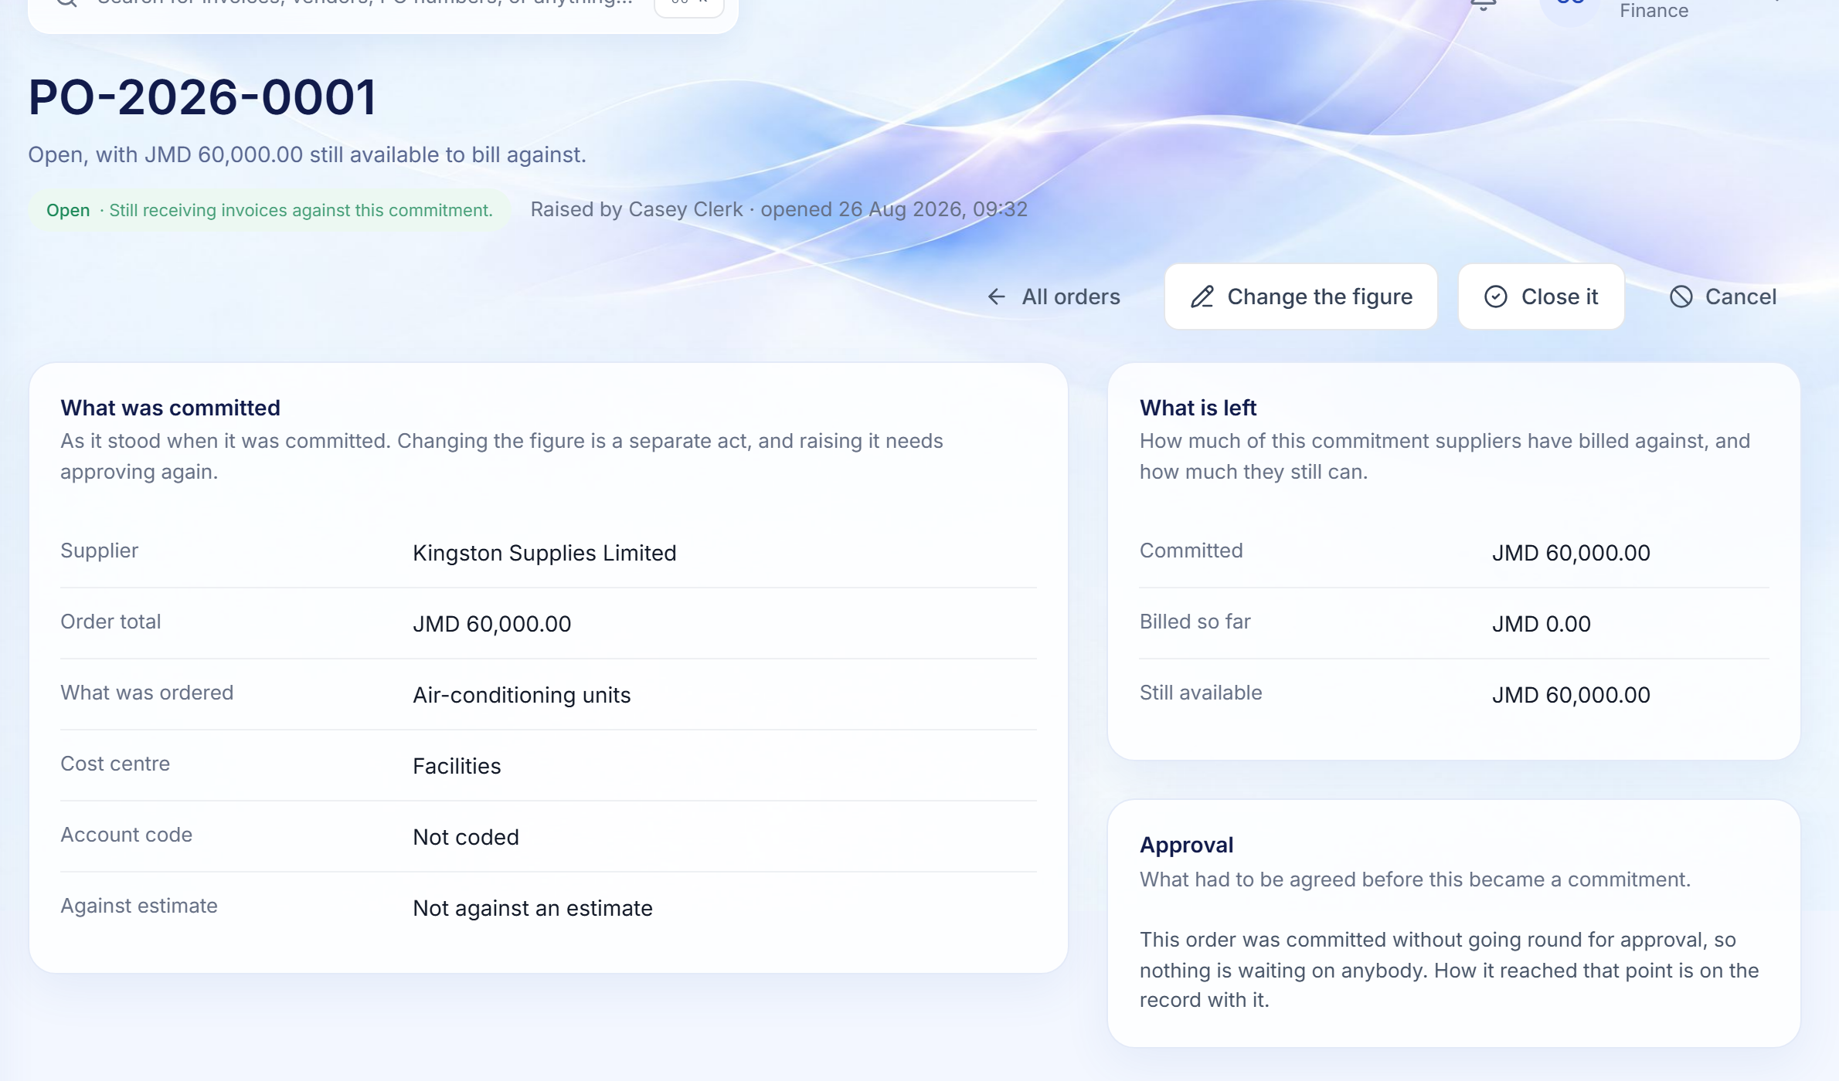
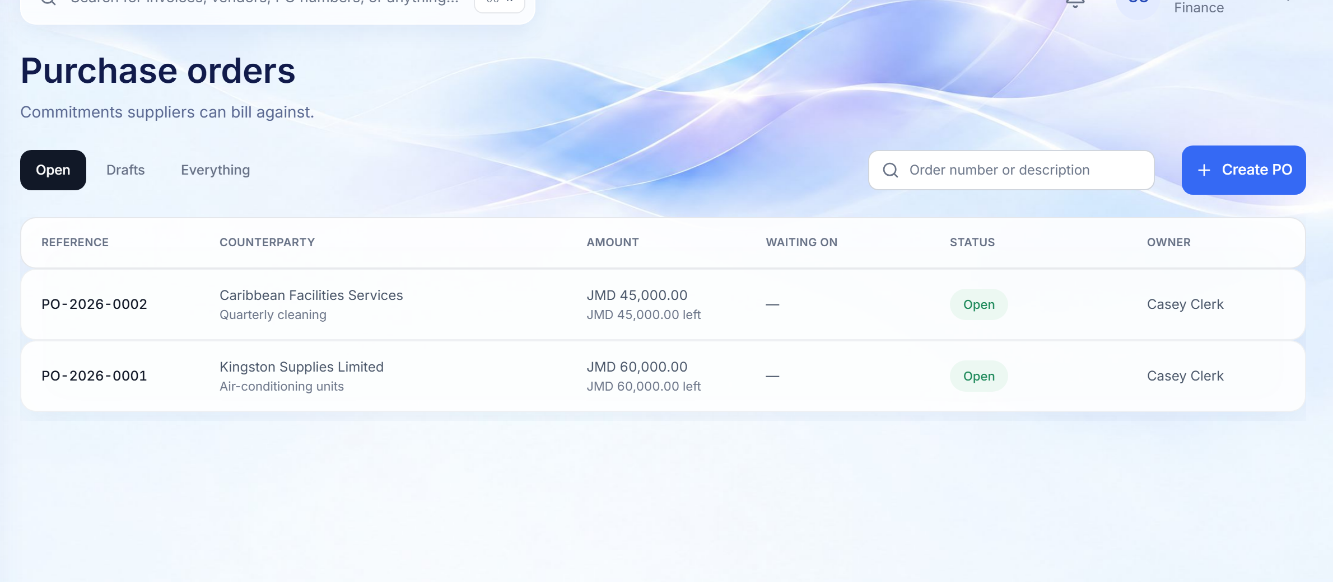
PURCHASE ORDERS
Commitments suppliers can bill against, with live capacity
Orders are required above a configurable threshold (initially JMD 50,000) and approved through the same matrix.
PURCHASE ORDER REGISTER
AN OPEN PURCHASE ORDER
3
2
1
A register of commitments
2
What is left, derived
3
Overruns refused
WHY IT MATTERS
Open, awaiting approval and closed orders, with what remains to bill on each.
Committed, billed so far and still available, calculated from the invoices linked to it.
An invoice that would exceed the order is stopped, with the shortfall named.
Committed spend is controlled before the invoice arrives, not discovered after it is paid.
Finora Flow · Client walkthrough · Approve spend
17
Notes:
Commitments suppliers can bill against, with live capacity
Orders are required above a configurable threshold (initially JMD 50,000) and approved through the same matrix.
Walk through:
1. A register of commitments: Open, awaiting approval and closed orders, with what remains to bill on each.
2. What is left, derived: Committed, billed so far and still available, calculated from the invoices linked to it.
3. Overruns refused: An invoice that would exceed the order is stopped, with the shortfall named.
Why it matters: Committed spend is controlled before the invoice arrives, not discovered after it is paid.

Slide 18
06
Invoice to payment
Validate, confirm receipt, approve, pay, and ask the supplier.
Invoices · Receipt sign-off · Payment packages · Vendor confirmation
Finora Flow · Client walkthrough · Invoice to payment
18

Slide 19
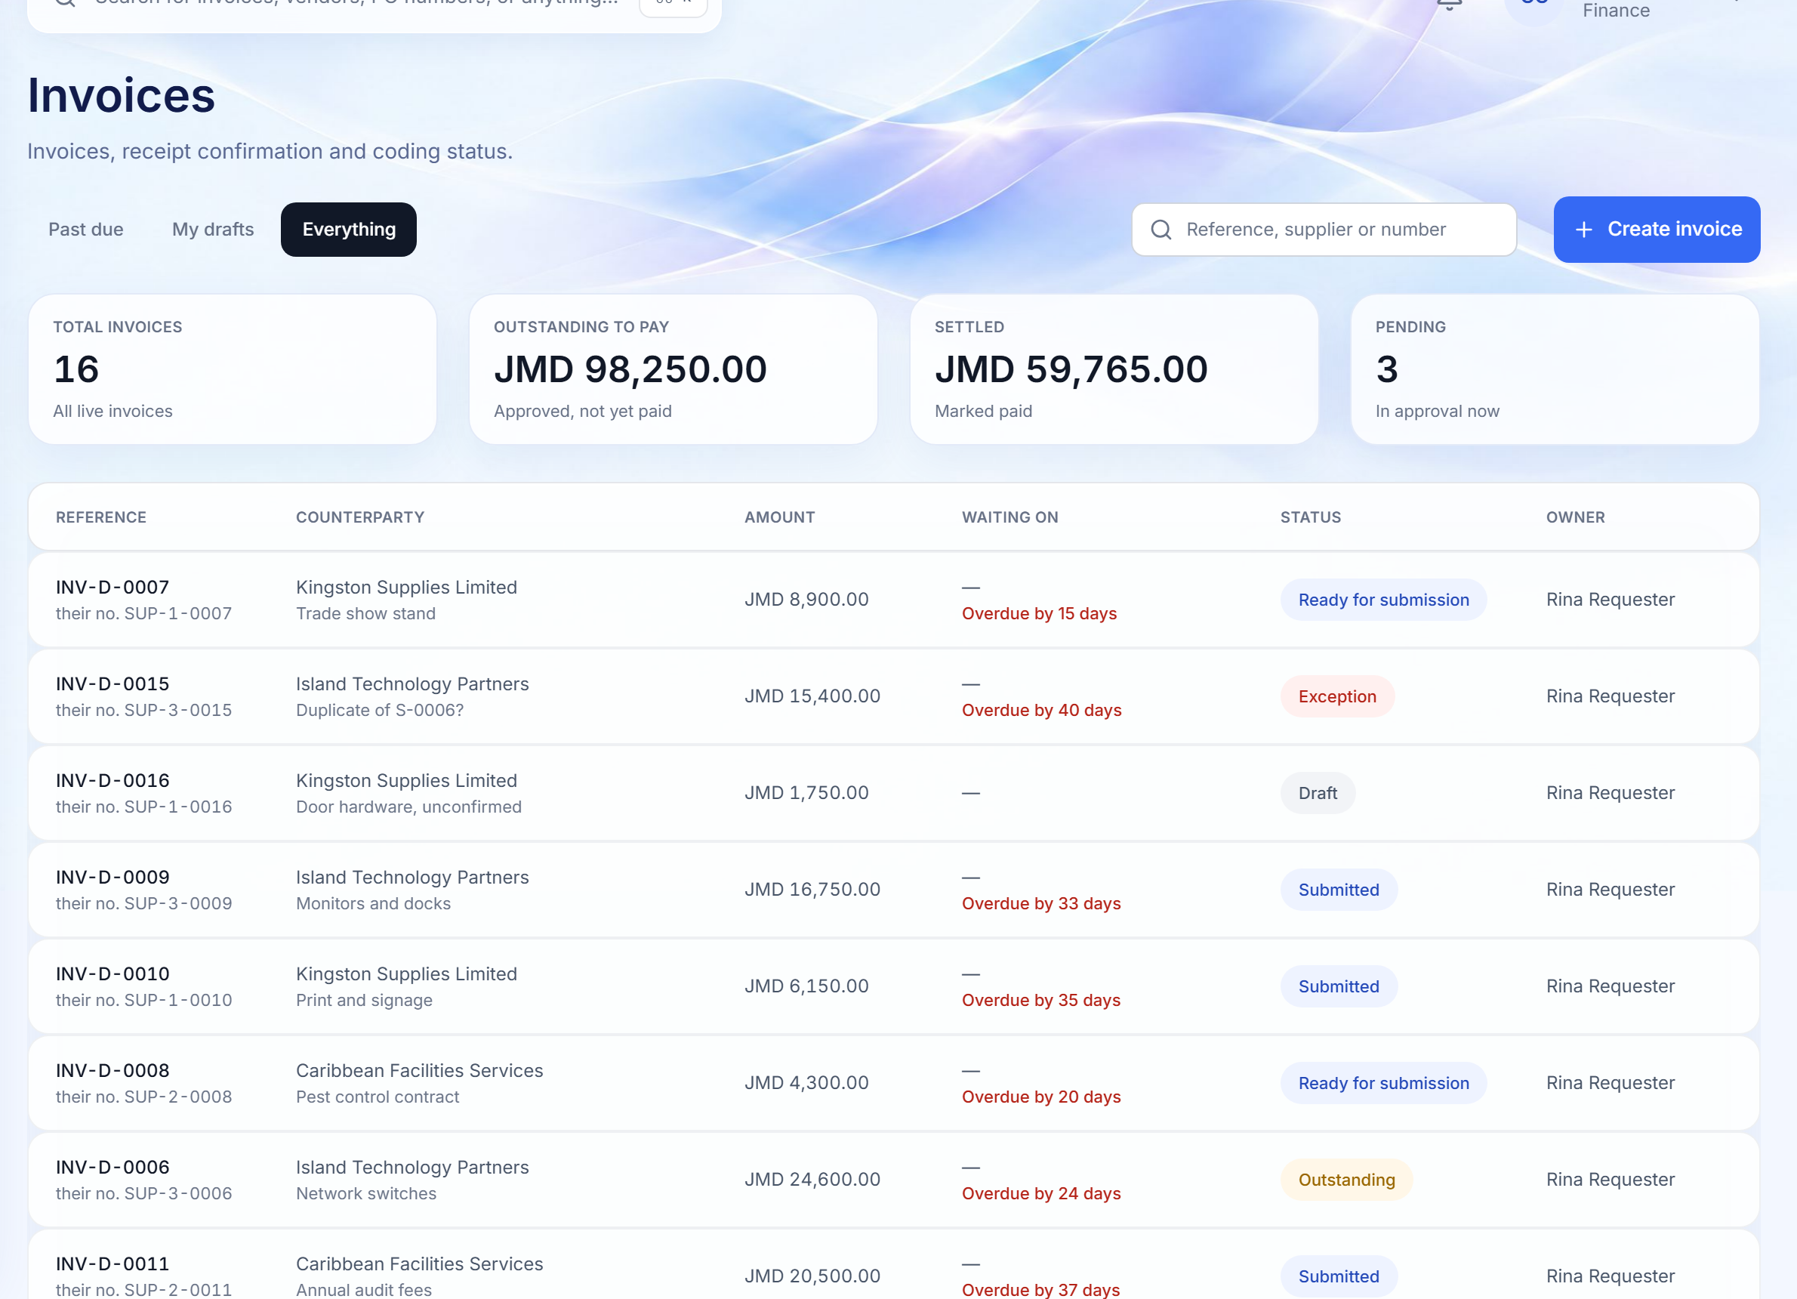
INVOICE REGISTER
Every supplier bill, what it is billed against, and who acts next
Headline figures are counted across the whole register, not just the page on screen.
1
Register-wide figures
Total invoices, outstanding to pay, settled and pending, from one aggregate.
1
2
Waiting on, and overdue
The person or step it is waiting on, with overdue and incomplete items flagged.
2
3
3
Status and owner
Workflow state and the requester accountable for confirming receipt.
WHY IT MATTERS
Accounts payable sees at a glance what is stuck, what is late and who can unblock it.
Finora Flow · Client walkthrough · Invoice to payment
19
Notes:
Every supplier bill, what it is billed against, and who acts next
Headline figures are counted across the whole register, not just the page on screen.
Walk through:
1. Register-wide figures: Total invoices, outstanding to pay, settled and pending, from one aggregate.
2. Waiting on, and overdue: The person or step it is waiting on, with overdue and incomplete items flagged.
3. Status and owner: Workflow state and the requester accountable for confirming receipt.
Why it matters: Accounts payable sees at a glance what is stuck, what is late and who can unblock it.

Slide 20
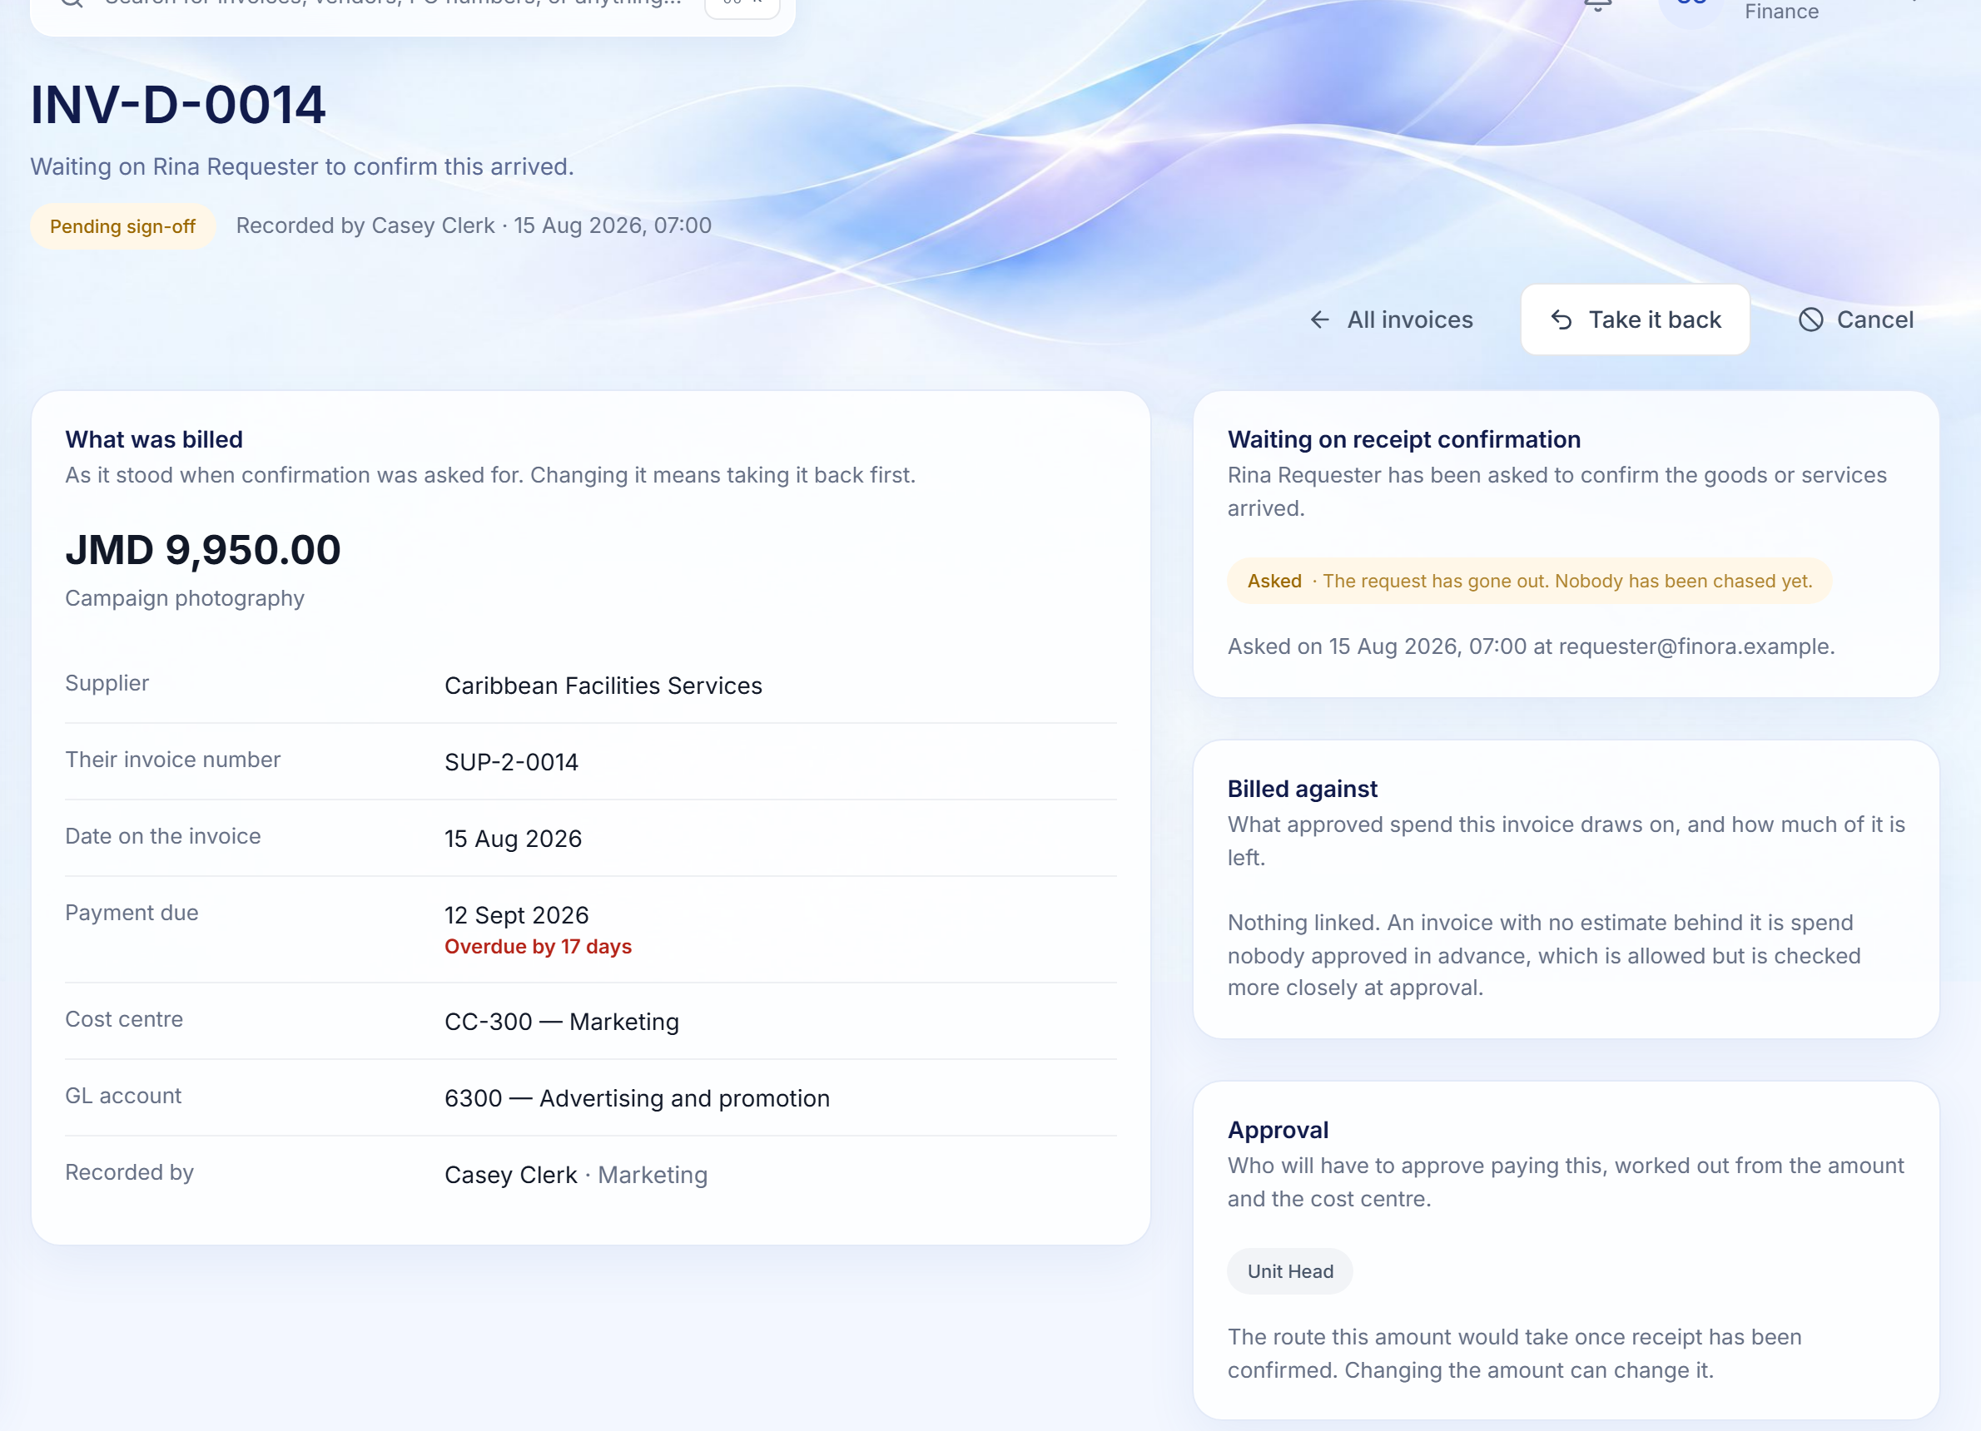
INVOICE CONTROL
Nothing is paid until someone outside finance confirms it arrived
The invoice itself lists every reason it cannot move yet, and the server enforces the same list.
1
Receipt confirmation
A named requester is asked to confirm the goods or services, and reminded every three working hours.
1
2
Billed against
Linked estimate or purchase order, with any overrun measured against a configurable tolerance.
3
Approval route
2
Worked out from the amount and cost centre, shown before it starts.
4
4
Due-date pressure
Overdue invoices are called out where they are listed and where they are opened.
3
WHY IT MATTERS
Duplicate invoice numbers from the same supplier are refused by the database itself, so the most expensive mistake in accounts payable cannot happen by accident.
Finora Flow · Client walkthrough · Invoice to payment
20
Notes:
Nothing is paid until someone outside finance confirms it arrived
The invoice itself lists every reason it cannot move yet, and the server enforces the same list.
Walk through:
1. Receipt confirmation: A named requester is asked to confirm the goods or services, and reminded every three working hours.
2. Billed against: Linked estimate or purchase order, with any overrun measured against a configurable tolerance.
3. Approval route: Worked out from the amount and cost centre, shown before it starts.
4. Due-date pressure: Overdue invoices are called out where they are listed and where they are opened.
Why it matters: Duplicate invoice numbers from the same supplier are refused by the database itself, so the most expensive mistake in accounts payable cannot happen by accident.

Slide 21
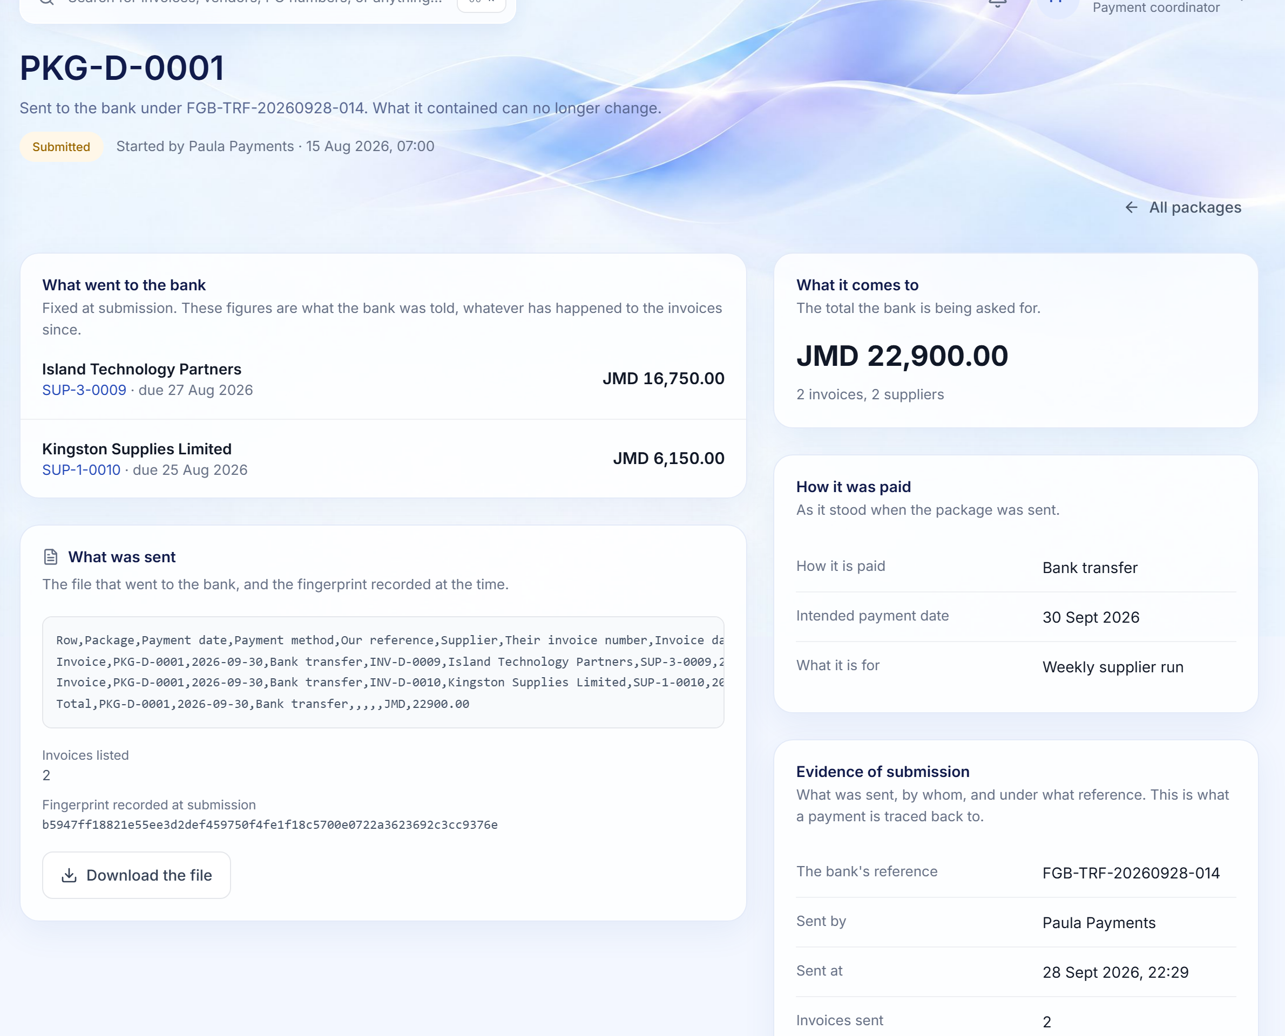
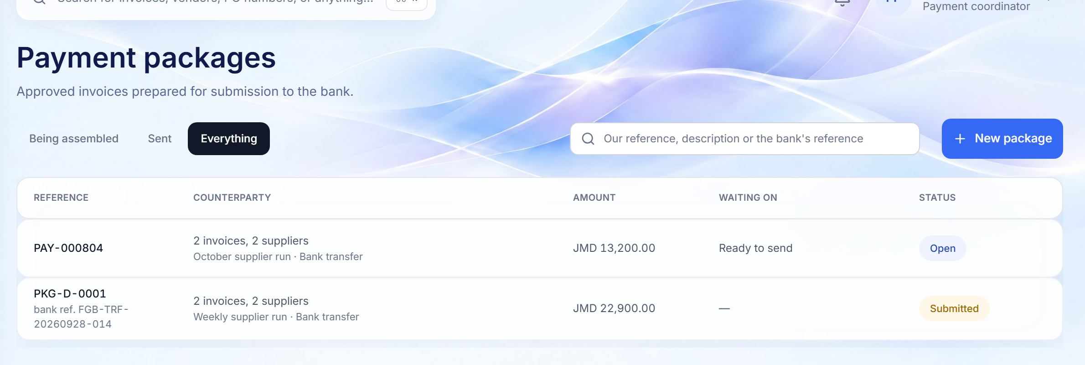
PAYMENT PACKAGES
Approved invoices gathered, sent once, and fingerprinted
Assembling, submitting and marking paid are separate permissions held by different people.
PAYMENT PACKAGE REGISTER
A SUBMITTED PACKAGE
1
2
3
1
Being assembled, or sent
2
The file the bank received
3
Evidence of submission
WHY IT MATTERS
Open packages lead; totals are kept per currency and never added across currencies.
A deterministic manifest with a SHA-256 fingerprint recorded at submission.
Bank reference, who sent it and when: what a payment is traced back to.
The same invoice cannot enter two packages, and nobody can both send money and declare it received.
Finora Flow · Client walkthrough · Invoice to payment
21
Notes:
Approved invoices gathered, sent once, and fingerprinted
Assembling, submitting and marking paid are separate permissions held by different people.
Walk through:
1. Being assembled, or sent: Open packages lead; totals are kept per currency and never added across currencies.
2. The file the bank received: A deterministic manifest with a SHA-256 fingerprint recorded at submission.
3. Evidence of submission: Bank reference, who sent it and when: what a payment is traced back to.
Why it matters: The same invoice cannot enter two packages, and nobody can both send money and declare it received.

Slide 22
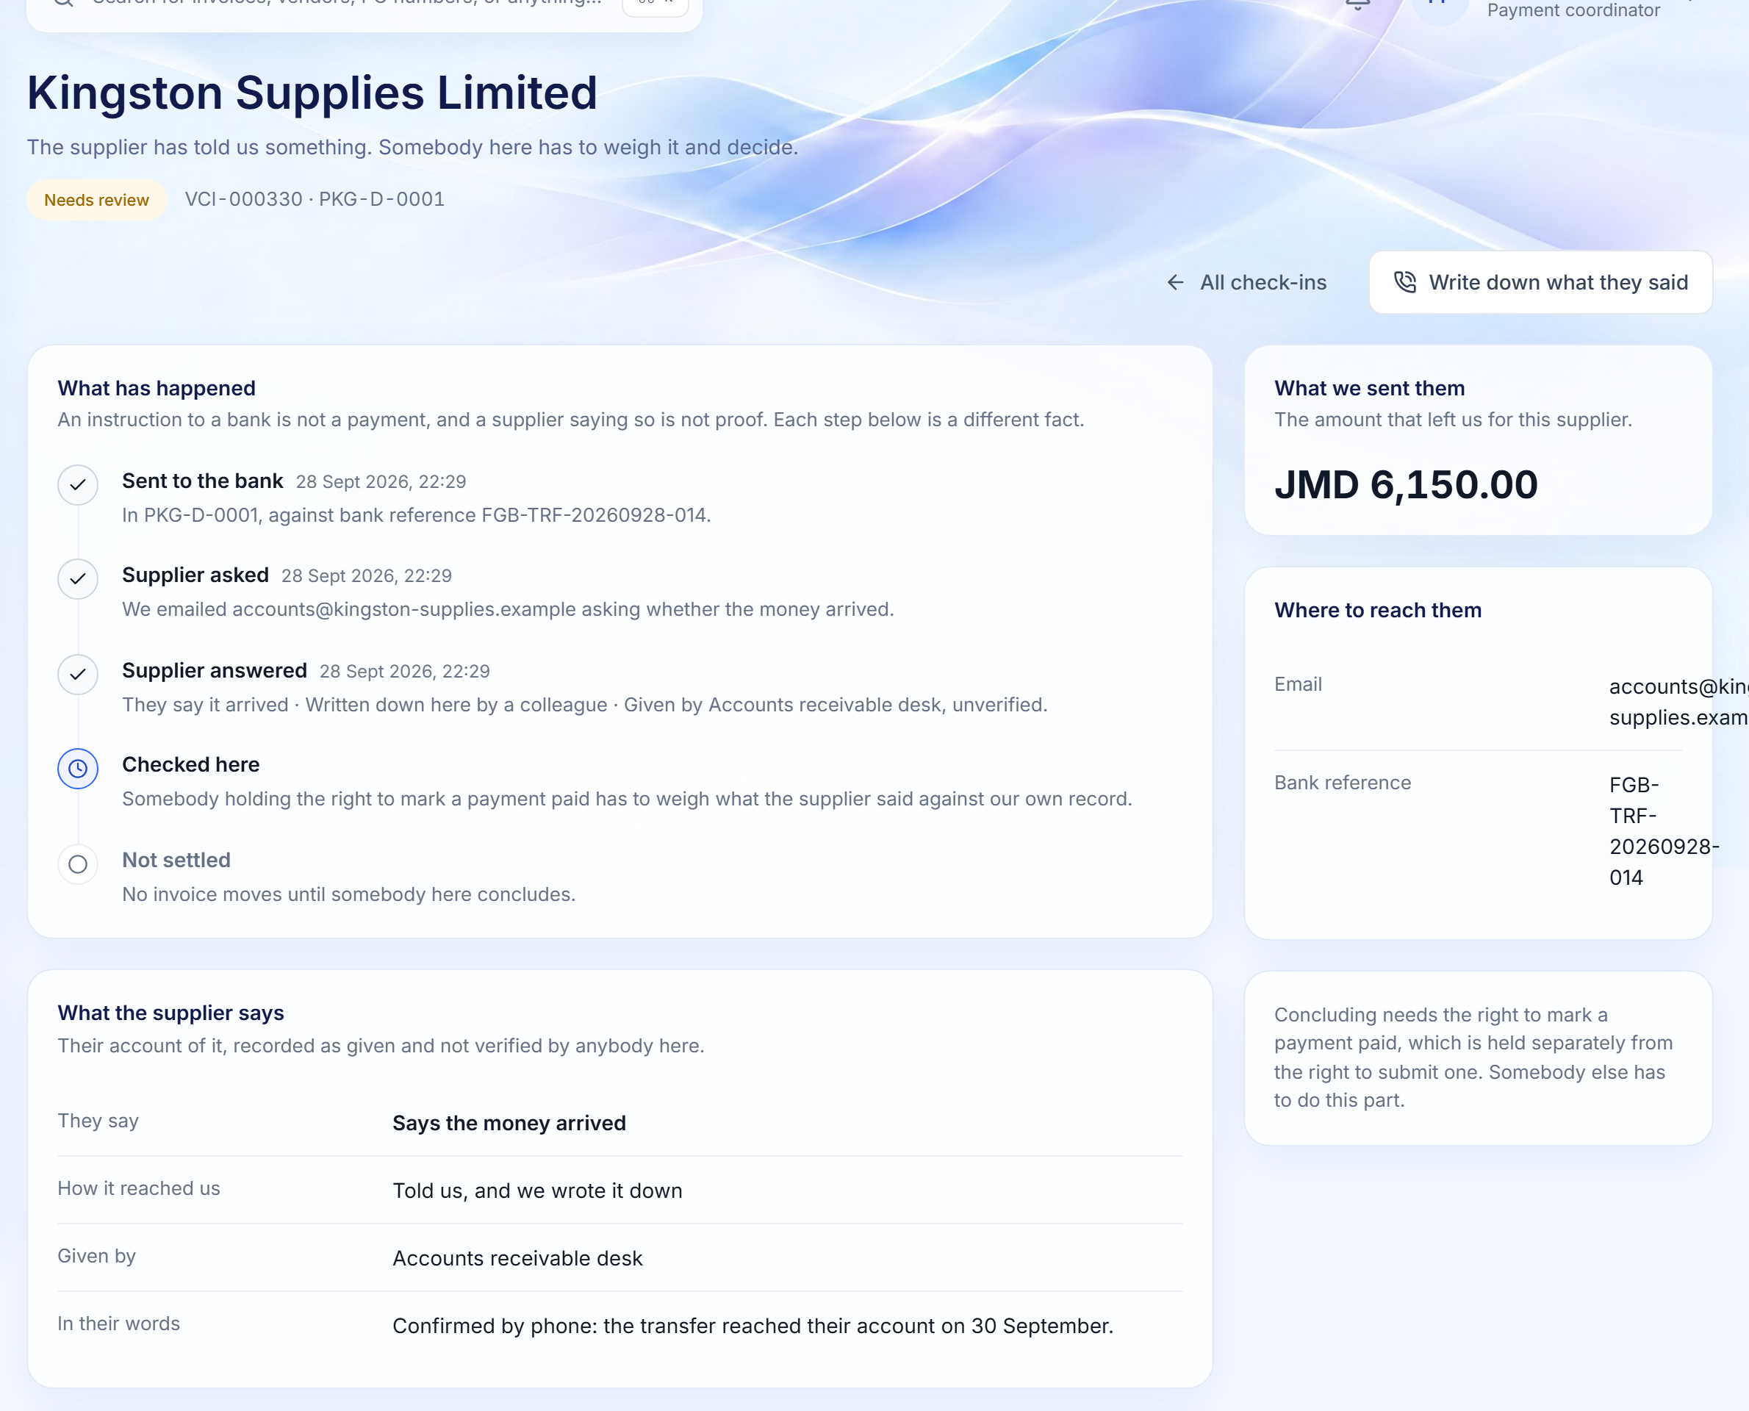
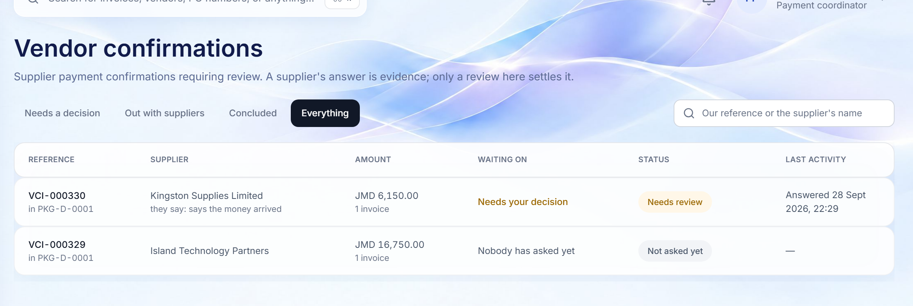
VENDOR CONFIRMATION
A supplier's answer is a claim; a person here concludes
After a package is sent, each supplier is asked whether the money arrived, by secure link or recorded by phone.
CONFIRMATION QUEUE
ONE SUPPLIER'S CHECK-IN
2
1
3
1
Whose turn is it?
2
Every step, a separate fact
3
Concluding is segregated
WHY IT MATTERS
Needs a decision, out with suppliers, or concluded, with the amount for each supplier.
Sent to bank, supplier asked, supplier answered, checked here, settled.
Only someone who holds 'mark paid', and did not submit the package, can conclude.
Paid means confirmed paid. A supplier saying so never turns an invoice green on its own.
Finora Flow · Client walkthrough · Invoice to payment
22
Notes:
A supplier's answer is a claim; a person here concludes
After a package is sent, each supplier is asked whether the money arrived, by secure link or recorded by phone.
Walk through:
1. Whose turn is it?: Needs a decision, out with suppliers, or concluded, with the amount for each supplier.
2. Every step, a separate fact: Sent to bank, supplier asked, supplier answered, checked here, settled.
3. Concluding is segregated: Only someone who holds 'mark paid', and did not submit the package, can conclude.
Why it matters: Paid means confirmed paid. A supplier saying so never turns an invoice green on its own.

Slide 23
07
Reconcile and close
Card statements coded and closed, accruals generated and locked, on time.
Credit-card periods · Coding and receipts · Month-end accruals · Exports
Finora Flow · Client walkthrough · Reconcile and close
23

Slide 24
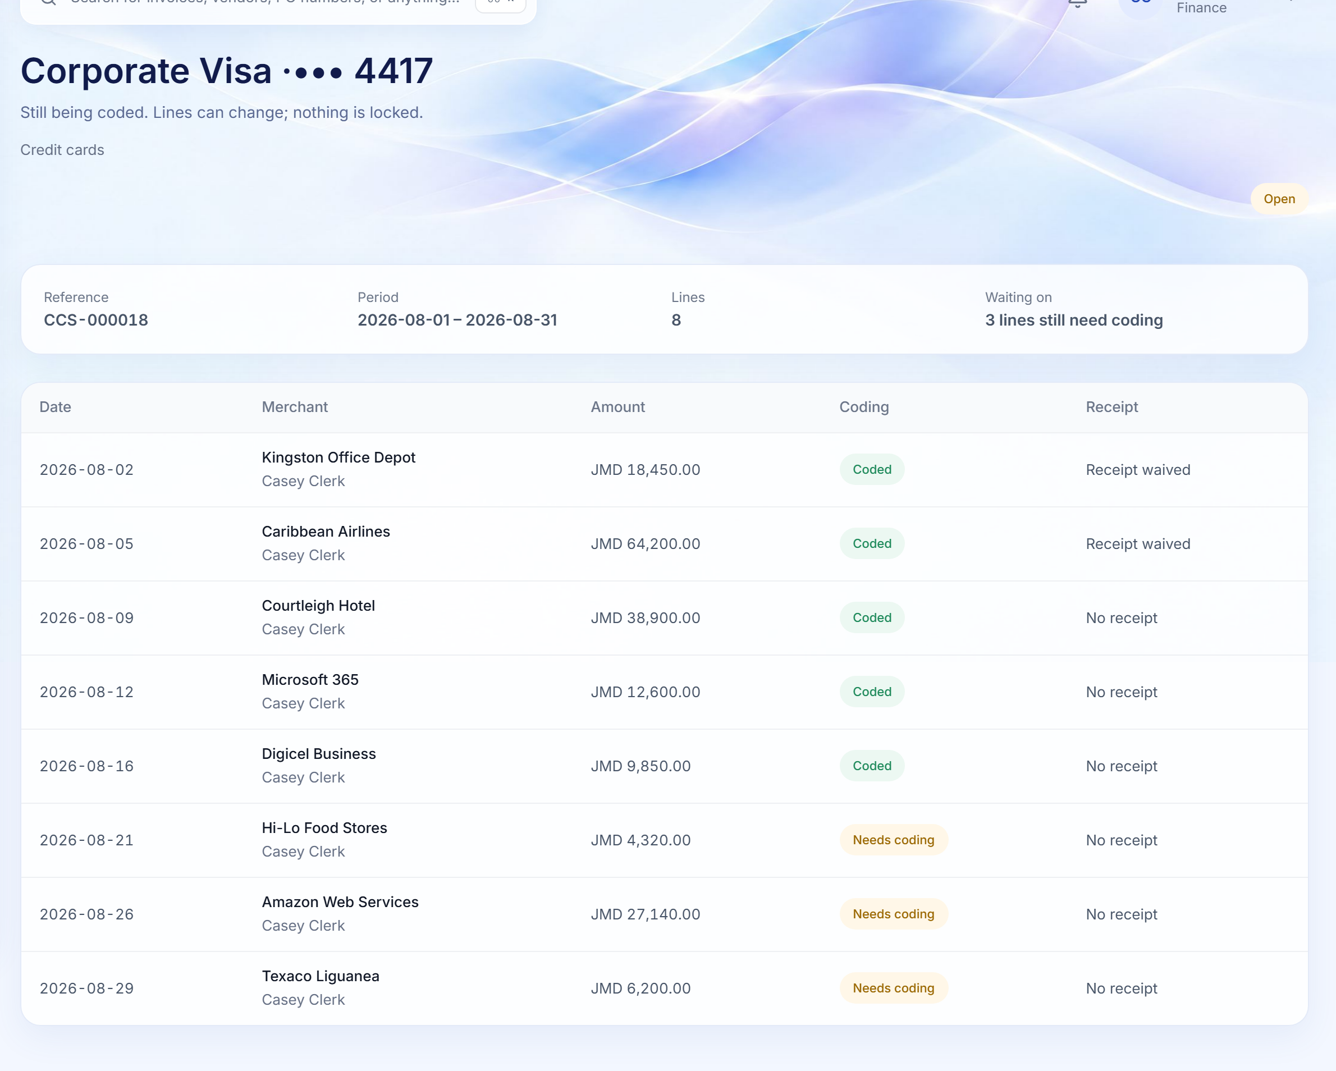
CREDIT-CARD RECONCILIATION
Statements imported, coded, receipted and closed
Import a statement CSV into a period; code each line to a GL account and cost centre; match or waive receipts.
1
Progress, at a glance
Lines, period and what is still waiting, such as lines that need coding.
2
Coding per line
1
GL account and cost centre, or an exception, with assistive suggestions kept beside the applied values.
2
3
3
Receipts matched or waived
A waiver needs a reason, and is recorded against the person who gave it.
WHY IT MATTERS
The person who coded a period cannot close it, so reconciliation is reviewed by design, not by habit.
Finora Flow · Client walkthrough · Reconcile and close
24
Notes:
Statements imported, coded, receipted and closed
Import a statement CSV into a period; code each line to a GL account and cost centre; match or waive receipts.
Walk through:
1. Progress, at a glance: Lines, period and what is still waiting, such as lines that need coding.
2. Coding per line: GL account and cost centre, or an exception, with assistive suggestions kept beside the applied values.
3. Receipts matched or waived: A waiver needs a reason, and is recorded against the person who gave it.
Why it matters: The person who coded a period cannot close it, so reconciliation is reviewed by design, not by habit.

Slide 25
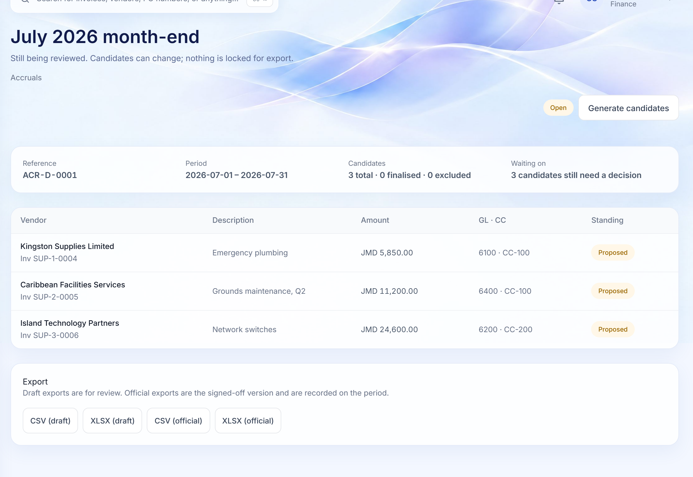
MONTH-END ACCRUALS
Unpaid commitments proposed, reviewed, locked and exported
Open a period, generate candidates from unpaid invoices, adjust with a reason, finalise and lock.
1
Generated, not assembled by hand
Candidates come from the invoices still owed at period end.
1
2
A decision per line
Each candidate is finalised or excluded; edits require a reason.
3
Versioned exports
2
Draft CSV and XLSX for review; official exports are the signed-off version.
WHY IT MATTERS
Month-end becomes a controlled, repeatable process, and locking is segregated from editing.
3
Finora Flow · Client walkthrough · Reconcile and close
25
Notes:
Unpaid commitments proposed, reviewed, locked and exported
Open a period, generate candidates from unpaid invoices, adjust with a reason, finalise and lock.
Walk through:
1. Generated, not assembled by hand: Candidates come from the invoices still owed at period end.
2. A decision per line: Each candidate is finalised or excluded; edits require a reason.
3. Versioned exports: Draft CSV and XLSX for review; official exports are the signed-off version.
Why it matters: Month-end becomes a controlled, repeatable process, and locking is segregated from editing.

Slide 26
08
Control and oversight
Segregation of duties, tamper-evident audit and operational health, built in.
Controls · Audit trail · System health · Intake health
Finora Flow · Client walkthrough · Control and oversight
26

Slide 27
08 · CONTROLS
Controls the system enforces, not the policy manual
Every rule below is checked on the server for every request. Hiding a button is never the control.
SOD
APPROVALS
INVOICES
WORKFLOW
Segregation of duties
Configurable approval matrix
Duplicate and overrun checks
Mandatory reasons
Whoever raises a request cannot approve it. Whoever records an invoice cannot confirm receipt. Whoever submits a payment cannot mark it paid. Coders cannot close; editors cannot lock.
Amount bands per currency, departmental routes, sequential and parallel steps and delegation. An amount no rule covers is refused, never routed to nobody.
Duplicate supplier invoice numbers refused by the database; overruns against the estimate or PO reported against a tolerance.
Rejection, cancellation, withdrawal, override and correction cannot be recorded without a written reason.
ACCESS
AI
EVIDENCE
INTEGRITY
Deny by default
AI has no authority
Immutable evidence
Safe concurrency
Every action needs a named permission, checked server-side; signed email links carry no authority of their own.
AI can propose, never approve, pay, mark paid or change configuration. A kill switch turns it off instantly.
Originals are content-addressed and write-once; financial and audit records are never hard-deleted.
Two people editing the same record cannot silently overwrite each other; the second is told to reload.
Finora Flow · Client walkthrough · Control and oversight
27

Slide 28
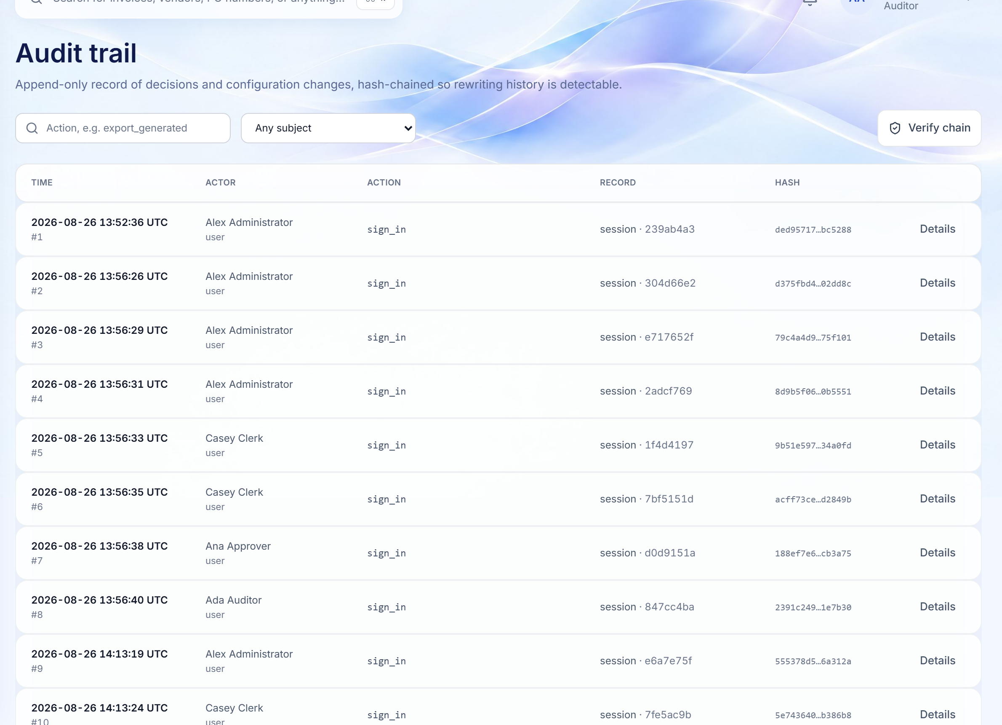
AUDIT TRAIL
An append-only, hash-chained record of every decision
Auditors read everything and change nothing, and can prove the history has not been rewritten.
1
Filter by action and subject
Find every export, configuration change or decision on a record.
1
4
2
3
2
Who, what, when
Actor, action, record and exact UTC time for every entry, in sequence.
3
Tamper-evident hashes
Each entry is chained to the one before; any edit breaks the chain.
4
Verify the chain
One click re-computes the chain over any range and reports the result.
WHY IT MATTERS
Audit preparation stops being an archaeology exercise: the evidence already exists, in order, and can be verified.
Finora Flow · Client walkthrough · Control and oversight
28
Notes:
An append-only, hash-chained record of every decision
Auditors read everything and change nothing, and can prove the history has not been rewritten.
Walk through:
1. Filter by action and subject: Find every export, configuration change or decision on a record.
2. Who, what, when: Actor, action, record and exact UTC time for every entry, in sequence.
3. Tamper-evident hashes: Each entry is chained to the one before; any edit breaks the chain.
4. Verify the chain: One click re-computes the chain over any range and reports the result.
Why it matters: Audit preparation stops being an archaeology exercise: the evidence already exists, in order, and can be verified.

Slide 29
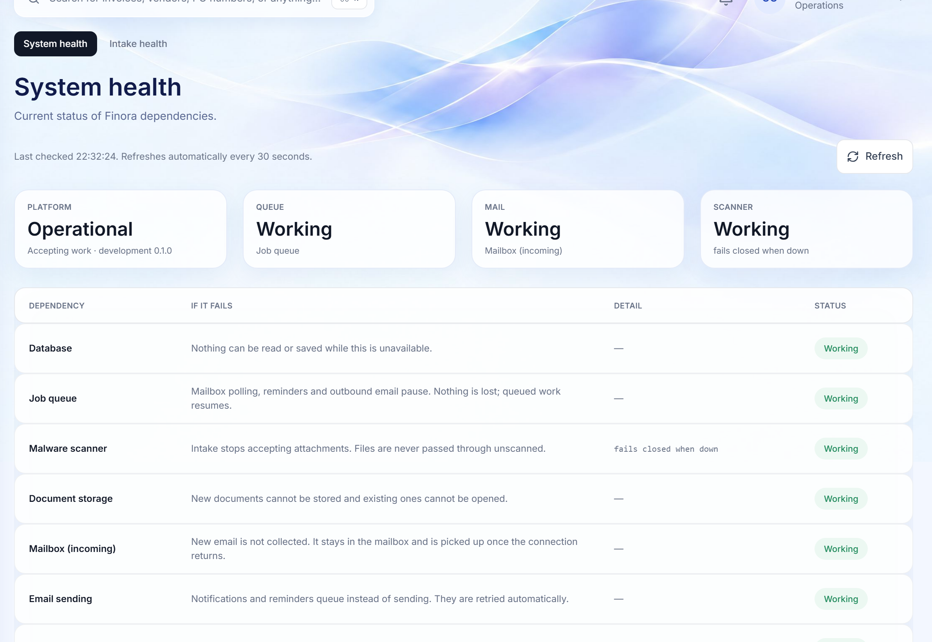
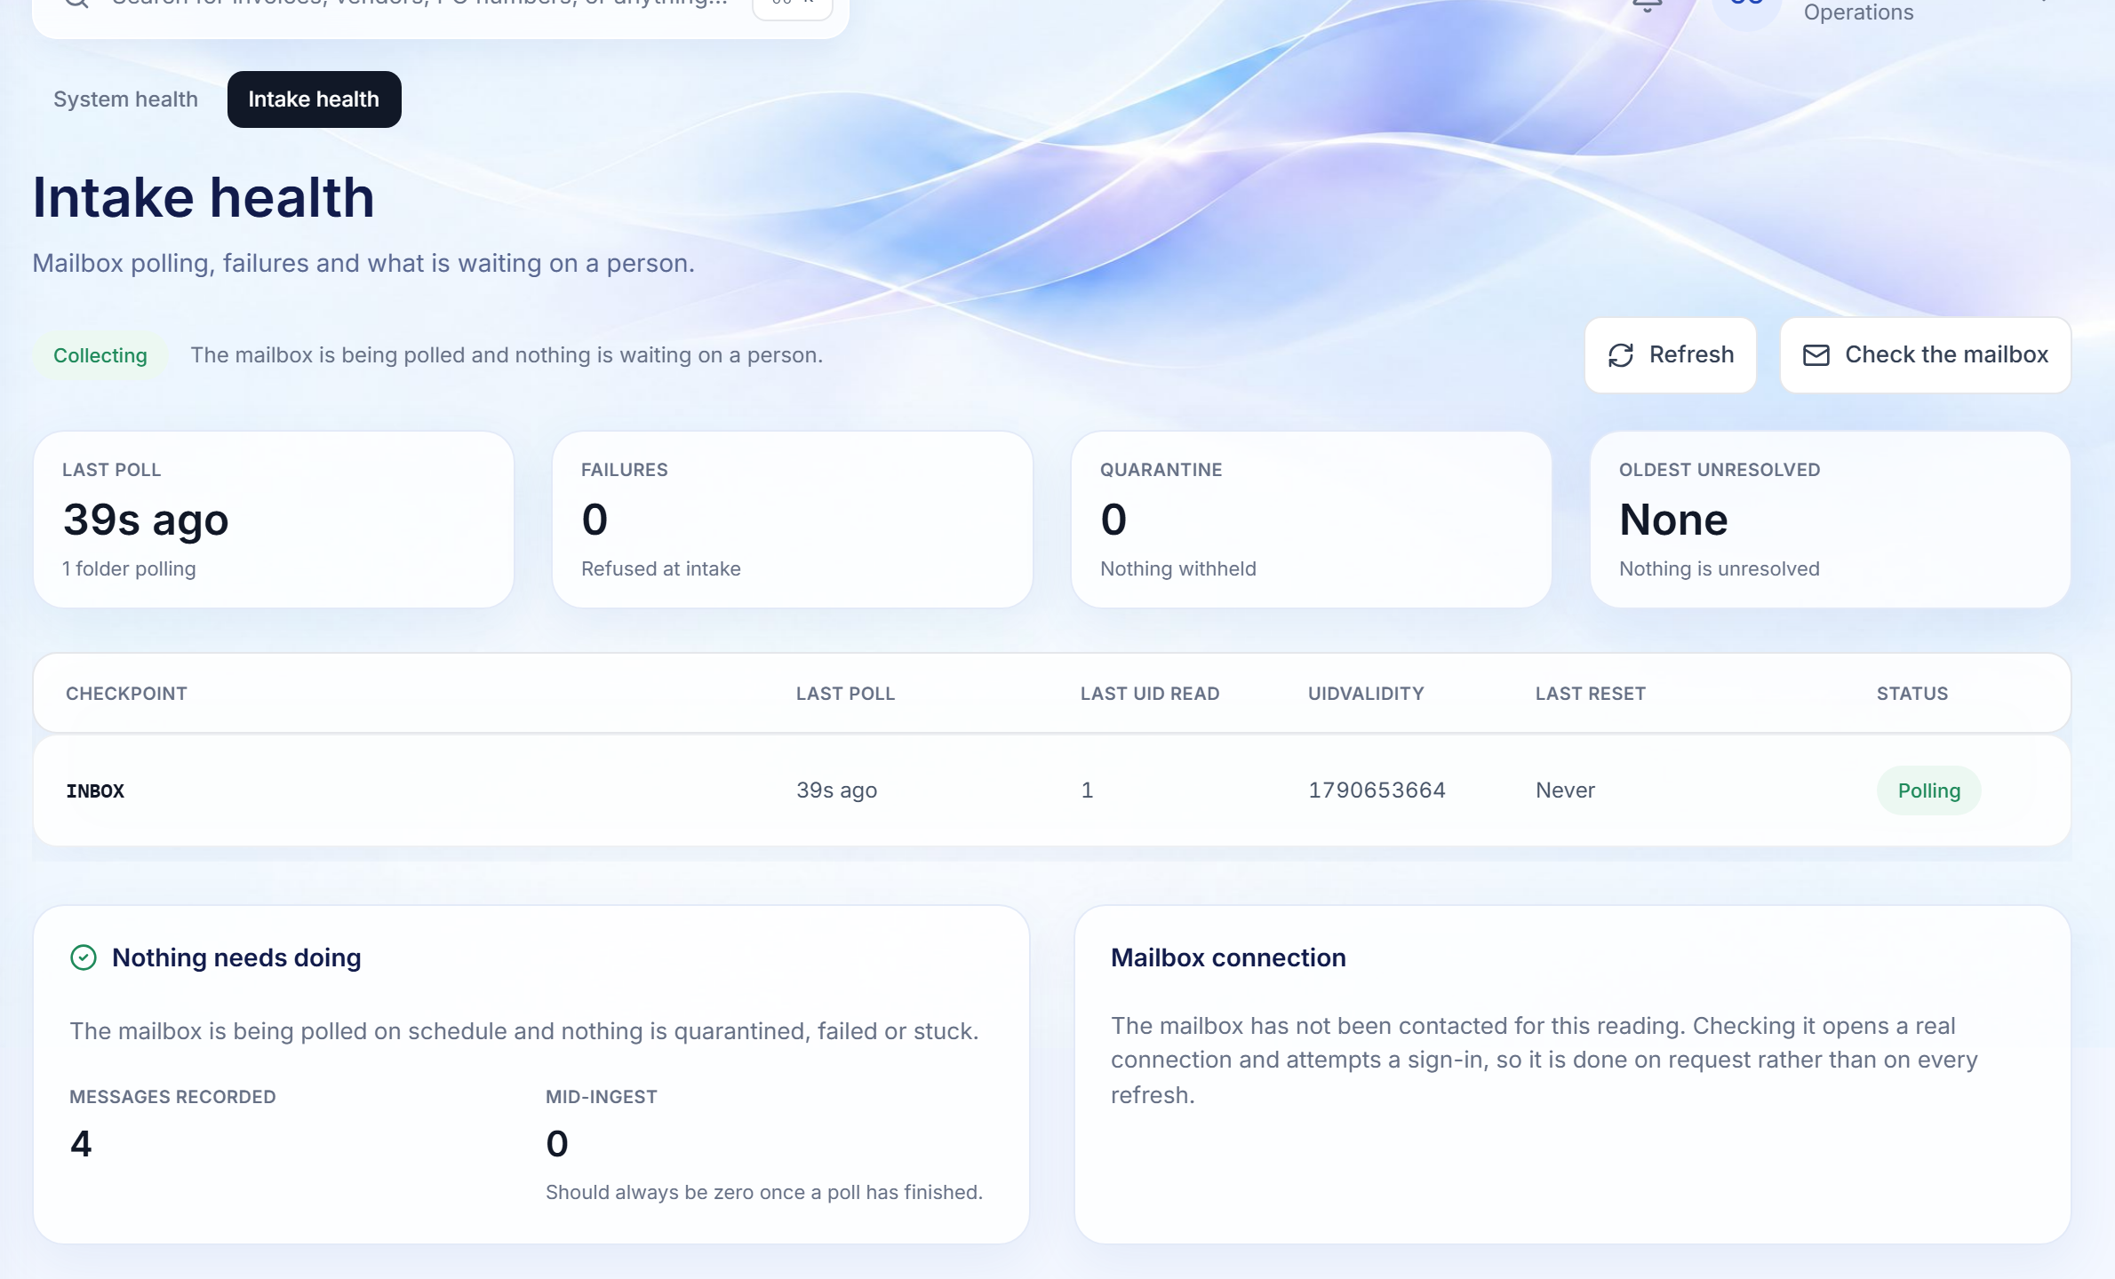
OPERATIONAL OVERSIGHT
The platform tells you when it needs attention
Live status of every dependency and of the mailbox pipeline, in plain language.
SYSTEM HEALTH
INTAKE HEALTH
3
1
2
1
Plain-language impact
2
Fail closed
3
Mailbox checkpoints
WHY IT MATTERS
Each service says what stops if it fails, and that queued work resumes.
If the malware scanner is down, intake stops accepting attachments rather than skipping the scan.
Last poll, failures, quarantine and oldest unresolved item for every mailbox.
Operations can prove the pipeline is healthy, and act before a stalled mailbox becomes a late payment.
Finora Flow · Client walkthrough · Control and oversight
29
Notes:
The platform tells you when it needs attention
Live status of every dependency and of the mailbox pipeline, in plain language.
Walk through:
1. Plain-language impact: Each service says what stops if it fails, and that queued work resumes.
2. Fail closed: If the malware scanner is down, intake stops accepting attachments rather than skipping the scan.
3. Mailbox checkpoints: Last poll, failures, quarantine and oldest unresolved item for every mailbox.
Why it matters: Operations can prove the pipeline is healthy, and act before a stalled mailbox becomes a late payment.

Slide 30
09
Visibility and administration
Management visibility and a platform your administrators control.
Reports · Approval matrix · Users and roles · Reference data · Policies
Finora Flow · Client walkthrough · Visibility and administration
30

Slide 31
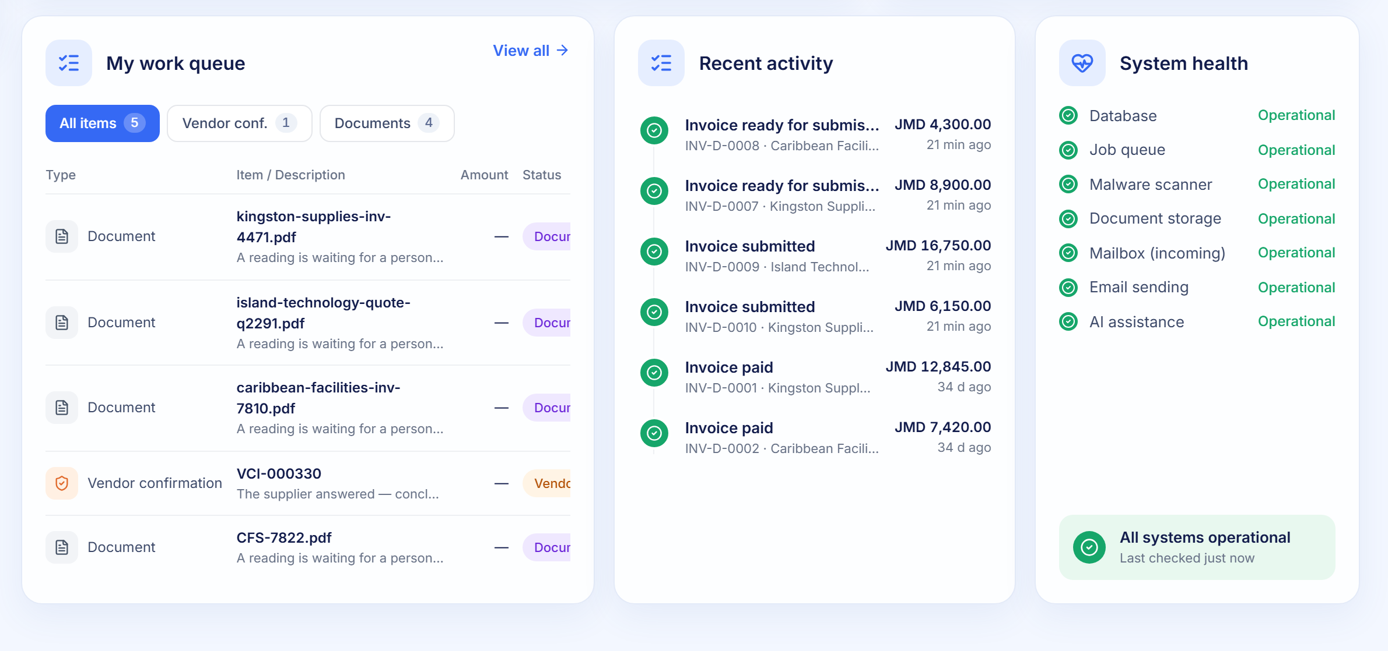
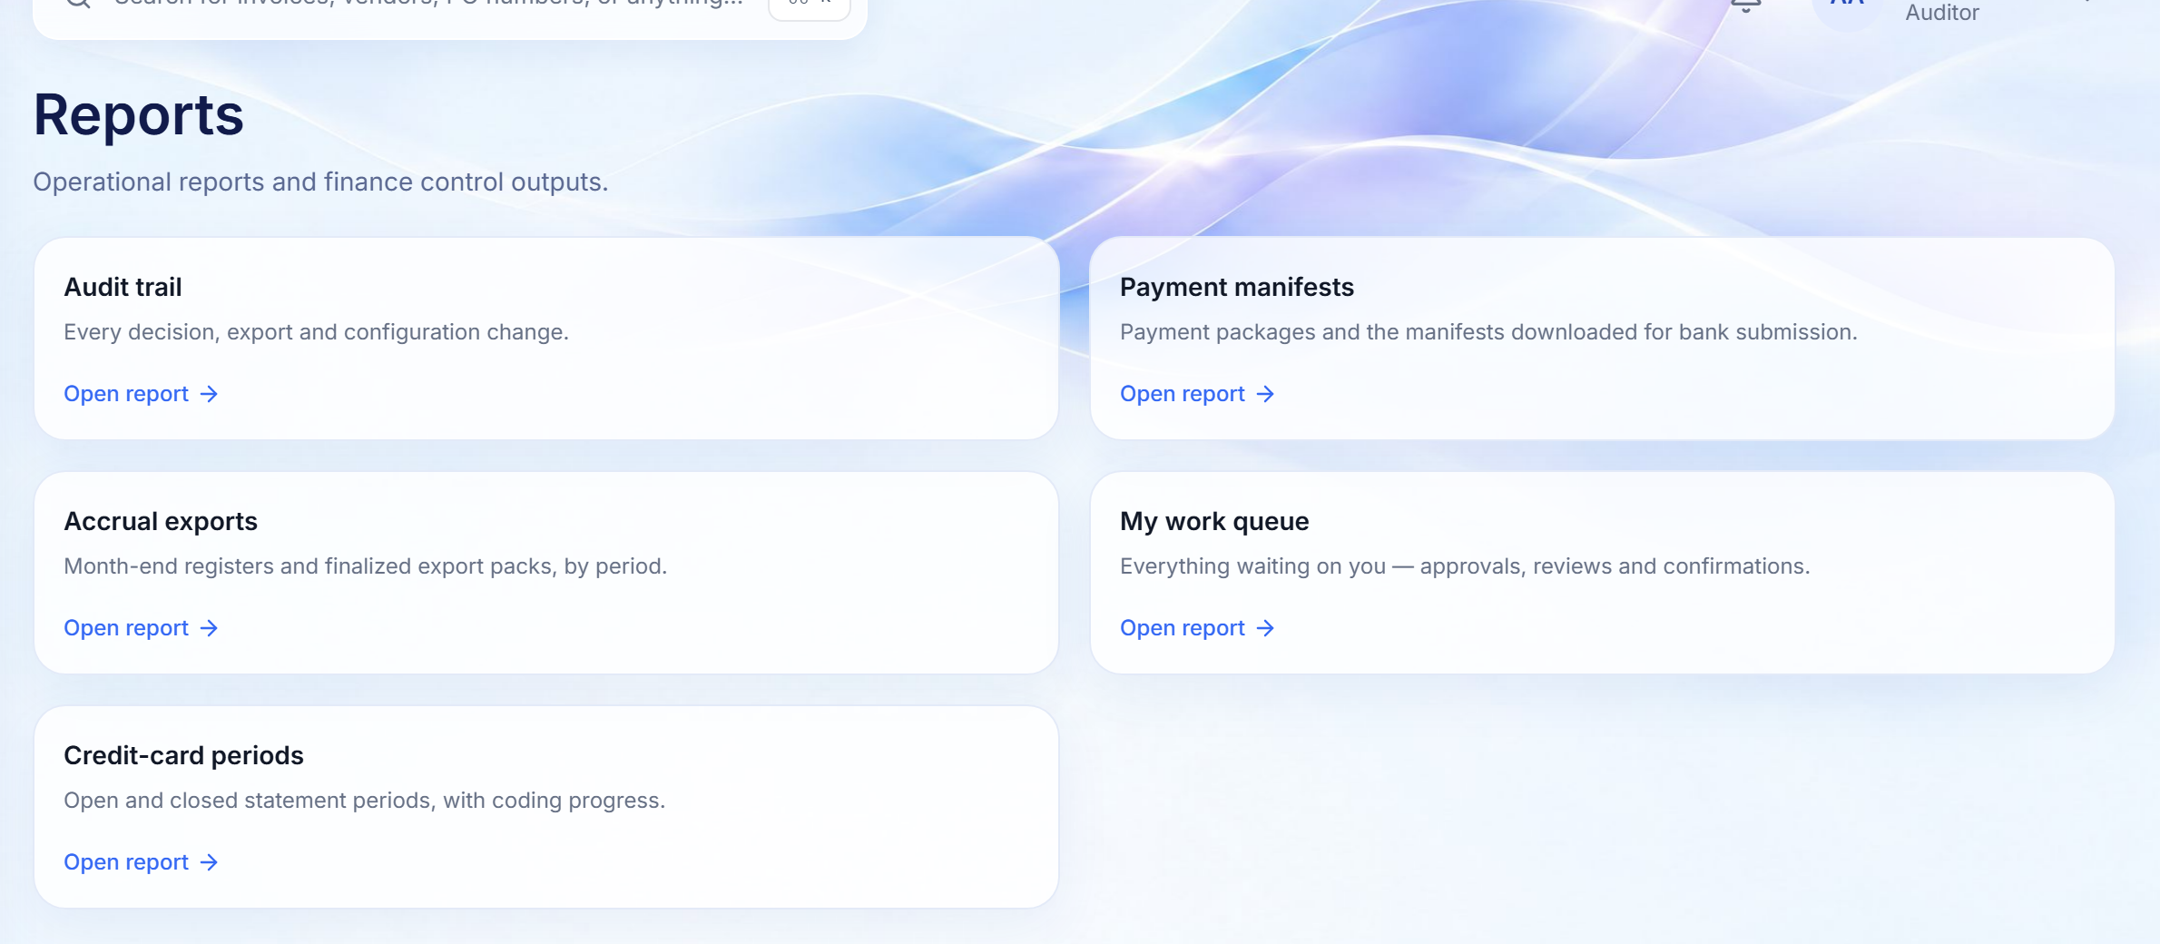
REPORTING
Management visibility, from live records
The dashboard for day-to-day oversight; the reports hub for audited exports.
DASHBOARD · WORK, ACTIVITY AND HEALTH
REPORTS HUB
1
2
3
1
Work by type
2
Recent activity
3
Audited exports
WHY IT MATTERS
Everything waiting, split by kind, one click from each item.
What changed most recently, with amounts and who it concerns.
Audit trail, payment manifests, accrual packs and card periods; every download is recorded.
Reporting is permission-aware: each person sees only the reports their role may open.
Finora Flow · Client walkthrough · Visibility and administration
31
Notes:
Management visibility, from live records
The dashboard for day-to-day oversight; the reports hub for audited exports.
Walk through:
1. Work by type: Everything waiting, split by kind, one click from each item.
2. Recent activity: What changed most recently, with amounts and who it concerns.
3. Audited exports: Audit trail, payment manifests, accrual packs and card periods; every download is recorded.
Why it matters: Reporting is permission-aware: each person sees only the reports their role may open.

Slide 32
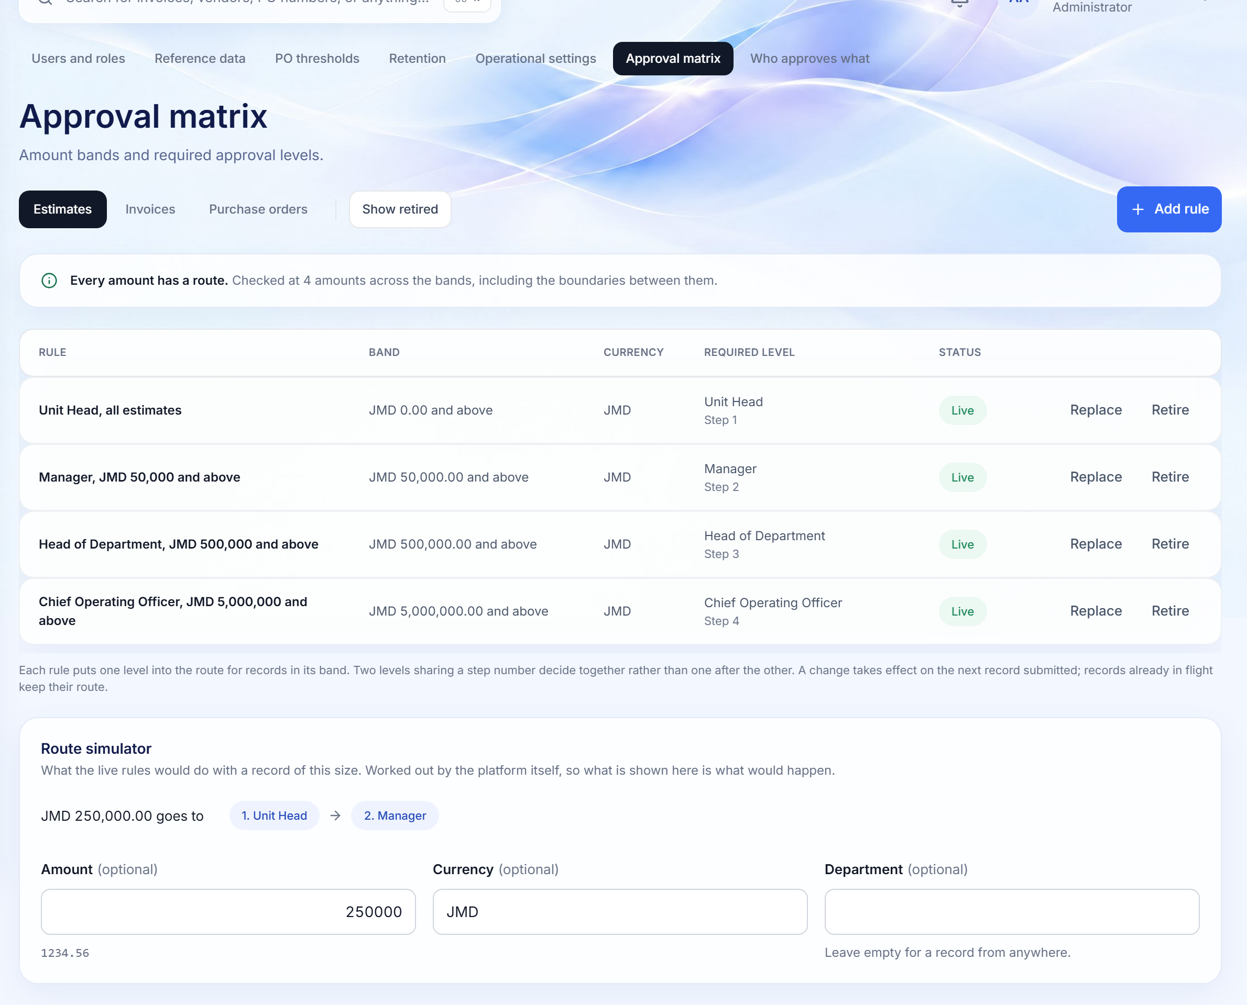
APPROVAL MATRIX
Routing rules your administrators own
Rules are data, not code. Changing one retires it and writes a successor, so past approvals stay explicable.
1
Per record type
Separate matrices for estimates, invoices and purchase orders.
1
2
Coherence checked first
2
Overlaps, gaps and unstaffed levels are named before the rules are listed.
3
3
Live rules
Band, currency, required level and step; replace or retire with a reason.
4
Route simulator
Type any amount and see exactly who would have to approve it.
4
WHY IT MATTERS
Policy changes take effect on the next submission without a deployment, and in-flight records keep the route they were given.
Finora Flow · Client walkthrough · Visibility and administration
32
Notes:
Routing rules your administrators own
Rules are data, not code. Changing one retires it and writes a successor, so past approvals stay explicable.
Walk through:
1. Per record type: Separate matrices for estimates, invoices and purchase orders.
2. Coherence checked first: Overlaps, gaps and unstaffed levels are named before the rules are listed.
3. Live rules: Band, currency, required level and step; replace or retire with a reason.
4. Route simulator: Type any amount and see exactly who would have to approve it.
Why it matters: Policy changes take effect on the next submission without a deployment, and in-flight records keep the route they were given.

Slide 33
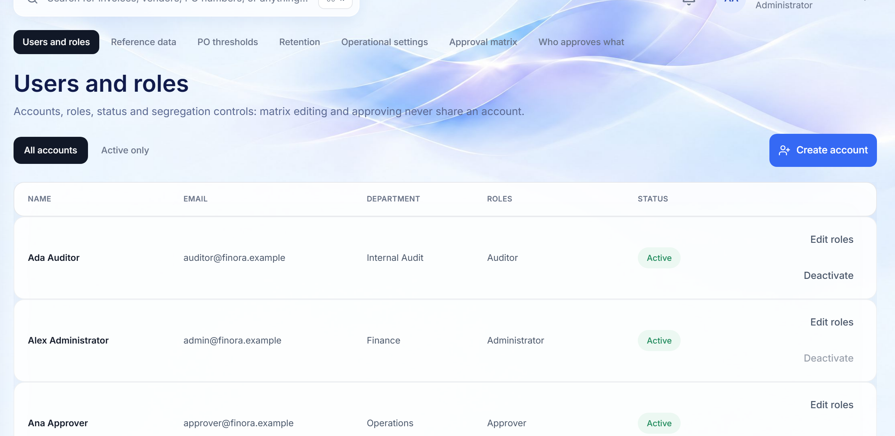
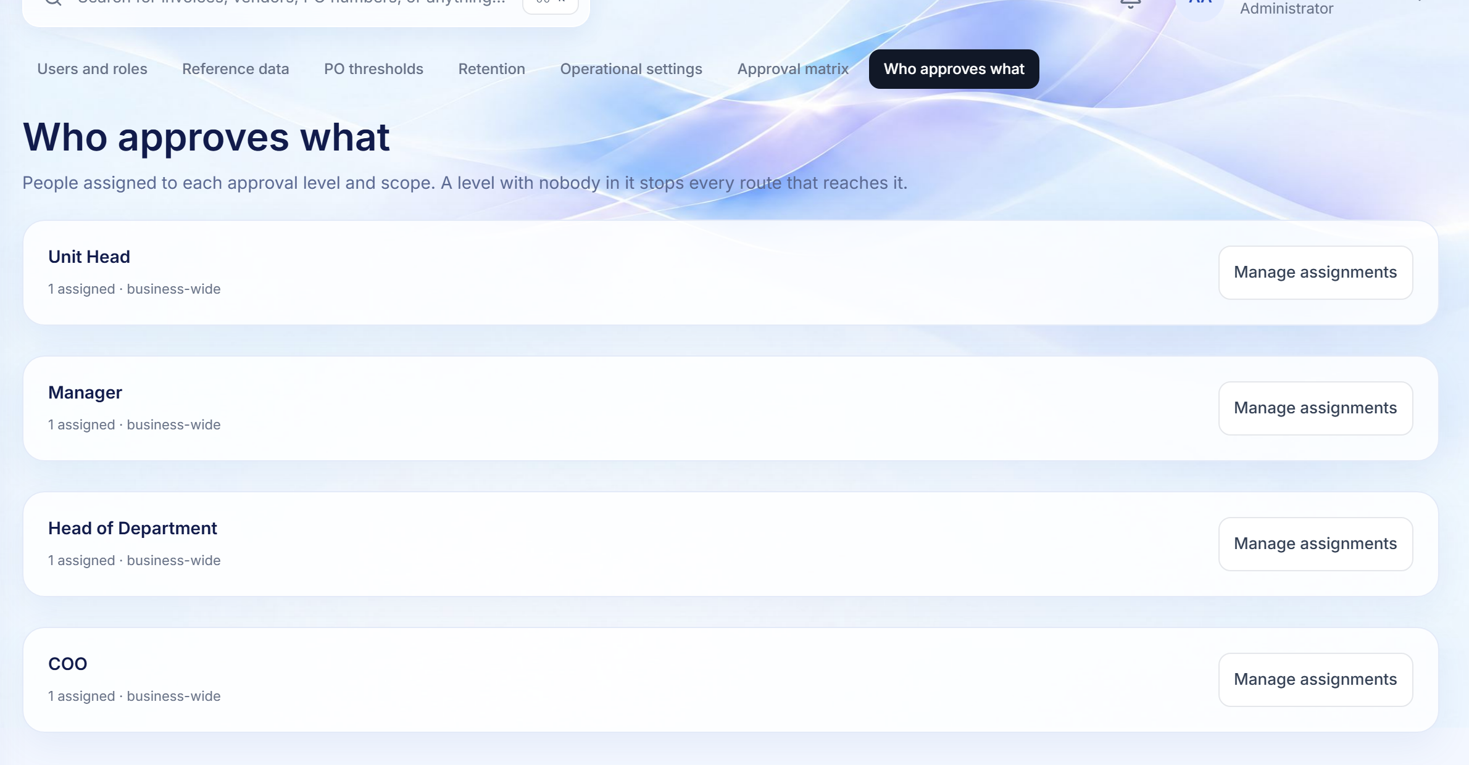
PEOPLE AND DELEGATION
Users, roles, approvers and cover while away
Role combinations that would break segregation of duties are refused at the moment they are granted.
USERS AND ROLES
WHO APPROVES WHAT
2
1
1
Accounts and roles
2
Levels staffed
3
Cover while away
WHY IT MATTERS
Create accounts, grant or revoke roles, deactivate with a reason.
Who holds Unit Head, Manager, Head of Department and COO, and where.
Approvers arrange their own cover; administrators can arrange it for someone already absent.
Absence stops being the reason a queue stalls, without weakening who may approve what.
Finora Flow · Client walkthrough · Visibility and administration
33
Notes:
Users, roles, approvers and cover while away
Role combinations that would break segregation of duties are refused at the moment they are granted.
Walk through:
1. Accounts and roles: Create accounts, grant or revoke roles, deactivate with a reason.
2. Levels staffed: Who holds Unit Head, Manager, Head of Department and COO, and where.
3. Cover while away: Approvers arrange their own cover; administrators can arrange it for someone already absent.
Why it matters: Absence stops being the reason a queue stalls, without weakening who may approve what.

Slide 34
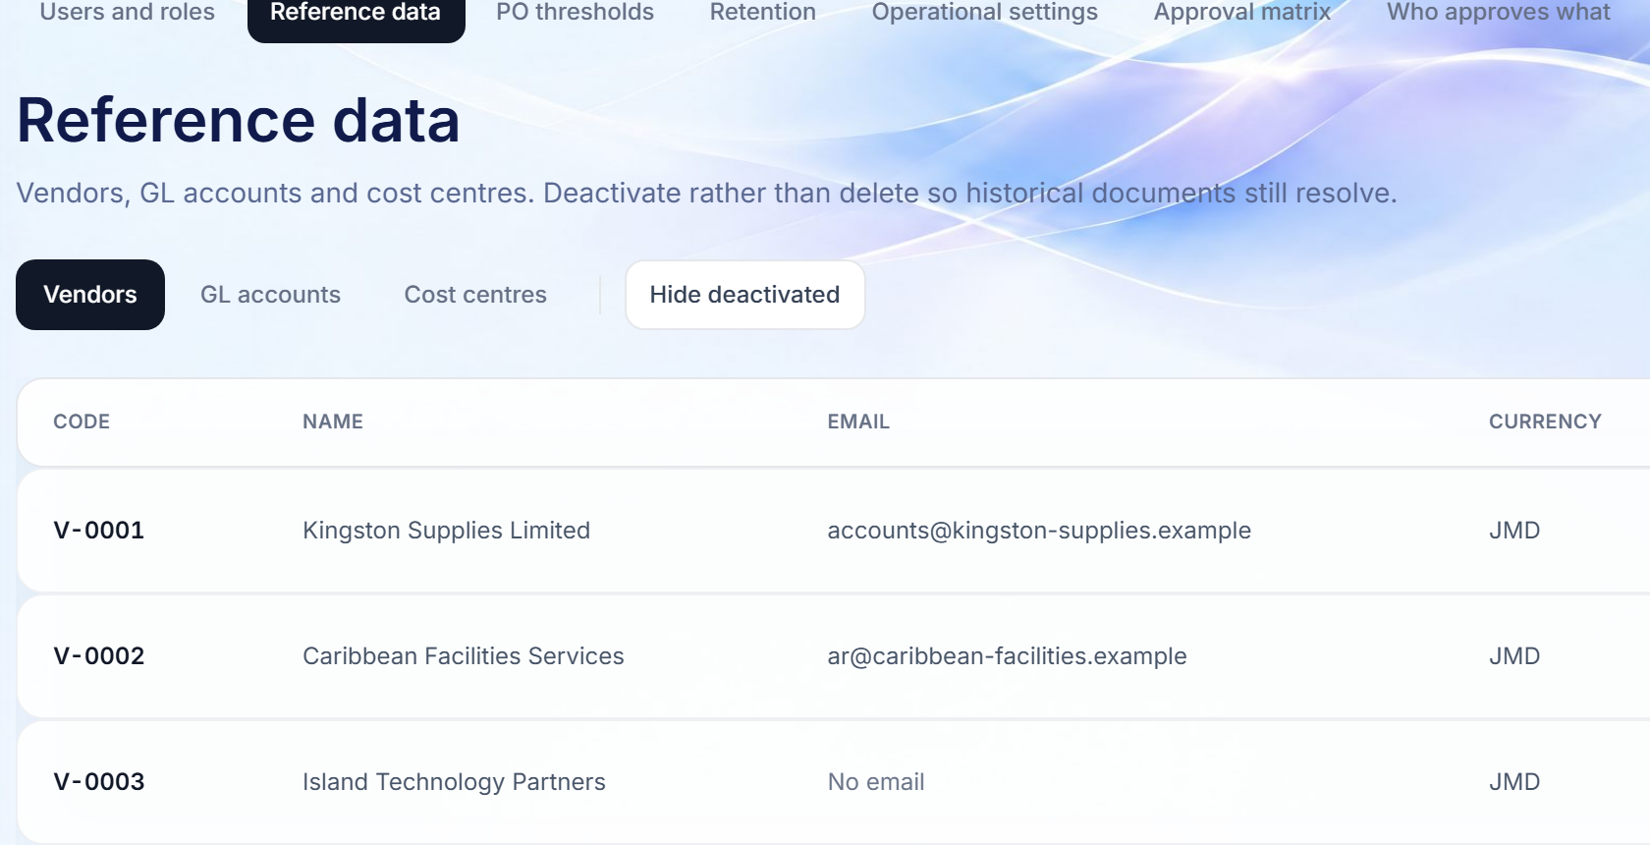
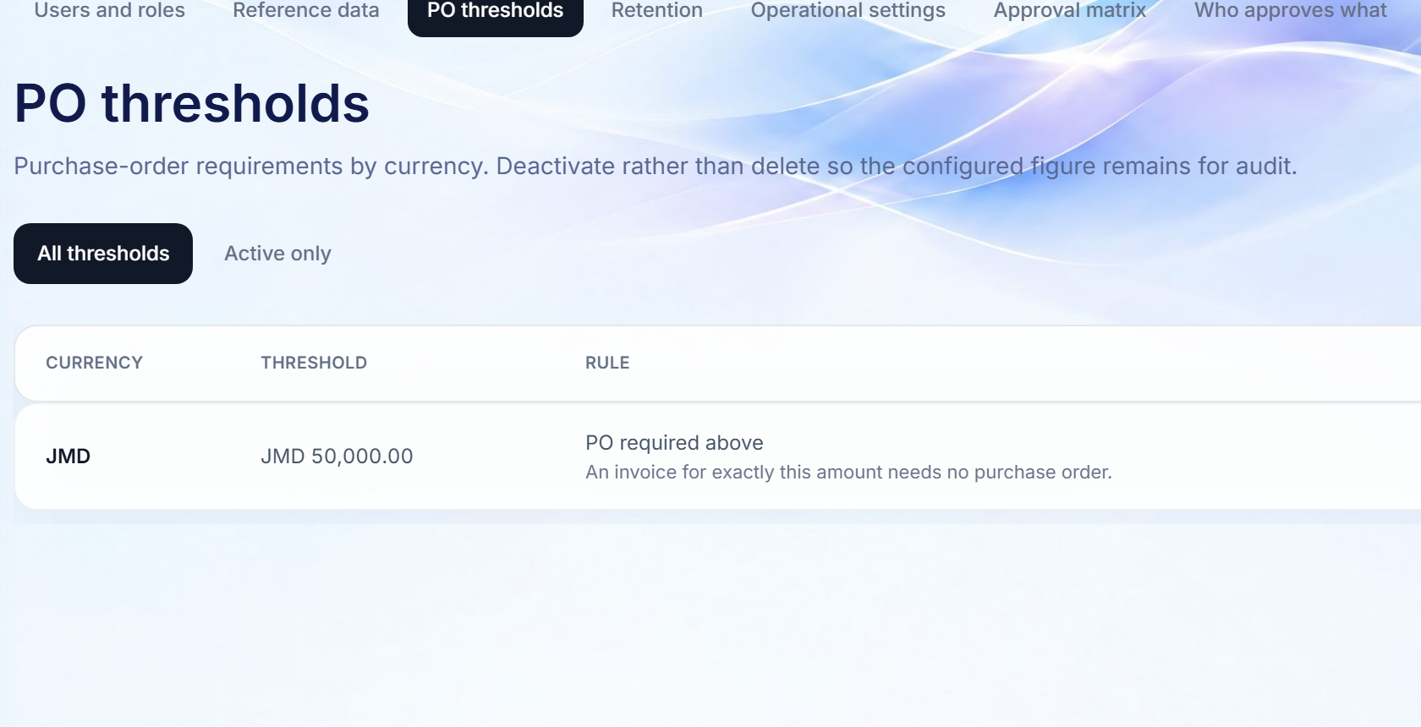
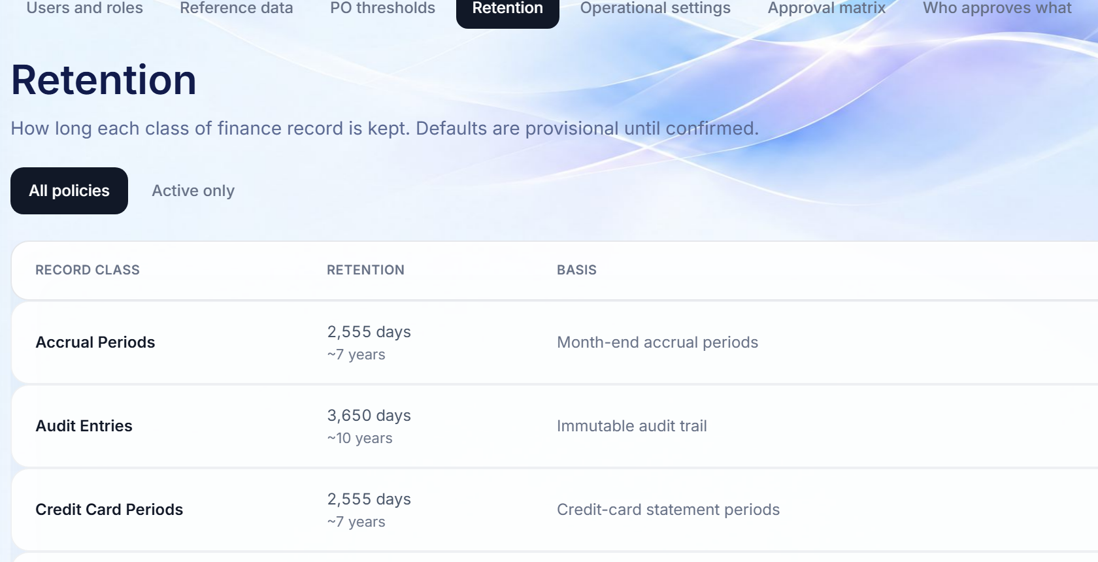
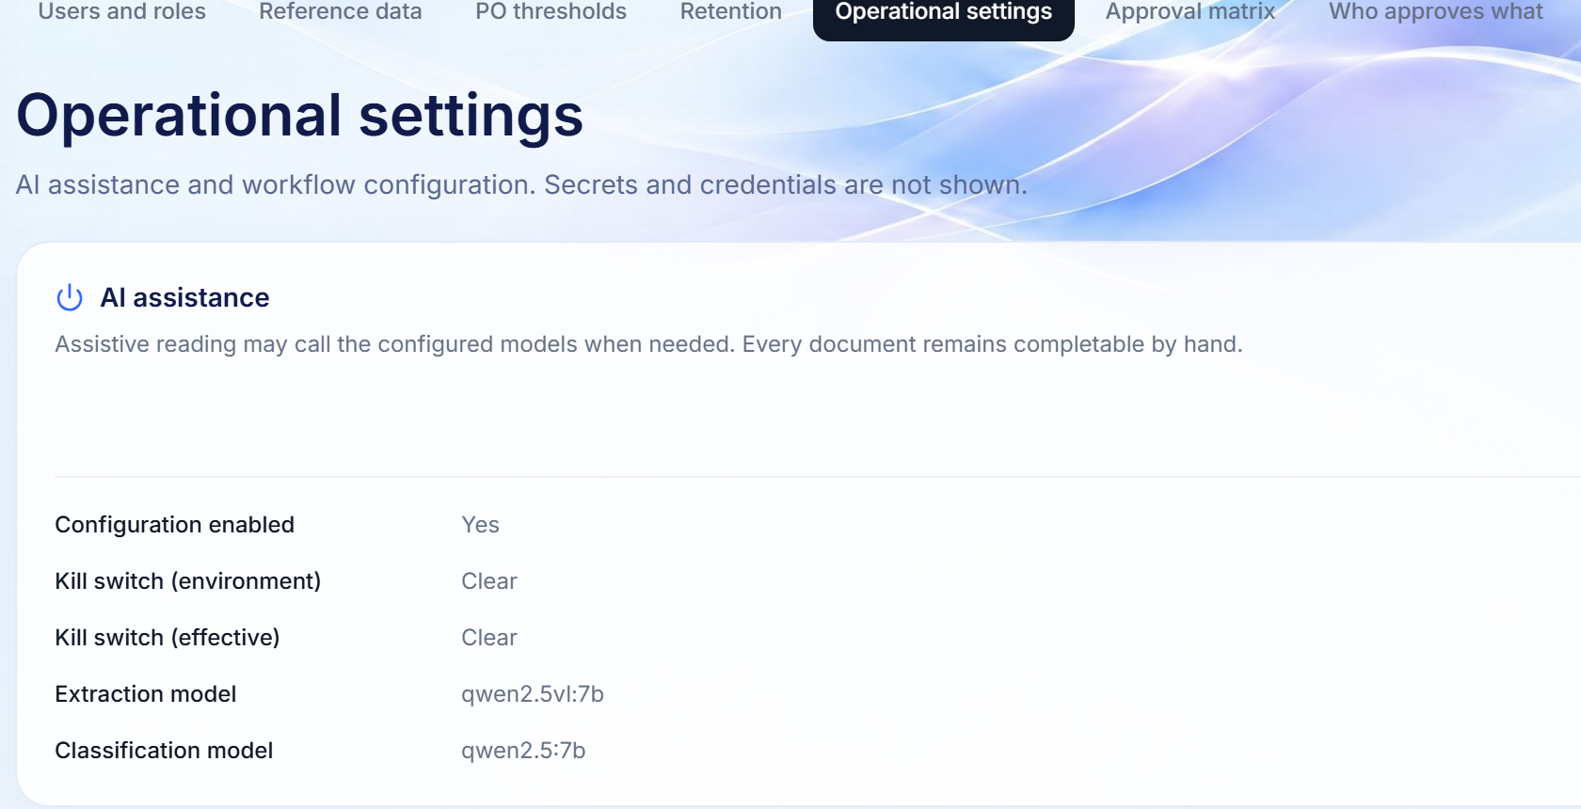
09 · CONFIGURATION
Policies and reference data, administered, not hard-coded
Every change is a recorded act with a reason; nothing requires a release to adjust.
Reference data
PO thresholds
Vendors, GL accounts and cost centres: the only counterparties money can be paid to.
Per currency: the amount above which a purchase order is required.
Retention
Operational settings
How long each record class is kept; the audit trail is never deleted.
The AI kill switch with a reason, and a read-only snapshot of workflow settings.
Finora Flow · Client walkthrough · Visibility and administration
34

Slide 35
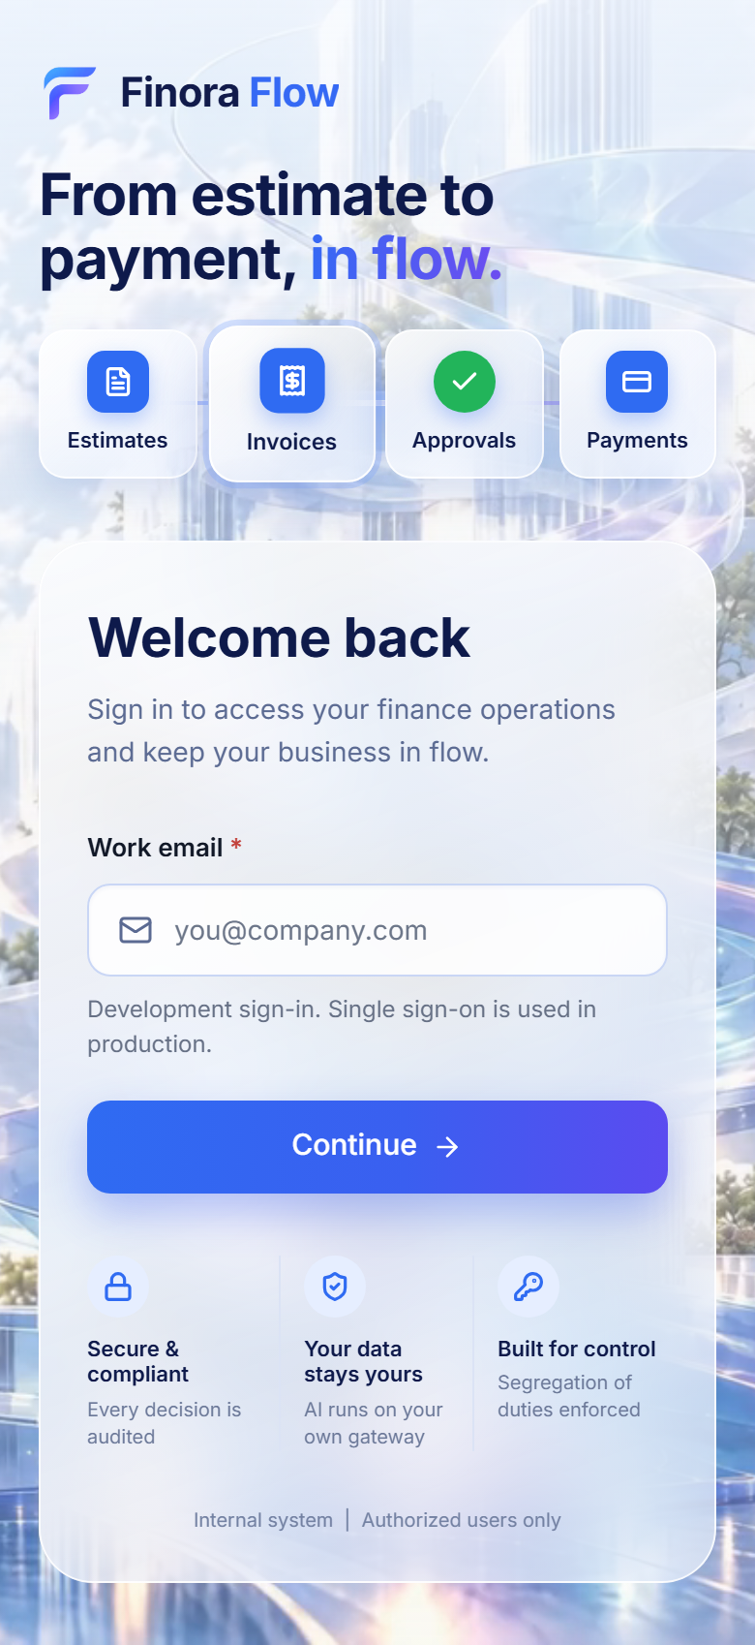
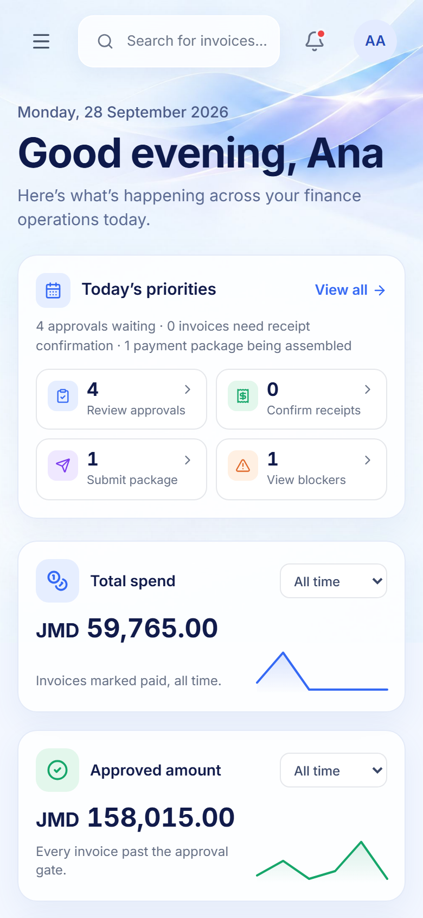
ANY DEVICE
The same platform on a phone, for approvals on the move
Responsive layouts, keyboard access, visible focus and reduced-motion support throughout.
SIGN-IN
DASHBOARD
1
Built to accessibility standards
Labelled controls, status never shown by colour alone, headings in order, visible keyboard focus.
2
Approve from anywhere
Queues, records and decisions work at phone width without sideways scrolling.
3
Motion with restraint
The animated flow respects the device's reduced-motion setting.
WHY IT MATTERS
Approvers are rarely at their desk; decisions should not wait for them to be.
Finora Flow · Client walkthrough · Visibility and administration
35
Notes:
The same platform on a phone, for approvals on the move
Walk through:
1. Built to accessibility standards: Labelled controls, status never shown by colour alone, headings in order, visible keyboard focus.
2. Approve from anywhere: Queues, records and decisions work at phone width without sideways scrolling.
3. Motion with restraint: The animated flow respects the device's reduced-motion setting.
Why it matters: Approvers are rarely at their desk; decisions should not wait for them to be.

Slide 36
VALUE TO YOUR ORGANISATION
What changes when Finora Flow runs your accounts payable
Outcomes the platform is designed to deliver, and the mechanisms that make them hold.
EFFICIENCY
SPEED
ACCURACY
Less manual work
Faster approvals
Fewer payment errors
Documents are read with evidence instead of re-keyed; one queue per person replaces inbox chasing; reminders escalate automatically.
Requests reach the right approver at once, oldest first, with cover for absence and three-hourly working-time reminders.
Receipt confirmation before approval, duplicate refusal, overrun checks and supplier confirmation after payment.
CONTROL
ASSURANCE
INSIGHT
Stronger control
Audit-ready by default
Clear visibility
Segregation of duties, a configurable matrix and mandatory reasons, enforced by the system for every action.
A hash-chained trail, immutable originals and versioned decisions mean the evidence already exists.
Live dashboards and registers show spend, commitments and blockers without waiting for a report.
Finora Flow · Client walkthrough · Value
36

Slide 37
WORKING WITH YOU
What we configure together during onboarding
The platform ships with safe, documented defaults. These are the decisions we confirm with your team.
✓
Approval bands and levels
✓
Thresholds and tolerances
Your real amount bands per currency and department, and who holds each level.
The PO threshold (default JMD 50,000) and any invoice overrun tolerance (default zero).
✓
Identity provider
✓
Mailbox and email
Single sign-on through your OIDC provider; local accounts are for development only.
The intake mailbox forwarding rule, IMAPS access and your SMTP relay.
✓
Bank file and payment methods
✓
Reference data and calendar
Your bank's manifest format; today the manifest is downloaded and uploaded to the bank.
Vendors, GL accounts, cost centres and your public-holiday calendar for reminders.
✓
Retention periods
✓
AI and OCR options
Confirm the provisional seven- and ten-year defaults against your policy.
AI is off unless you connect a provider on your gateway; an OCR engine for scanned pages is a deployment choice.
Finora Flow · Client walkthrough · Working with you
37

Slide 38
Finora Flow
Next steps
1
A working session with your finance team
Walk one of your real invoices through the flow, end to end.
2
Confirm your policies
Approval bands, thresholds, retention and reminders, configured with you.
3
Pilot on your infrastructure
Containers on your network, your mailbox, your identity provider.
From estimate to payment, in flow.

