Slide 1

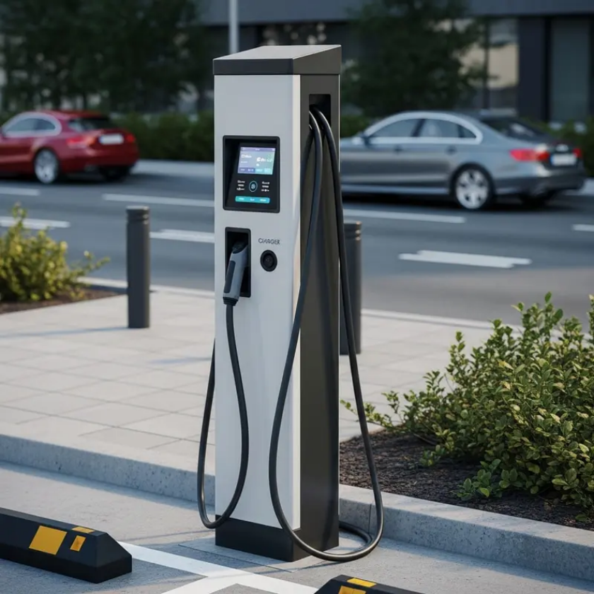
Statistical Analysis of NYC Lots and Garages
Electric Vehicle Charging Data
An exploration of charging patterns, energy consumption, and user behavior
Tasmia Alamgir
Zubaer Rahman Chowdhury
Tasin Tayeba Khan
Matthew Goldman
Report Date: December 3, 2025

Slide 2










Why EV Charging Analysis Matters
Analyzing Electric Vehicle (EV) charging data provides crucial insights for creating efficient and sustainable EV ecosystems. We collected our dataset from NYC open Data. They publish daily usage of each
Urban Planning
Grid Management
Understanding charging patterns helps city planners design better infrastructure and anticipate future needs.
Analyzing energy consumption patterns helps utilities manage demand and integrate renewable sources.
Strategic Deployment
User Experience
Identifying optimal locations for charging stations based on usage patterns and demand forecasts.
Improving charger availability and reducing wait times through data-driven insights.
This analysis contributes to more efficient and sustainable EV ecosystems, addressing challenges in real-time.

Slide 3












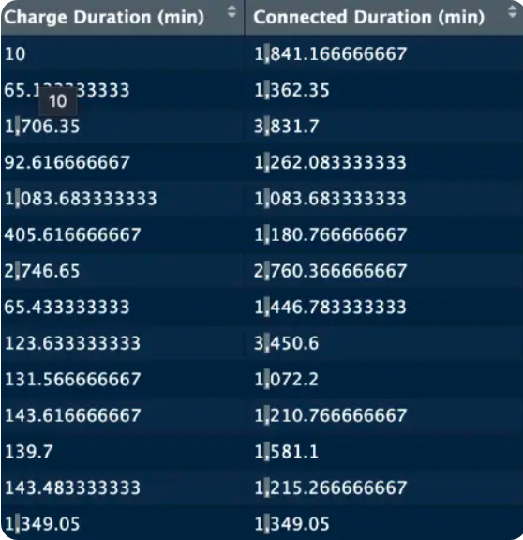
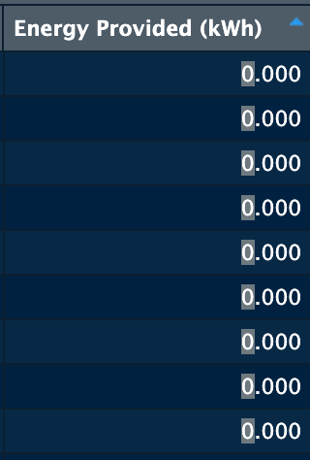
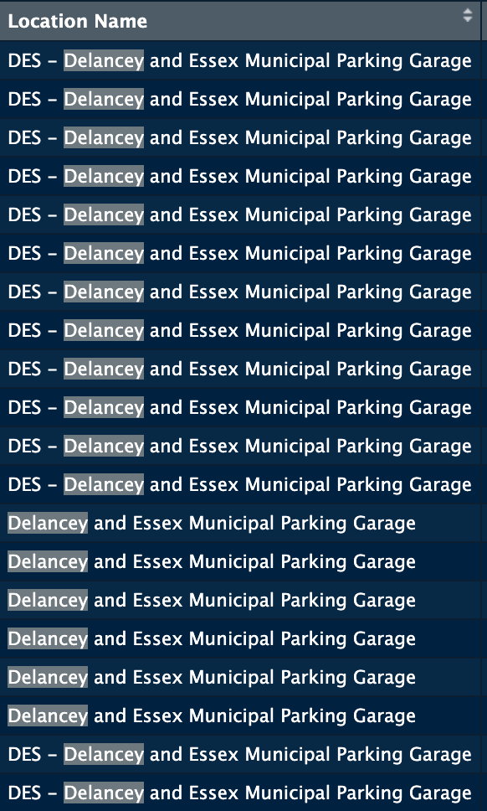



Dataset Overview and Cleaning Process
Dataset Overview
Cleaning Process
Comprehensive data on EV charging sessions in municipal parking lots, containing info about:
Removal of Irrelevant Data
Removed columns (Driver ID, Invalidity Reason, Country) and rows with DISCONNECTED status.
Date, Connected/Disconnected Time
Location Name, Station Name
Connector ID, Session Status
Handling Missing Values
Energy Provided (kWh), Duration (min)
Dropped rows with any NA values to ensure data completeness.
Standardization of Location Names
Consolidated data for same physical locations (e.g., "JGU" mapped to "Jerome Gun Hill Road").
Correction of Data Types
Converted Charge Duration and Connected Duration from character to numeric types.
Feature Engineering
Added temporal indicators (weekday, is_weekend, is_holiday_2024) and manufacturer identification.

Slide 4























Final Dataset Structure
Temporal Variables
Location Variables
Date
(Proper date)
Station Name
(Station name)
Connected Time
(Time connected)
Location Name
(Location address)
Disconnected Time
(Time disconnected)
Connector ID
(Connector id)
weekday
(Day of week)
ID Tag
(User id)
is_weekend
(Boolean)
Manufacturer
(Charger manufacturer)
is_holiday_2024
(Boolean)
Duration Variables
Energy Variables
Charge Duration (min)
(Duration)
Energy Provided (kWh)
(Energy)
Connected Duration (min)
(Time connected)
Session Status
(PAID/ROAMING)
Dataset includes 202,554 sessions after cleaning (199,035 used in analysis)

Slide 5







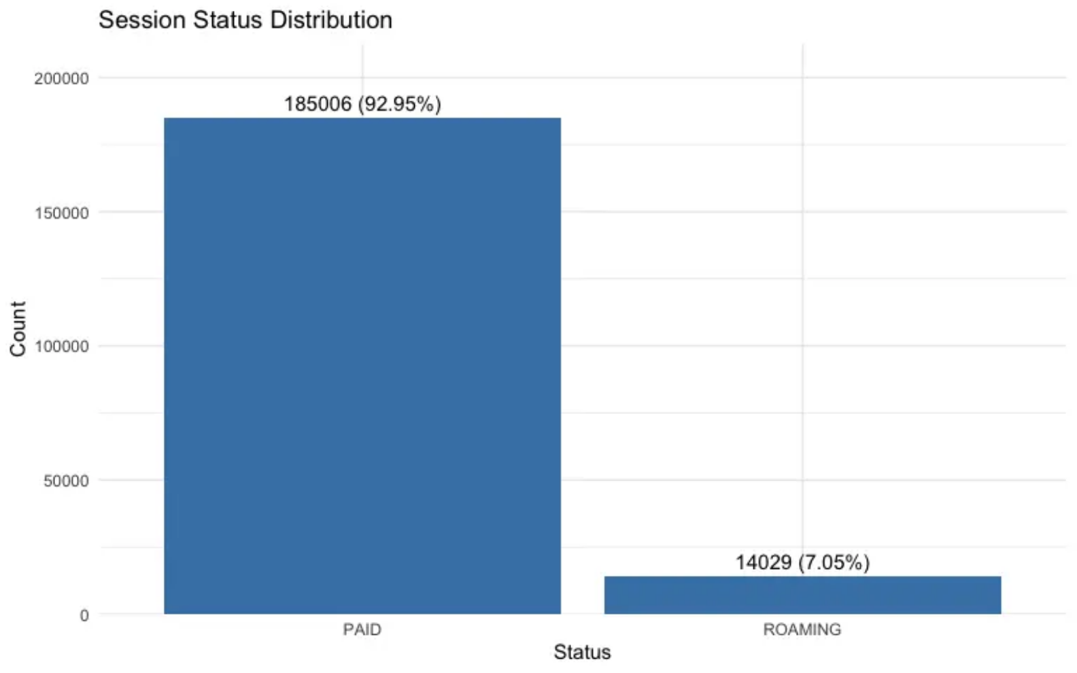
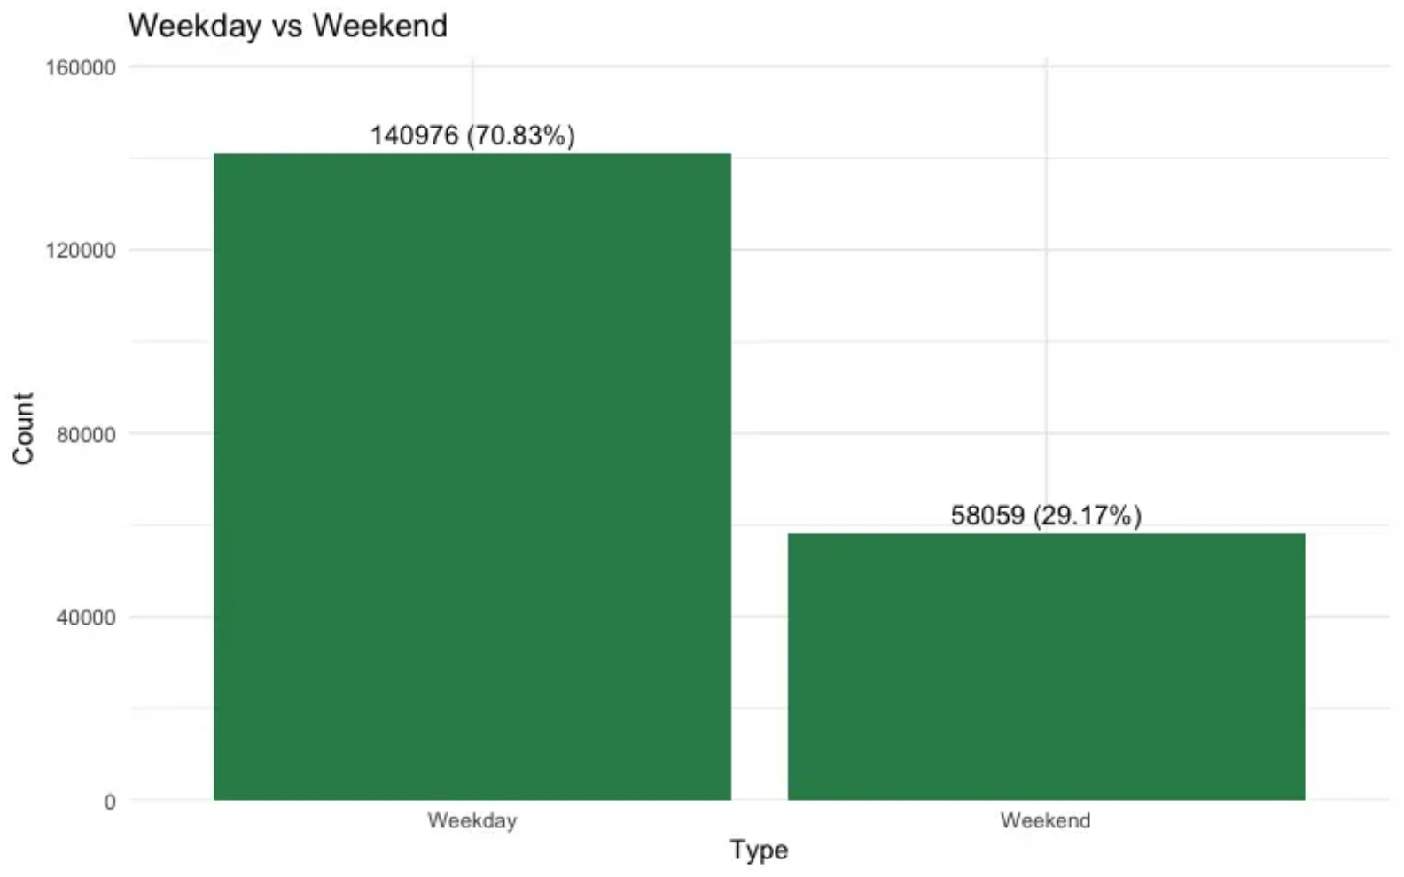

Usage Patterns Overview
Analysis of EV charging data reveals clear patterns in session status and temporal usage that inform infrastructure planning.
92.95% of sessions are successfully completed and paid for
70.83% of charging activity occurs on weekdays
7.05% are roaming sessions (initiated through partner apps)
29.17% occurs on weekends, with longer duration sessions
Session Status Distribution
Weekday vs Weekend Usage
Overwhelming majority (92.95%) of sessions are directly paid, indicating users primarily pay for their own charging

Slide 6

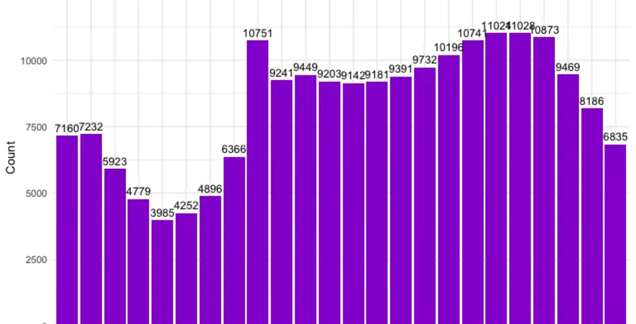
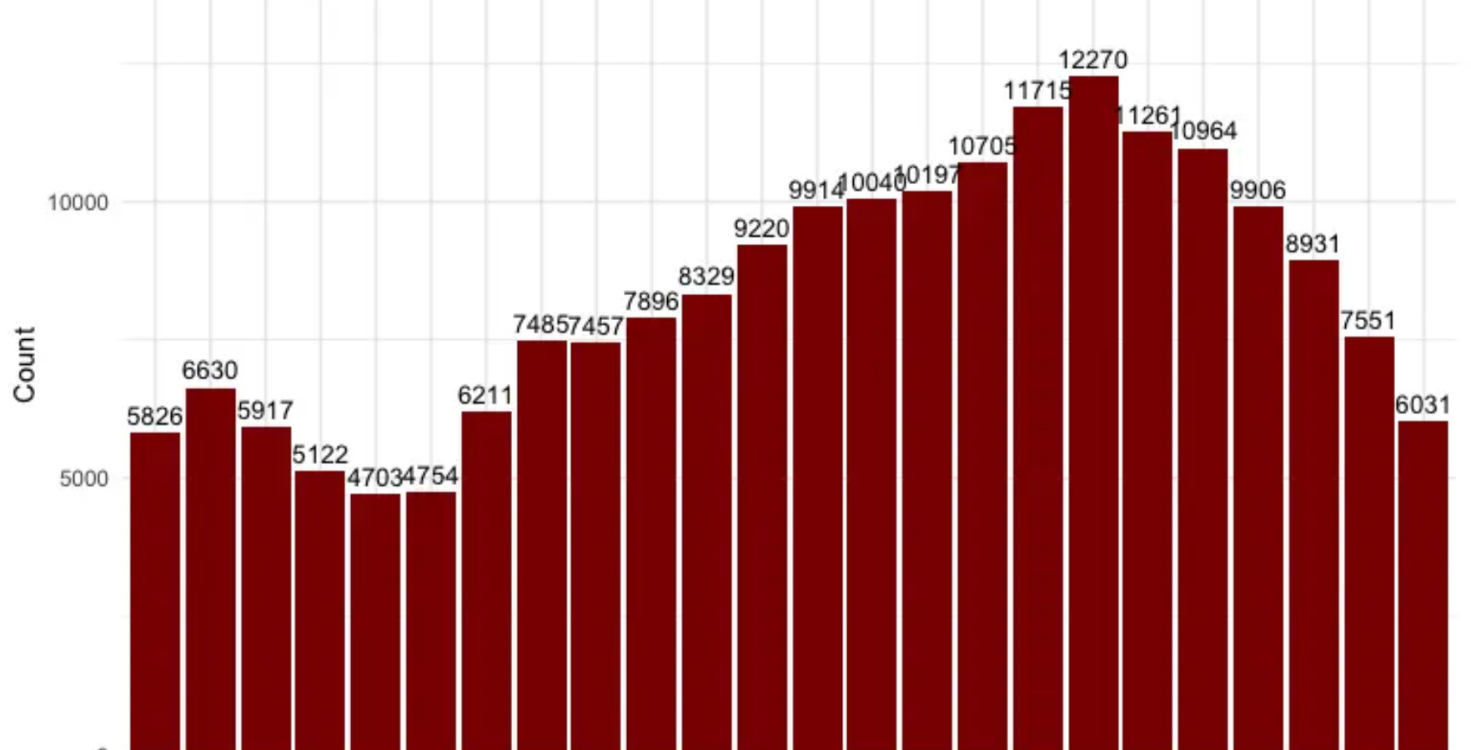



Temporal Charging Hotspots
Analysis of charging data reveals distinct temporal patterns that align with daily activities and work schedules.
Peak Charging Start Times (24-hour period)
Peak Charging End Times (24-hour period)
Key Insights:
Weekday afternoons (17:00-19:00) show highest charging activity, correlating with work schedules
Early mornings (0-6:00) show consistent but lower charging activity, likely from overnight charging

Slide 7
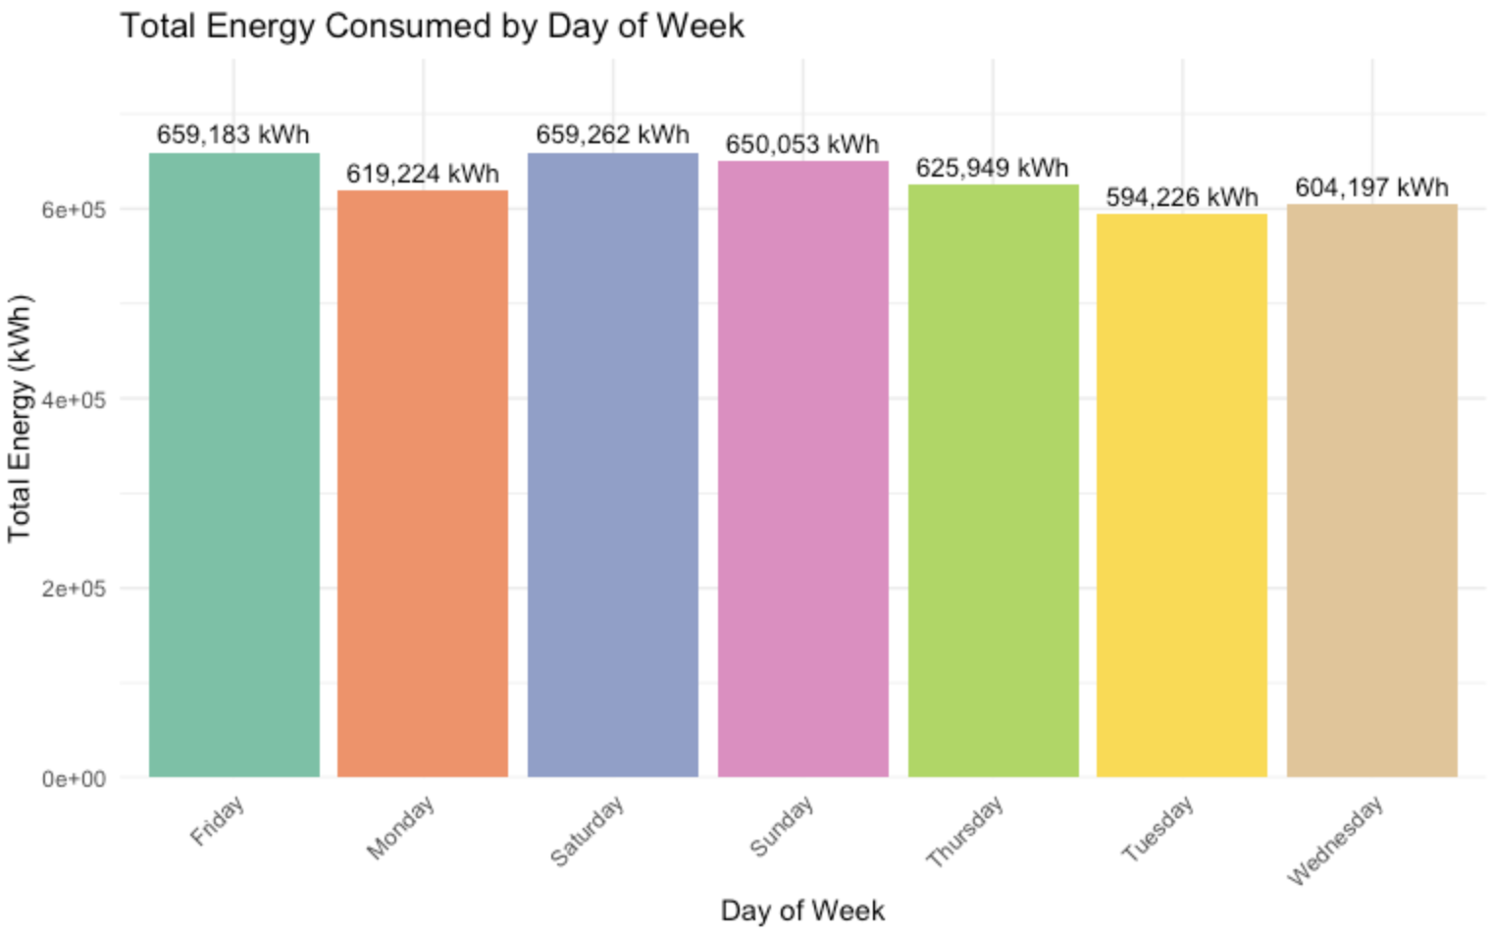
Day of Week Charging Pattern
Analysis of charging sessions by day and hour reveals distinct temporal patterns across the week.

Slide 8
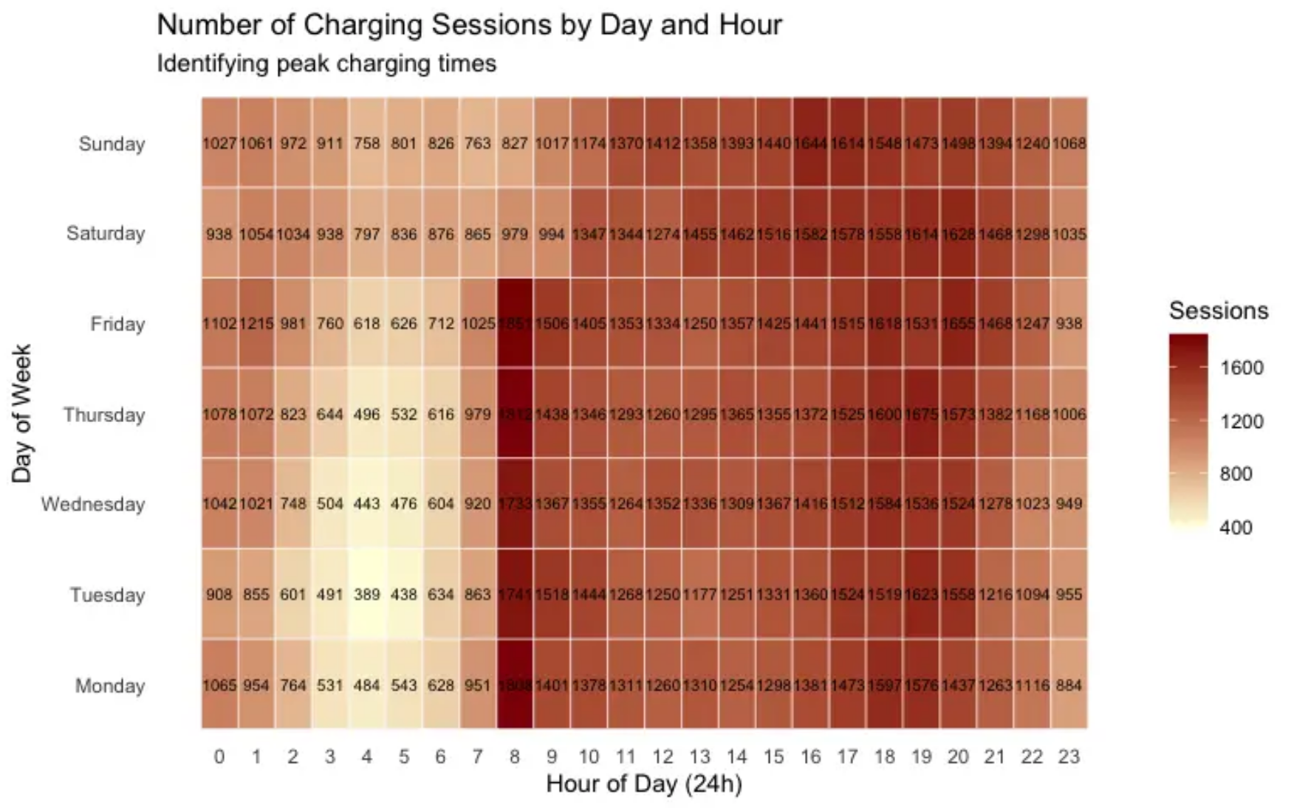

Temporal Usage Heatmap Insights
Analysis of charging sessions by day and hour reveals distinct temporal patterns across the week.
Planning Implications
These patterns suggest optimal charging times vary by day, with weekends showing distinct behavior that requires separate planning considerations.

Slide 9



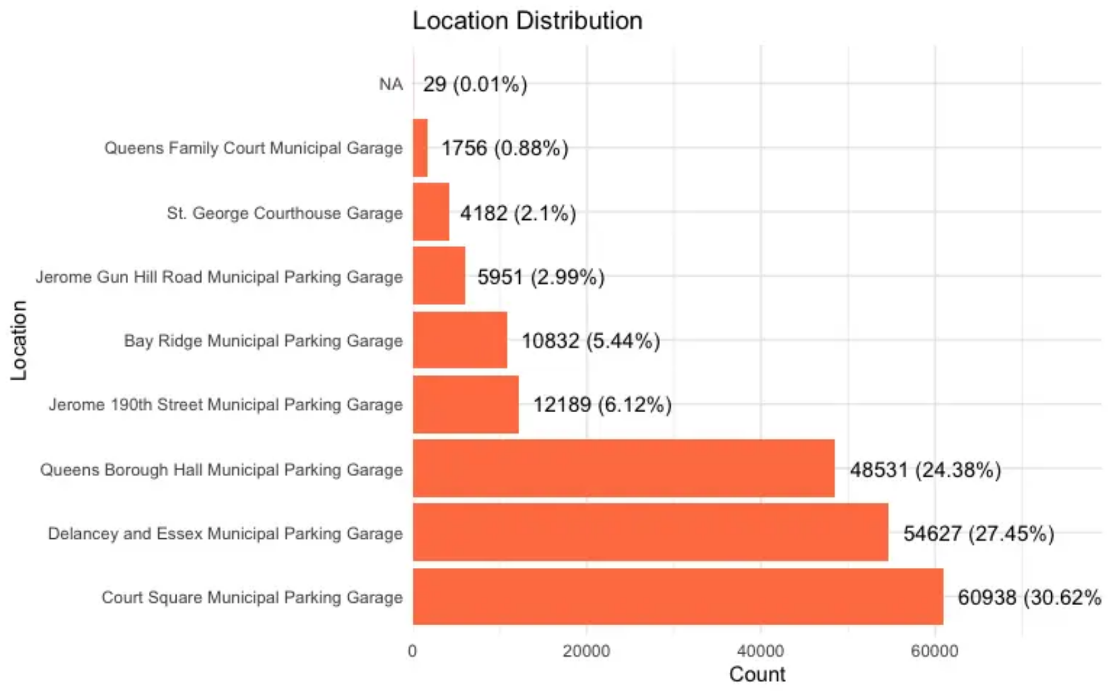
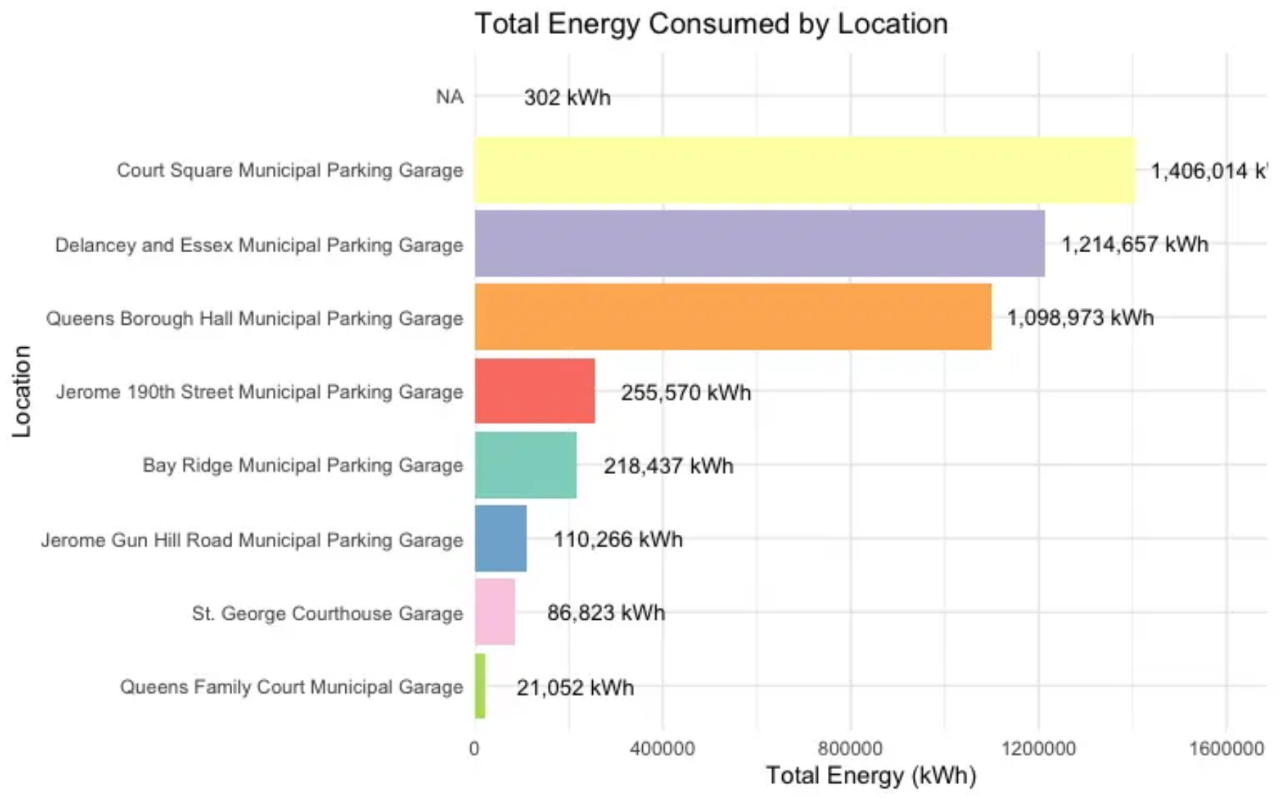

Location Distribution and Energy Consumption
Location Distribution
Energy Consumption
Court Square (30.62%) and Delancey and Essex (27.45%) are the two busiest locations, accounting for over half of all charging sessions.
Court Square consumes 1,406,014 kWh with avg. of 23.07 kWh/session, while Delancey and Essex consumes 1,214,657 kWh with avg. of 22.24 kWh/session.

Slide 10
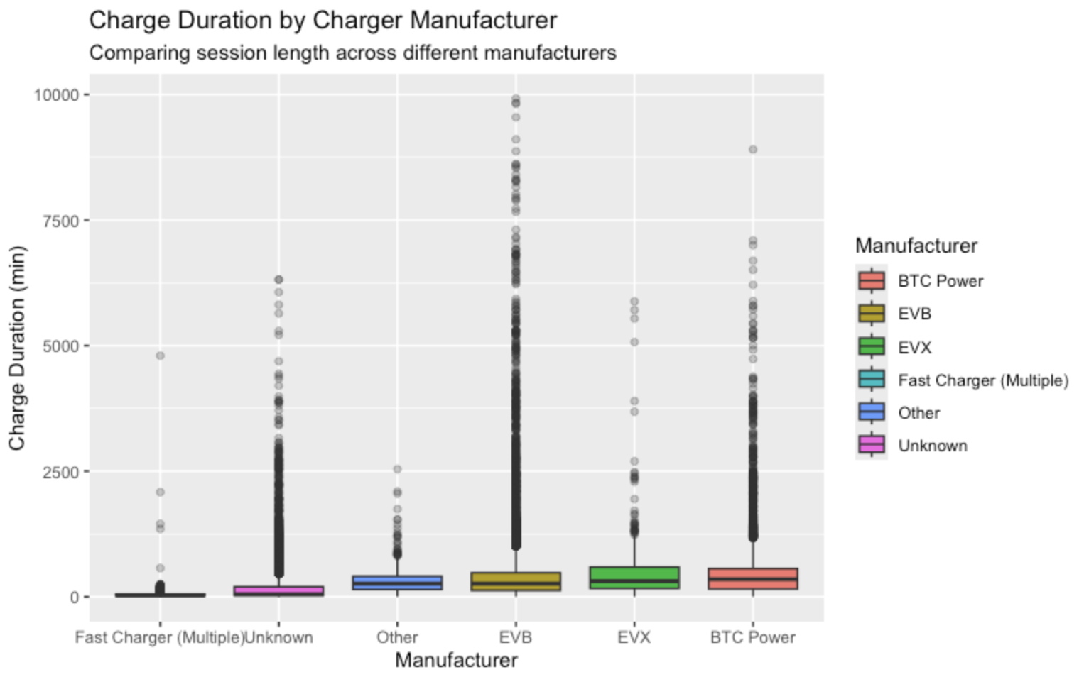
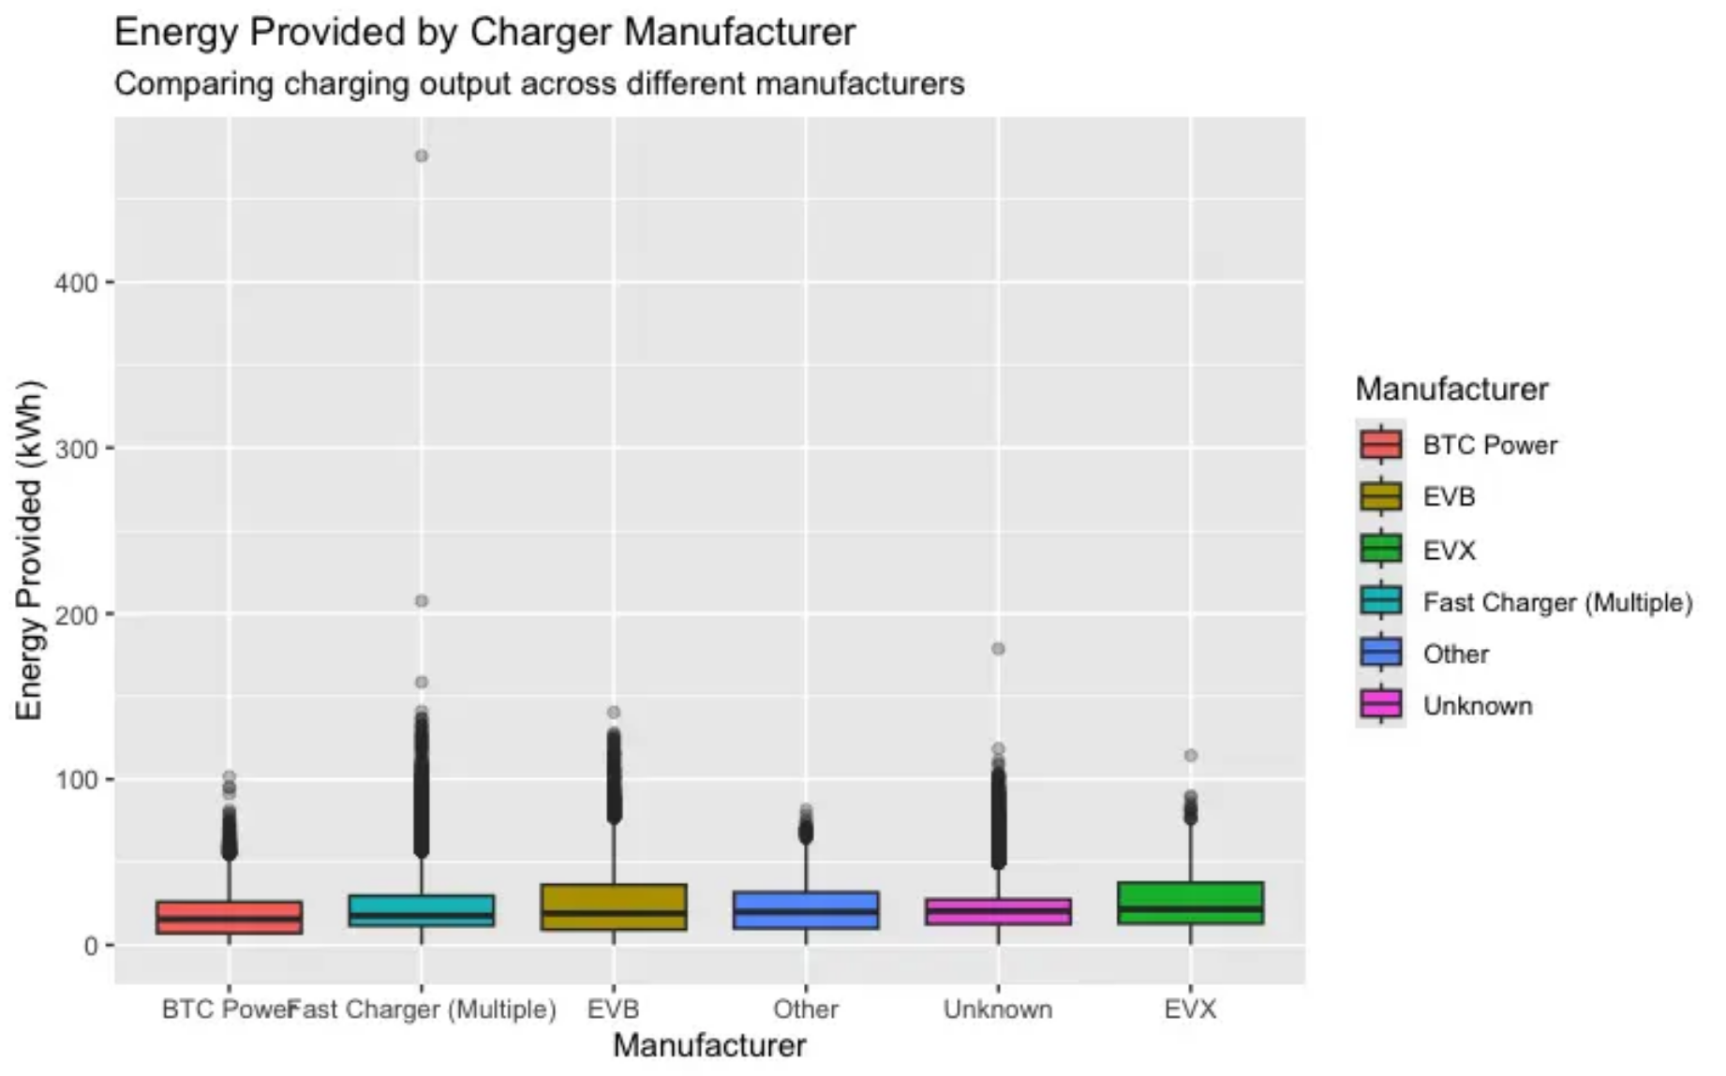
Manufacturer Performance Comparison
Energy Output Comparison by Manufacturer
Charge Duration: EVB shows the highest median charge duration and the most variability with extreme outliers reaching 10,000+ minutes, while Fast Chargers have the shortest and most consistent charge times.
Energy Provided: All manufacturers deliver similar median energy output (~20-30 kWh), but there are significant outliers, especially for EVB and Fast Chargers reaching up to 400+ kWh.

Slide 11











Key Statistical Summary
Our analysis reveals important statistical characteristics in EV charging patterns, highlighting significant variability and non-normal distributions.
Energy Provided (kWh)
Charge Duration (min)
Mean
Median
Mode
Mean
Median
Mode
22.167 kWh
19.17 kWh
20.007 kWh
170.730 min
51.28 min
36.000 min
CV
Skewness
IQR
CV
Skewness
IQR
73.72%
1.339
19.176 kWh
192.11%
7.988
163.750 min
Right-skewed distribution with high variability (CV = 73.72%)
Extreme right-skewed distribution with high variability (CV = 192.11%)
Key Statistical Insights
Energy provided shows slight positive skewness (1.339), indicating more sessions with lower energy consumption and fewer with high delivery.
Charge duration displays extreme skewness (7.988), with most sessions being short but a few exceptionally long sessions pulling the mean upward.

Slide 12
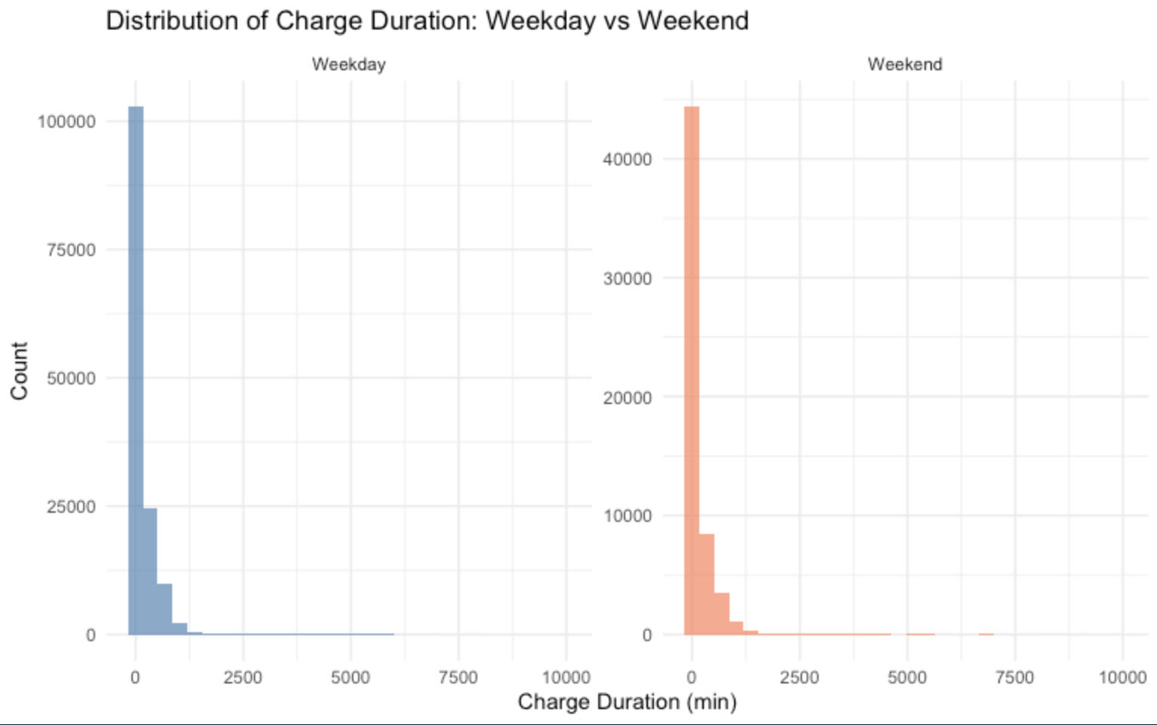
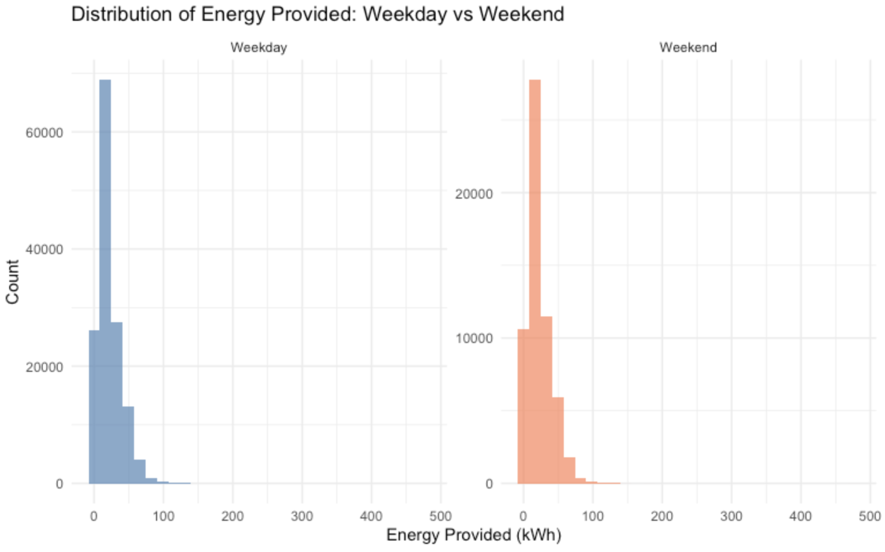
Weekend vs Weekday Differences

Slide 13
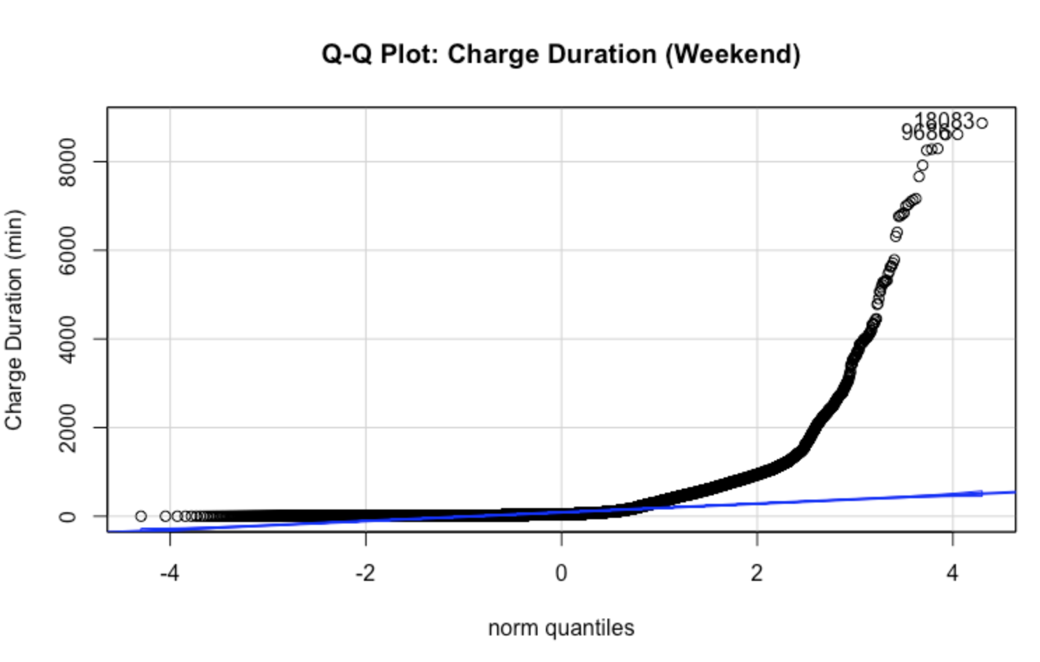
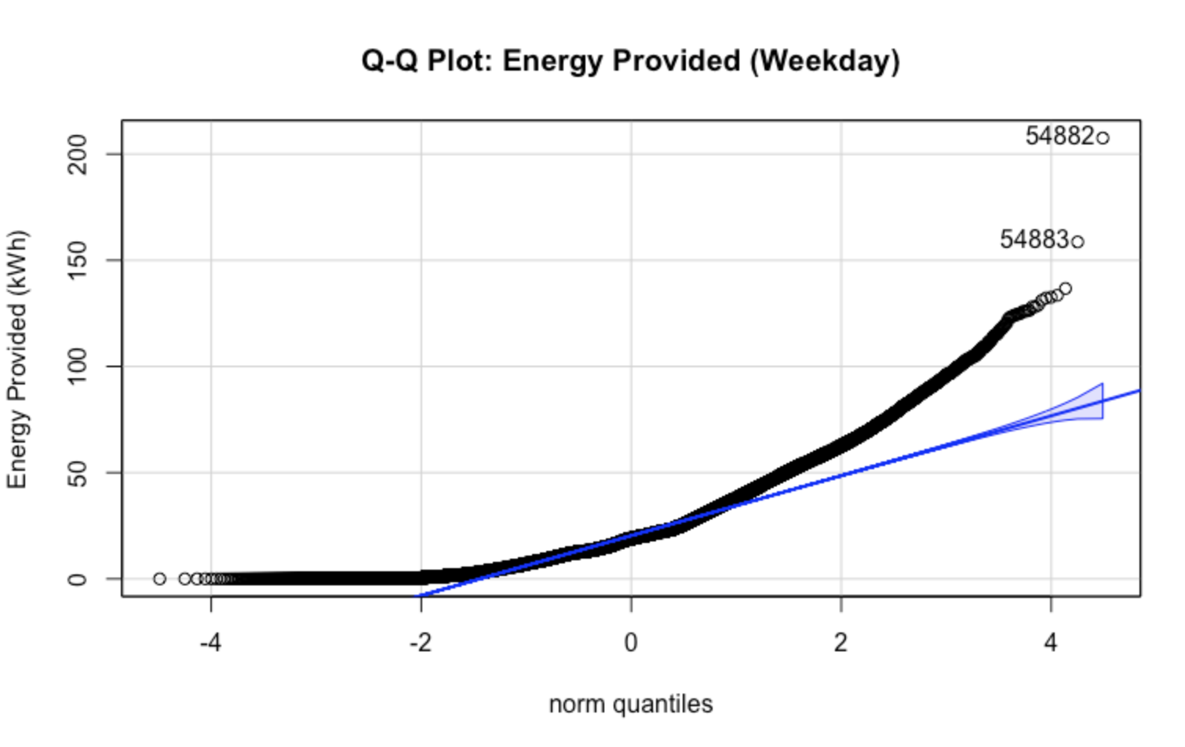
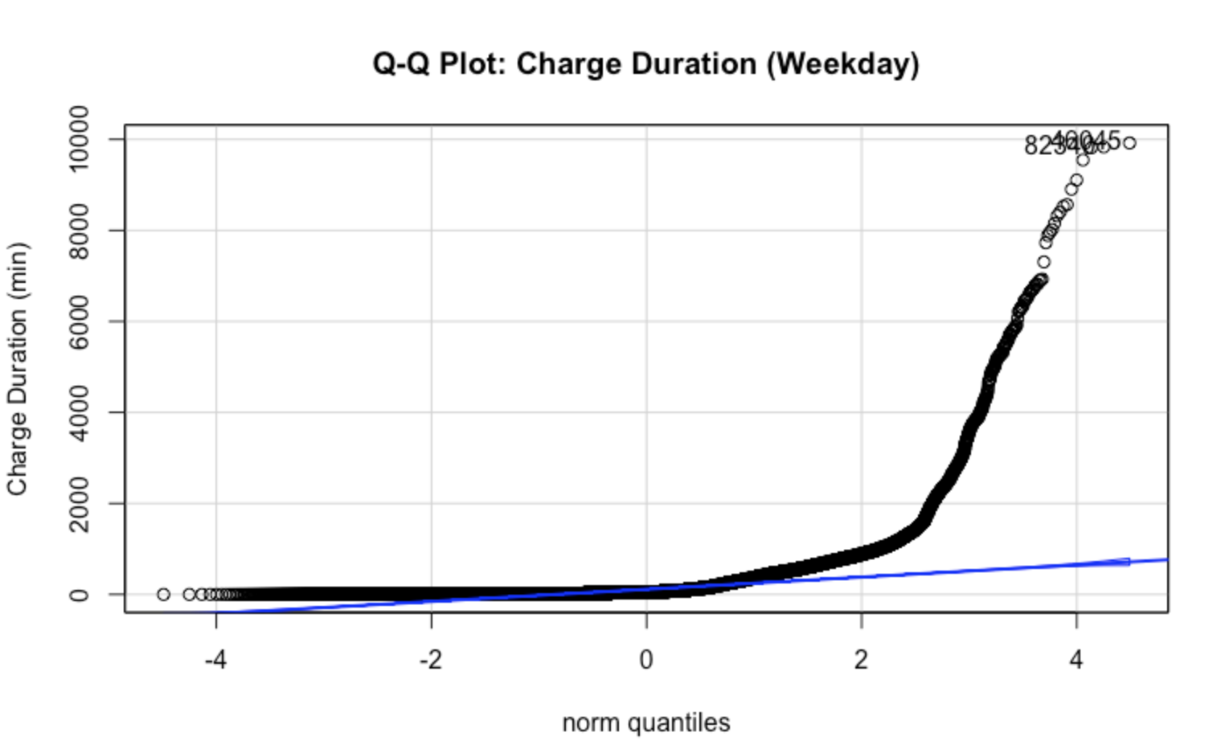
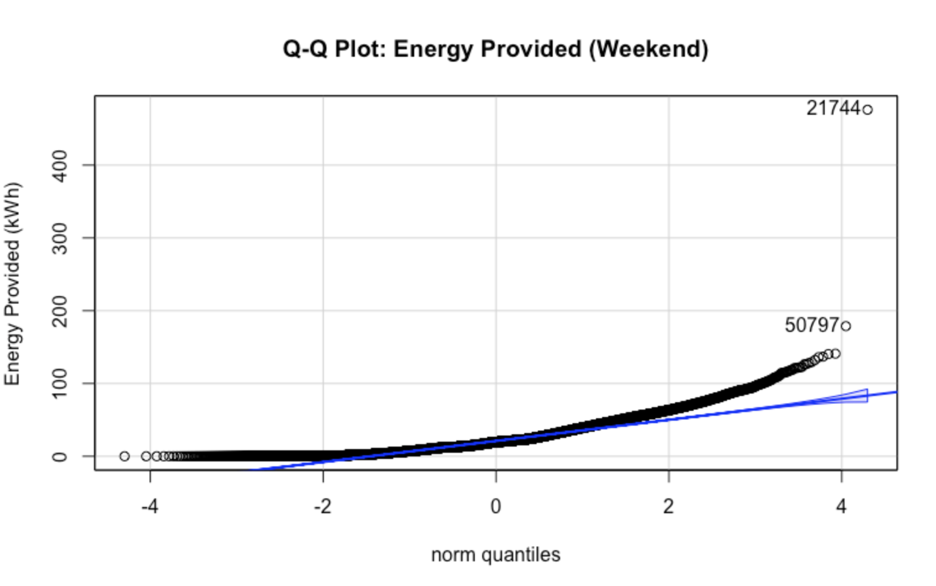
Weekend vs Weekday Differences

Slide 14






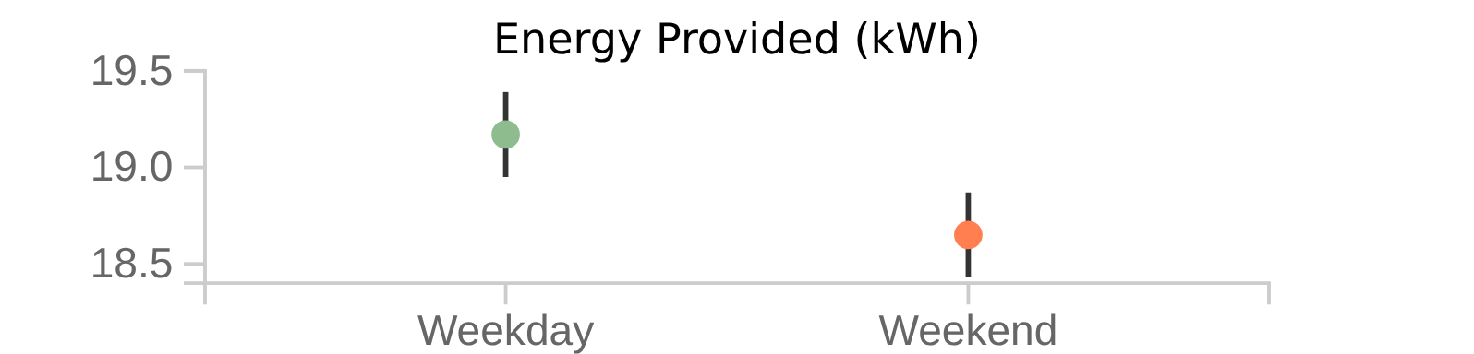
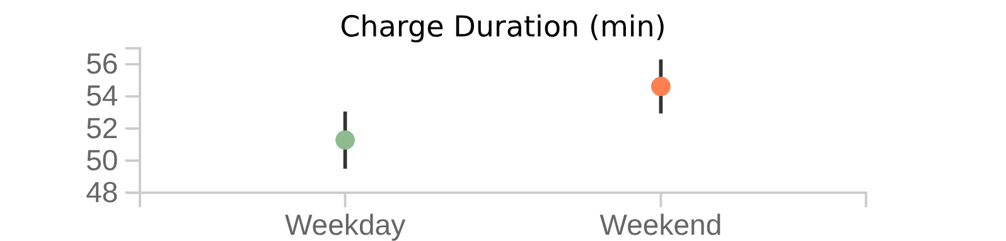



Weekend vs Weekday Differences
Non-parametric Wilcoxon tests reveal significant differences in charging patterns between weekends and weekdays.
Energy Provided (kWh)
Charge Duration (min)
W statistic: 4019331198
W statistic: 4288121703
p-value: 3.461205e-10
p-value: 2.7662e-63
95% CI: -0.518 to -0.267 kWh
95% CI: 3.317 to 4.24 min
Statistical Significance
Both tests resulted in p-values far below 0.05, leading to the rejection of the null hypotheses. This indicates a significant difference in charging patterns between weekends and weekdays.

Slide 15
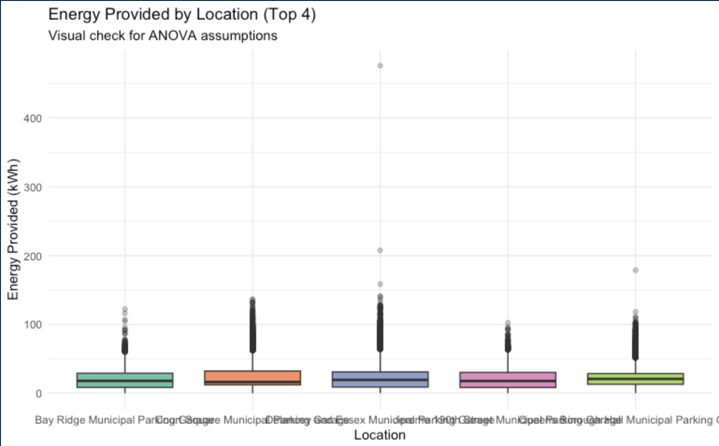
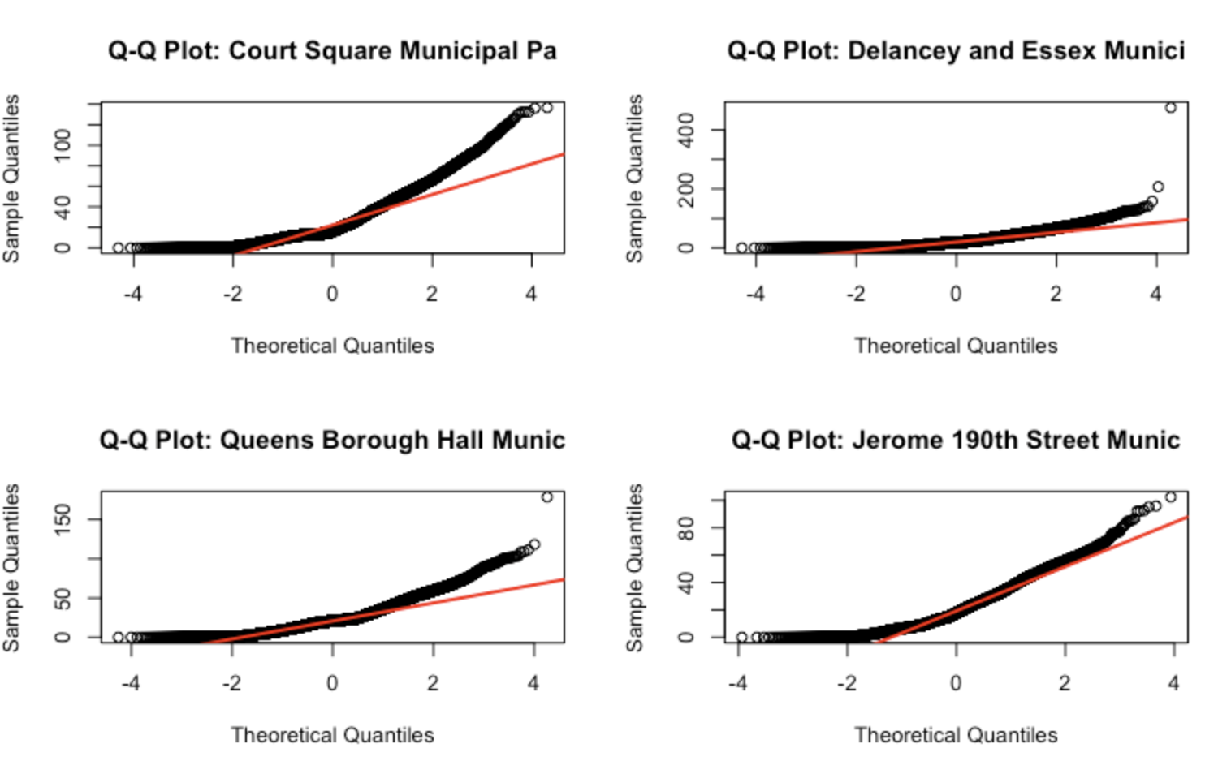
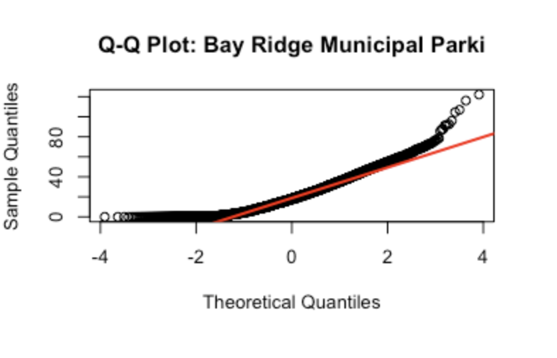
Location-Based Energy Variations

Slide 16










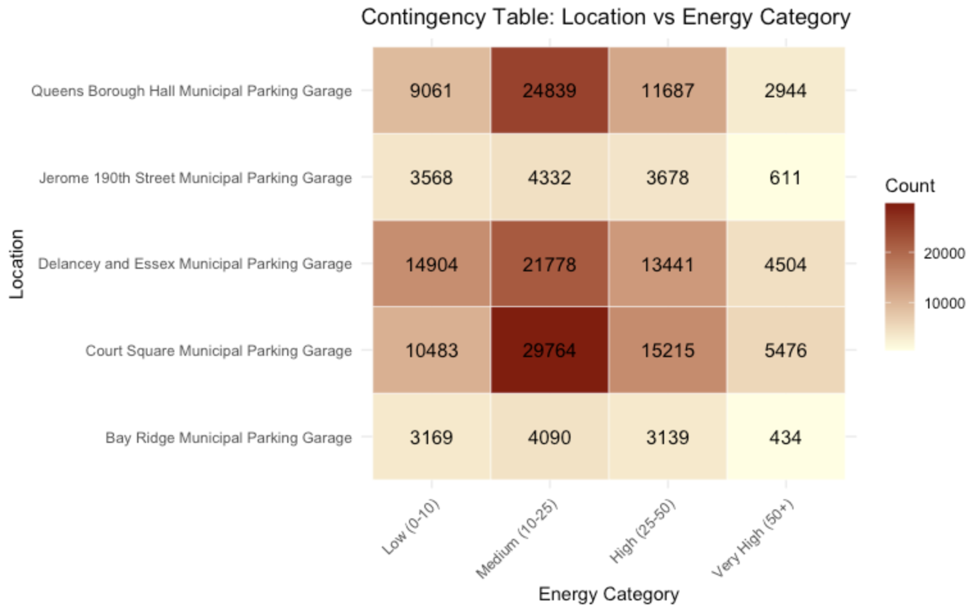
Location-Based Energy Variations
Statistical analysis reveals differences in energy consumption across charging locations.
Kruskal-Wallis Test
Chi-Square Test
Non-parametric test comparing energy distribution
Tests independence between location and energy consumption
Chi-squared
df
p-value
Chi-squared
df
p-value
647.98
4
6.39e-139
4259.91
12
0.00e+00
Significant difference exists
Location and energy category are dependent

Slide 17



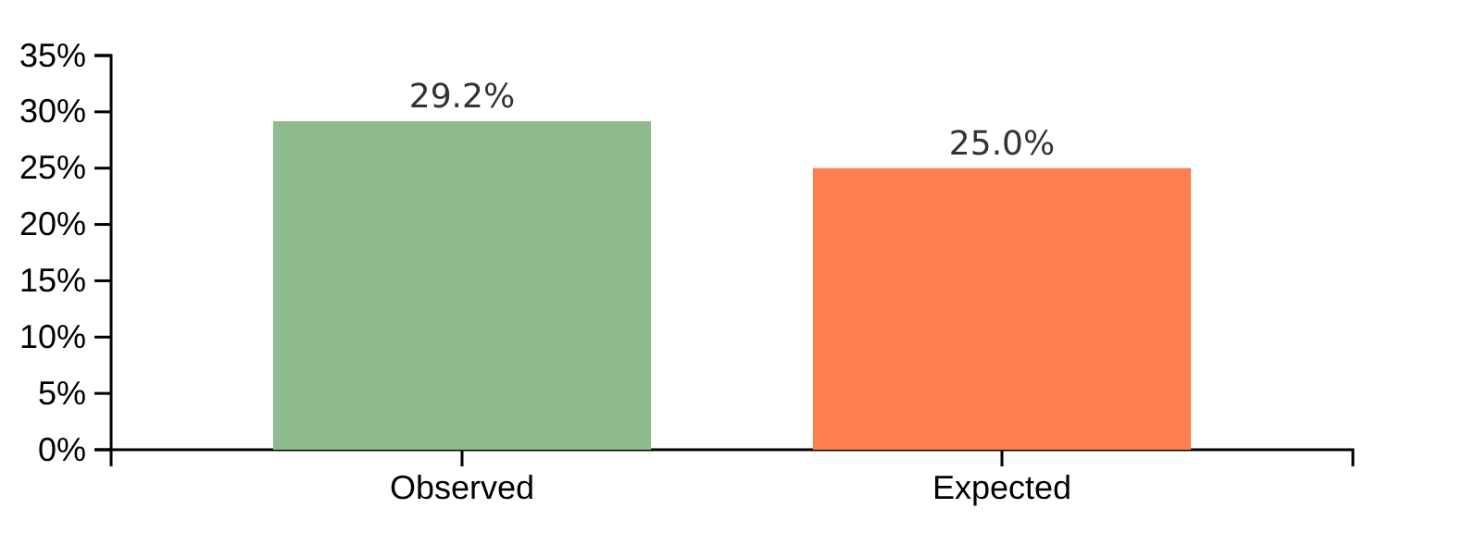
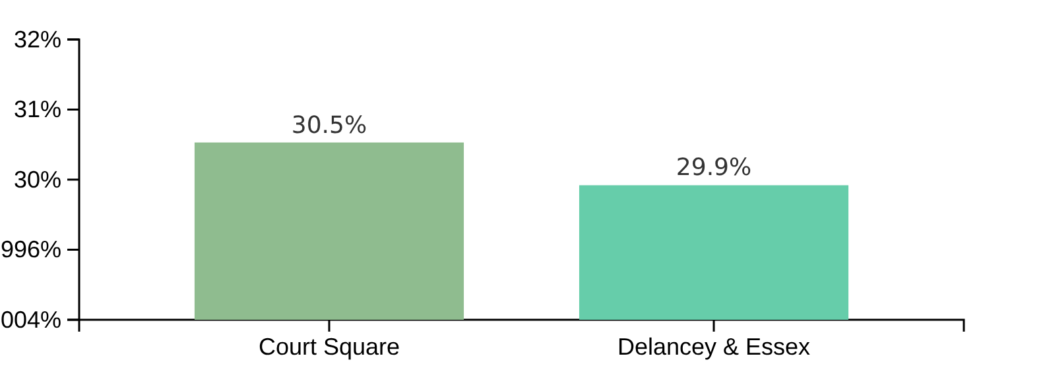

Weekend Usage Proportion Analysis
Weekend Proportion vs. Expected
Location-Specific Weekend Usage
Weekend sessions account for 29.17% of total usage, significantly higher than expected 25%.
Weekend usage varies significantly between locations, with Court Square showing higher usage than Delancey and Essex.
One-sample z-test: z = 42.9661, p ≈ 0
Two-sample z-test: p = 0.0237
95% CI: 0.2897 to 0.2937
Difference: 0.61% (Court Square vs. Delancey)

Slide 18
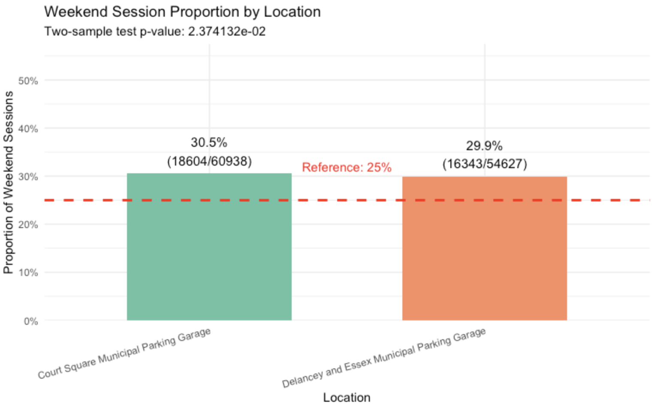
Weekend Usage Proportion Analysis

Slide 19







Variance Analysis Between Groups
F-tests reveal significant differences in energy consumption variance between different session types and time periods.
PAID vs ROAMING Sessions
Weekend vs Weekday Usage
PAID Sessions:
ROAMING Sessions:
Weekday Sessions:
Weekend Sessions:
Count: 185,006
Count: 14,029
Count: 140,976
Count: 58,059
Variance: 267.38 kWh²
Variance: 253.23 kWh²
Variance: 262.50 kWh²
Variance: 277.82 kWh²
Std Dev: 16.35 kWh
Std Dev: 15.91 kWh
Std Dev: 16.20 kWh
Std Dev: 16.67 kWh
F-Test Results:
F-Test Results:
F-statistic: 1.0559, p-value: 1.34e-05
F-statistic: 0.9448, p-value: 3.10e-16
Decision: Reject H₀ - Variances differ
Decision: Reject H₀ - Variances differ

Slide 20
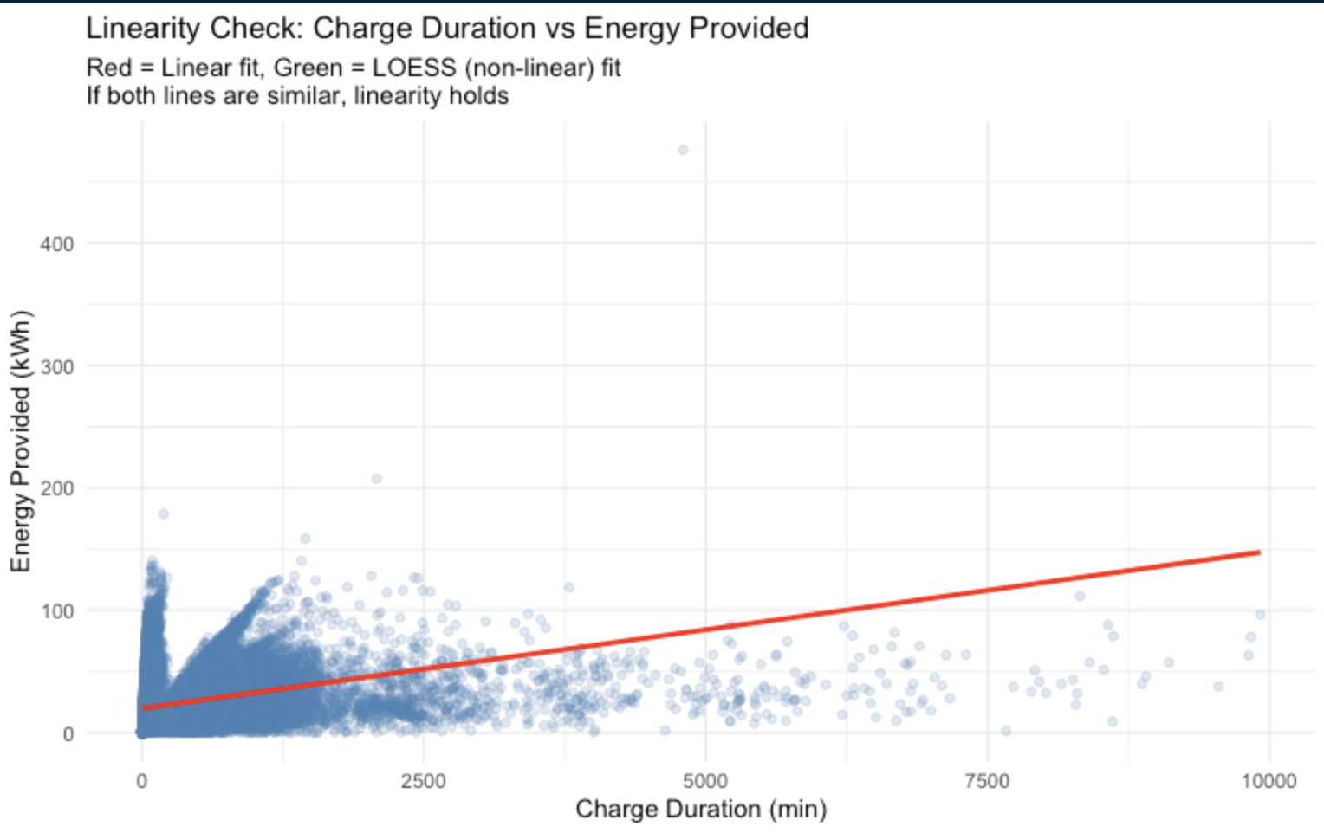
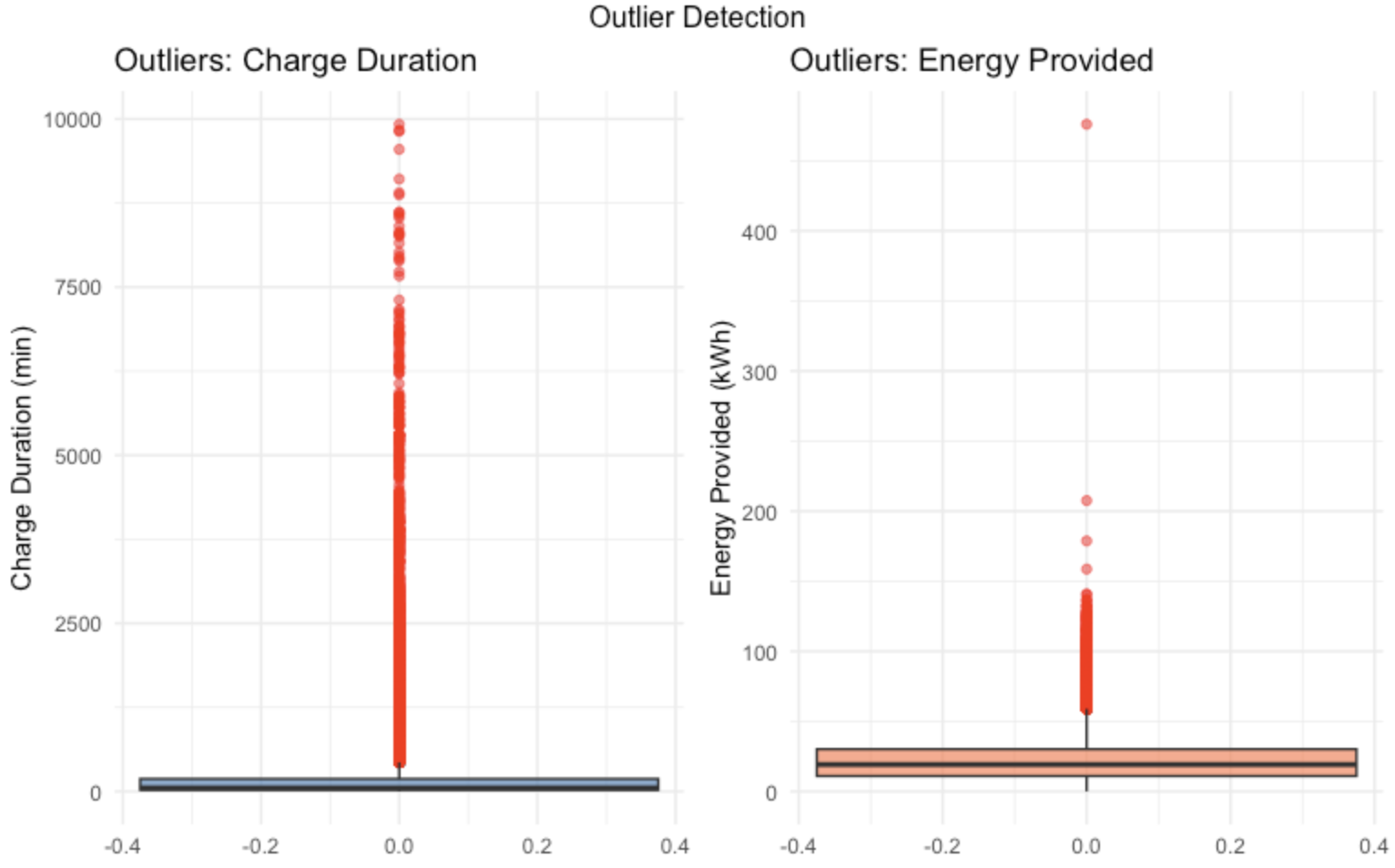
Is there a linear relationship between Charge Duration and Energy Provided?

Slide 21









Key Findings Summary
Peak Weekday Demand
Location-Specific Differences
Charging demand peaks during weekday afternoons and evenings, correlating with commuter schedules and post-work activities.
Energy consumption and session duration vary significantly across locations, with Court Square Municipal Parking Garage showing highest energy consumption.
Higher Weekend Usage
Manufacturer Performance
Weekend charging sessions (29%) significantly exceed the expected 25%, with variation between locations.
Significant differences in energy provided and charge duration across manufacturers, indicating performance variations.
These findings provide valuable insights for optimizing EV charging infrastructure and services.

Slide 22









Implications for Infrastructure Planning
Our analysis reveals valuable insights for optimizing EV charging infrastructure and services.
Dynamic Pricing Strategies
Maintenance Optimization
Peak demand patterns suggest tiered pricing models based on time of day and location.
Manufacturer-specific performance data enables targeted maintenance to improve reliability.
Weekend Capacity Planning
Strategic Infrastructure Investment
Higher weekend usage (29%) than expected (25%) suggests need for robust weekend capacity.
Location-specific analysis guides optimal placement of charging stations and resource allocation.
Future Research Directions
Develop predictive models for demand forecasting, explore holiday impacts, and analyze specific driver demographics for granular insights.

