Slide 1


Cardiac Modeling of
Steady-State Transients in the Ventricular Myocyte
Raymond Tran
University of Queensland
July 10 2013
UCSD PRIME

Slide 2
Progress
Learned to run experiments on Nimrod Portal.
Executed basic test runs on single parameters adjustments with Nimrod/G.
Adjusted MATLAB code and Nimrod plan file in preparation for parametric sweep of applied current values.

Slide 3
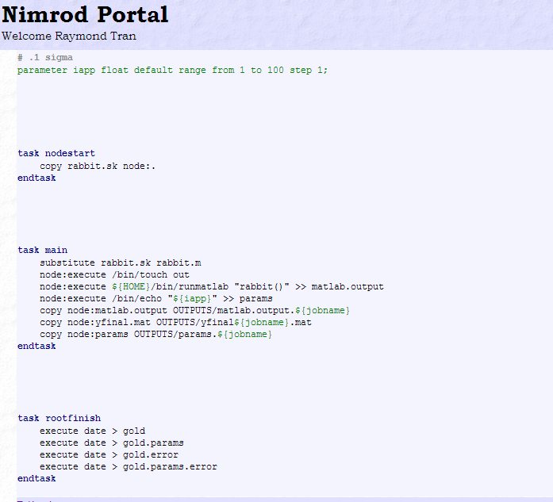
Current Objectives
Need to write a MATLAB script for the plan file that extracts the values of AP, [Ca]i, [Na]i, and [K]i and plots their change over time to reduce amount of memory transferred on Nimrod.
The current plan file of the experiment that needs to be adjusted.

Slide 4
Goals
Begin first experiment by testing a range of values for the applied current.
After testing the applied current, I will test a combination of values for the applied current with its duration.

Slide 5
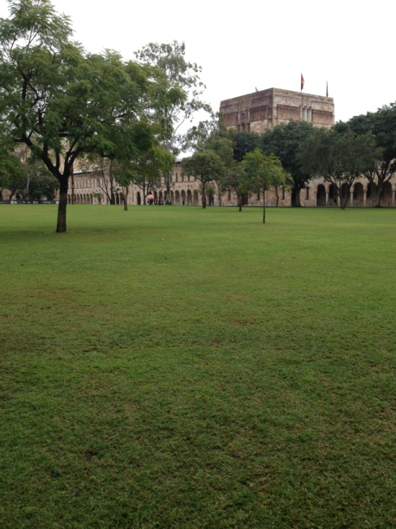





Culture

Slide 6
Acknowledgements
University of California, San Diego
Dr. Anushka Michailova, Department of Bioengineering.
UCSD PRIME – Dr. Peter Arzberger, Dr. Gabriele Wienhausen, Ms. Teri Simas.
University of Queensland
Dr. David Abramson, Centre for Research Computing
Hoang Nguyen, Ph.D. student at University of Queensland

