Slide 1


Cardiac Modeling of
Steady-State Transients in the Ventricular Myocyte
Raymond Tran
University of Queensland
July 17 2013
UCSD PRIME

Slide 2
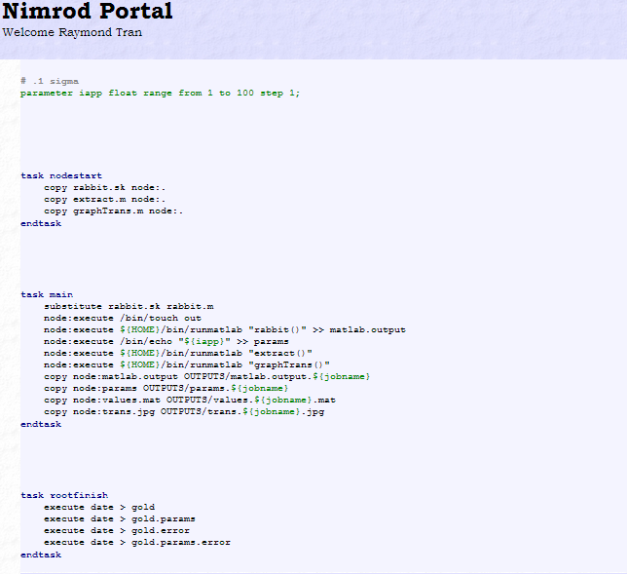
Progress
Wrote MATLAB scripts to extract data and generate graphs for AP, [Ca]i, [Na]i, and [K]i transients.
Incorporated the MATLAB scripts with Nimrod portal and adjusted the plan file.
Revised plan file incorporating the MATLAB scripts

Slide 3
Current Task
Conducted a parameter sweep for the applied current values. However, of the 100 jobs completed via Nimrod/G, 8 jobs contained errors.
Working to correct the errors of the experiment. This must be completed before the experiment can be run again.

Slide 4
Tentative Goals
Correct errors, rerun the parameter sweep.
Go over the generated plots and observe if there are steady-state transients that are in agreement with the figures from the original model.
Incorporate the parameter of duration with the applied current and evaluate the combinations. Must handle the 2100 jobs generated.

Slide 5



Culture
Top left: Spotted! Wild wallabies. Bottom Left: Sunset view from the shore of
Stradbroke Island. Right: A picture with some friends from all over the world.

Slide 6
Acknowledgements
University of California, San Diego
Dr. Anushka Michailova, Department of Bioengineering.
UCSD PRIME – Dr. Peter Arzberger, Dr. Gabriele Wienhausen, Ms. Teri Simas.
University of Queensland
Dr. David Abramson, Centre for Research Computing
Hoang Nguyen, Ph.D. student at University of Queensland

