Slide 1


Cardiac Modeling of
Steady-State Transients in the Ventricular Myocyte
Raymond Tran
University of Queensland
July 24 2013
UCSD PRIME

Slide 2
Project Overview: Steady-State
The Shannon et al model of the cardiac cell is a powerful tool in understanding the coordination and regulation of the processes behind excitation contraction coupling in the ventricular myocyte.
Steady-state describes the behavior of a specific transient when it continues to operate in the same repetitive stimulation over time; this state does not change unless the cellular environment is altered.

Slide 3

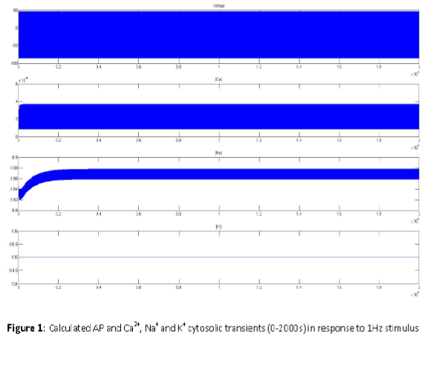
Limitations of the Original Model
The original model achieves
steady-state transients
over an extended period of
time, indicated by the
plateaus in the graphs.
However, the transient for
K+ (the last figure on the
bottom) does not account
for change over time;
therefore the transients in
the model are incorrectly
predicted.

Slide 4
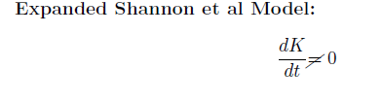
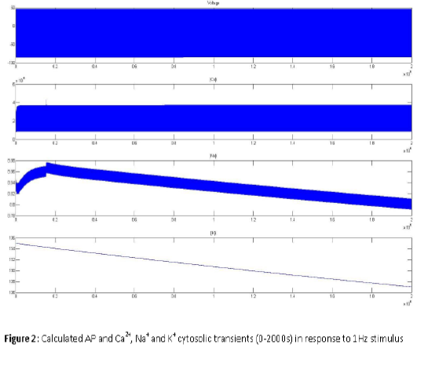
The Project—Overcoming the Limitation
Adjusted the model to account for the change in potassium concentration.
However, as indicated in the figure, the Na and K do not reach steady-state over the same simulation.
Solution: Use Nimrod to test multiple parameters and search for steady-state transients.
My research involves searching for the new transients for AP, [Ca]i, [Na]i, and [K]i.

Slide 5
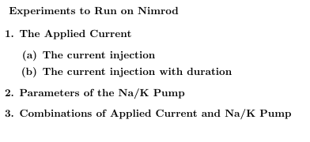
Distributed Computing with Nimrod/G
Nimrod/G is a specialized parametric modeling system that can be used for conducting parametric sweeps across computing resources.
I will use Nimrod to run multiple experiments, testing different set of parameters in the model that may influence steady-state behavior.

Slide 6
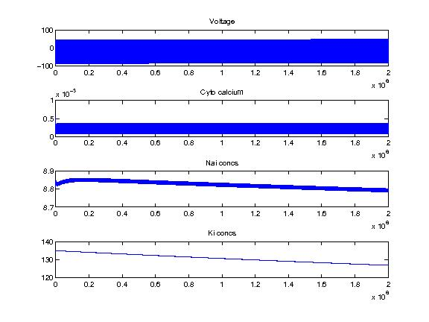
Progress to Date
Extracted data from the experiments testing all values of the current injection. None of the values produced the desired results.
Next step—Run Nimrod to analyze all possible combinations of current injection and its duration.
The extracted data for a specific value of the current injection.

Slide 7
Tentative Goals
Write a MATLAB script that can go through all the jobs on Nimrod and search for a steady-state transient. This will be a very useful program to handle the large amount of parameter combinations.
Start experiments on Na/K pump parameters.

Slide 8
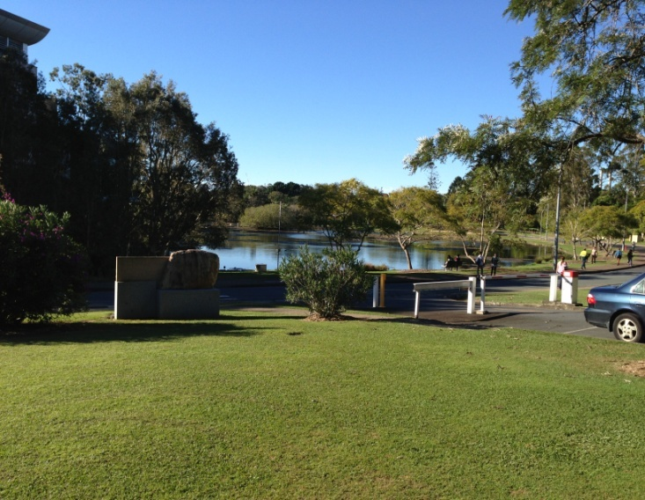


Culture
Top left: The campus lakes. Bottom Left: Fish and chips at a local restaurant near the university. Right: A picture at Story Bridge, overlooking the Brisbane River.

Slide 9
Acknowledgements
University of California, San Diego
Dr. Anushka Michailova, Department of Bioengineering.
UCSD PRIME – Dr. Peter Arzberger, Dr. Gabriele Wienhausen, Ms. Teri Simas.
University of Queensland
Dr. David Abramson, Centre for Research Computing
Hoang Nguyen, Ph.D. student at University of Queensland

