Slide 1


Cardiac Modeling of
Steady-State Transients in the Ventricular Myocyte
Raymond Tran
University of Queensland
July 31 2013
UCSD PRIME

Slide 2
Project Overview: Steady-State
Steady-state describes the behavior of a specific transient when it continues to operate in the same repetitive stimulation over time; this state does not change unless the cellular environment is altered.
This project focuses on using the Nimrod toolkit to perform multiple parameter sweeps on the expanded Shannon et al computational cardiac model. The data will then be analyzed to search for steady-state transients in AP, [Ca]i, [Na]i, [K]i.

Slide 3
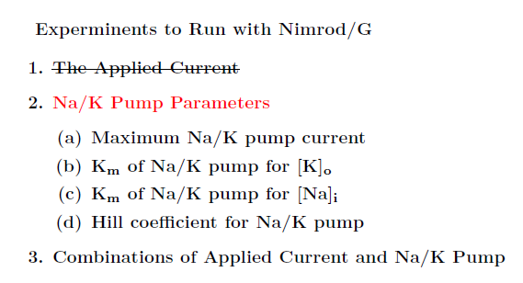
Progress
Conducted parameter sweep and extracted the data of injected current and its duration– as predicted from last weeks results, this set of values did not influence steady-state.
Moving on to test the next set of parameters.

Slide 4
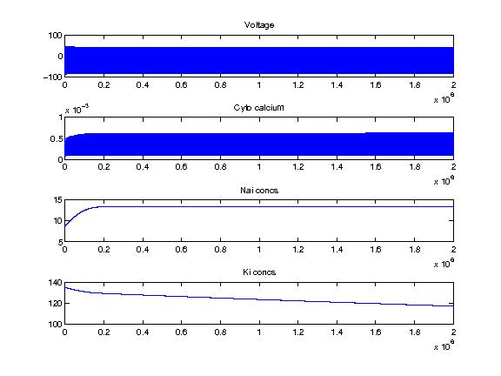
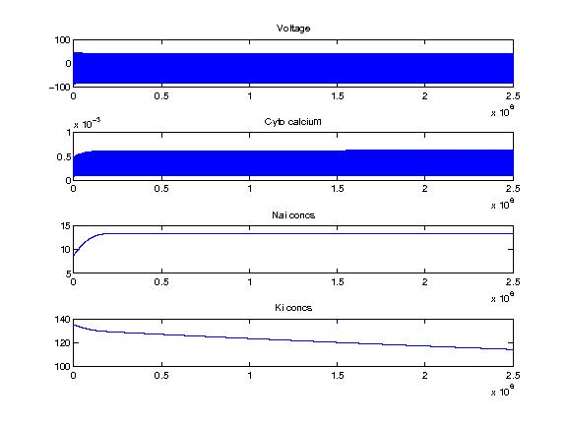
Results thus far
Data set generated at 2000 seconds (left) and 2500 seconds (right)
Ran 625 jobs on Nimrod to generate graphs of transients.
Generated graphs at different time intervals that are close to steady-state behavior, therefore these parameters should be further tested.

Slide 5
Experimental Design
There are 20 million different combinations of parameters for the Na/K pump.
Rather than testing all the combinations, it is better to look for the parameters with the most influence on steady-state behavior.
Solution: The tool Nimrod/O provides a framework which can be used to optimize a target output for an application.
Extracted objective output
The Shannon et al code
Nimrod/O
Schedule file

Slide 6
Tentative Plans
Finish writing a MATLAB script that calculates steady-state values. This is the objective output file that will be incorporated to Nimrod/O.
Use Nimrod/O and search for any parameters which will result in a steady-state transient.

Slide 7

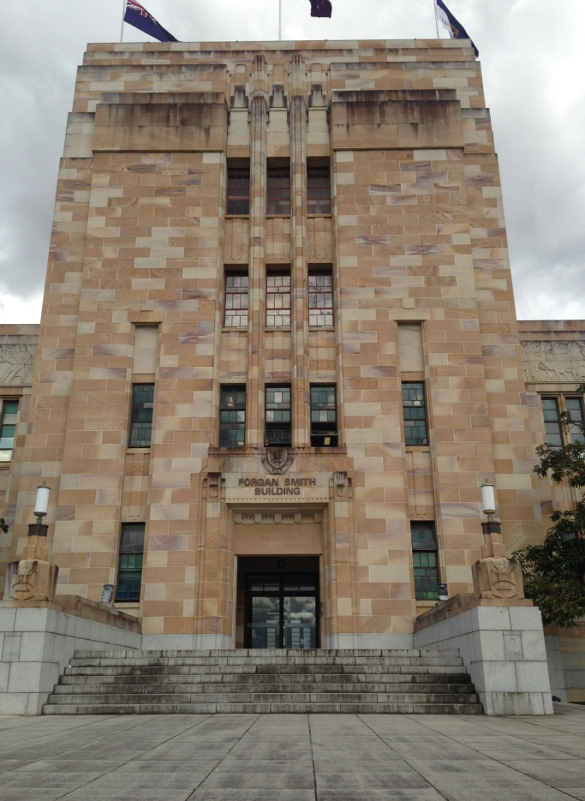


Culture
Left: A memorial for fallen war veterans in central city. Middle: One of the main halls at the university. Top right: A delectable Australian treat–ice cream with butterscotch and shortbread. Bottom right: One of Australia’s most popular biscuits.

Slide 8
Acknowledgements
University of California, San Diego
Dr. Anushka Michailova, Department of Bioengineering.
UCSD PRIME – Dr. Peter Arzberger, Dr. Gabriele Wienhausen, Ms. Teri Simas.
University of Queensland
Dr. David Abramson, Centre for Research Computing
Hoang Nguyen, Ph.D. student at University of Queensland

