Slide 1


Cardiac Modeling of
Steady-State Transients in the Ventricular Myocyte
Raymond Tran
University of Queensland
July 31 2013
UCSD PRIME

Slide 2
Project Overview: Steady-State
Steady-state describes the behavior of a specific transient when it continues to operate in the same repetitive stimulation over time; this state does not change unless the cellular environment is altered.
This project focuses on using the Nimrod toolkit to perform multiple parameter sweeps on the expanded Shannon et al computational cardiac model. The data will then be analyzed to search for steady-state transients in AP, [Ca]i, [Na]i, [K]i.

Slide 3
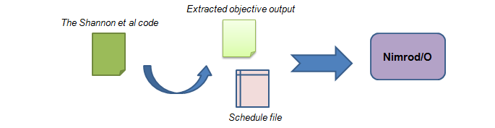
Progress with Nimrod/O
Finished writing an objective function file as a MATLAB script that will be incorporated in Nimrod/O .
Revising the schedule file to run the first optimization experiment with Nimrod/O.

Slide 4
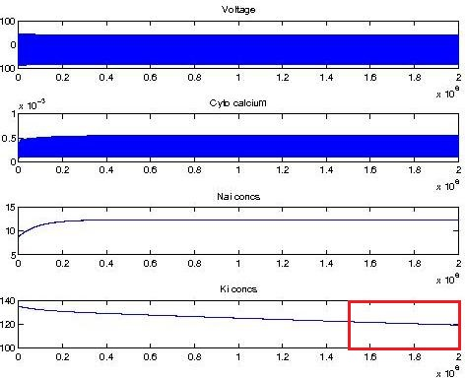
Objective Output Design
Extracts the last 25% of the simulation, then calculates the average rate of change of the K⁺ concentration.
I will use Nimrod/O to minimize this value to see if any parameters can yield potassium values close to a steady-state.
Figure. A transient of interest which will be evaluated for steady-state .

Slide 5
Tentative Plans
Get the first optimization experiment running on Nimrod/O.
Continue to learn more about Nimrod/O and the optimization methods that could be utilized for the experiment.
Set up multiple experiments that will effectively test all the relevant parameter combinations of the Na/K pump.

Slide 6
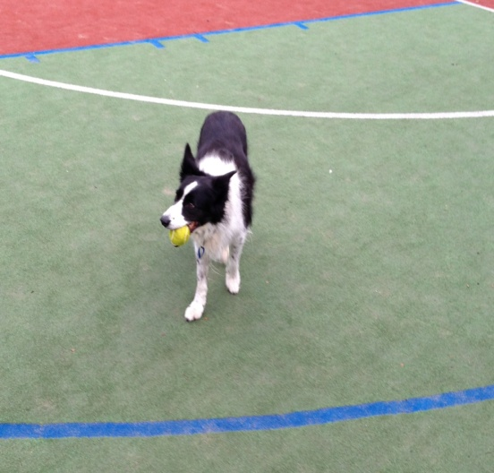

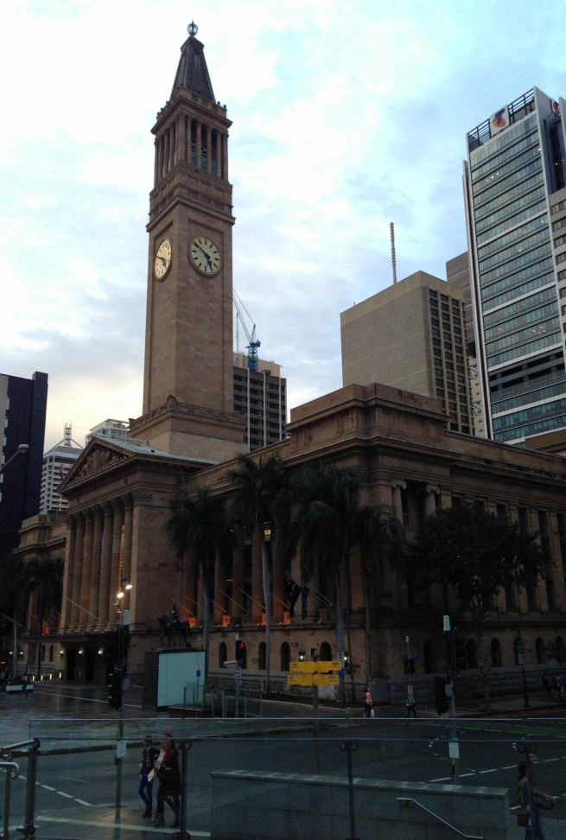
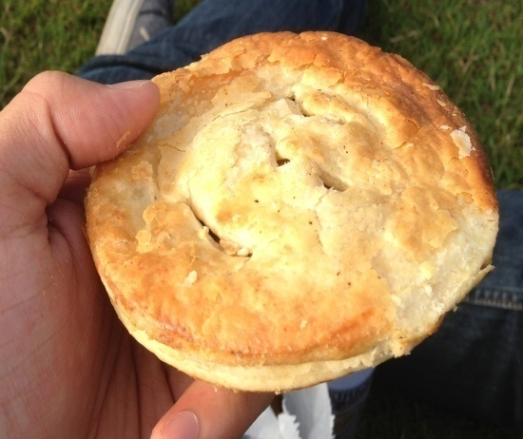
Culture
Top Left: An unexpected friend at Indooroopilly State school. Bottom left: An Aussie classic— a homemade meat pie. Middle: The fountain at the campus lakes. Right: The arts museum located in central Brisbane.

Slide 7
Acknowledgements
University of California, San Diego
Dr. Anushka Michailova, Department of Bioengineering.
UCSD PRIME – Dr. Peter Arzberger, Dr. Gabriele Wienhausen, Ms. Teri Simas.
University of Queensland
Dr. David Abramson, Centre for Research Computing.
Hoang Nguyen, Ph.D. student at University of Queensland.

