Slide 1


Cardiac Modeling of
Steady-State Transients in the Ventricular Myocyte
Raymond Tran
University of Queensland
August 14 2013
UCSD PRIME

Slide 2
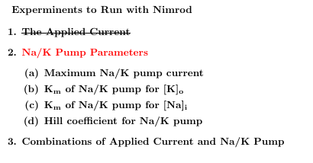
Project Overview: Steady-State
Steady-state describes the behavior of a specific transient when it continues to operate in the same repetitive stimulation over time; this state does not change unless the cellular environment is altered.
This project focuses on using the Nimrod toolkit to perform multiple parameter sweeps on the expanded Shannon et al computational cardiac model. The data will then be analyzed to search for steady-state transients in AP, [Ca]i, [Na]i, [K]i.

Slide 3
Accomplishments thus far
Utilized Nimrod/G to test values of applied current and its duration in the Shannon et al cardiac model at 1 Hz. Concluded that these combinations of parameters cannot help the model reach a steady-state behavior for intracellular potassium.
Tested different granularities and combinations for the Na/K pump parameters using Nimrod/G. In process of concluding the experiments by optimizing the computational model with Nimrod/O.

Slide 4
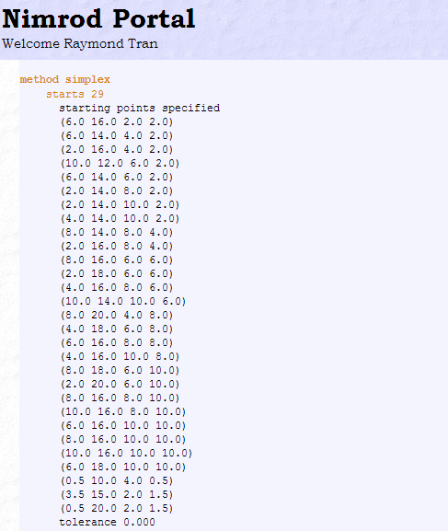
Progress with Nimrod/O
Extracted data from previous Na/K pump experiments on Nimrod/G. The parameter combinations that seemed closest to reaching [K]⁺ steady-state are used as starting points that will drive the Simplex optimization algorithms on Nimrod/O.
Conducted a search for the full Na/K parameter ranges.

Slide 5
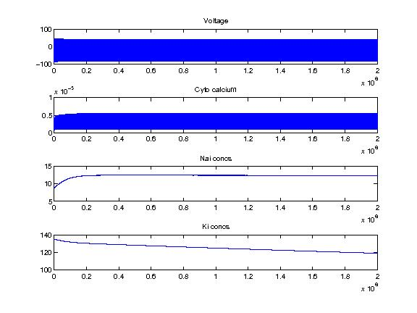
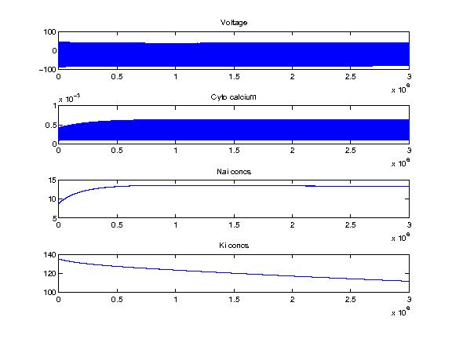
Results
Produced [K⁺]i transients that appear close to a steady-state behavior at 2000 seconds, but when these were further evaluated at an extended time simulation of 3000 seconds, the model still has problems reaching a steady-state.
The transients of one of the Nimrod/O starting points taken at 2000 secs (left) and 3000 secs (right)

Slide 6
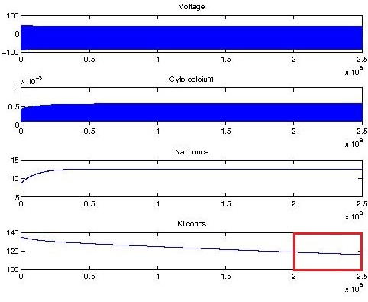
Current Nimrod/O experiment
The results produced from the first optimization experiment on Nimrod/O indicate that the model cannot produce steady-state transients for [K]i for the combination of Na/K pump parameters: IbarNaK, hill, KmKo, and KmNaip. However, I am currently running one more experiment at a longer model simulation to verify this.
The model is run at 2500 seconds and optimized to reduce the rate of change in the last 500 impulses of simulation

Slide 7
Plans for the next two weeks
Conclude the optimization experiments on Na/K pump parameters. Possibly utilize other optimization methods to search for steady-state transients.
Test the applied current parameter set (I_app and t_app) with Na/K pump parameters using Nimrod/O. With time permitting, Nimrod/G will be used to find new parameter spaces that can direct the optimization.

Slide 8





A Weekend at Byron Bay!

Slide 9
Acknowledgements
University of California, San Diego
Dr. Anushka Michailova, Department of Bioengineering.
UCSD PRIME – Dr. Gabriele Wienhausen, Dr. Peter Arzberger, Ms. Teri Simas.
University of Queensland
Dr. David Abramson, Centre for Research Computing.
Dr. Timos Kipouros, Cambridge Engineering Design Center.
Blair Bethwaite, Monash eScience and Grid Engineering Lab.
Hoang Nguyen, Monash eScience and Grid Engineering Lab.

