Slide 1


Cardiac Modeling of
Steady-State Transients in the Ventricular Myocyte
Raymond Tran
University of Queensland
August 24 2013
UCSD PRIME

Slide 2
Project Overview: Steady-State
Steady-state describes the behavior of a specific transient when it continues to operate in the same repetitive stimulation over time; this state does not change unless the cellular environment is altered.
This project focuses on using the Nimrod toolkit to perform multiple parameter sweeps on the expanded Shannon et al computational cardiac model. The data will then be analyzed to search for steady-state transients in AP, [Ca]i, [Na]i, [K]i.

Slide 3
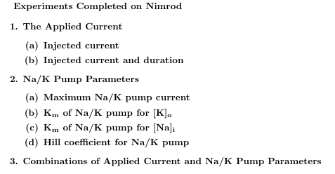
Accomplishments
Completed all optimization experiments of the applied current and Na/K pump on Nimrod/O.
Concluded that these sets of parameters could not influence a steady-state intracellular potassium behavior.

Slide 4
Future Work
The problem that persisted throughout the project was achieving a steady-state behavior for Ki in the expanded Shannon et al model. However, there are six additional potassium channels that may influence potassium stability.
Discuss and share project results with Dr. Michailova, then devise optimization experiments to test the remaining channels.

Slide 5




Culture

Slide 6
Acknowledgements
University of California, San Diego
Dr. Anushka Michailova, Department of Bioengineering.
UCSD PRIME – Dr. Gabriele Wienhausen, Dr. Peter Arzberger, Ms. Teri Simas.
University of Queensland
Dr. David Abramson, Centre for Research Computing.
Dr. Timos Kipouros, Cambridge Engineering Design Center.
Blair Bethwaite, Monash eScience and Grid Engineering Lab.
Hoang Nguyen, Monash eScience and Grid Engineering Lab.

