Slide 1

B.TECH CSE – 3RD SEMESTER
IILM UNIVERSITY
Frontend Development Internship
Student: Taslim Khan| Enrollment: 25SCS1003004521
Organization: CodeAlpha | Duration: 1 August – 30 August 2026

Slide 2
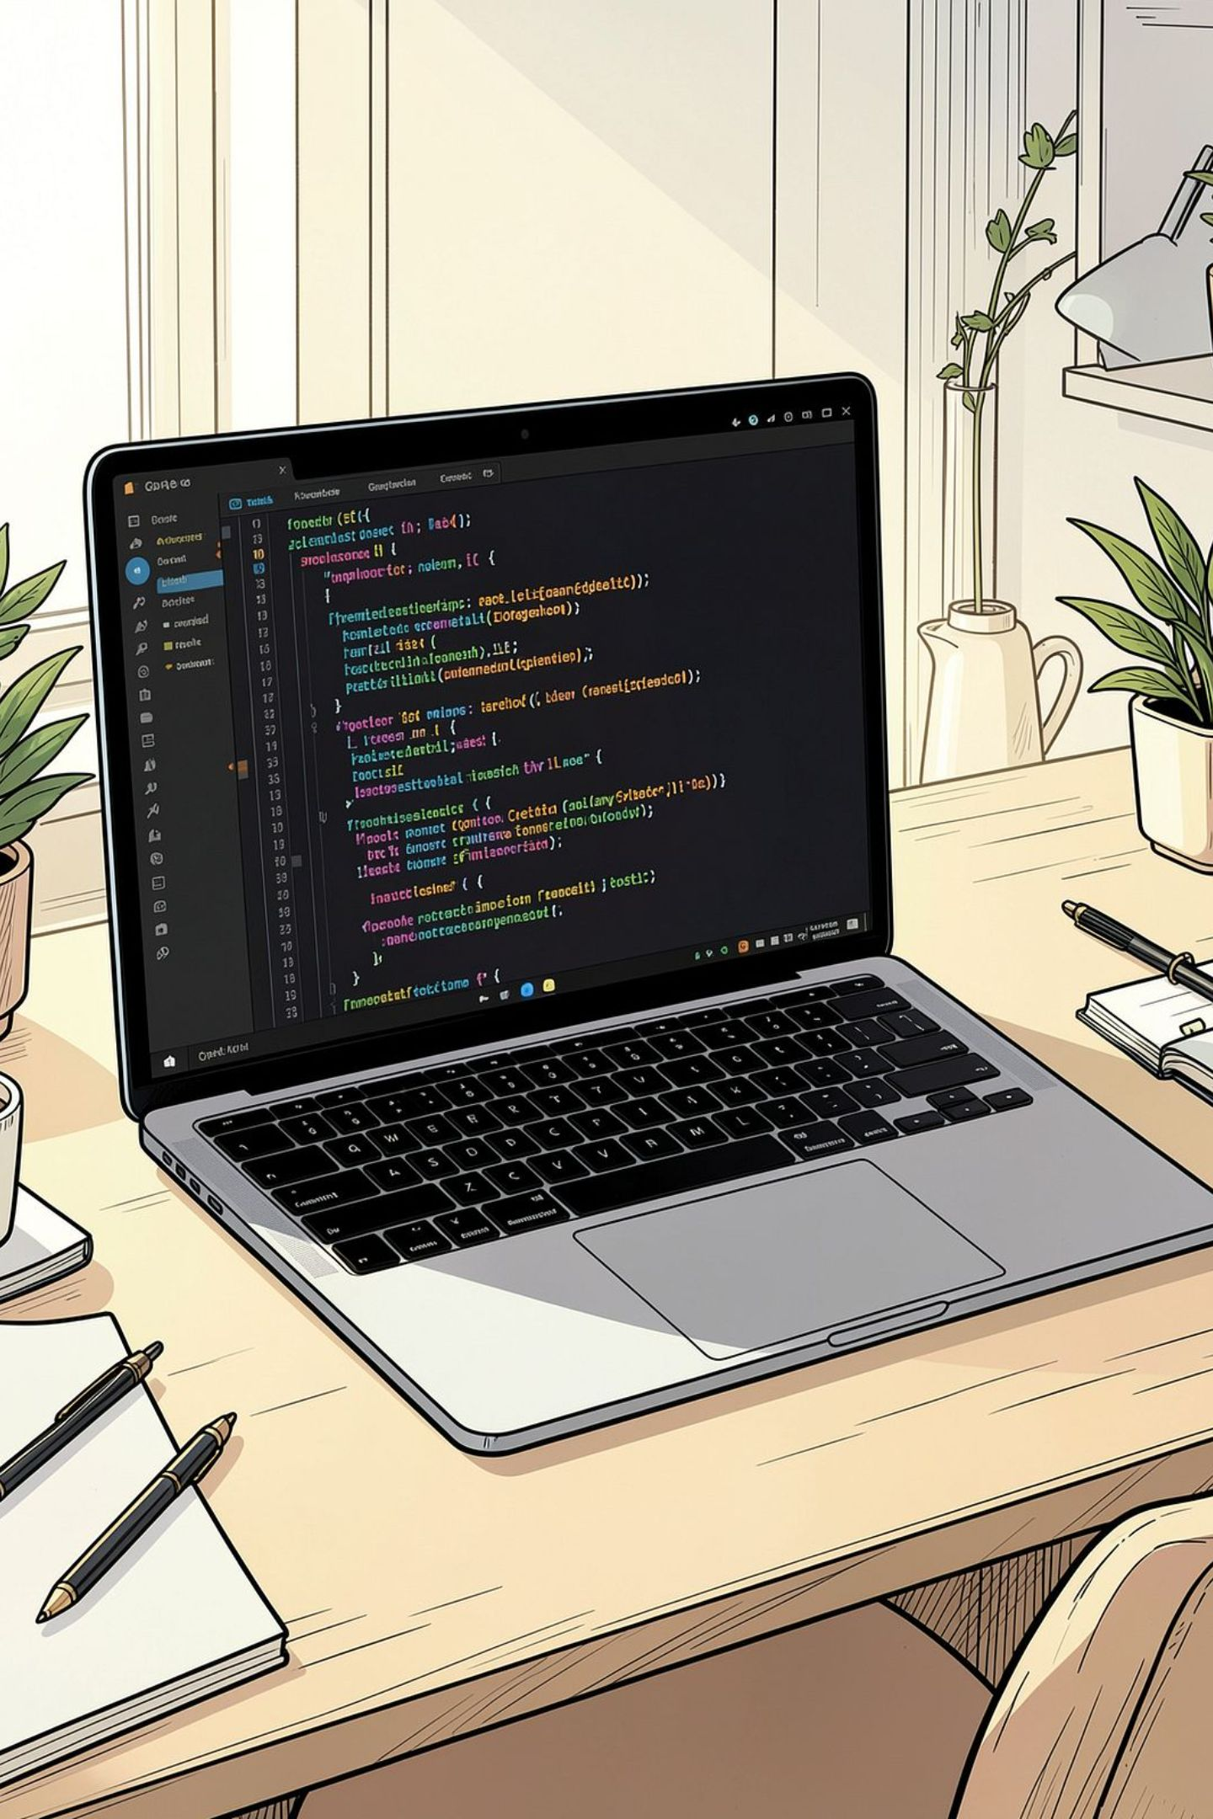
OVERVIEW
Internship Overview
Organization
CodeAlpha — a virtual internship platform offering hands-on, project-based learning in software development.
Domain & Mode
Frontend Development, delivered fully online with structured, assignment-based project work.
Core Technologies
HTML, CSS, and JavaScript — the foundational stack for building interactive web interfaces.
Duration
1 July 2026 to 30 July 2026 — one month of focused, practical frontend development.

Slide 3

OBJECTIVES
Internship Objectives
Apply Frontend Concepts
Translate theoretical knowledge into real, working web projects.
Build Structured Interfaces
Design visually organized and semantically correct web layouts.
Implement Interactivity
Use JavaScript to handle user input and dynamic behavior.
Test & Debug
Practice browser-based testing, debugging, and iterative refinement.
Use GitHub
Maintain versioned source code and present projects professionally.

Slide 4
TECH STACK
Technologies & Tools
HTML5
CSS3
JavaScript
Semantic page structure, content organization, and accessibility-ready markup.
Responsive layouts, typography, color schemes, and visual polish.
Event handling, DOM manipulation, and client-side application logic.
GitHub
VS Code / Browser
Version control, source-code hosting, and project presentation.
Primary development environment and live testing platform.

Slide 5

PROJECT 1
Personal Portfolio Website
A single-page responsive portfolio showcasing the developer's skills, projects, and contact information — built entirely with HTML, CSS, and JavaScript.
Sections
Files
Repo
Header, About, Skills, Projects, Contact
index.html, style.css, script.js
rakesh25scs/CodeAlpha-Portfolio

Slide 6
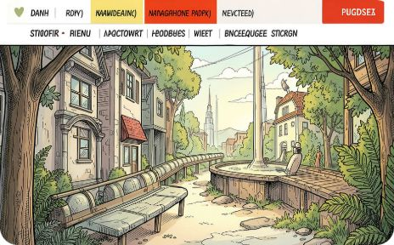

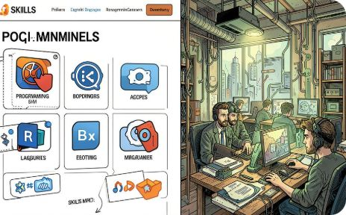
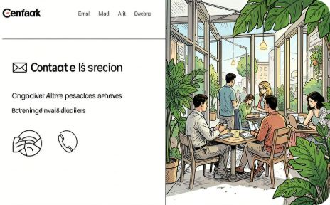
PROJECT 1 — FEATURES
Portfolio — Key Features
Sticky Navigation
Hero Section
Skills & Projects
Contact & Responsive
Persistent header with smooth-scrolling section links for easy navigation.
Introductory banner presenting the developer's name, role, and tagline.
Displays HTML, CSS, JavaScript, Java, and C++ alongside the calculator project.
Email and phone details with layout adjustments for smaller screens.

Slide 7
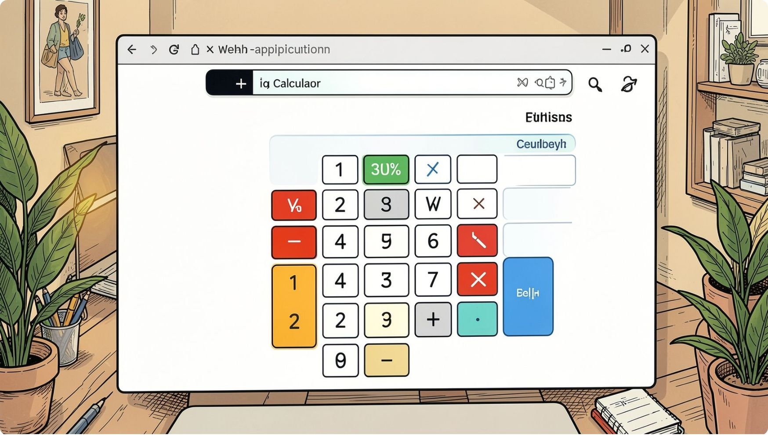
PROJECT 2
Web Calculator
A fully functional browser-based calculator built with HTML, CSS, and JavaScript — featuring a clean four-column button grid and real-time input display.
Operations
Controls
Interface
+ − × ÷ % and decimal input
Clear (C) and Delete (⌫) buttons
4-column button grid layout

Slide 8
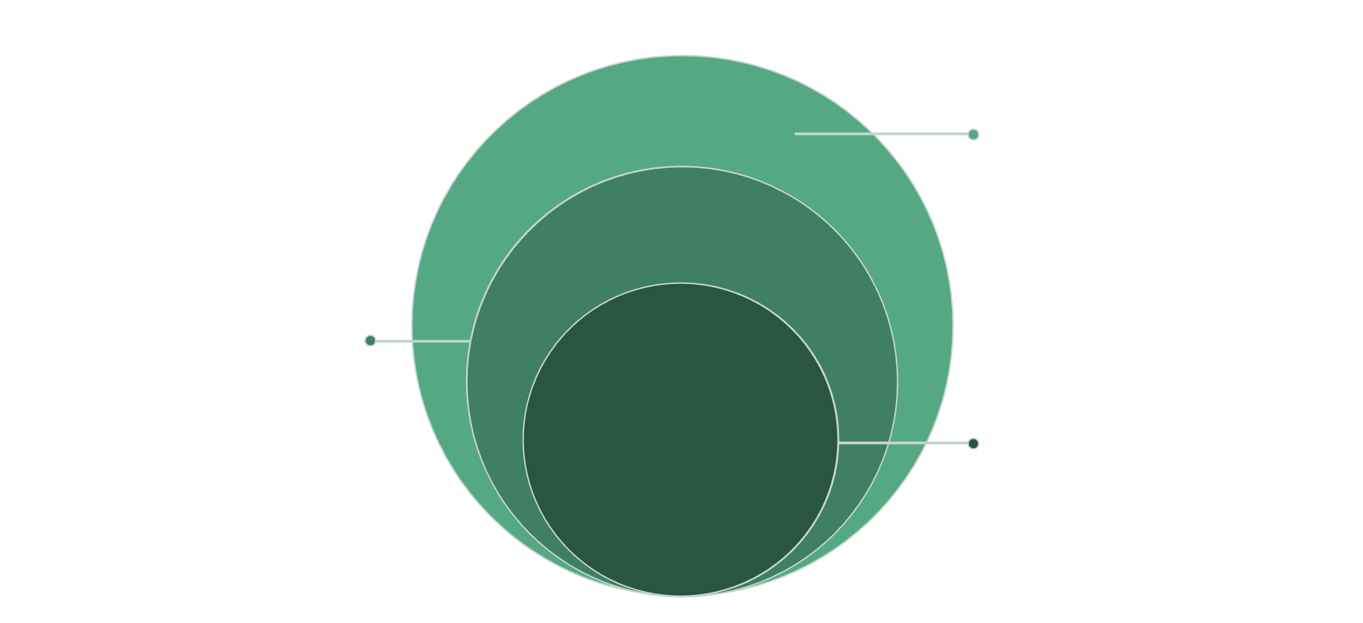
ARCHITECTURE
System Architecture
JavaScript & DOM
Behavior and rendering: events, DOM execution
CSS
Presentation: layout, colors, responsive
HTML
Structure: sections, controls, content
Each layer plays a distinct role: HTML defines structure, CSS controls presentation, JavaScript drives behavior, and the browser's DOM ties everything together for the end user.

Slide 9
METHODOLOGY
Development Methodology
01
02
Requirement Analysis
Interface & Layout Design
Define project scope, features, and user expectations.
Plan visual structure, navigation flow, and responsive breakpoints.
03
04
HTML / CSS / JS Implementation
Browser Testing
Write semantic markup, apply styles, and add interactivity.
Validate functionality and layout across screen sizes.
05
06
Debugging & Refinement
GitHub Publication
Identify and fix errors, then polish the user experience.
Commit code, write documentation, and publish the repository.

Slide 10


OUTCOMES
Learning Outcomes & Conclusion
HTML & CSS
Stronger grasp of semantic structure, responsive layouts, and visual styling.
JavaScript
Practical experience with DOM events, input handling, and application logic.
Debugging
Improved problem-solving through iterative browser-based testing.
GitHub
Version-controlled project presentation and professional code hosting.
This one-month virtual internship at CodeAlpha provided hands-on experience in frontend development. Building a portfolio website and a calculator strengthened skills in HTML, CSS, and JavaScript while introducing professional workflows with GitHub.

