Slide 1
Demonstration Of Rateit
By
Abid Saleh

Slide 2
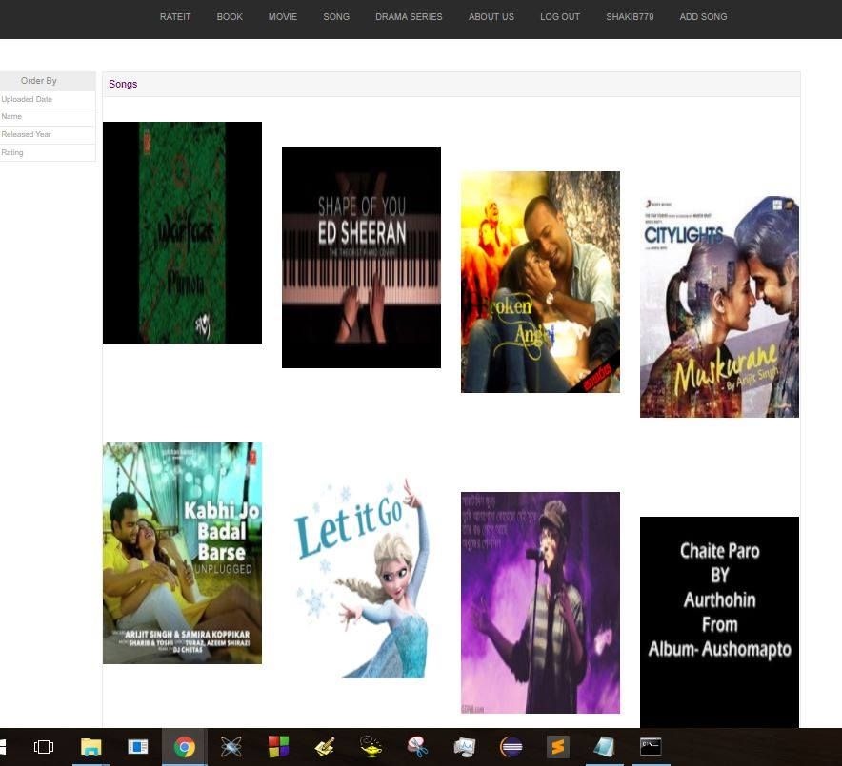
Songs list

Slide 3
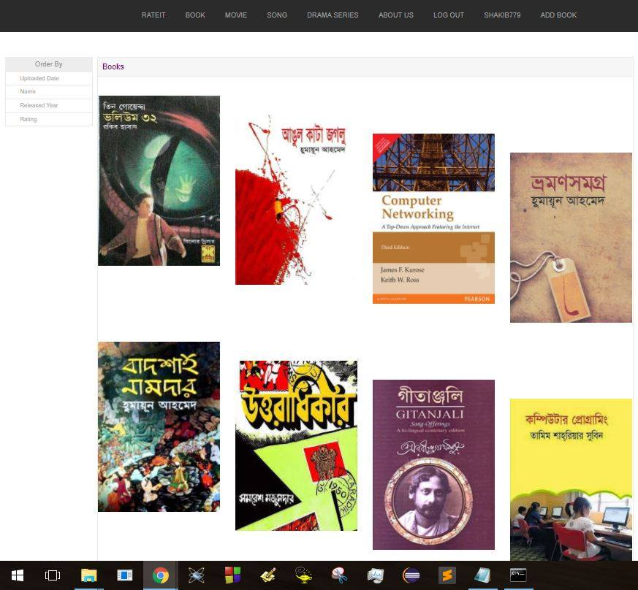
Books list

Slide 4
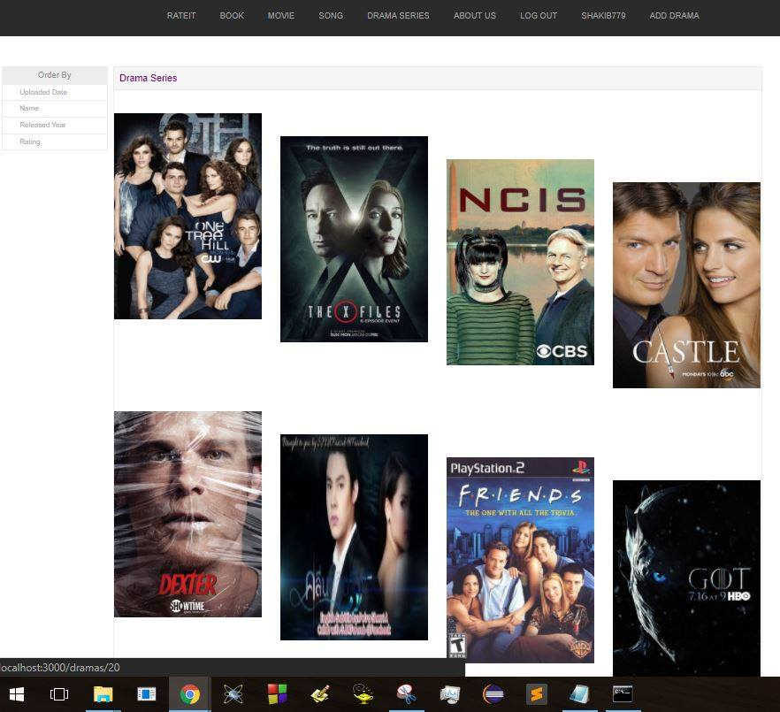
Drama series list

Slide 5
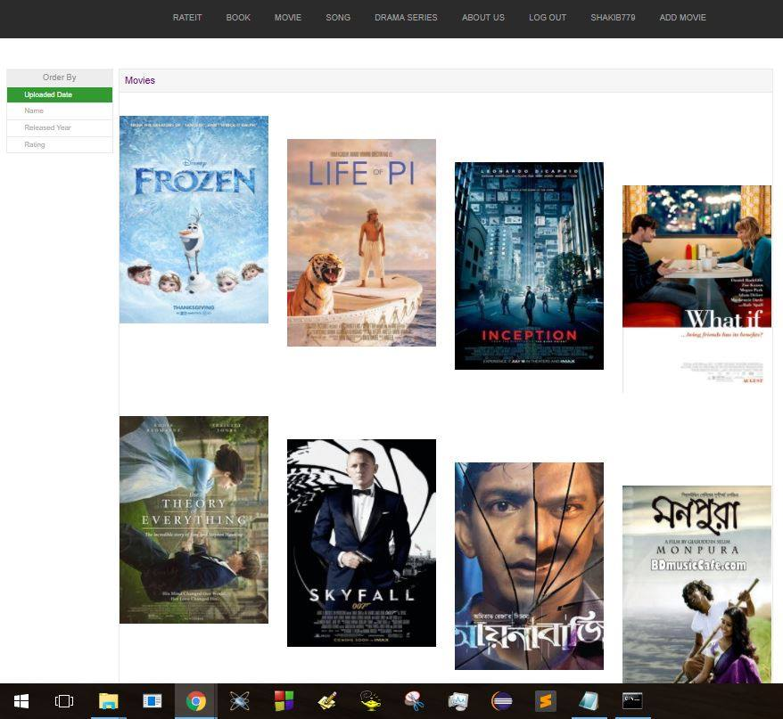
Movies list

Slide 6
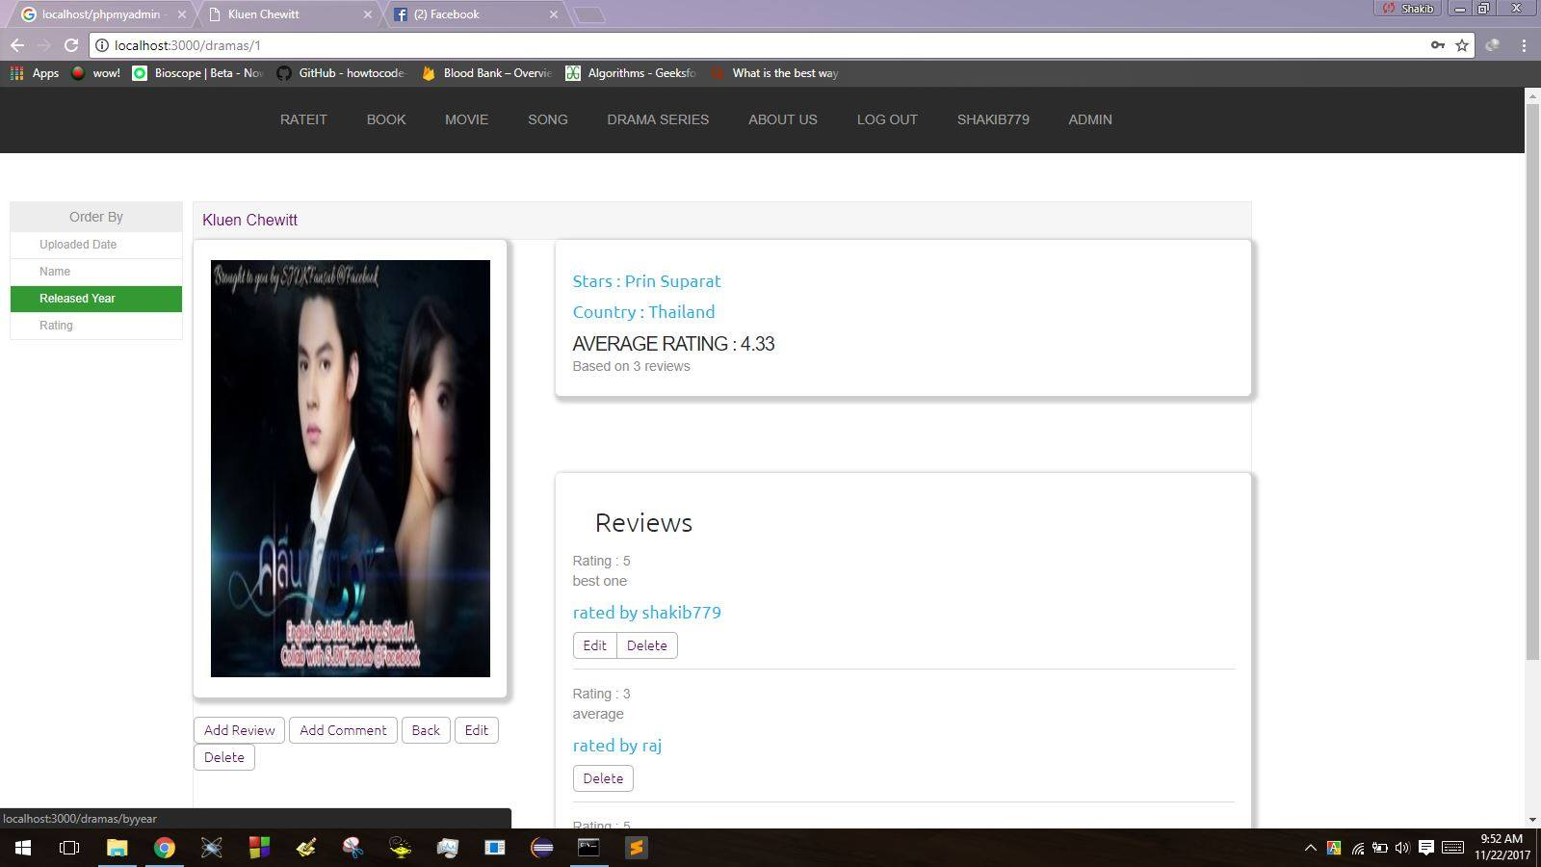
Review and Rating

Slide 7
Thank You

