Slide 1

BJIT ACADEMY
Business Manner
Shamsus Saleehin
Image Placeholder

Slide 2
Topics covered: Session 1
01
What are Business Manners
02
Dress and Grooming- Formal & Casual Attire
03
Presentable Bearing
04
How to Greet Others & Benefits of Greeting
05
Work Rules At Office
07

Slide 3
What are Business Manners ?
Business manners are a form of etiquette that working people need when working with peers, senior coworkers, superiors and clients, as well as when attending a customer.
In order to carry out your work smoothly, you must acquire the business manners appropriate to a working person.
You must also be aware that your attitude and manners will have a direct influence on your company’s image and the way others judge it.

Slide 4
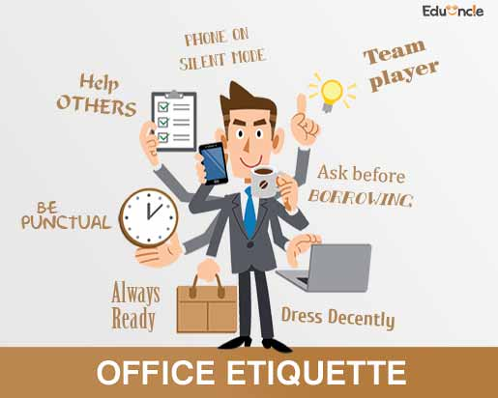
Business Manners Include the Following:
Dress and grooming that looks clean
Presentable bearing (while walking, sitting, standing, etc)
Greetings and bows appropriate to the situation
Use of words approriate to the situation and person
Appropriate work attitude
Reassuring mannerisms when speaking on the phone
Writing basic business e-mails and documents

Slide 5
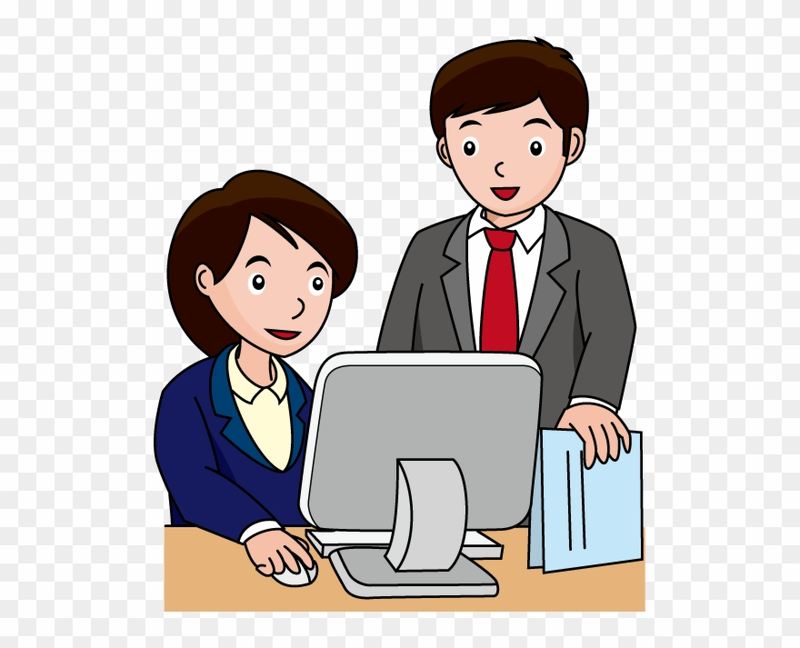
Dress and Grooming Questions to Consider:
Facial
Hair
Shirt
Pants
Socks
Clothes
Hands
Bag
Shoes

Slide 6







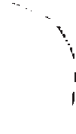



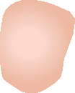






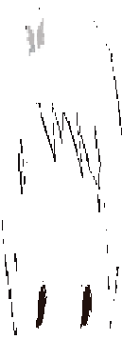




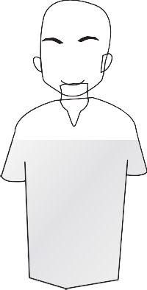





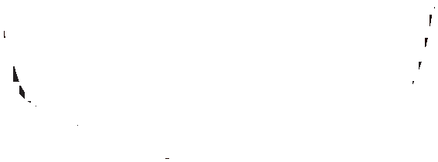
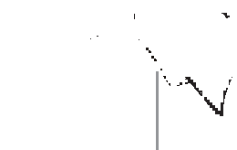








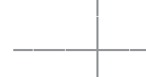














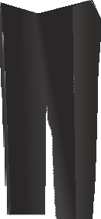
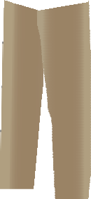





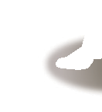


















How to Choose a Shirt
A white shirt can’t fail. When it comes to colored shirts, warm-colored shirts tend to make an overly flashy impression, so pale shirts in cool colors are safest. It is also important to consider how a shirt balances with a suit. In the case of patterned (striped, checkered) shirts, choose thin-lined patterns that almost appear plain.
Casual Attire
Most of the company has one office day where everyone can come with a casual dress. In BJIT we follow Friday as our Casual office day. We can wear Shirt pant and can avoid suit on the casual office day. Panjabi is also a good Friday casual attire. So, we need to keep in mind we don’t become too much casual on this day. If we wear T shirt that must have collar.

Slide 7
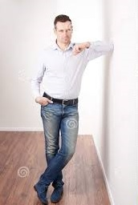
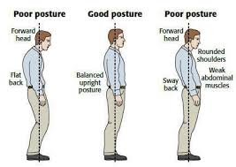
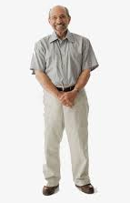
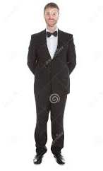

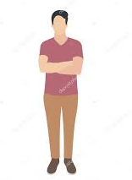
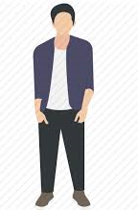

Presentable Bearing: Standing
Show respect to everyone position and behave politely. Follow the tips as follows:
Do’s
Stand with your back straight
Stand with chest out, stomach in
Relax your shoulders & keep even
Men: Keep hands straight down at your sides
Women: Overlap your hands with left hand on top
Feet should form 30-degree ~ 60-degree angel.

Slide 8
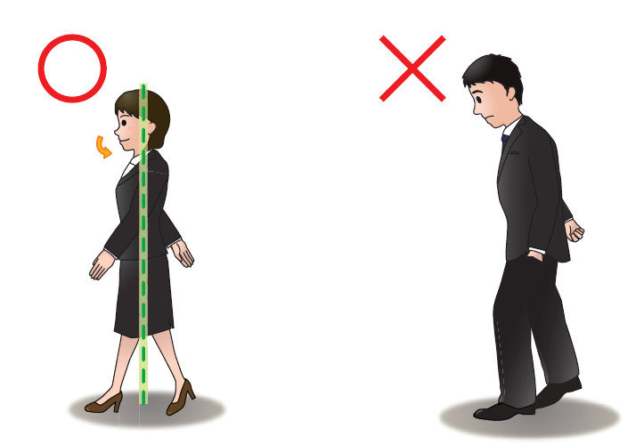
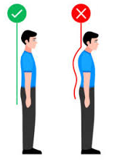
Presentable Bearing: Walking
Not only make good impression but also prevent from growing tired. Follow the tips as below:
Do’s & Don’ts
Walk with your back straight
Chin slightly tucked in, extend legs fully.
Don’t sway your shoulders
Don’t drag your feet or step loudly
Walk at right speed: Not too fast, Not too slow.

Slide 9
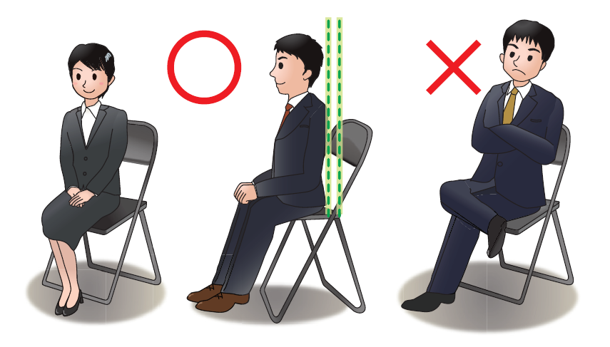
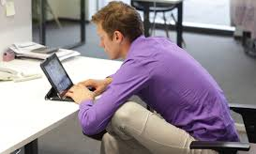
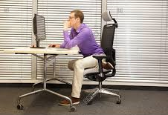
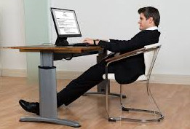
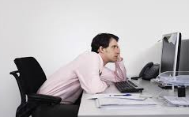
Presentable Bearing: Sitting
When sit down in a chair, it is easy to relax and let your posture slip. Follow the tips:
Do’s
Keep your back straight
Men: Leave space for about 2 fists between your knees
Keep hands on top of thighs
Women: Keep your knees together and fold your hands top of thighs

Slide 10
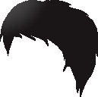
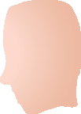


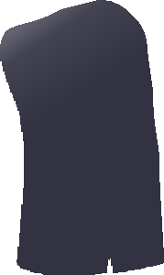


















Greetings
Everything should start with a greeting
When?
Encounter someone
Start day in the office
Benefit?
Connect with people
Conversation with smooth start
Favor from counter person
Return greeting 🡪 Receive same spirit
Points to keep in mind !!
Take the initiative to offer greetings
Be Heartful & speak audibly
Stay energetic with bright voice
Make eye contact & smile naturally
Use appropriate greetings
Someone greetings 🡪 be sure to reply
Give attention, be sincere, confident
Don’t be nervous and stay comfort

Slide 11
Basic Greetings & Formalities (Farewells)
Greetings:
Morning
Noon/Afternoon
Evening
(Till 11:00 AM/12:00PM) 🡪 Good Morning! (Ohayō gozaimasu)
(After 11:00 AM/12:00PM) 🡪 Good Afternoon! (Konnichiwa)
Evening (After 6:00 PM) 🡪 Good Evening! (Konbanwa)
→
→
→

Slide 12
Basic Greetings & Formalities (Farewells)
Farewells & Formalities
When leaving desk
Make the purpose and destination clear to other people and your boss.
Inform how long will be away
Phrase when leaving 🡪 Itte kimasu = I am going out! See you later!
Phrase when see off 🡪 Itte rasshai mase
When returning desk
Don’t sit down in silence, instead say something to those around you.
Phrase when you return 🡪 Otsukare sama desu = Welcome back!
Phrase when you are receiving 🡪 Okaeri nasai. Otsukare sama deshita.- Thank you for your hard work.
When leaving workplace
Phrase when leaving 🡪 Osaki ni shitsurei shimasu,
Phrase when see off 🡪 Otsukare sama deshita
Osaki ni shitsurei shimasu = I am going to leave before you.
*Which is said at office usually. For example, You are working but your colleague is going to leave before you. Then your colleague can say this to you with the feeling liken "Sorry brother, I wish I could stay here with you but due to emergency family issue I need to leave.."

Slide 13
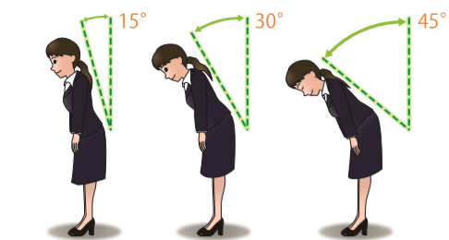
Bowing
Bow when offering greetings! 🡪 Express respect and sincerity by how you bow
Bow type differs depending on 🡪
Whom You are Bowing, Place & Purpose
Don’t just obey the form :
Make it heartfelt & sincere
Keep back straight & feet together
Men: Keep hands straight down along the seams of pant
Women: Bring hands forward naturally & gently overlap them Infront of body.
While keeping neck straight, lower upper body by bending at the waist.
Keep your gaze lowered
Raise backup slowly, shortly after the other person.
BOW
Respectful BOW
Deep BOW

Slide 14
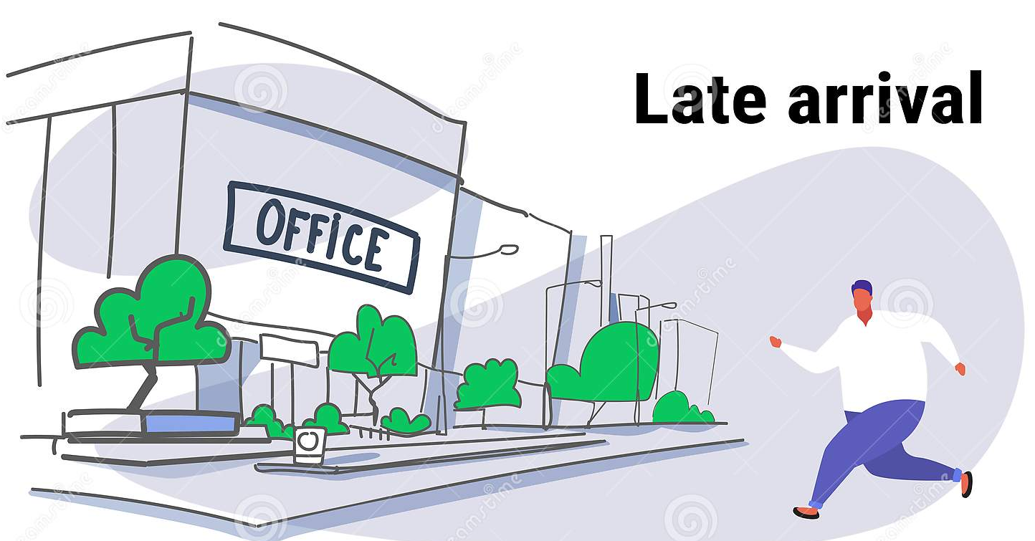
Work Rules
Arrival Time
The official time the workday begins is not the time when you should arrive at work—it’s when you’re supposed to start doing your work. So, try to arrive at your desk at least five minutes before work starts During that time, think over your plans for the day and your work priorities in order to begin your work efficiently. A working person should never arrive late. When it becomes clear that you won’t be able to avoid arriving late, call to inform your workplace before starting time.
Calling Ahead for Late Arrival
The reason, when it becomes clear that you will arrive late, inform your company. If it begins to look like you may arrive much later than your estimated time of arrival, contact your company again.
Submitting Proof of Transportation Delay
When delay arriving at office try to provide proof of delay, if there is any accident and due to that there was unusual traffic you can take picture of that and can share with your supervisor.

Slide 15
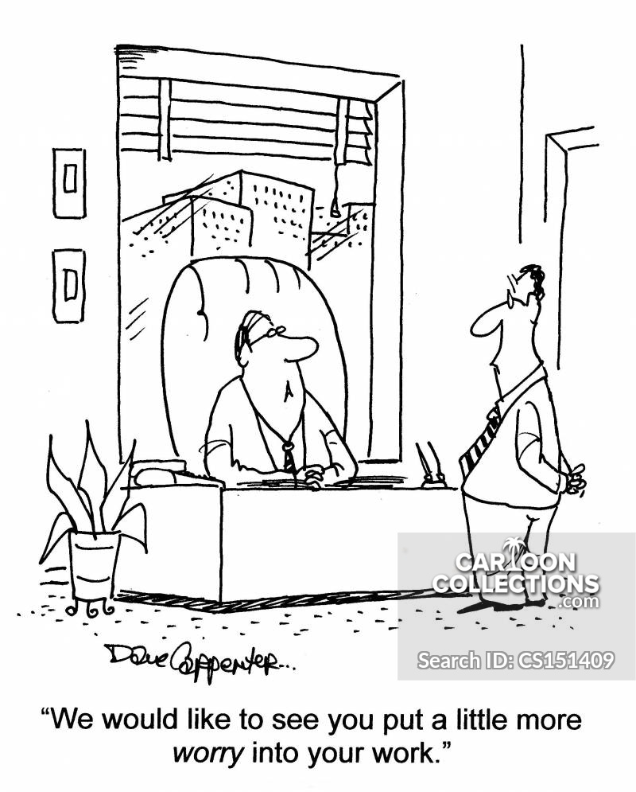
Requesting Leave
You may take a planned leave by submitting a request ahead of time, or you may have to take leave suddenly for unavoidable circumstances. In either case, it is important to be mindful of work circumstances and show consideration for those around you when taking leave.
Requesting Leave Beforehand
Once you have decided upon the days you want to take leave, inform the company as soon as possible, adjust your work schedule, and seek the understanding of those around you.
Sudden Leave
Suddenly calling in to request leave the morning of a day you want off will cause others trouble. Be aware that often taking leave suddenly will decrease your coworkers’ trust in you. However, illness and family circumstances can make such an event unavoidable.

Slide 16
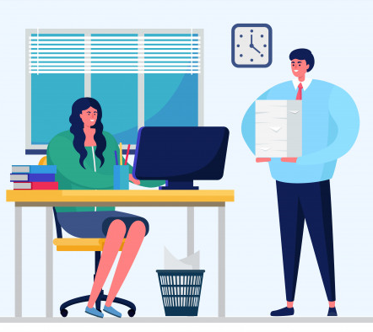
Health Management
View the daily care of your health as an essential part of work. Strive to stay healthy for working by getting plenty of sleep, proper nutrition, and regular exercise. Be extra careful when the seasons are changing or when you find yourself working lots of overtime.
Manners When Leaving Work
When it’s quitting time and you’ve finished your work for the day, ask if there is any work you may assist your superiors or other coworkers with. If there isn’t, offer an appropriate farewell before leaving.
When leaving work, straighten up your desk, offer a farewell to those around you, and leave promptly. Planning the next day’s work before you leave will help you to proceed smoothly through the following day.

Slide 17
Thank You
For Watching

