Slide 1
Decision Support System for Agriculture: Crop Disease Recognition and Classification through an Optimized Convolution Neural Network (CNN)
Md. Taslim - 170106

Slide 2








Presentation Outline
5. Methodology
1.Broad Domain
2. Research Problem
6. Result Analysis
3. Motivation
7. Contribution
4. Related Works
8. Conclusion

Slide 3
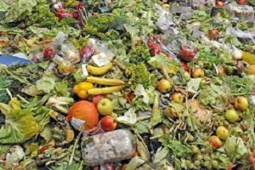
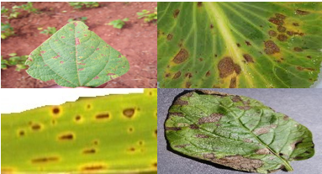
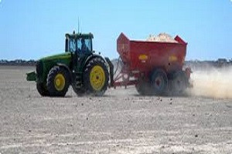
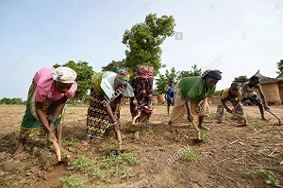
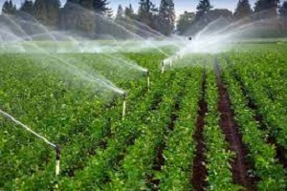
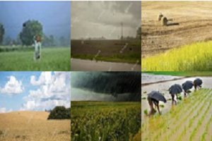
Food Waste Control
Diseases Control
Soil-Sensitive Fields
Agricultural Production Processes
Water Resources Management
Climate Change Adaptation
1. Broad Domain

Slide 4
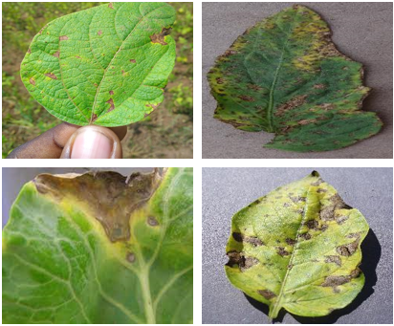
Manually Compare Leaf Diseases.
Detect Leaf Diseases By Only Assumption.
The Entire Detection Process is Manual.
2. Research Problem

Slide 5
Country | Irrigated Crops Area | Crops Per Year
Bangladesh | 8770k hectors | 2/more
Propose a sustainable solution to address the research problem.
Increase annual crops production by detecting leaf diseases.
To propose an automation method.
Smart digital solution to Identify the crops diseases.
Accurate and timely detection of diseases to maximize the profit.
Accommodate fourth industrial revolution in agriculture.
3. Motivation

Slide 6

Classify apple leaf diseases [1] by using computer vision techniques method.
Proposed a restructured residual dense network to detect tomato leaf disease [2].
Cassava leaf disease detection using convolutional neural networks [3].
Approach | Scope
Leaf Image | RGB Image Format
YOLOV4 Algorithm | Better Method can apply
Approach | Scope
Image Resolution | Light Illumination problem can improved
Restructured Residual Dense Network | Better Method can apply
4. Related Works
Approach | Scope
Physical Inspection and Supervision | We are intended to classify color
Convolutional Neural Networks | Can propose Color Classification way

Slide 7

Related Works | Our Approach
Used white paper as background while data acquisition [4]. Sunlight illumination problem [5]. Z-Test Approximation Method [6]. Leaf image classification by deep learning [7]. | Used hand and white paper as background while data acquisition. Better preprocessing process. Crops and associated diseases classification using Convolution Neural Network.
Short Analysis

Slide 8
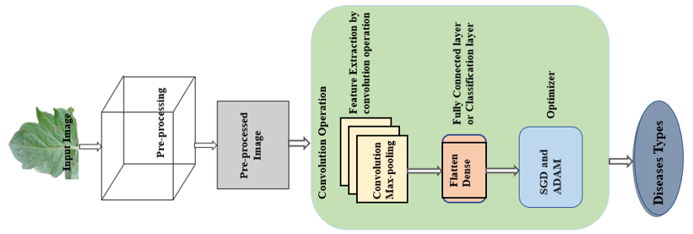
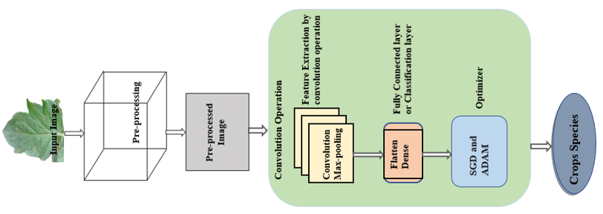
5. Overall Methodology
Model-1: Diseases Types
Model-2: Crops Species

Slide 9
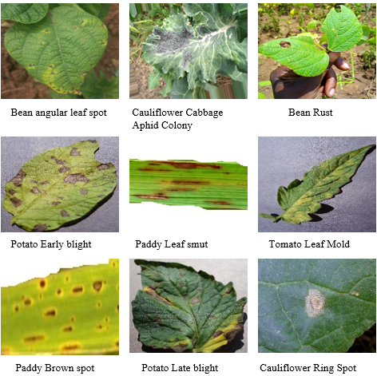
Data Description
Snapshot of sample image
5 different crops.
Total 14,624 images with 21 classes.
Dataset collected from fields and online sources.
Own collected dataset 7120.
Collected from online sources 7504 [8]

Slide 10
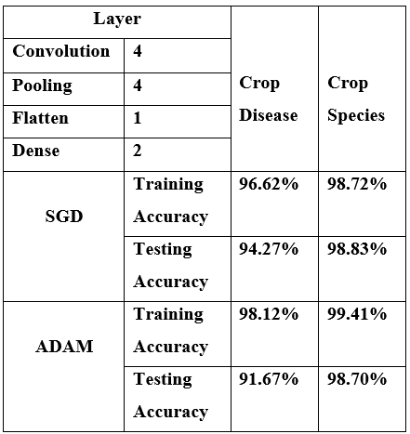
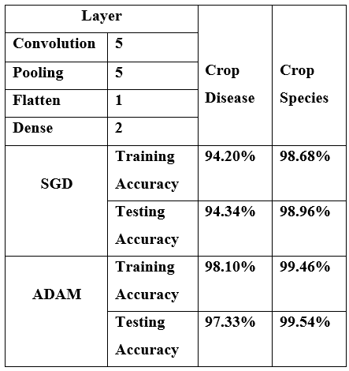
Optimized Model Investigation
Model_Layer_4
Model_Layer_5

Slide 11
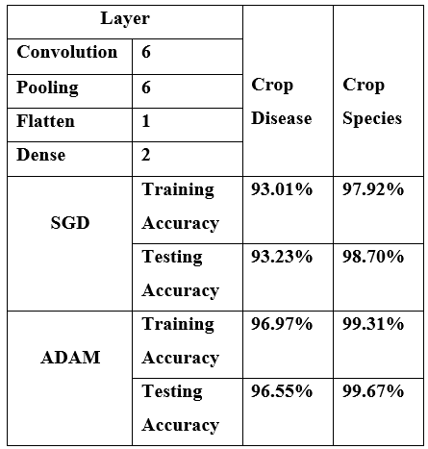
Optimized Model Investigation
Model_Layer_6

Slide 12
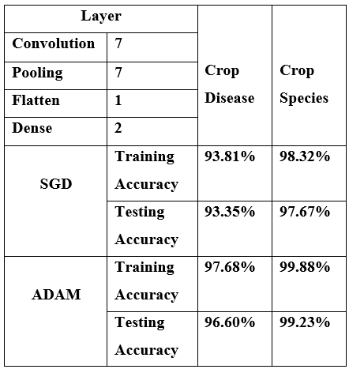
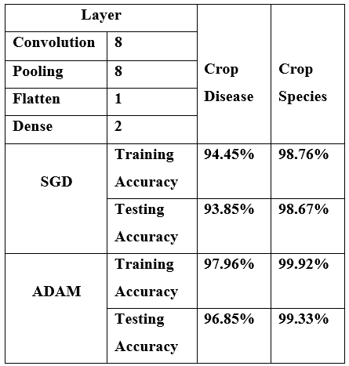
Optimized Model Investigation
Model_Layer_7
Model_Layer_8

Slide 13
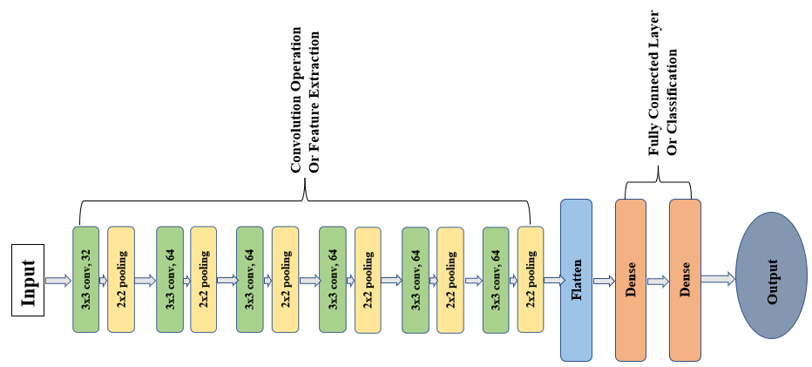
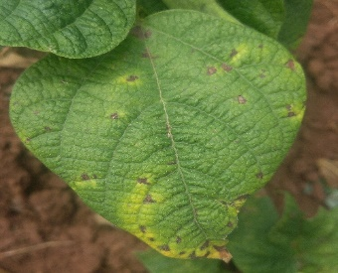
Proposed Optimized Convolution Neural Network architecture
Adaptive Moment Estimation(Adam)
Stochastic Gradient Descent(SGD)
Learning Rate = 1e-3
Loss = SparseCategoricalCrossentropy
Batch Size = 64
Number of Epoch =100

Slide 14
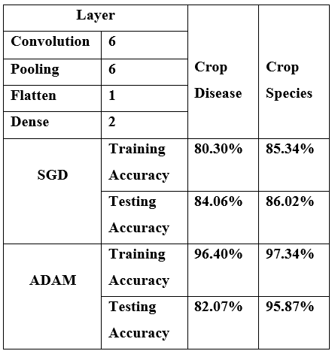
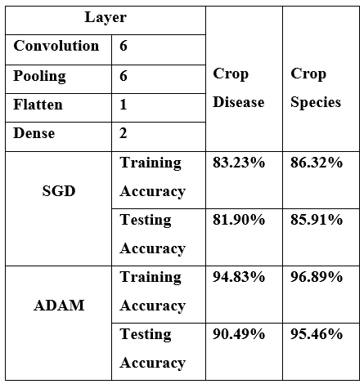
Model_OWN_Data
Model_SIMU_Data

Slide 15
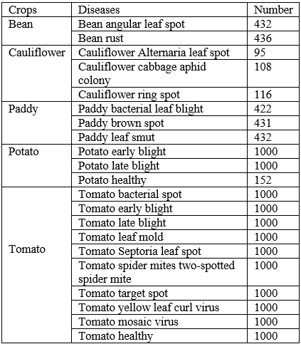
Result Analysis of Proposed Model
Training Data Set | 11,712
Validation Data Set | 1408
Test Data Set | 1536
Train, Validation and Test Data Set
Final Data Set

Slide 16
Proposed Model Accuracy For Adam Optimizer
Metrics | Crop Disease | Crop Species
Training Accuracy | 96.97% | 99.31%
Validation Accuracy | 96.66% | 99.01%
Training Loss | 9% | 1.88%
Validation Loss | 9.95% | 2.17%
Testing accuracy | 96.55% | 99.67%

Slide 17
Proposed Model Accuracy For SGD Optimizer
Metrics | Crop Disease | Crop Species
Training Accuracy | 93.01% | 97.92%
Validation Accuracy | 92.47% | 98.44%
Training Loss | 20.79% | 5.29%
Validation Loss | 21.25% | 4.76%
Testing accuracy | 93.23% | 98.70%

Slide 18
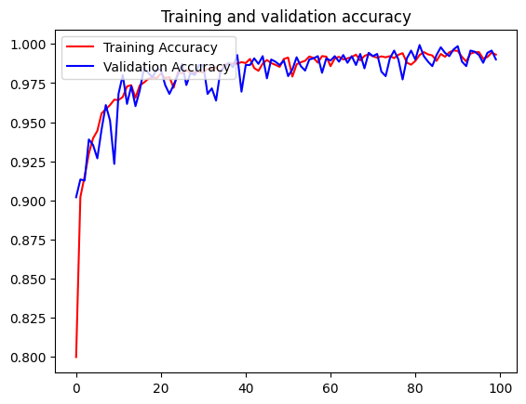
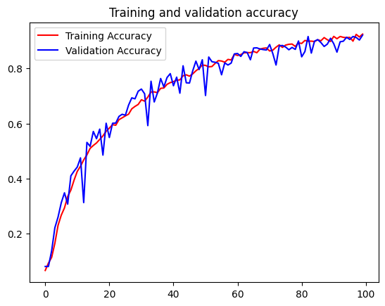
Proposed Model Accuracy For Adam Optimizer
Crop Species Accuracy
Crop Disease Accuracy

Slide 19
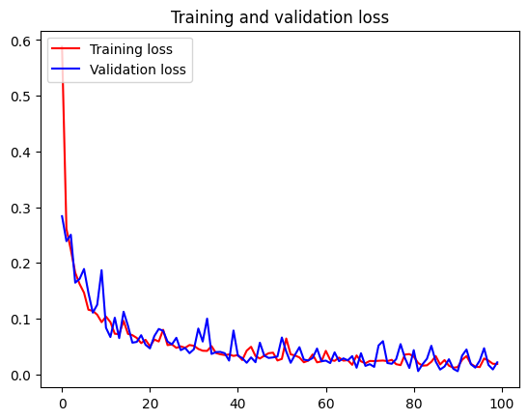
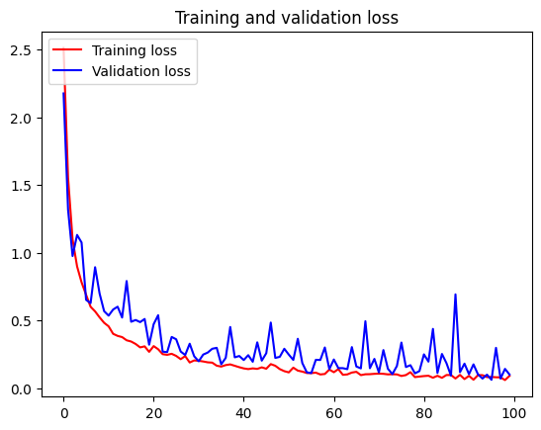
Proposed Model Loss For Adam Optimizer
Crop Species Loss
Crop Disease Loss

Slide 20
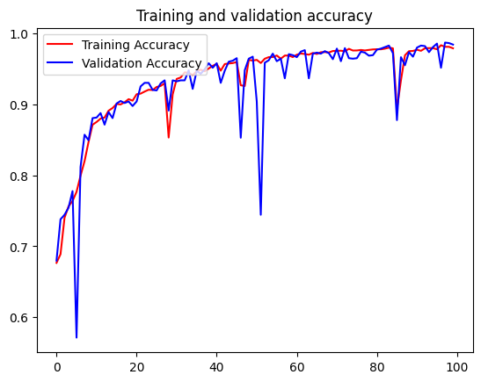
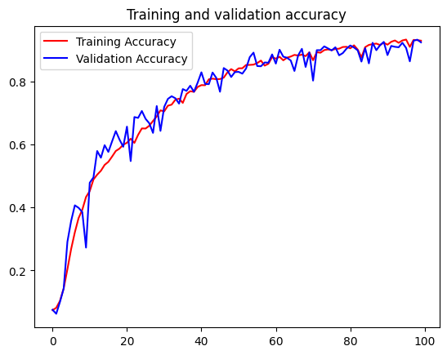
Proposed Model Accuracy For SGD Optimizer
Crop Species Accuracy
Crop Disease Accuracy

Slide 21
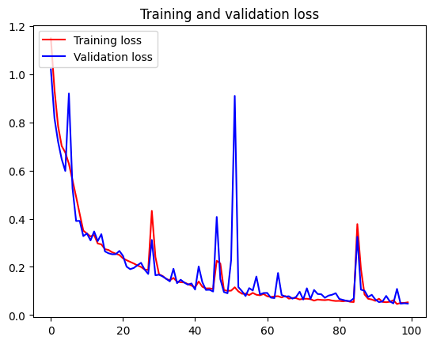
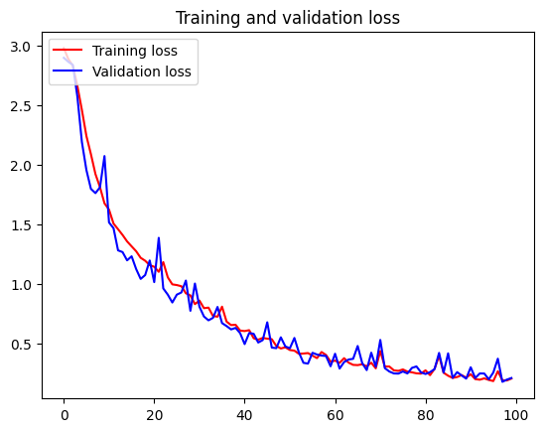
Proposed Model Loss For SGD Optimizer
Crop Species Accuracy
Crop Disease Accuracy

Slide 22
Proposed Model | Previous Study
96.55% | [9] | 93.82%
 | [10] | 81.4%
 | [11] | 93%
 | [12] | 95.04%
 | [13] | 92.60%
 | [14] | 86.21%
6. Result Comparison
Accuracy Comparison With Others Proposed Methods

Slide 23

Collect a new locality based crop species and disease Dataset.
Cleaning and Organizing the dataset to fit this in CNN model.
Investigate different model architectures to find optimized model.
CNN architecture training with Automated Decision-Making learning process for better classification.
Implement different optimizers to examine the performance of the model.
Successfully achieved 96.55% (disease) and 99.67% (species) accuracy in CNN method.
7. Contribution

Slide 24



Future Extension
Reduce Computational Complexity
DeepLabV3+ Can be Integrated in Smart Phone
Best Model Can be Integrated in Smart Phone
Develop Smart Application for Farmers
Propose Smart Solution

Slide 25
8. Conclusion
Our proposed methods achieved 96.55 % (disease) and 99.67 % (species) accuracy.
Proposed methods can address a major area of agronomy in Bangladesh.
Implementation of this research would be a tremendous consequence for our farmers in Bangladesh.
Accurate detection of crop disease would be fruitful for crops.
Annual staple crops production rate would be increased.
Bangladesh would be economically strong.

Slide 26

PUBLISHED
International Conference of Agricultural Science and Engineering 2022, Malaysia
FUNDED
This research was funded by the ICT Division [56.00.0000.053.20.001.22-303].
Acknowledgment

Slide 27
Reference
Roy AM, Bhaduri J. A deep learning enabled multi-class plant disease detection model based on computer vision. AI. 2021 Aug 26;2(3):413-28.
Zhou C, Zhou S, Xing J, Song J. Tomato leaf disease identification by restructured deep residual dense network. IEEE Access. 2021 Feb 12; 9:28822-31.
Sambasivam G, Opiyo GD. A predictive machine learning application in agriculture: Cassava disease detection and classification with imbalanced dataset using convolutional neural networks. Egyptian Informatics Journal. 2021 Mar 1;22(1):27-34.
K. R. Prilianti, S. P. Yuwono, M. A. Adhiwibawa, M. N. Prihastyanti, L. Limantara, and T. H. Brotosudarmo, “Automatic leaf color level determination for need based fertilizer using fuzzy logic on mobile application: Amodel for soybean leaves,” Proceedings - 2014 6th International Conference on Information Technology and Electrical Engineering: Leveraging Research and Technology Through University-Industry Collaboration,ICITEE 2014, 2015.
A. Singh and M. L. Singh, “Automated color prediction of paddy crop leaf using image processing,” Proceedings - 2015 IEEE International Conference on Technological Innovations in ICT for Agriculture and Rural Development, TIAR 2015, no. Tiar, pp. 24–32, 2015.
R. John, B. C. Ii, B. S. Ece, S. R. Soltes, and A. V. Tatel, “Android-based image processing application for rice nitrogen management,” no. March, 2012.
Militante SV, Gerardo BD, Dionisio NV. Plant leaf detection and disease recognition using deep learning. In2019 IEEE Eurasia conference on IOT, communication and engineering (ECICE) 2019 Oct 3 (pp. 579-582). IEEE.

Slide 28
https://www.kaggle.com/datasets/nafishamoin/bangladeshi-crops-disease-dataset
Adedoja A, Owolawi PA, Mapayi T. Deep learning based on nasnet for plant disease recognition using
leave images. In2019 international conference on advances in big data, computing and data
communication systems (icABCD) 2019 Aug 5 (pp. 1-5). IEEE.
10. Panchal AV, Patel SC, Bagyalakshmi K, Kumar P, Khan IR, Soni M. Image-based plant diseases detection
using deep learning. Materials Today: Proceedings. 2021 Aug 3.
11. Sambasivam G, Opiyo GD. A predictive machine learning application in agriculture: Cassava disease
detection and classification with imbalanced dataset using convolutional neural networks. Egyptian
Informatics Journal. 2021 Mar 1;22(1):27-34.
12. Janarthan S, Thuseethan S, Rajasegarar S, Lyu Q, Zheng Y, Yearwood J. Deep metric learning based citrus
disease classification with sparse data. IEEE Access. 2020 Sep 3; 8:162588-600.
13. Zeng Q, Ma X, Cheng B, Zhou E, Pang W. Gans-based data augmentation for citrus disease severity
detection using deep learning. IEEE Access. 2020 Sep 18; 8:172882-91.
14. Chouhan SS, Kaul A, Singh UP, Jain S. Bacterial foraging optimization based radial basis function neural
network (BRBFNN) for identification and classification of plant leaf diseases: An automatic approach
towards plant pathology. Ieee Access. 2018 Feb 12; 6:8852-63.

Slide 29


THANK YOU

Slide 32

Presenting the explanation of how the optimized model was found.
Training the model with our own data and simulated data.
Add acknowledgment.
UPDATE

