Slide 1
RAISS LAB WEBSITE
Research in AI, IoT and Software Security
Presented by
MD. Taslim
Roll: 170106

Slide 2
PAGES
Home
News
Projects
People
Publications
Grants
Software
Contact
News

Slide 3
Implemented Pages
Home
People
Software
Contact

Slide 4
FEATURE
ADMIN PANEL
Add Post
Edit Post
Add People
Edit People
Add Software Description
USER PANEL
Send Message
Can see the post
Can see the People
Can see the Software Description
ADMIN
PANEL
USER
PANEL

Slide 5
TECHNOLOGIES USED
HTML
CSS
JavaScript
PHP
MySQL

Slide 6
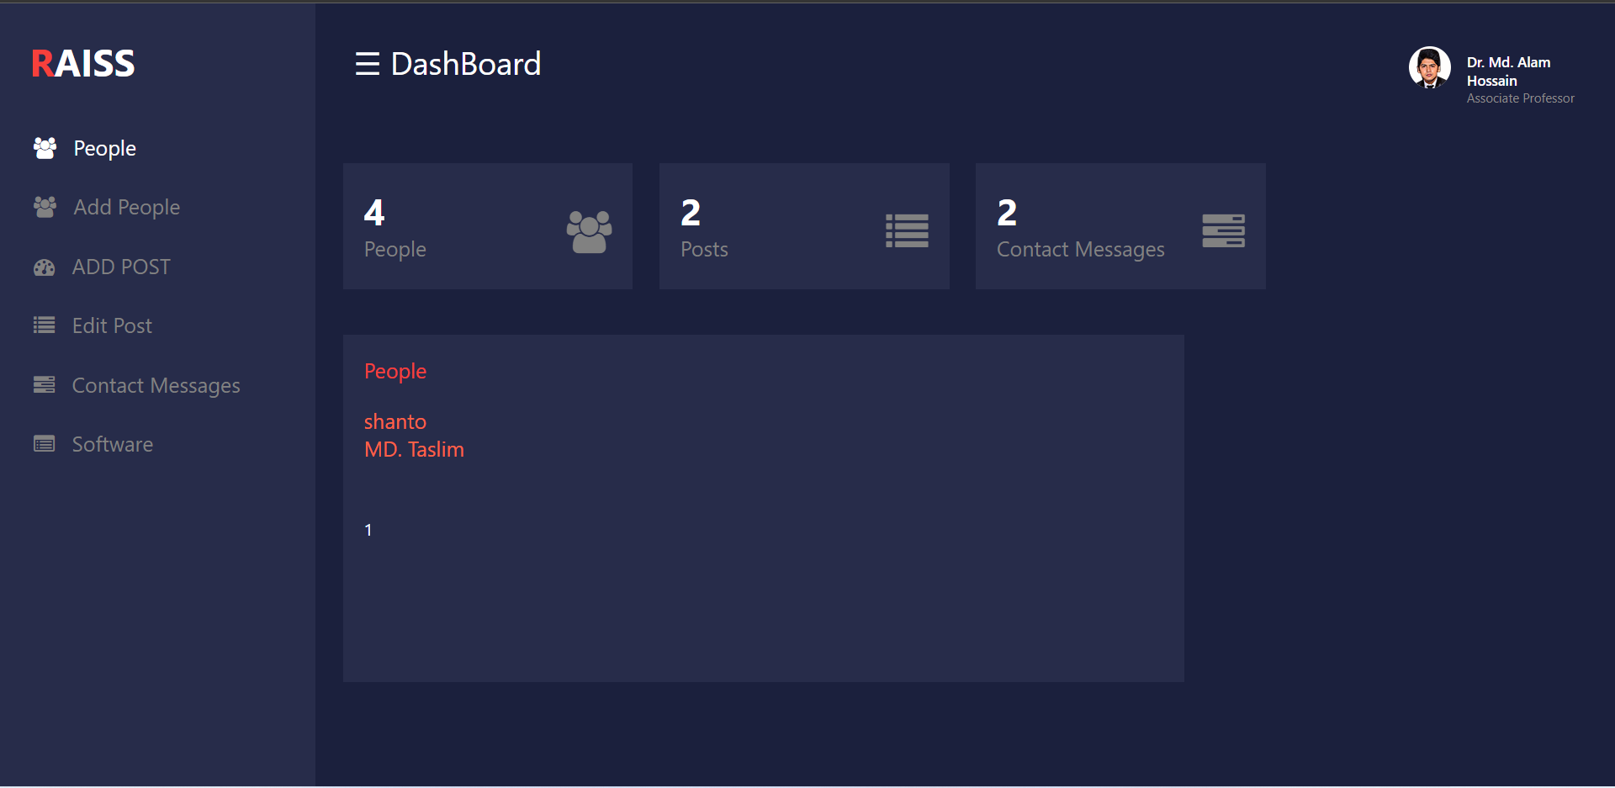
DASHBOARD

Slide 7
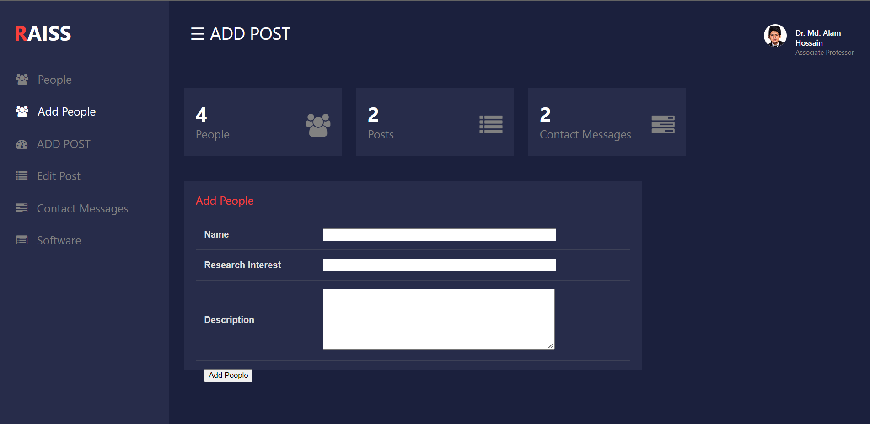
DASHBOARD CONT….

Slide 8
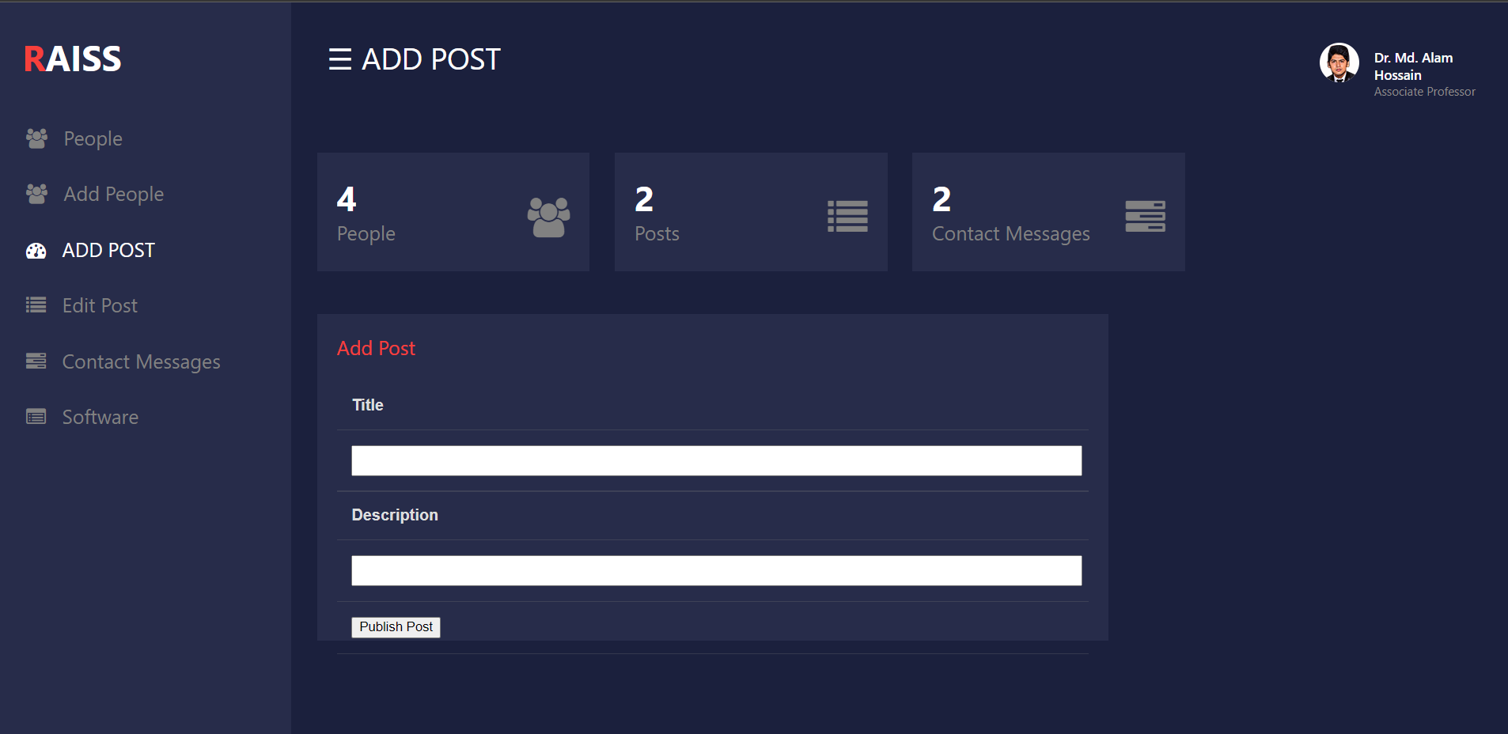
DASHBOARD CONT….

Slide 9
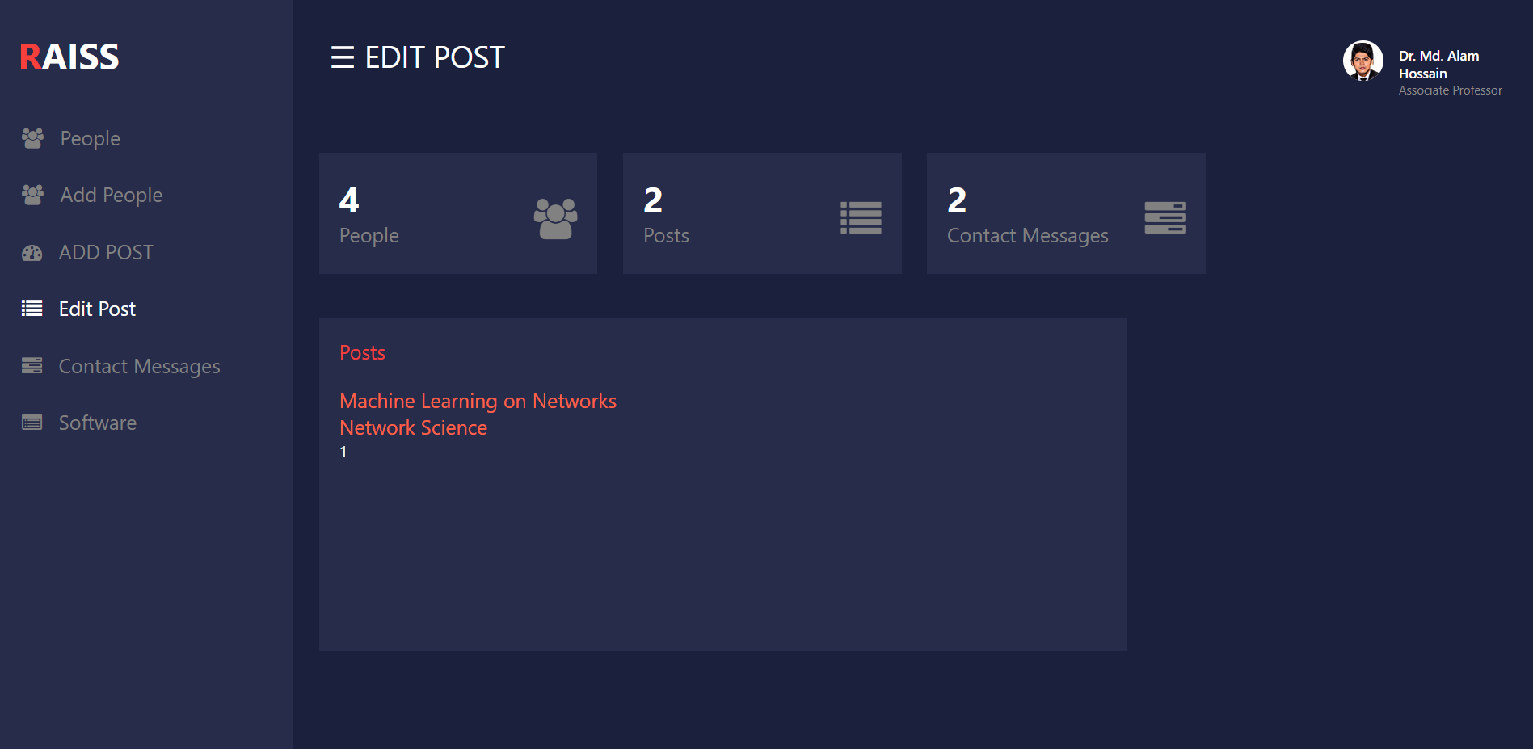
DASHBOARD CONT….

Slide 10
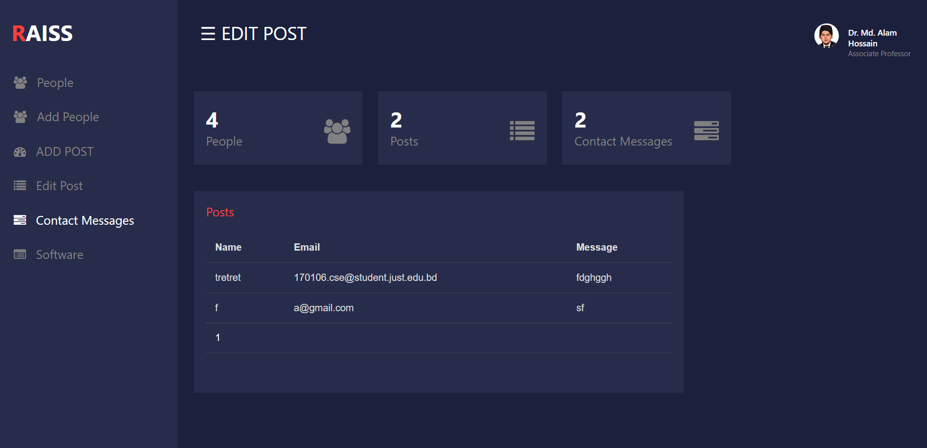
DASHBOARD CONT….

Slide 11
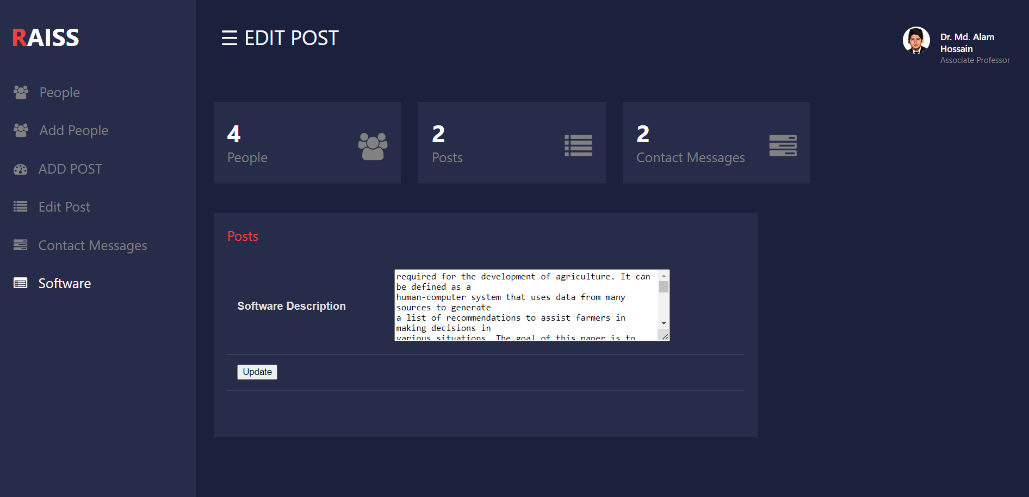
DASHBOARD CONT….

Slide 12

Home
News
Projects
People
Publications
Grants
Software
Contact
Our research focuses on machine learning machine Learning on Internet of Things, Smart Agriculture and Software Security.
Machine Learning on Networks
Current scientific and social endeavors are generating data that can be modeled as graphs: high-throughput biological experiments, screening of chemical compounds, social networks, ecological networks and food-webs, database schemas and ontologies. Most current research concentrates on problems where the graph structure is inherently static. But networks in the real world are dynamic with a wide range of temporal changes: while the topology of networks such as social networks and transportation networks undergoes gradual change (or evolution), the content (information flow, annotations) changes more rapidly. Mining and analysis of these annotated and dynamic graphs is crucial for advancing the state of scientific research, accurate modeling and analysis, and engineering of new systems. Our goal is to develop a set of machine learning, analysis, and modeling methods for such networks.

Slide 13
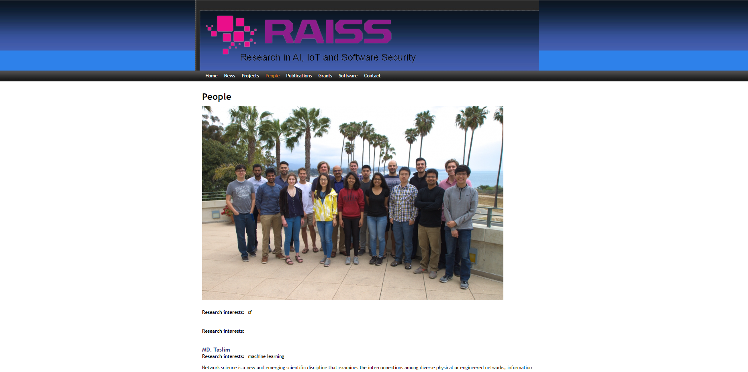

Slide 14
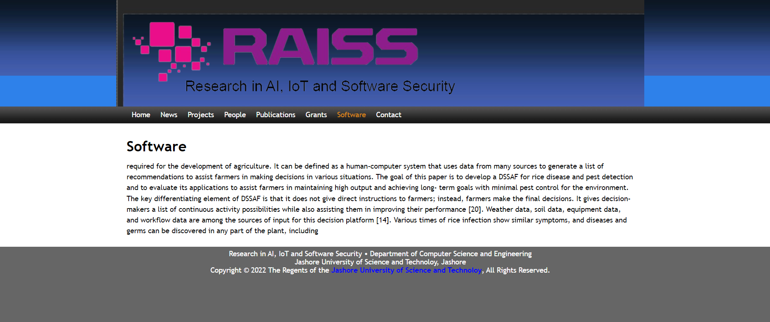

Slide 15
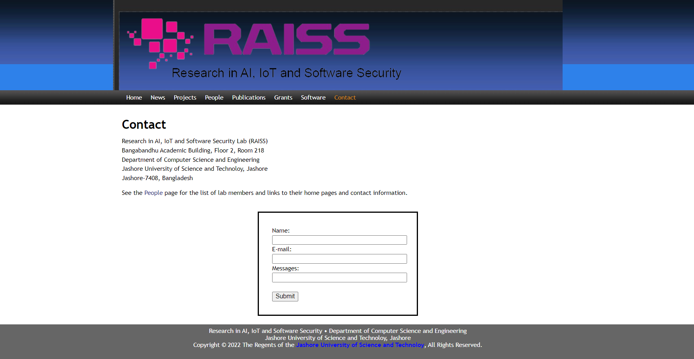

Slide 16


THANK YOU

