Slide 1

Proactiveness
Md. Taslim Hosen Shanto

Slide 2

Presentation Outline
Introduction
Definition and Explanation
Benefits of Reactiveness
Strategies and Techniques
Case Studies or Examples
Overcoming Challenges
Tips for Implementation

Slide 3
3

Slide 4
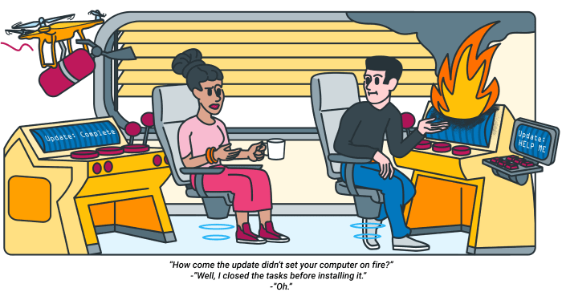
What Is Reactiveness?
Proactive people are constantly moving forward, looking to the future, and making things happen.
4

Slide 5

Example of Reactiveness
Anyone who has achieved success, such as sportsmen, business leaders, and politicians, did not accomplish things alone. They proactively sought out help.
5

Slide 6
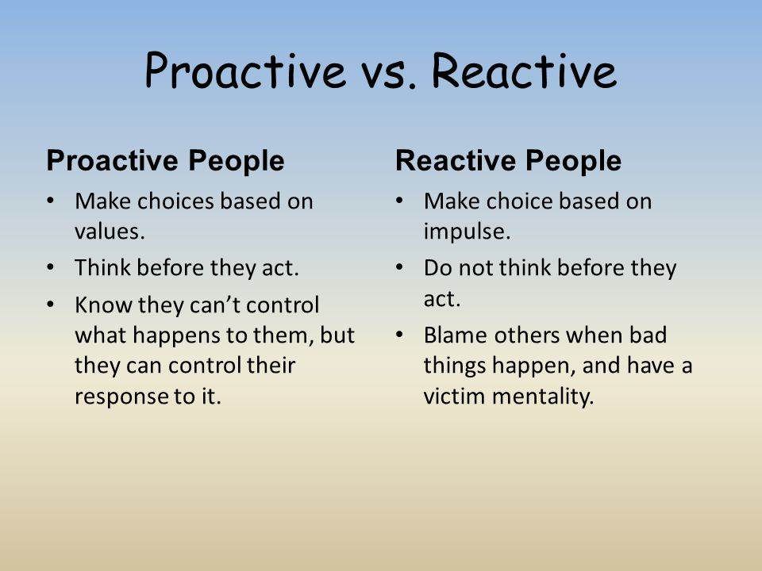
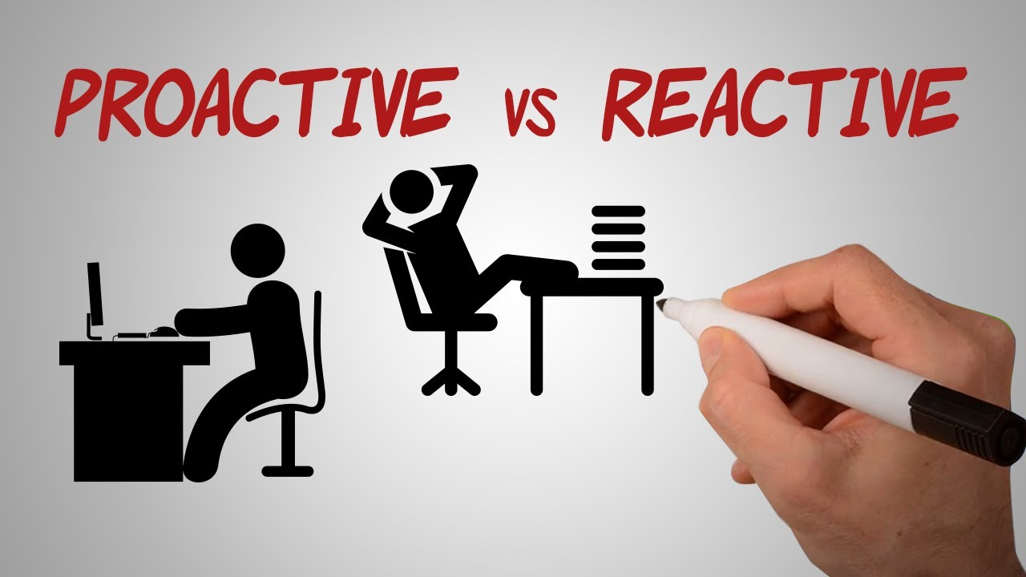
Reactive Vs Proactive
6

Slide 7
How to be more proactive at work?
Planning
Communicating
Organizing
7

Slide 8
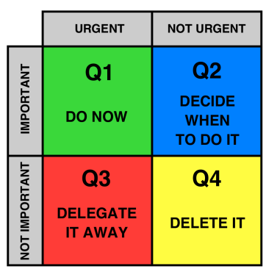


Planning
Set Priorities
Set Solutions
Be Realistic
8

Slide 9




Organizing
Write a list
Update your calendar
Use technology
Develop systems
9

Slide 10



Communicating
Reply Promptly
Share information
Practice Empathy
10

Slide 11


THANK YOU
11

