Slide 1
Decision Support System for Pest control in agriculture

Slide 2
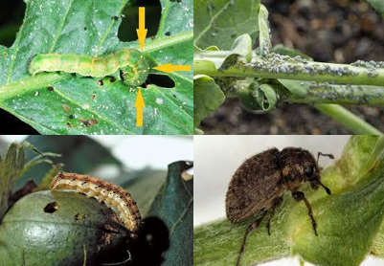

Pest Attack Type
Pest Attack Time
Pest Species
When attack the pest
INTRODUCTION

Slide 3

Increased crop quality
Improved sustainability
Environmental protection
Rural development
OBJECTIVE

Slide 4

Reference | Existing Innovation
[1] | Using ML techniques , they proposed an automated insect detection system.
[2] | Their proposed system predict the early detection of plant diseases and harmful insects.
[3] | In this study , proposed a approach that recognized the insect based on the current state of the traps using CNN.
1. Barbedo, J.G.A. Detecting and Classifying Pests in Crops Using Proximal Images and Machine Learning: A Review. AI 2020, 1, 312–328. [CrossRef]
2. Behmann, J.; Mahlein, A.K.; Rumpf, T.; Römer, C.; Plümer, L. A review of advanced machine learning methods for the detection of biotic stress in precision crop protection. Precis. Agric. 2015, 16, 239–260. [CrossRef]
3. Barbedo, J.G.A.; Castro, G.B. A Study on CNN-Based Detection of Psyllids in Sticky Traps Using Multiple Image Data Sources. AI 2020, 1, 198–208. [CrossRef]
LITERATURE
REVIEW

Slide 5
Reference | Existing Innovation
[4] | They presents a prediction model for Helicoverpa armigera, which represents the number of insects weekly.
[5] | Their proposed model provided an estimation of insect population dynamics after the first detection of their larvae.
[6] | This model predict the Helicoverpa armigera in future periods which is presented according to the expected climate changes.
4. Sagar, D.; Nebapure, S.M.; Chander, S. Development and validation of weather based prediction model for Helicoverpa armigera in chickpea. J. Agrometeorol. 2017, 19, 328–333.
5. Blum, M.; Nestel, D.; Cohen, Y.; Goldshtein, E.; Helman, D.; Lensky, I.M. Predicting Heliothis (Helicoverpa armigera) pest population dynamics with an age-structured insect population model driven by satellite data. Ecol. Model. 2018, 369, 1–12. [CrossRef]
6. Mathukumalli, S.R.; Dammu, M.; Sengottaiyan, V.; Ongolu, S.; Biradar, A.K.; Kondru, V.R.; Karlapudi, S.; Bellapukonda, M.K.R.; Chitiprolu, R.R.A.; Cherukumalli, S.R. Prediction of Helicoverpa armigera Hubner on pigeonpea during future climate change periods using MarkSim multimodel data. Agric. For. Meteorol. 2016, 228, 130–138. [CrossRef]
LITERATURE
REVIEW CON…

Slide 6
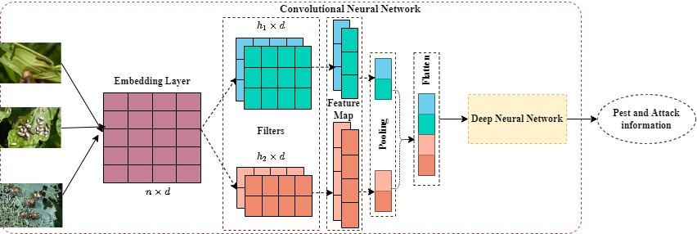
METHODOLOGY

Slide 7

MAJOR MILSTONE | MONTH
 | 6-7 | 7-8 | 8-9 | 9-10 | 10-11 | 11-12
Problem Identification
Literature Study
Requirement Analysis
Data Collection and Data Validation
Model Fitting and System Development
Feedback and Modification of Systems
Paper Writing and Feedback and Modification
Paper Publication
WORK PLAN

Slide 8


THANK YOU

