Slide 1

Proactiveness
Md. Taslim Hosen Shanto

Slide 2

Presentation Outline
Introduction
Definition and Explanation
Example of Reactiveness
Reactive Vs Proactive
How to be more proactive at work?

Slide 3
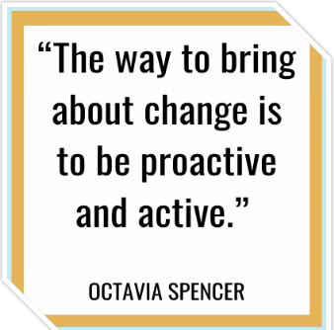
3

Slide 4
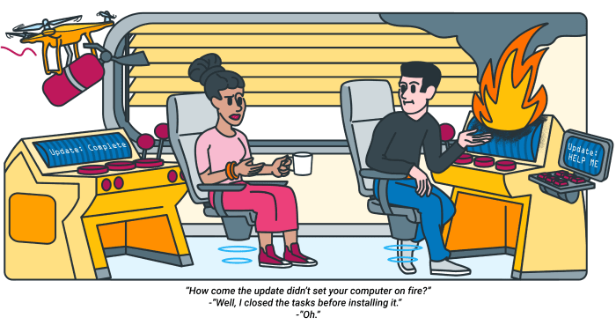
What Is Rroactiveness?
Proactive people are constantly moving forward, looking to the future, and making things happen.
4

Slide 5

Example of Rroactiveness
Anyone who has achieved success, such as sportsmen, business leaders, and politicians, did not accomplish things alone. They proactively sought out help.
5

Slide 6
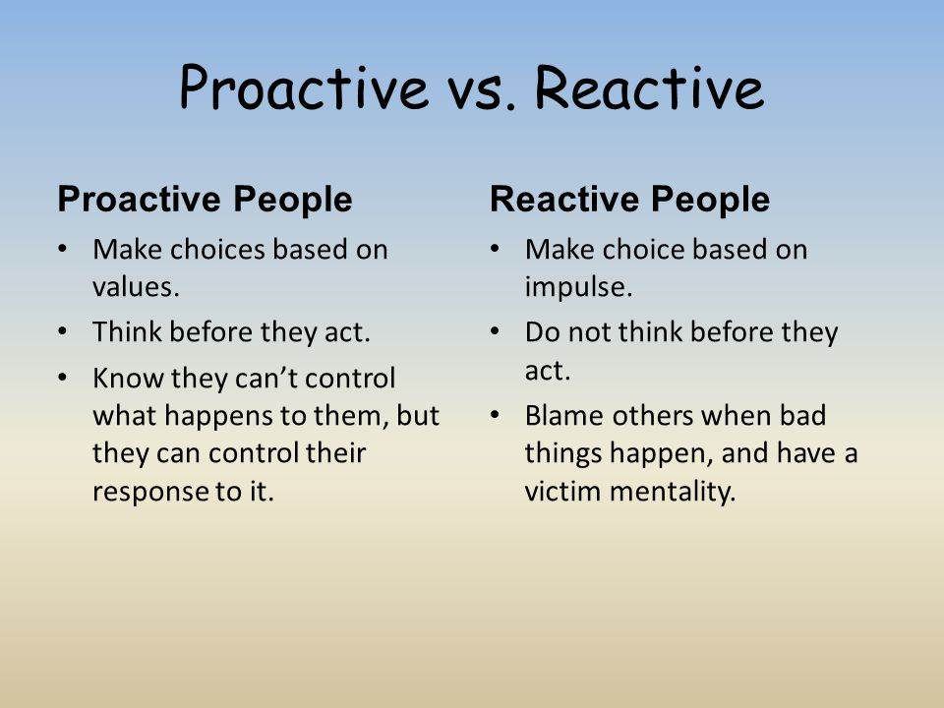
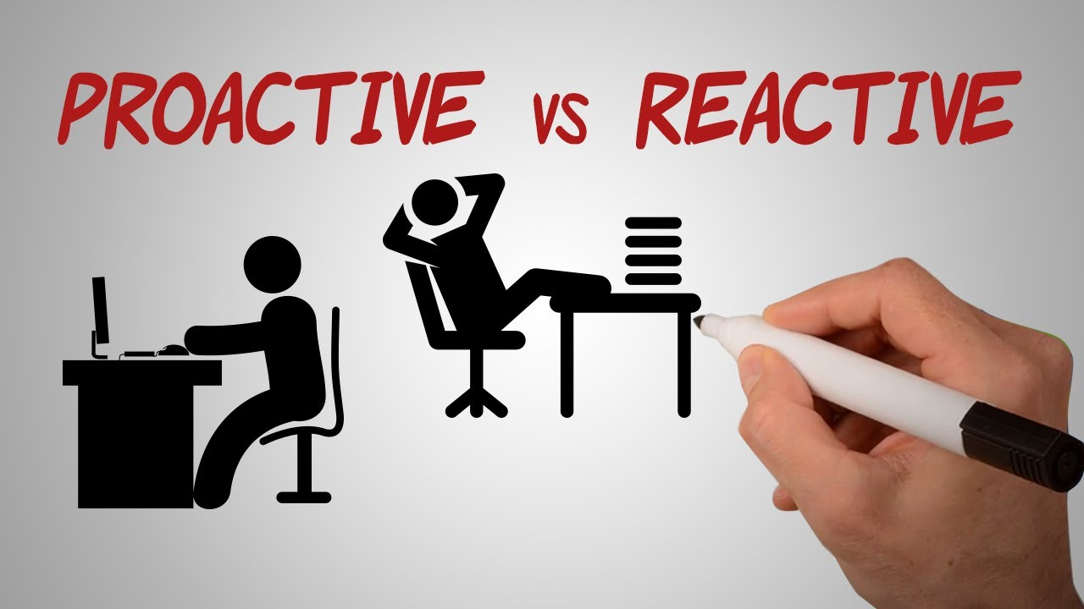
Reactive Vs Proactive
6

Slide 7
How to be more proactive at work?
Planning
Communicating
Organizing
7

Slide 8
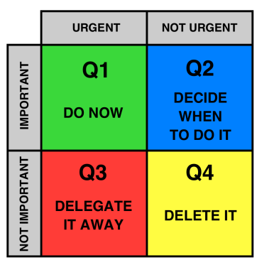


Planning
Set Priorities
Set Solutions
Be Realistic
8

Slide 9




Organizing
Write a list
Update your calendar
Use technology
Develop systems
9

Slide 10



Communicating
Reply Promptly
Share information
Practice Empathy
10

Slide 11

Business Communication
Md. Taslim Hosen Shanto

Slide 12
Presentation Outline
What is Communication?
Essentials of workplace communication
How to chose the right communication Medium
Clarifying the objectives
Elements of verbal Communications
Email etiquettes

Slide 13





Effective communication is essential for being proactive at work as it facilitates information sharing, collaboration, and the expression of ideas and feedback.
14

Slide 14
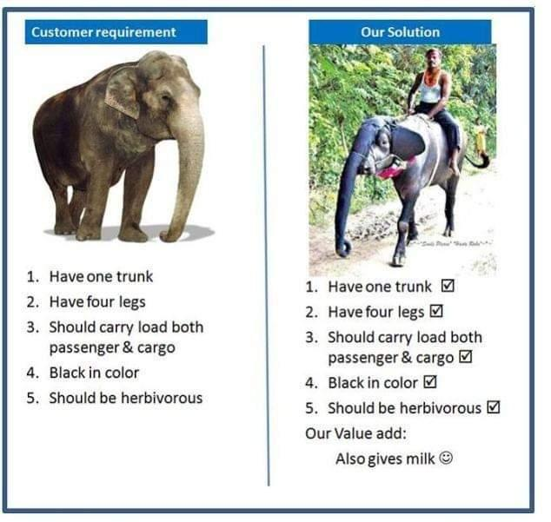
Example of Poor Communication
15

Slide 15
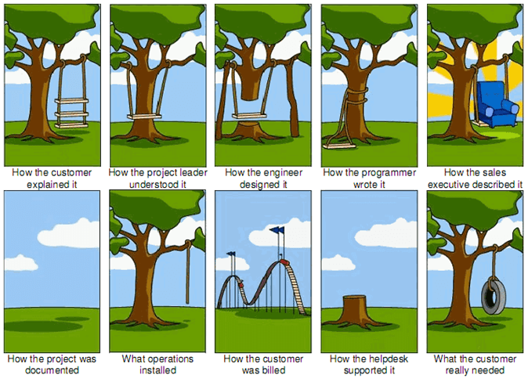
Example of Poor Communication
16

Slide 16
Three Basic Essentials For Workplace Communication
Look at situations from the other person(s) perspective
Choose the right communication medium
Be clear with your objective
17

Slide 17
Communication Mediums
Face-to-Face Communication
Phone /Video chat
Text/Chat
Email
Meetings
18

Slide 18


Choosing the right Communication Medium
What is the best communication medium to use?
19

Slide 19

Be Clear With Your Objective
Your OBJECTIVE is simply your goal
Being clear with your objective is crucial for effective communication and proactive action, as it helps you articulate your goals, align others' understanding, and focus your efforts toward achieving desired outcomes.
20

Slide 20
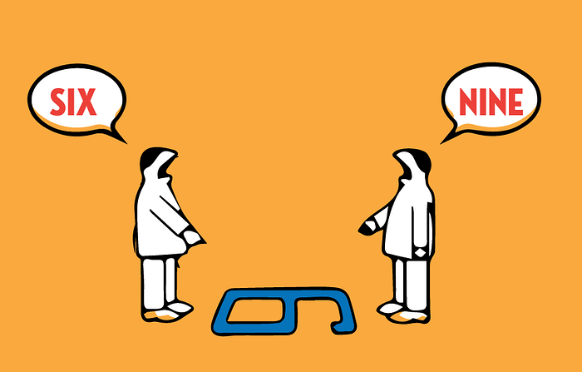
Look At Situations From The Other Person’s Perspective
Consider others' perspectives to be proactive at work by fostering empathy, effective communication, and collaborative problem-solving.
21

Slide 21
Verbal & Nonverbal
Communication at Workplace
Choose your words wisely
Listen actively
Tone of voice
Body language and non-verbal cues
22

Slide 22

Email Etiquettes
Use a professional email address
Use a clear and concise subject line
Use a professional greeting
Keep it concise and focused
Use proper language and tone
Be mindful of your formatting
Proofread before sending
Use a professional email signature
Be cautious with attachments
Use appropriate salutations and sign-offs
23

Slide 23


THANK YOU
24

