Slide 1

Ebola Simulation using Networks
Arthur Couteau & Marco Torredimare

Slide 2
SEIHFR Model
S
E
I
H
F
R
States:
S: Susceptible
E: Exposed
I: Infected
H: Hospitalized
F: Traditional funerals
R: Removed (either recovered or safely buried)

Slide 3
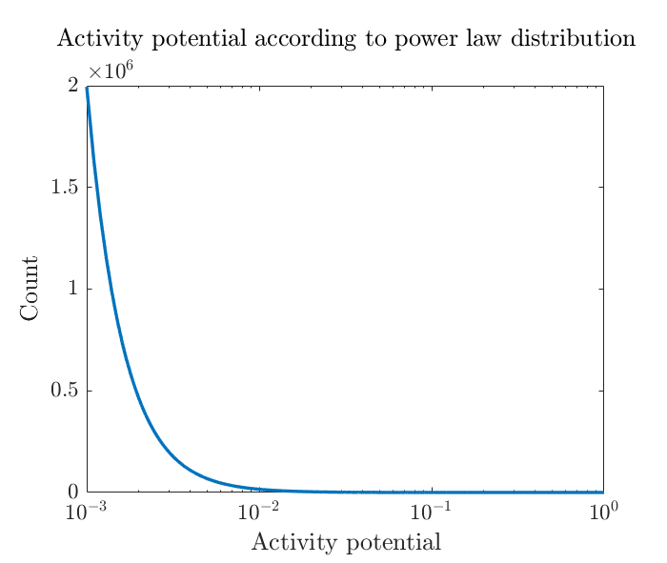
Network implementation of SEIHFR
Activity Driven Network (ADN)
At each time step, previous edges are removed and new ones are created
Each node in the network is associated an activity potential according to power law distribution
The activity potential represents the probablity to become active at each time step
When becoming active, a node will create m edges with random nodes in the network

Slide 4
Network implementation of SEIHFR
Actuation of the states
1
1
1
1
1
S
S
E
E
E
2
5
2
5
2
5
2
5
2
5
S
S
S
S
S
S
S
S
S
S
3
4
3
S
4
I
3
S
4
I
3
S
4
R
3
S
4
R
S
I
a) Start of iteration
b) Node 4 becomes active
c) Node 1 becomes Exposed
d) Node 4 becomes Recovered
e) Edges are removed
Virus spreading can come from contact with I, H and F
Probabilities of infection and rates of transition are taken from literature [1]
[1] A. Rizzo, B. Pedalino, and M. Porri. A network model for ebola spreading. Journal of Theoretical Biology, 394:212-222, 2016.

Slide 5
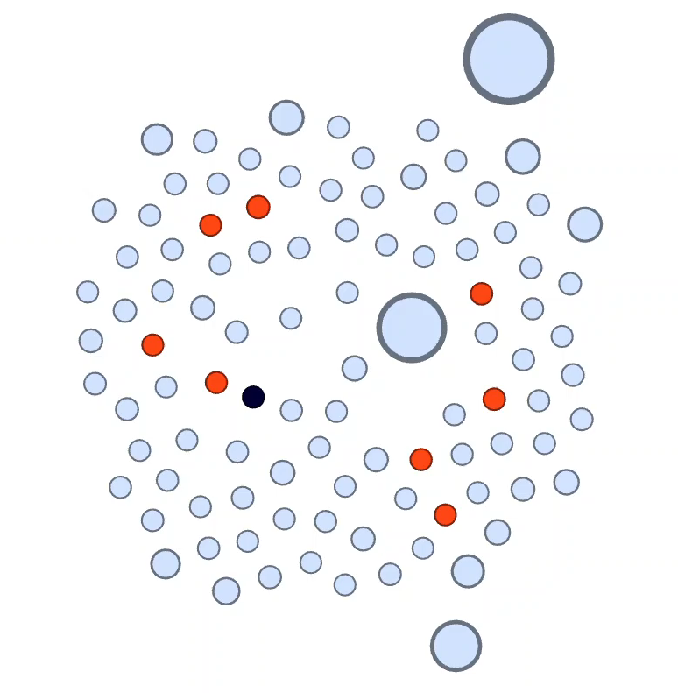
Network implementation of SEIHFR
Gephi Visualization
Legend:
S: Susceptible
E: Exposed
I: Infected
H: Hospitalized
F: Traditional funerals
R: Recovered
D: Dead

Slide 9
Contact information and credits
ETH Zurich
Organisational unit
Street address
Postcode City
www.ethz.ch/en.html
Publisher: Organisational unit of ETH Zurich
Design: Designer Name
Images: Credit (slide xx), Credit (slide xx)
© ETH Zurich, December 2013

