Slide 1

Ebola Simulation using Networks
Arthur Couteau & Marco Torredimare

Slide 2
SIR Variation
[1]
SEIHFR Model
S
E
I
H
F
R
States:
S: Susceptible
E: Exposed
I: Infected
H: Hospitalized
F: Traditional funerals
R: Removed (either recovered or safely buried)
[1] J. Legrand, R. F. Grais, P. Y. Boelle, A. J. Valleron, and A. Flahault. Understanding the dynamics of ebola epidemics. Epidemiol. Infect., 135:610-621,2007.

Slide 3
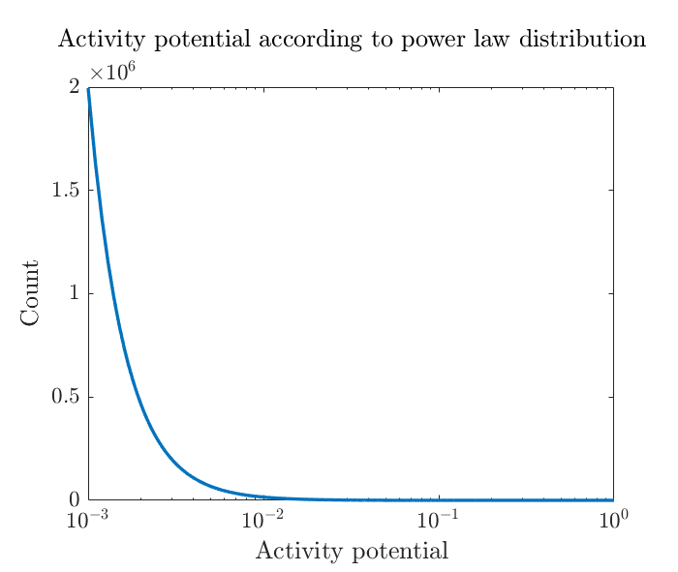
Network implementation of SEIHFR
Activity Driven Network (ADN)
At each time step, previous edges are removed and new ones are created
Each node in the network is associated an activity potential according to power law distribution
The activity potential represents the probablity to become active at each time step
When becoming active, a node will create m edges with random nodes in the network

Slide 4
Network implementation of SEIHFR
Actuation of the states (N = 5, m = 2)
1
1
1
1
1
S
S
E
E
E
2
5
2
5
2
5
2
5
2
5
S
S
S
S
S
S
S
S
S
S
3
4
3
S
4
I
3
S
4
I
3
S
4
R
3
S
4
R
S
I
a) Start of iteration
b) Node 4 becomes active
c) Node 1 becomes Exposed
d) Node 4 becomes Recovered
e) Edges are removed
Virus spreading can come from contact with I, H and F
Probabilities of infection and rates of transition are taken from literature [1]
[1] A. Rizzo, B. Pedalino, and M. Porri. A network model for ebola spreading. Journal of Theoretical Biology, 394:212-222, 2016.

Slide 5
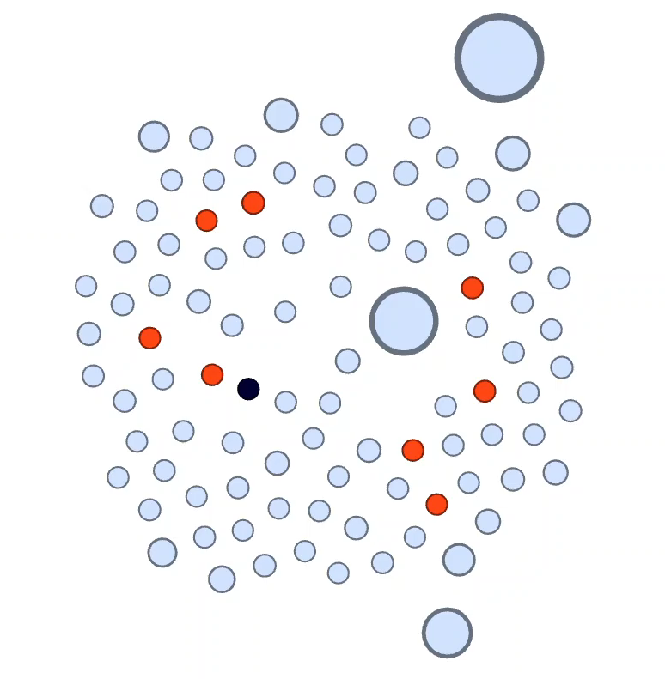
Network implementation of SEIHFR
Gephi Visualization
S: Susceptible
E: Exposed
I: Infected
H: Hospitalized
F: Traditional funeral
R: Recovered
D: Safely buried

Slide 6
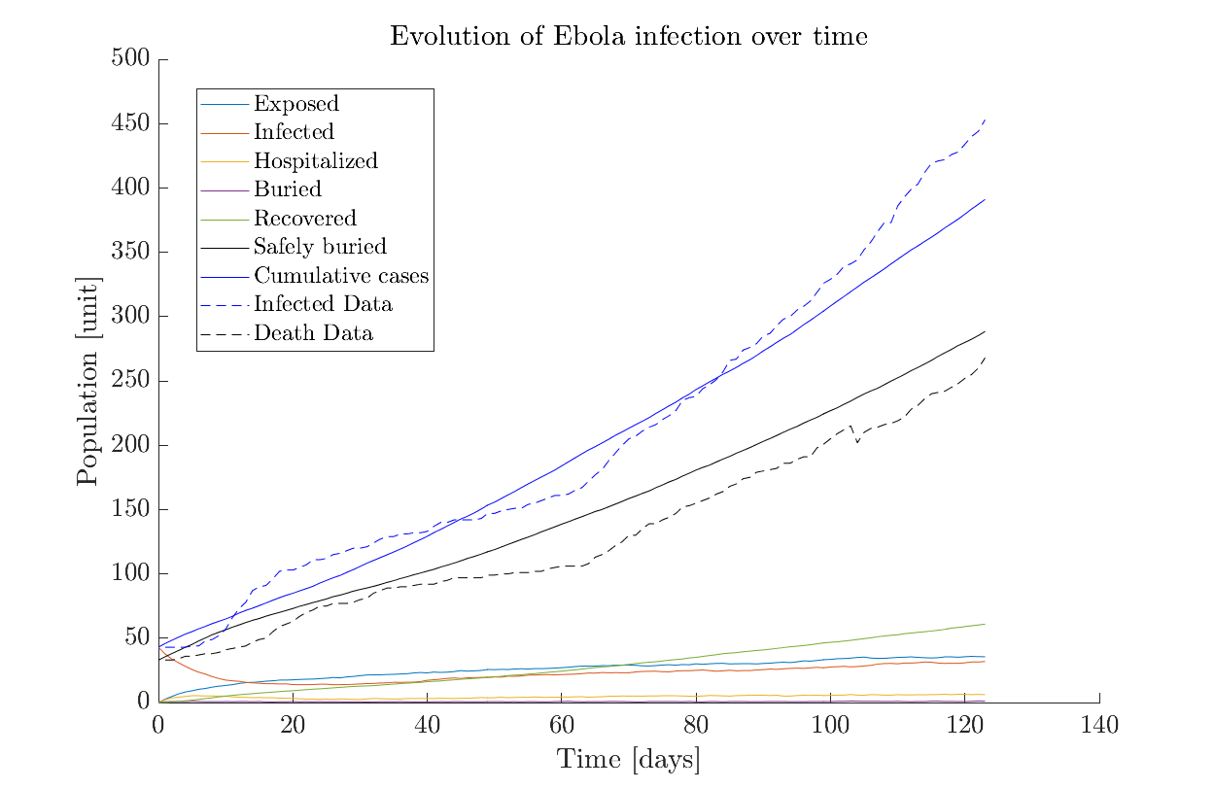
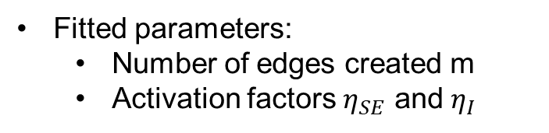
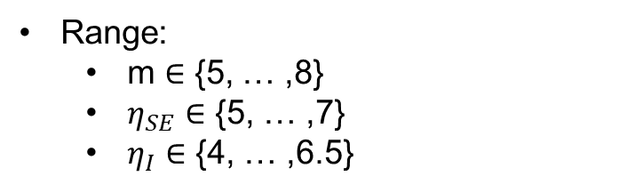
Parameters fit
ADN parameters
Fitted parameters:
Number of edges created m
Activation factors $η_{SE}$ and $η_{I}$
Range:
m $∈$ {5, … ,8}
$η_{SE}$ $∈$ {5, … ,7}
$η_{I}$ $∈$ {4, … ,6.5}
Data comes from WHO reports of the actual Ebola outbreak in North-Kivu, RDC (since August 4, 2018)

Slide 7
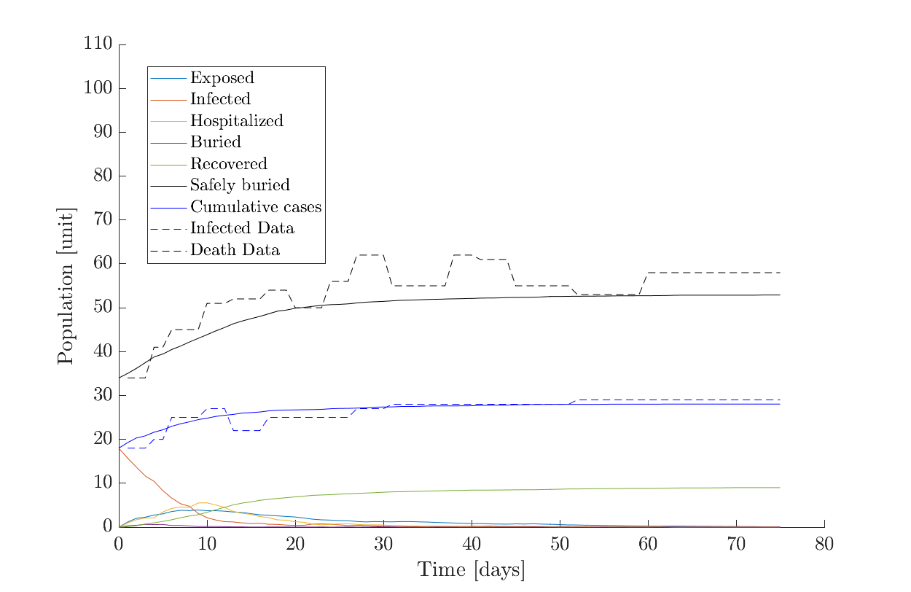
Model validation
Comparison with previous outbreak data
Data comes from WHO reports of the Ebola outbreak in Equateur, RDC (from May 11 to July 25, 2018

Slide 8
Thank you for your attention !

Slide 9
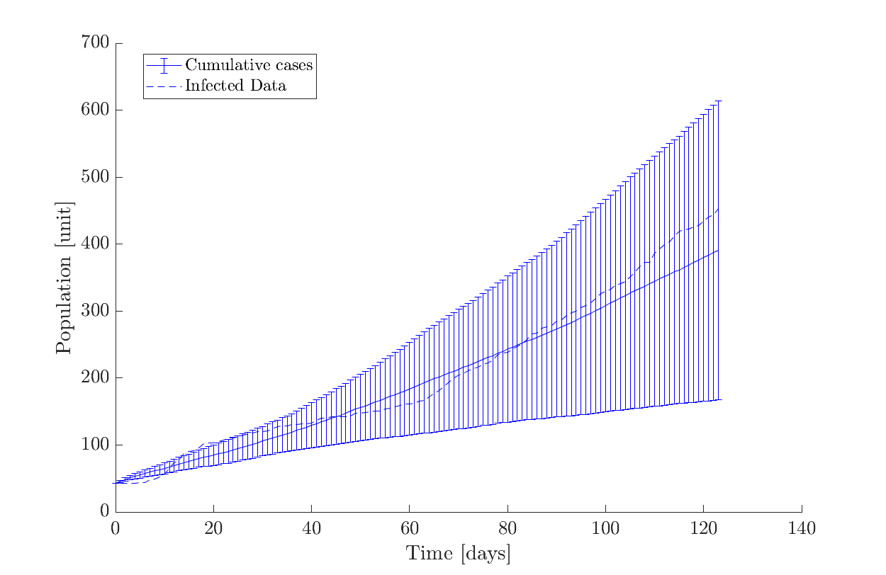
Parameters fit
Fit with error bars

