Slide 1


IE402 - OPTIMIZATION
Presented by Group - 5
IMAGE RESTORATION USING
CONVOLUTIONAL AUTOENCODERS

Slide 2
INTRODUCTION
Image restoration aims to involve recovering a high-quality image from a degraded or distorted version. This is a significant challenge in computer vision, particularly in digital photography, video processing, and medical imaging applications.
Autoencoders are a learning architecture comprising of two networks:
Encoder - Compresses the input data into a lower-dimensional representation.
Decoder - Reconstructs the original data from this compressed representation.

Slide 3


PROBLEM STATEMENT
Dataset: Pairs of grayscale images and color images
Objective: Learn a function f to map grayscale ​ to color ​.
Model: where 𝑦̂𝑖 - is the predicted color image generated by the model given the parameters θ
Loss Function: Mean Absolute Error (MAE)
​
Goal: Minimize this loss to improve color prediction accuracy.

Slide 4
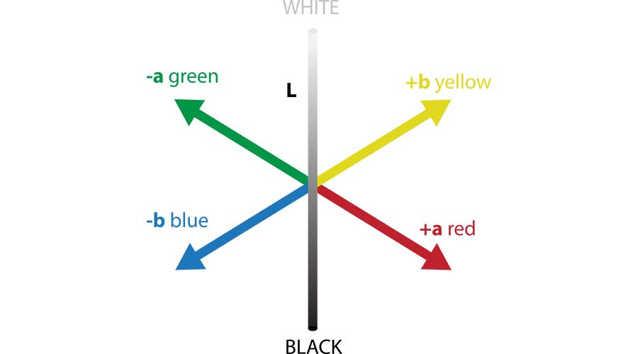
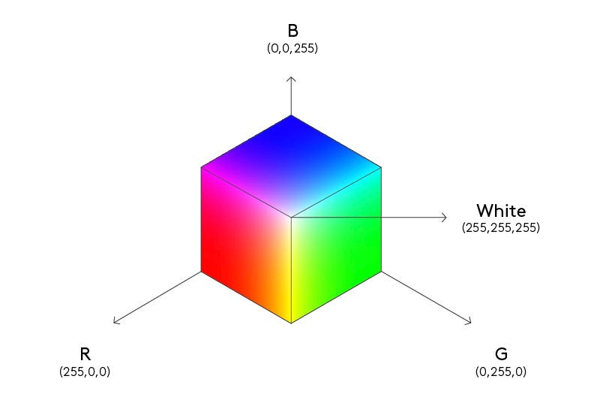
COLOR SPACES
LAB Space
RGB Space

Slide 5
WHY AUTOENCODERS ?
An autoencoder is a type of artificial neural network used primarily for unsupervised learning tasks, such as data compression, noise reduction, and dimensionality reduction.
Non-linear transformations: Capture complex patterns beyond linear relationships.
High-dimensional capability: Better suited for complex, high-dimensional data.
Denoising: Easily adaptable for noise reduction tasks.

Slide 6
AUTOENCODER PROCESSING
Autoencoder Structure:
Input: Grayscale Image (G)
Encoder: Extracts Features via Convolutions
Decoder: Reconstructs Colorized Image
Key Components:
Convolutional Layers (for feature extraction)
Activation Functions (introducing non-linearity)
Downsampling and Upsampling (to manage spatial dimensions)
Purpose: Capture essential features for accurate colorization.

Slide 7
KEY TECHNIQUES IN AUTOENCODER PROCESSING
1. Downsampling
Strided Convolutions: Reduces spatial dimensions with stride > 1
Max Pooling: Retains critical features via max values in pooling window
2. Activation Functions
ReLU: f(x)=max⁡(0,x)
Leaky ReLU: Allows gradient flow for negative inputs
3. Upsampling
Transposed Convolutions: Reverses downsampling to restore image size
Goal: Efficiently compress and reconstruct image details.

Slide 8
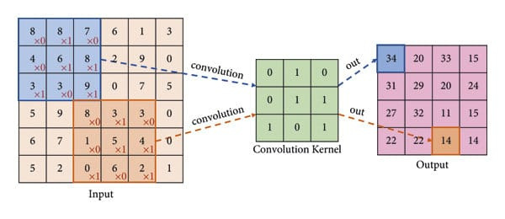
DOWNSAMPLING

Slide 9
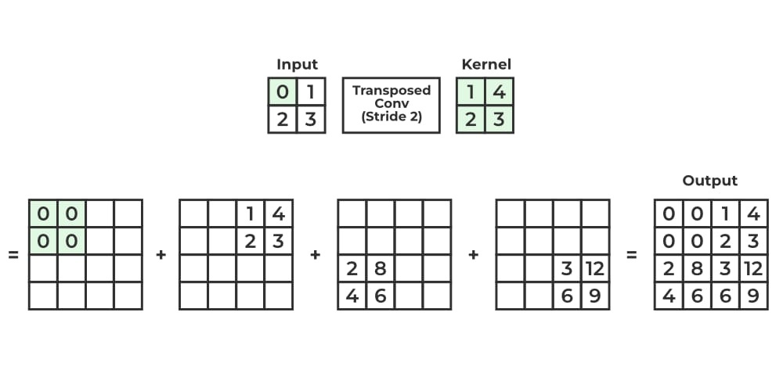
UPSAMPLING

Slide 10

ENHANCEMENTS AND EVALUATION
Skip Connections:
Purpose: Preserve spatial information lost in downsampling
Operation: Concatenate encoder output with decoder input
Loss Function for Colorization Accuracy:
Mean Absolute Error (MAE):
Objective: Minimize MAE for accurate colorization
Outcome: High-quality colorization with fine-grained detail retention.

Slide 11
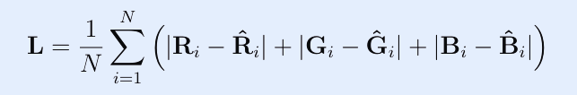
ADAM OPTIMIZER
Adam (Adaptive Moment Estimator) is a stochastic gradient descent (SGD) optimization algorithm used to train deep neural networks.
It is a combination of the ‘gradient descent with momentum’ algorithm and the ‘RMSP’ algorithm.
Loss Function:

Slide 12

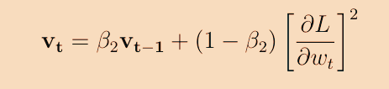
TWO KEY COMPONENTS OF ADAM
1. Momentum: Accelerates the gradient descent algorithm by using the exponentially weighted average of the gradients, which helps the algorithm converge faster.
2. RMSprop: An adaptive learning algorithm that improves on AdaGrad by using the exponential moving average of squared gradients instead of their cumulative sum.

Slide 13


Bias-Corrected First Moment
This correction scales mt so that its expected value E[ˆmt] aligns with the true gradient g, yielding an unbiased estimate of the gradient’s mean.
2. Bias-Corrected Second Moment
This correction adjusts vt so that E[ˆ vt] approximates the square of the gradient, g2, providing an unbiased estimate of the gradient’s variance.

Slide 14
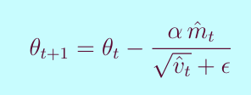
WEIGHT UPDATE
Adam updates each weight based on the adjusted first and second moments:
This adaptive update means weights associated with large gradients get smaller updates, while weights with smaller gradients get larger updates.

Slide 15
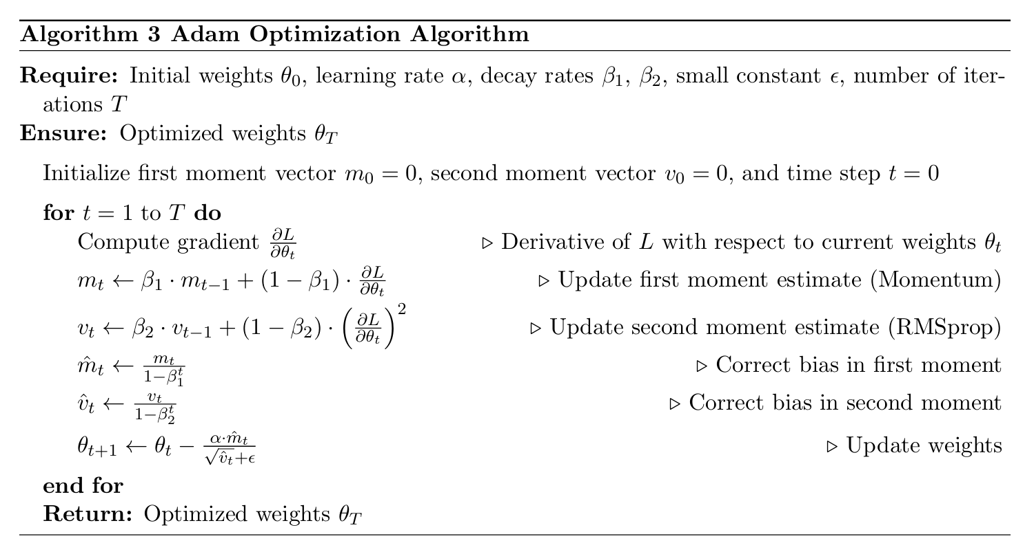
ADAM OPTIMIZER PSEUDOCODE

Slide 16
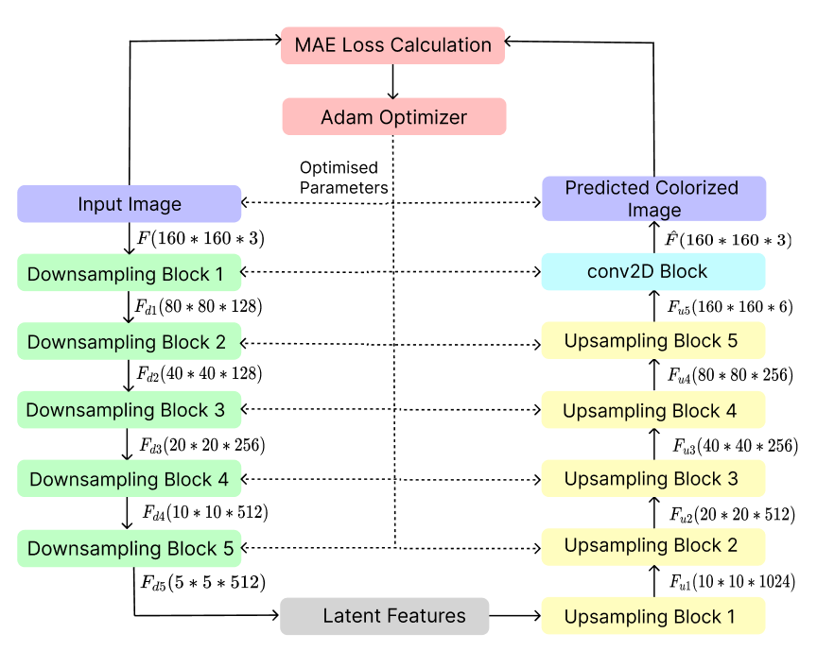
MODEL FLOW

Slide 17
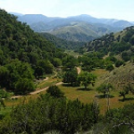
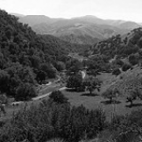
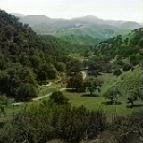
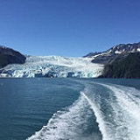
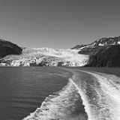
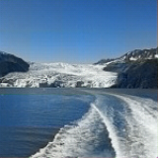
RESULT AND ANALYSIS
COLOR
GRAY
PREDICTED

Slide 18
WHY ARE WE GETTING ONLY 50% ACCURACY ?
Performance Metrics
Accuracy:
Achieved: 50%
Limitations: Doesn’t fully capture human visual perception.
SSIM (Structural Similarity Index):
Achieved: High SSIM value around 95%
Benefit: Reflects perceptual similarity, better aligns with human judgment.
---

Slide 19
Observations:
Accuracy: Limited due to strict pixel-by-pixel color match requirement.
High SSIM: Indicates realistic and perceptually accurate colorization.
Conclusion:
SSIM > Accuracy for evaluating colorization quality.
High SSIM score shows effectiveness in producing visually accurate images.

Slide 20
Thank You
Group Members
202201129 - Tasmay Patel
202201207 - Swayam Hingu
202201253 - Smit Fefar
202201504 - Kishan Pansuriya
202201525 - Heer Shah

